Slide 1
October 2018

Slide 2
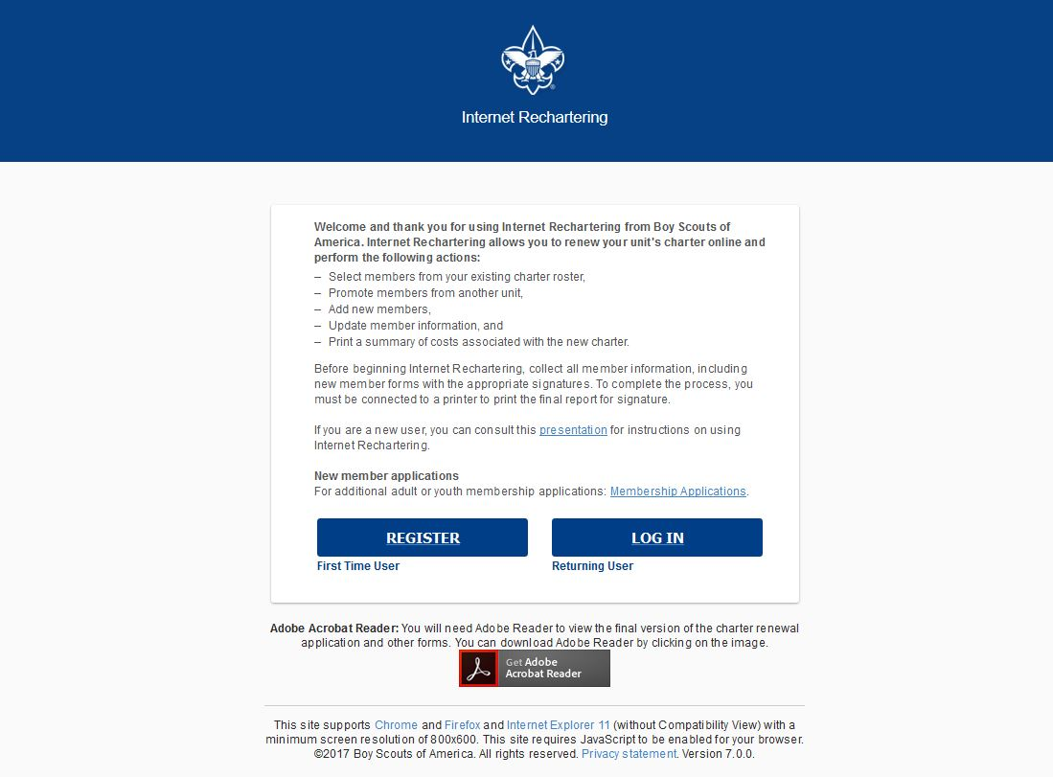
Clicking on the link provided by your local council for Internet Rechartering brings you to this page. The first time you go in you must select Register.

Slide 3
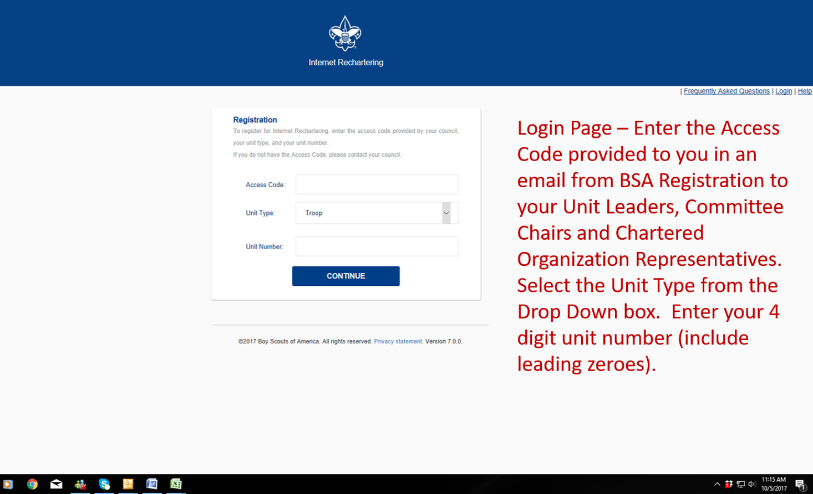

Slide 4
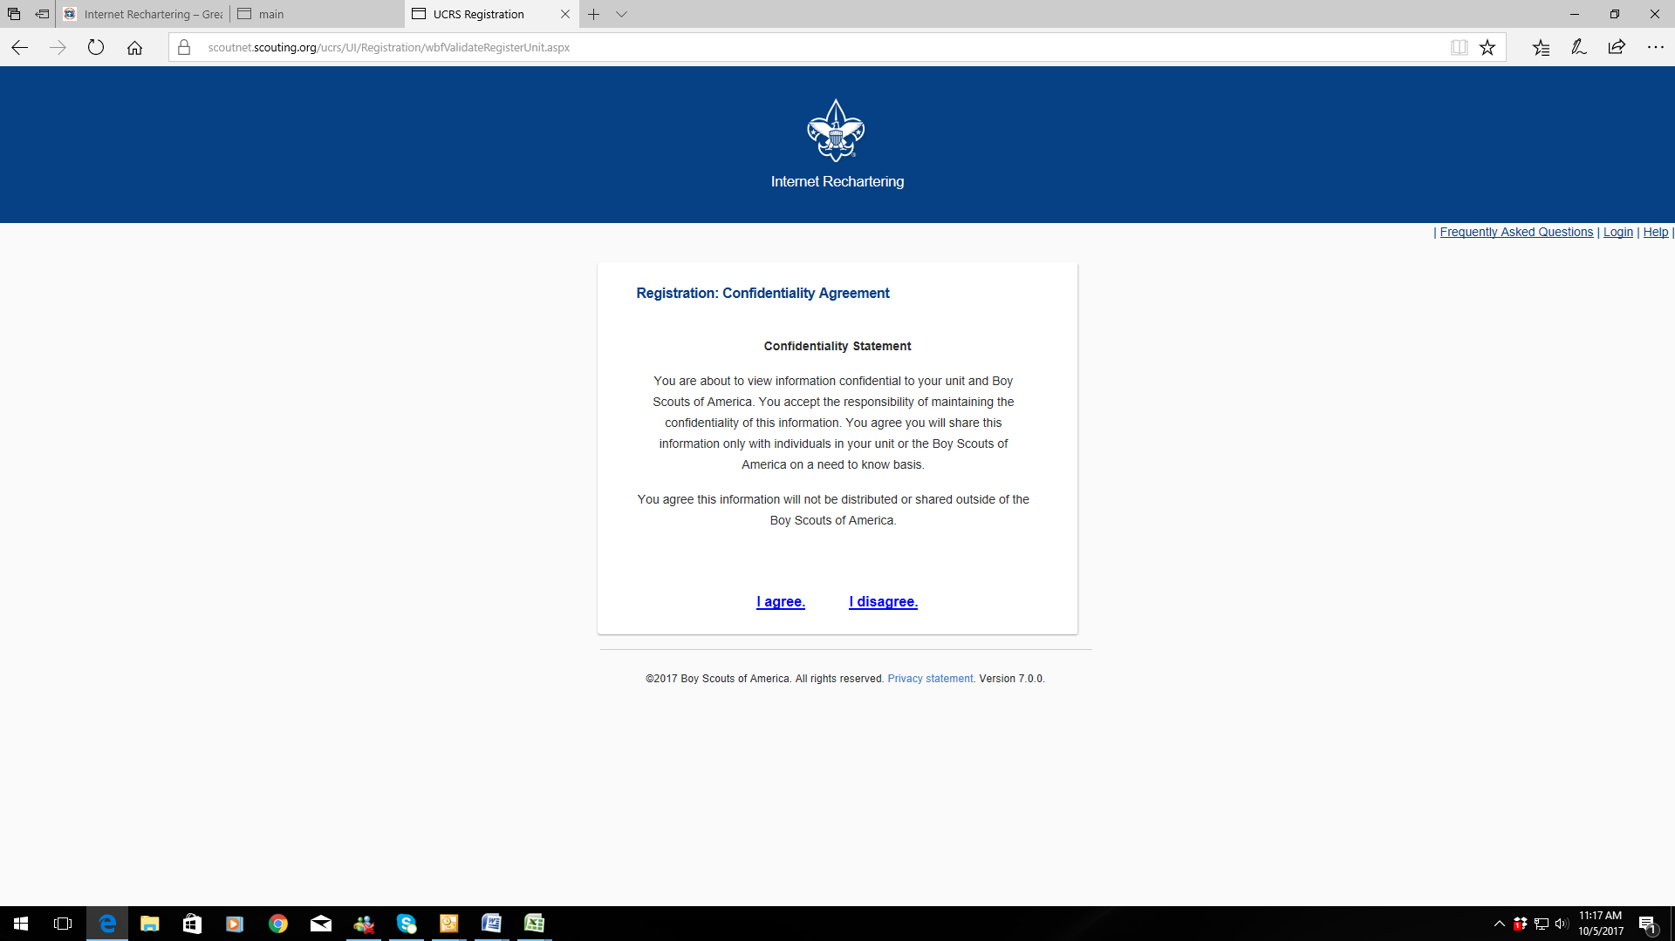
In order to continue, you must agree to the confidentiality statement.

Slide 5
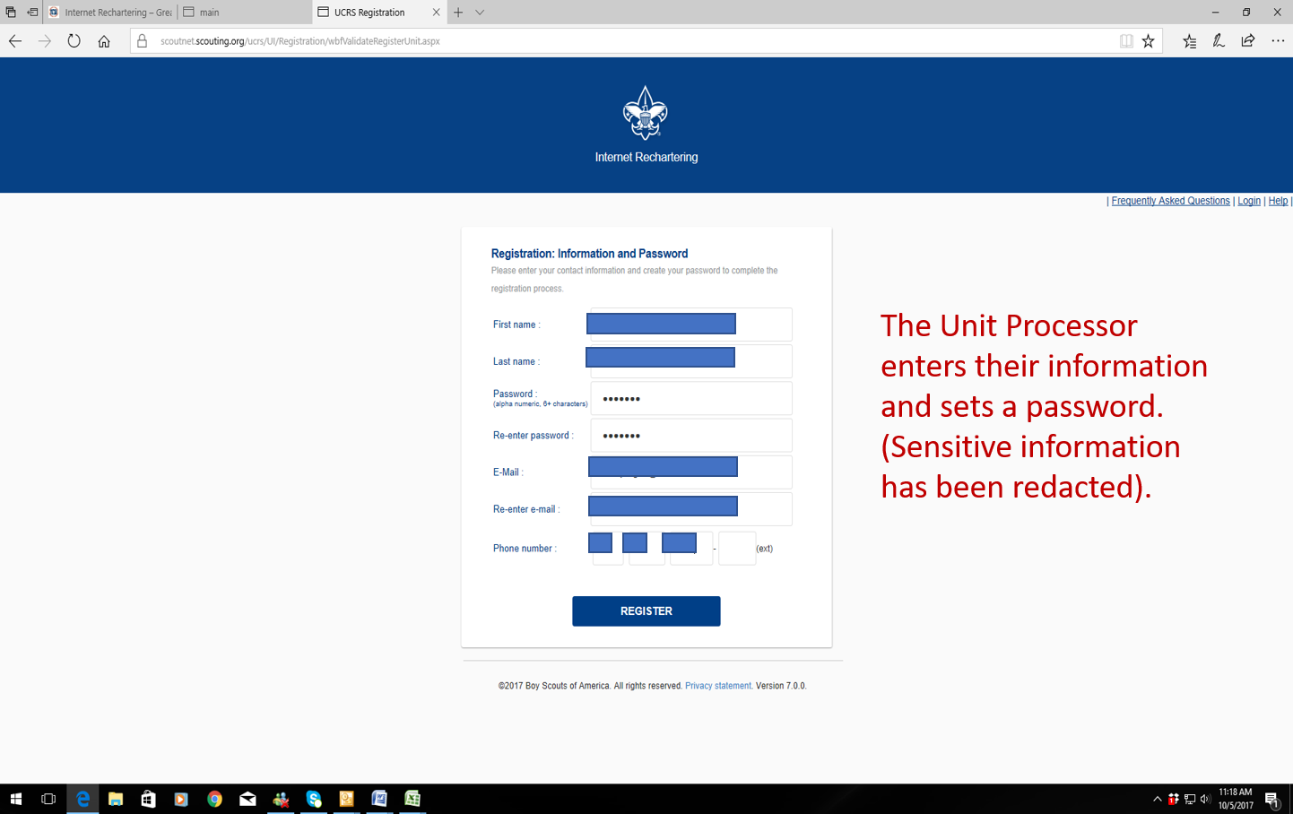

Slide 6
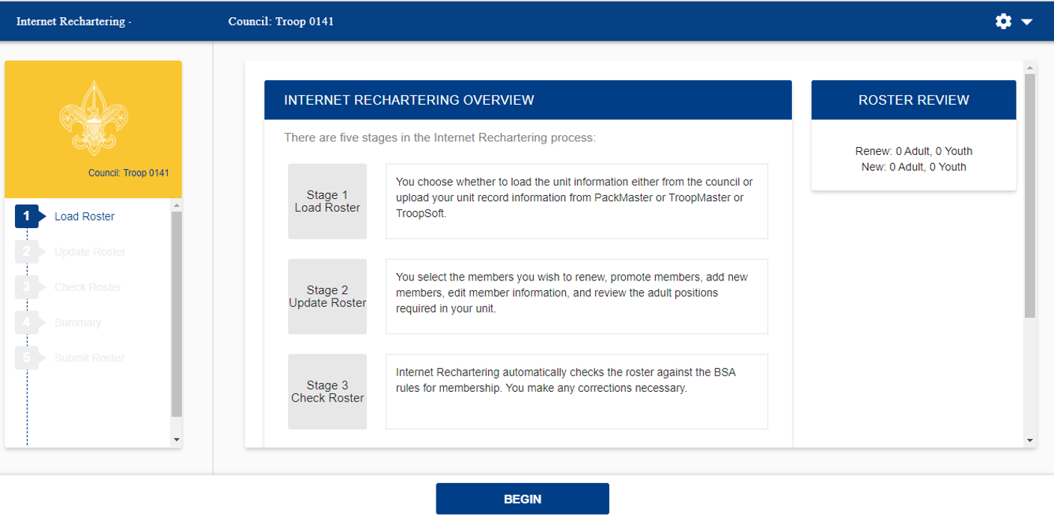
The stages to Internet Rechartering appear on this screen. You will progress through the stages until you have successfully entered all the information and all the BSA requirements have been met.

Slide 7
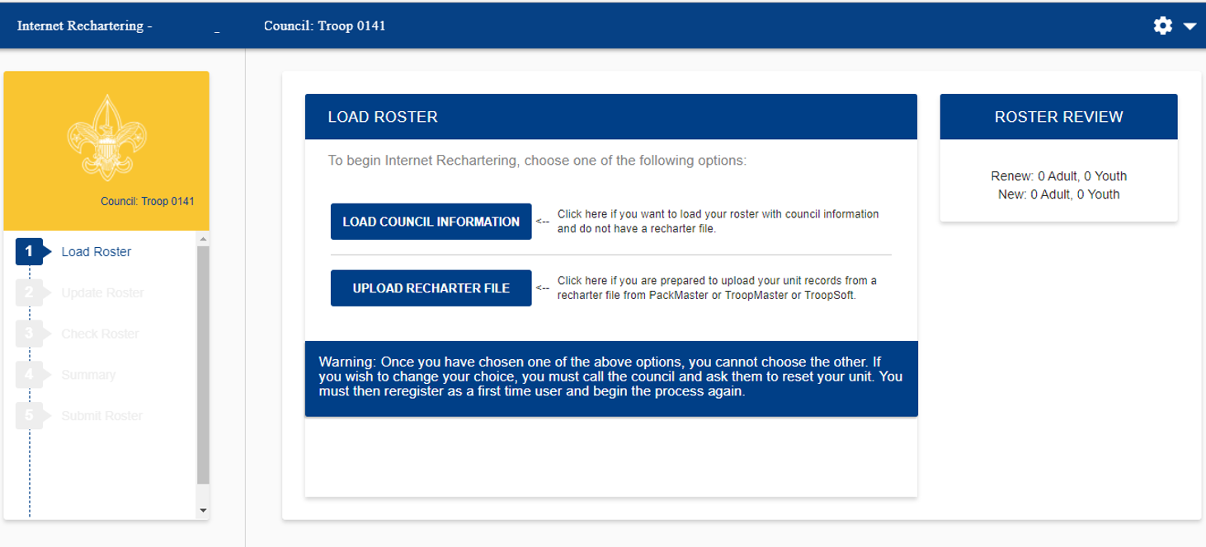
Load Roster – here you have the option of loading the roster from what is on record with your council, or you may load the roster information from another tool your unit may be using, like PackMaster, TroopMaster, or TroopSoft.

Slide 8
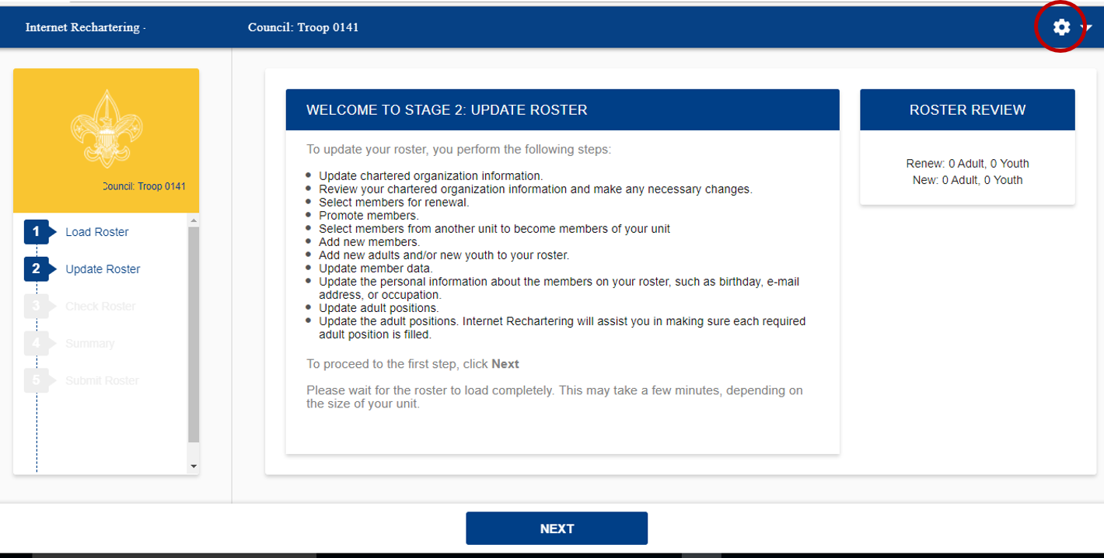
Stage 2 is where you will update the information on your roster. There are several steps to updating the roster. Select Next when you are ready to begin.
If at any time you wish to stop, you select the gear in the upper right corner and Log Out. All changes you have made will be saved.

Slide 9
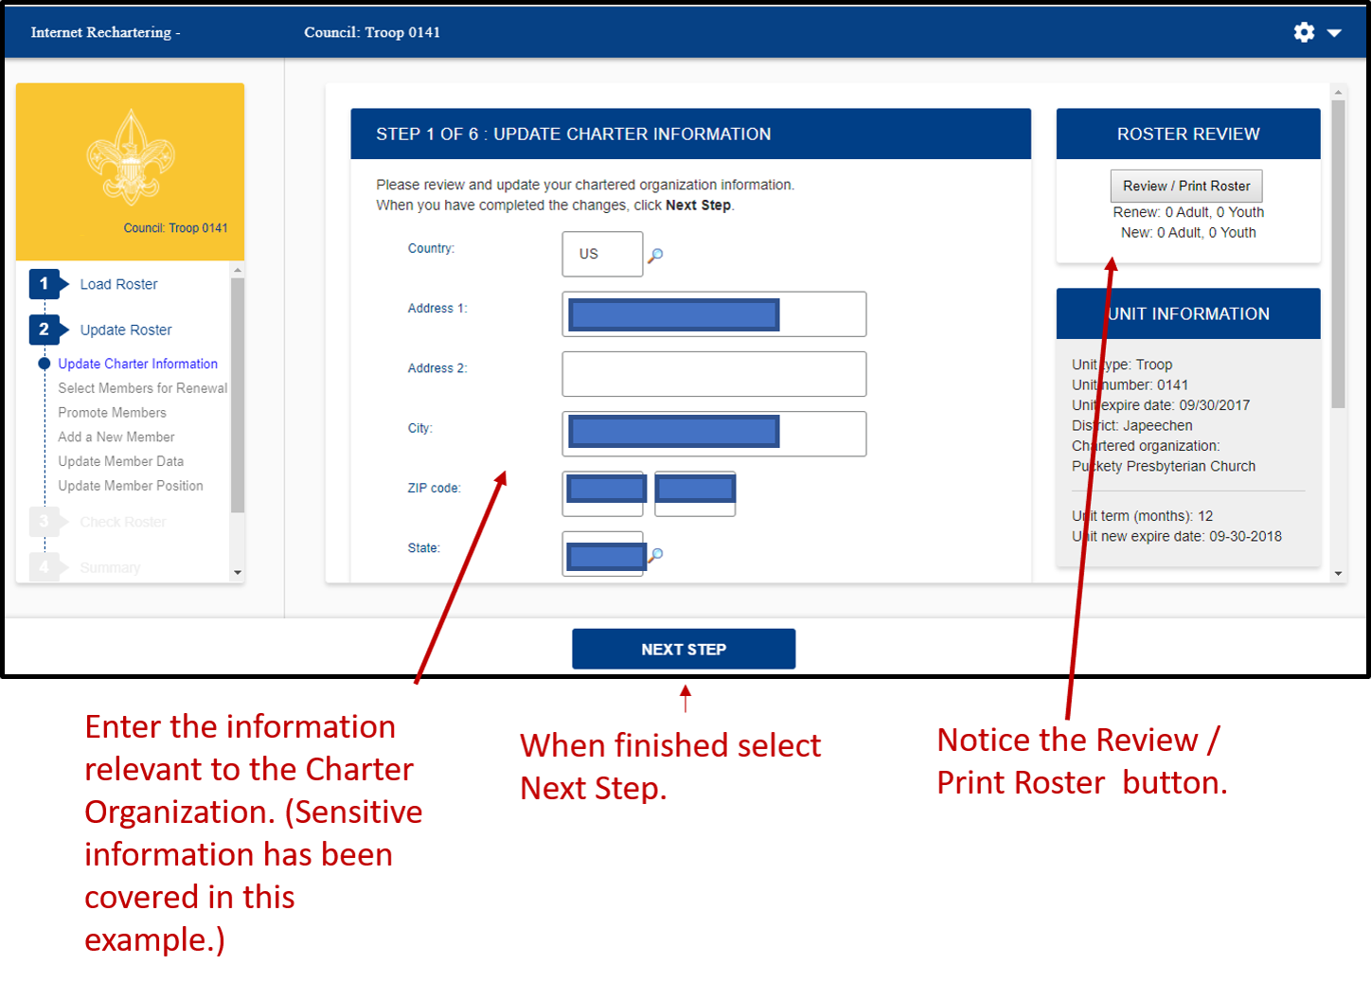

Slide 10
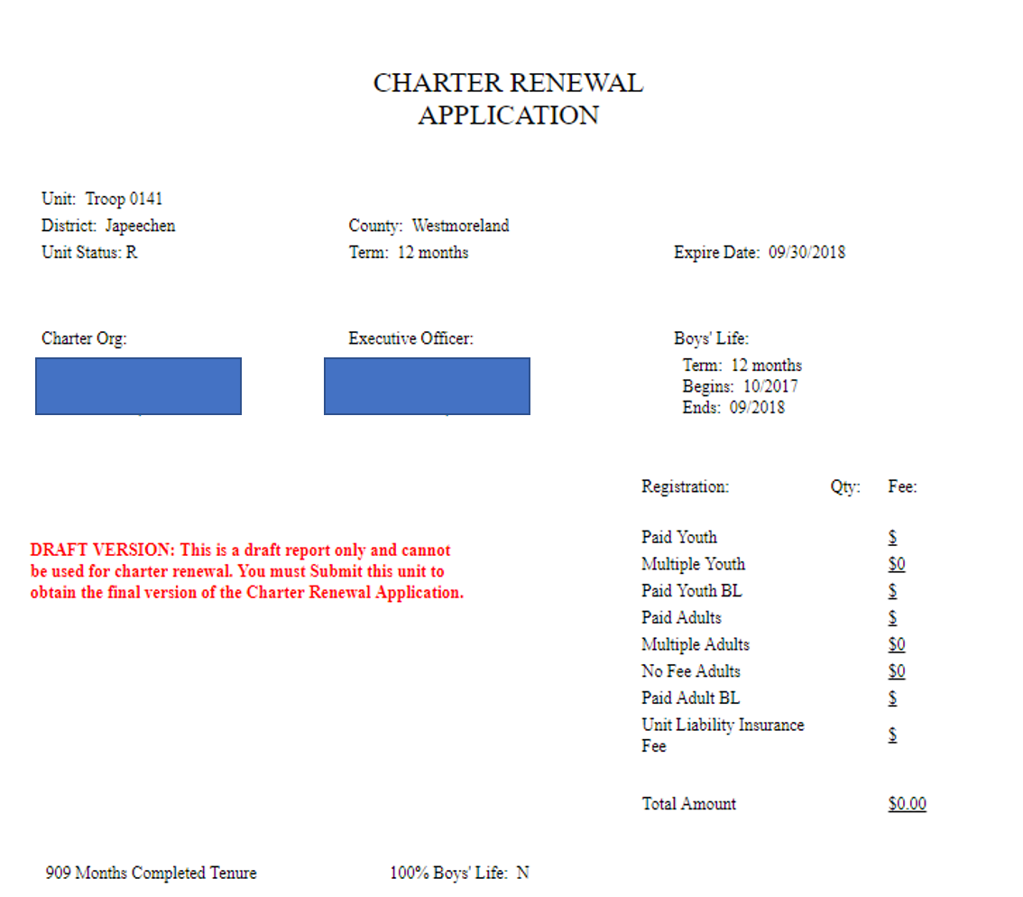
Pressing the Review / Print Roster Button will give you a copy of the Charter Renewal Application, which may then be printed if desired.

Slide 11
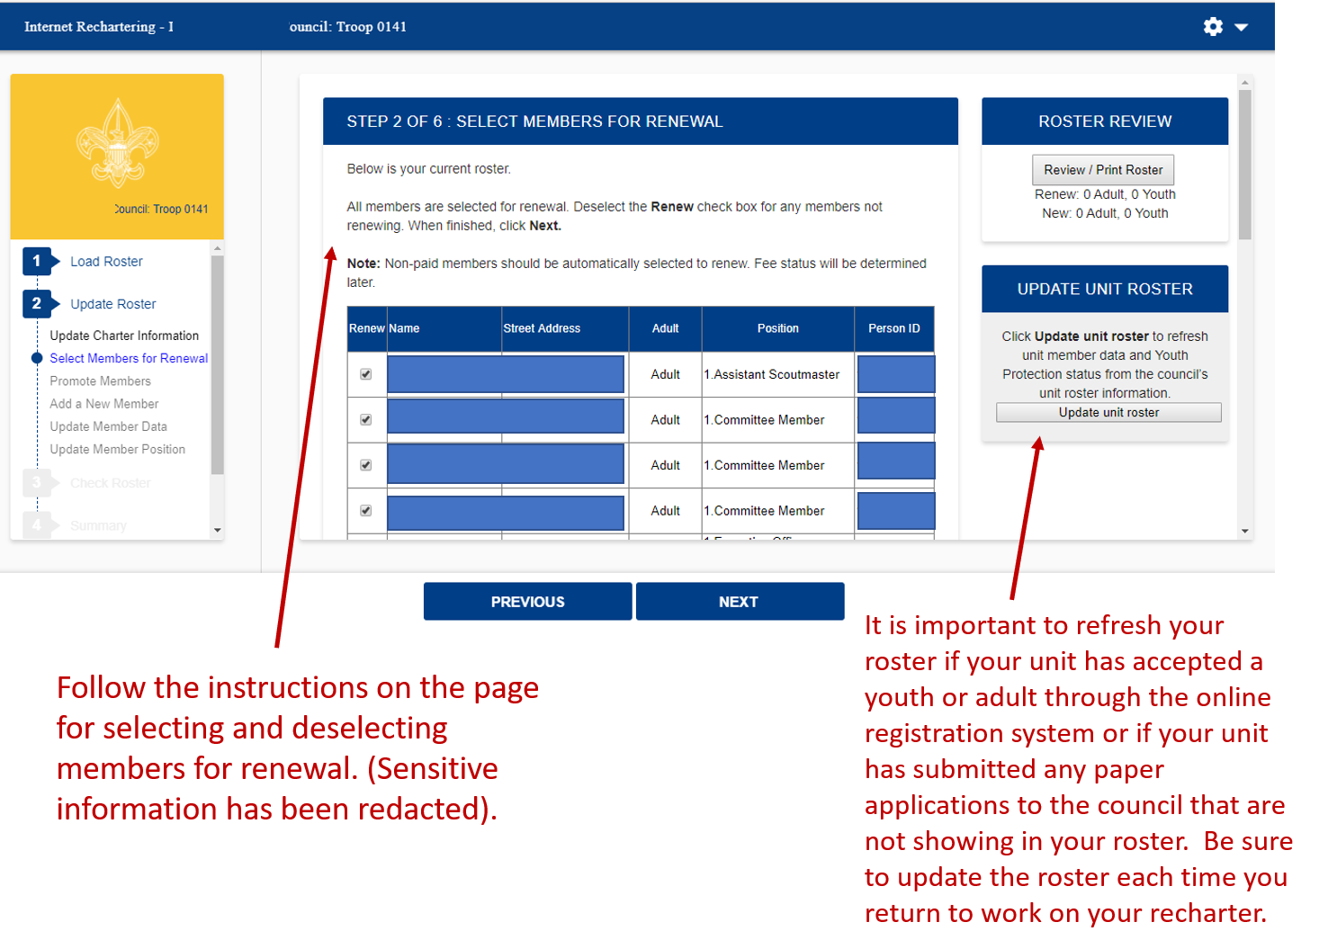

Slide 12
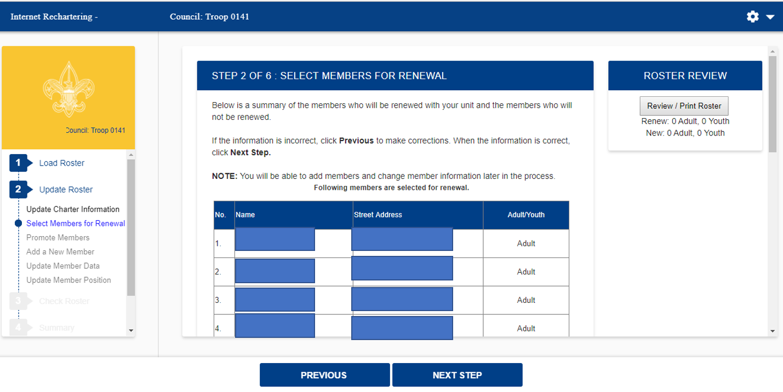
After deselecting members from the previous screen, only the members in your unit will show here. You may correct any incorrect information.

Slide 13
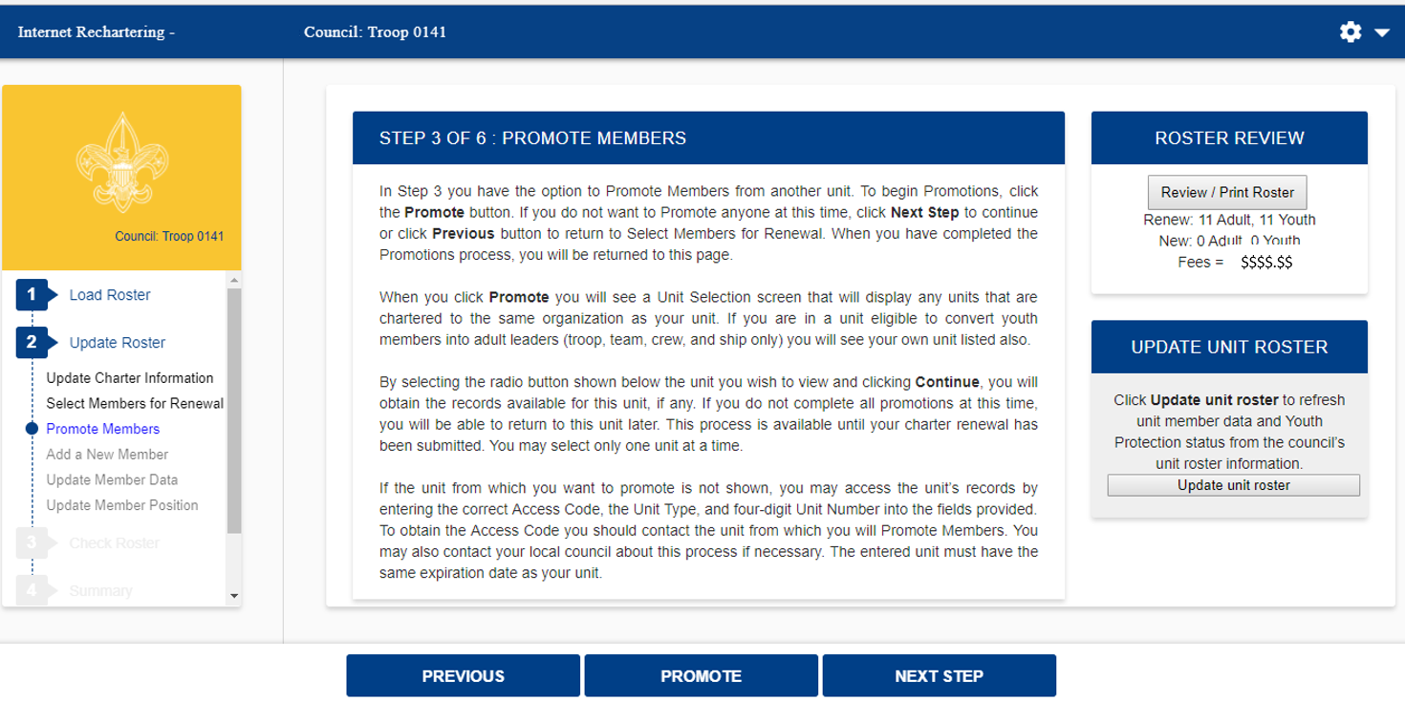
Follow the instructions for promoting members into your unit from another unit. Note you will need access codes for units in which you are not a member. Notice that you will see a fee on the righthand side of your screen under Roster Review. This is a view of only the registration fees for youth and adult members, not your final fee for recharter.

Slide 14
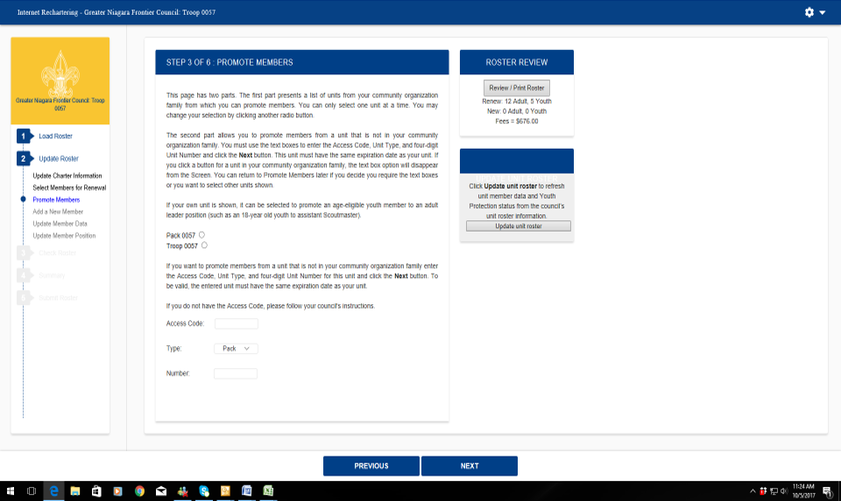
Follow the instructions for promoting members into your unit from another unit. Note you will need access codes for units in which you are not a member.

Slide 15
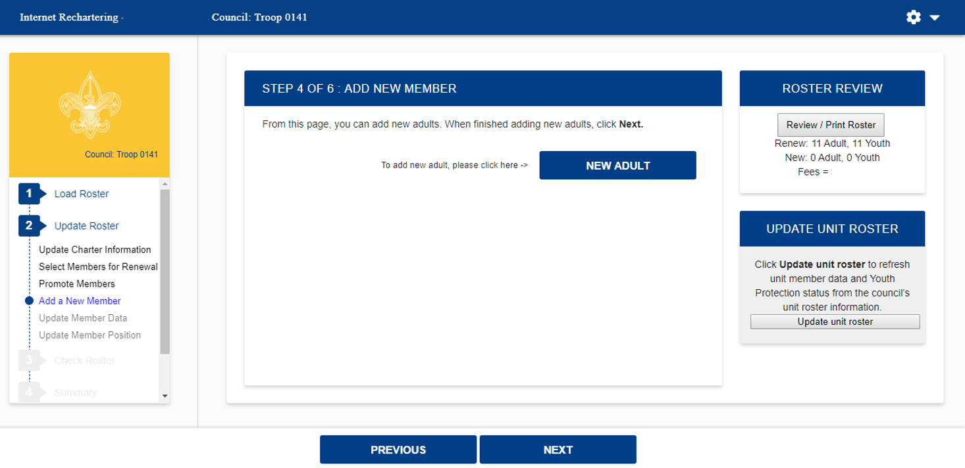
Here you may add a new adult.

Slide 16
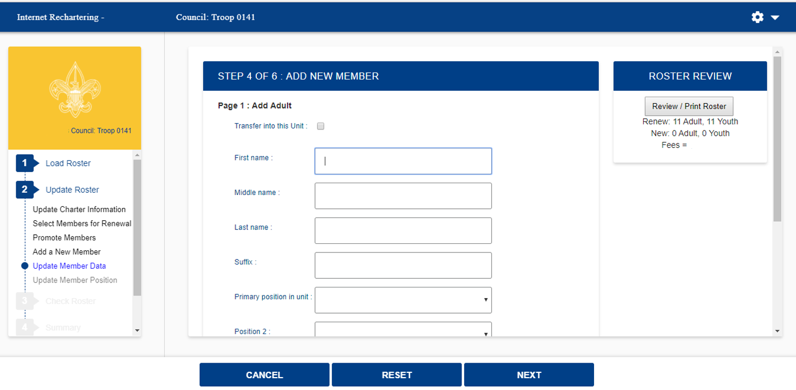
Complete the information for a new adult.

Slide 17
Note the warning about the social security number. You will not be asked to enter a social security number.
Here you will enter the youth protection completion date for the adult. You will need to submit the signed completed application, YPT certificate, and any other supplemental documents the council requires.

Slide 18
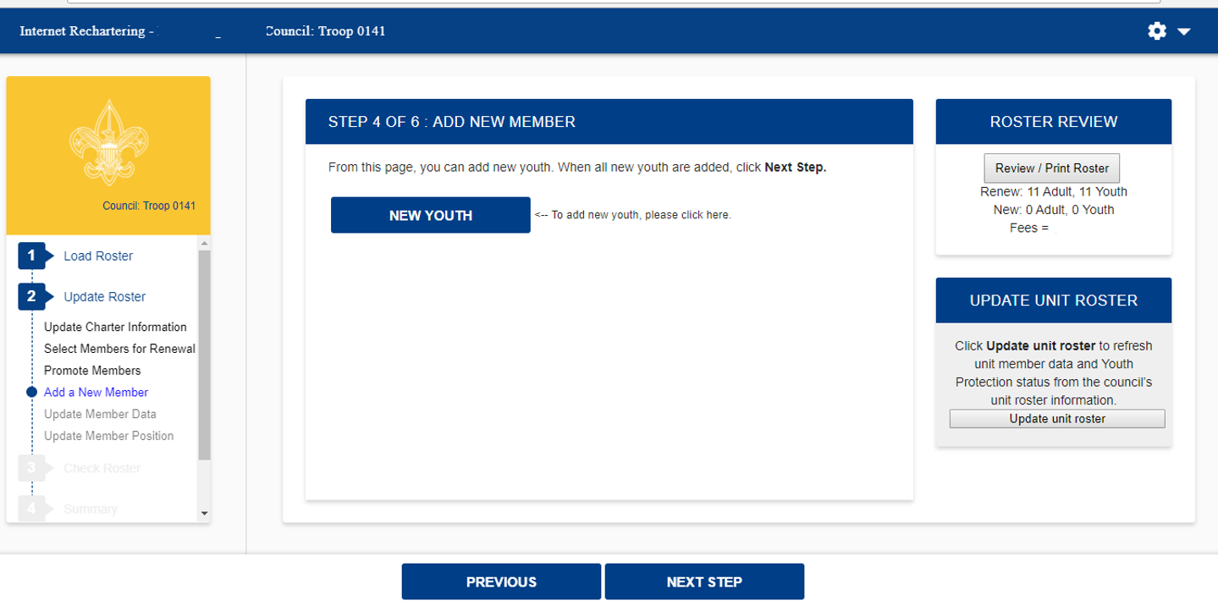
Here you may add a new youth member.

Slide 19
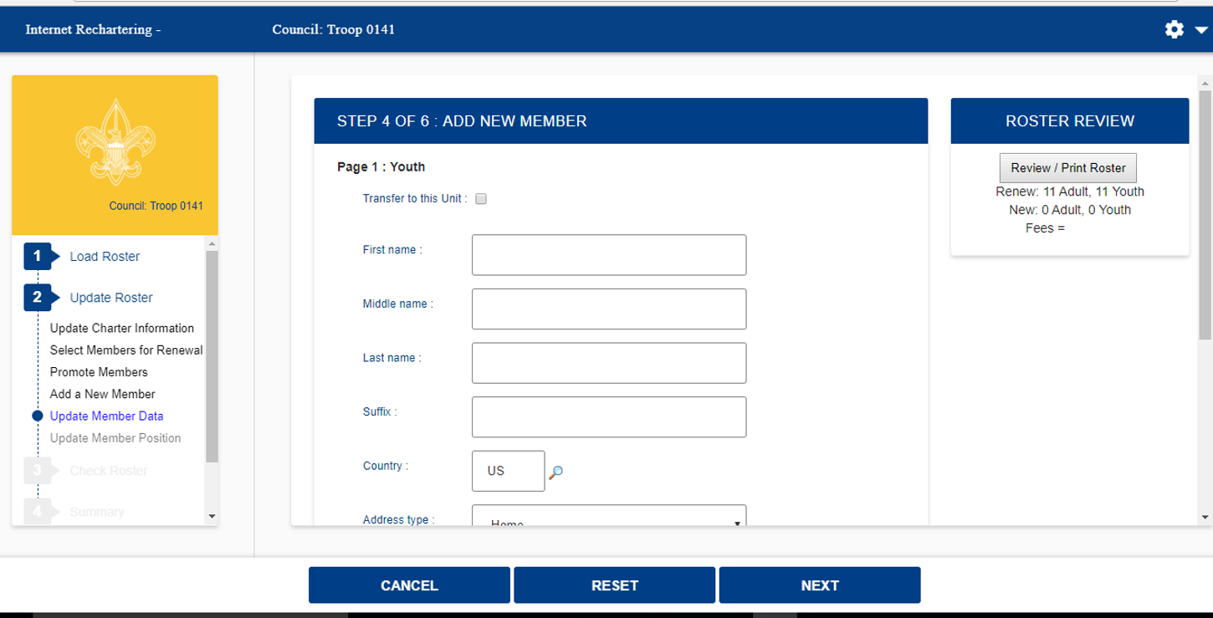
Enter new youth member information

Slide 20
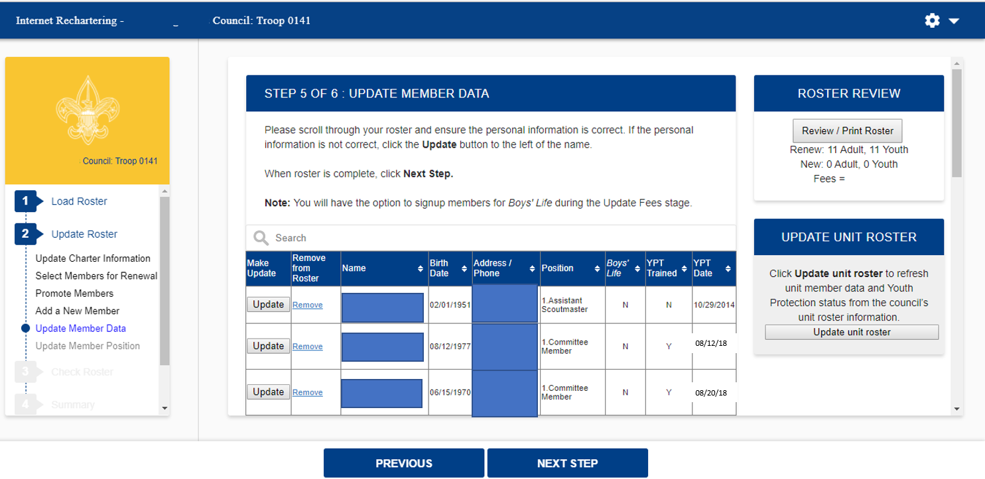
Here you have the opportunity to update information on your members. (Sensitive information has been redacted).

Slide 21
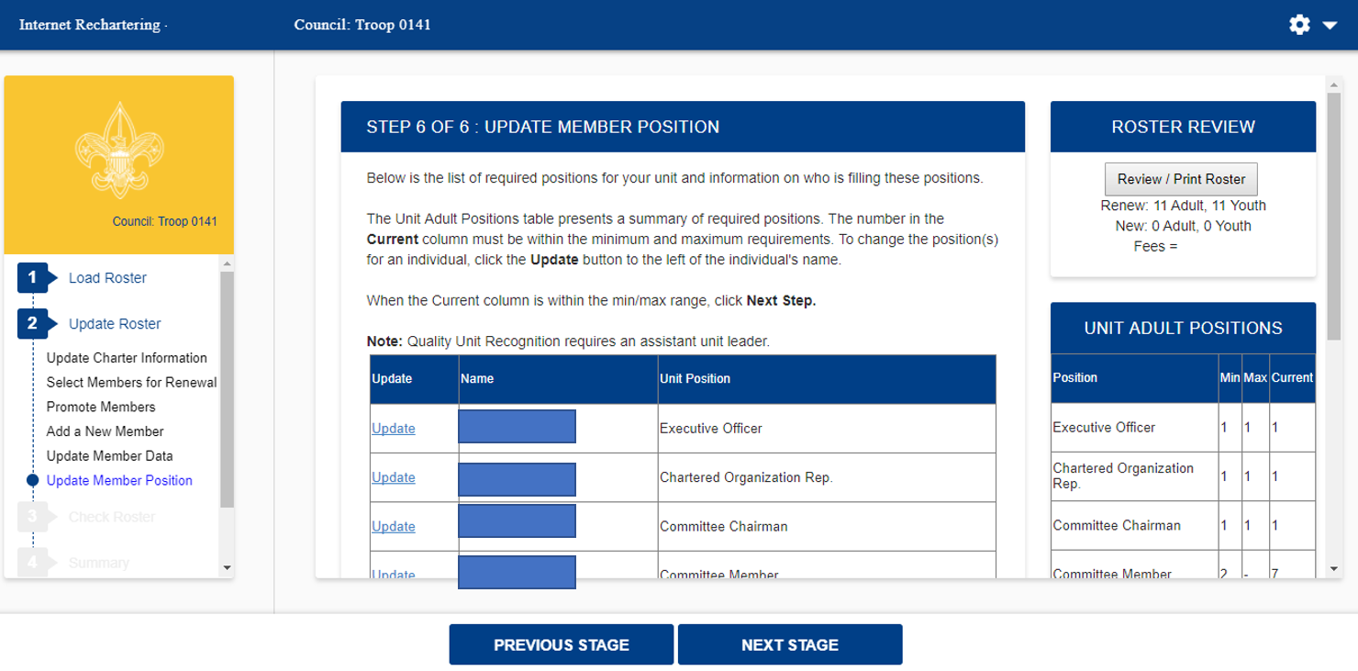
$$$$.$$
Here you are able to see if you have the required minimum unit adult positions for your unit type. (Sensitive information has been redacted).

Slide 22
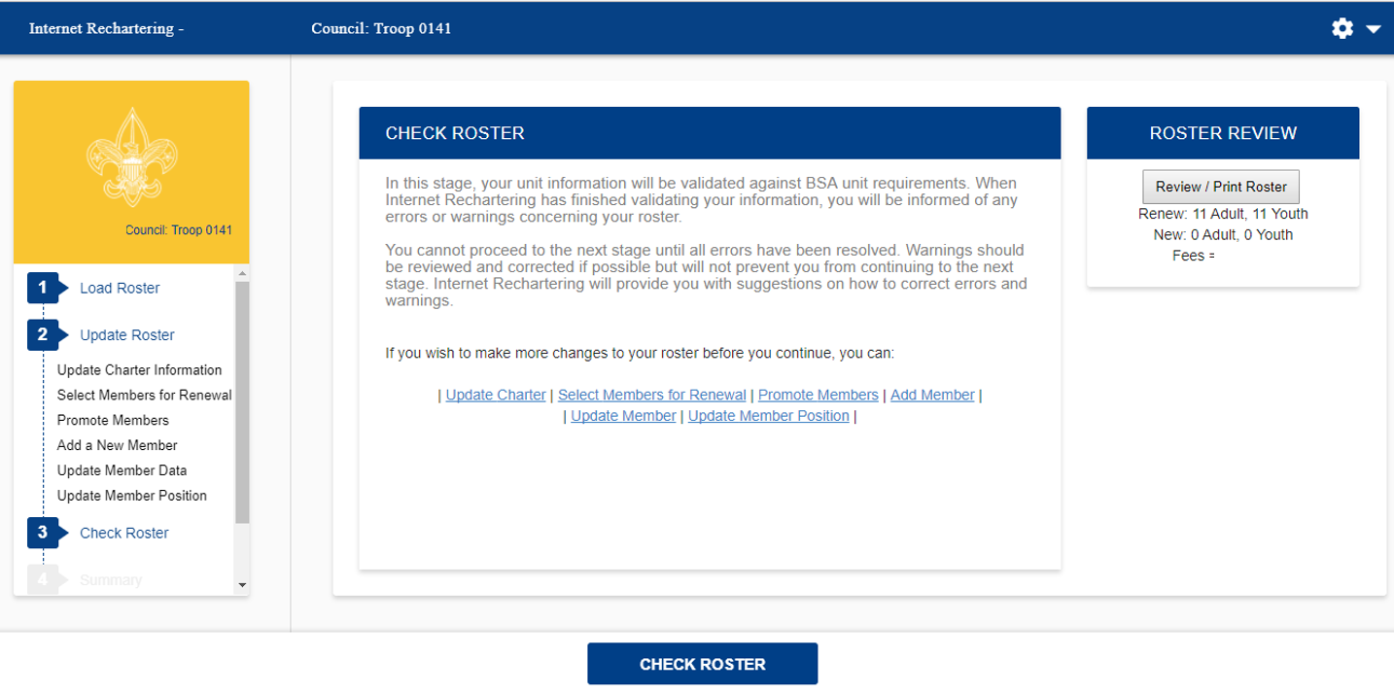
$$$$.$$
Once you have made all your changes, you select Check Roster and your roster will be validated against the BSA unit requirements, including youth protection requirements of the members.

Slide 23
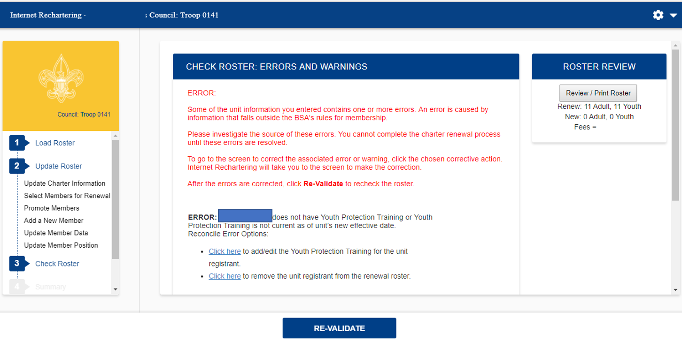
If there are any errors they are indicated on this page. (Sensitive information has been redacted).

Slide 24
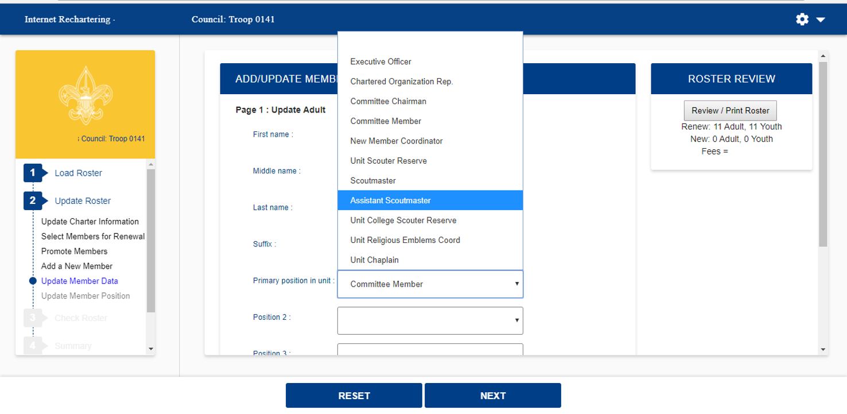
After selecting the member in error, you will be able to make changes to correct the error. The unit processor will be able to modify YPT dates, but should be done so with proper documentation.

Slide 25
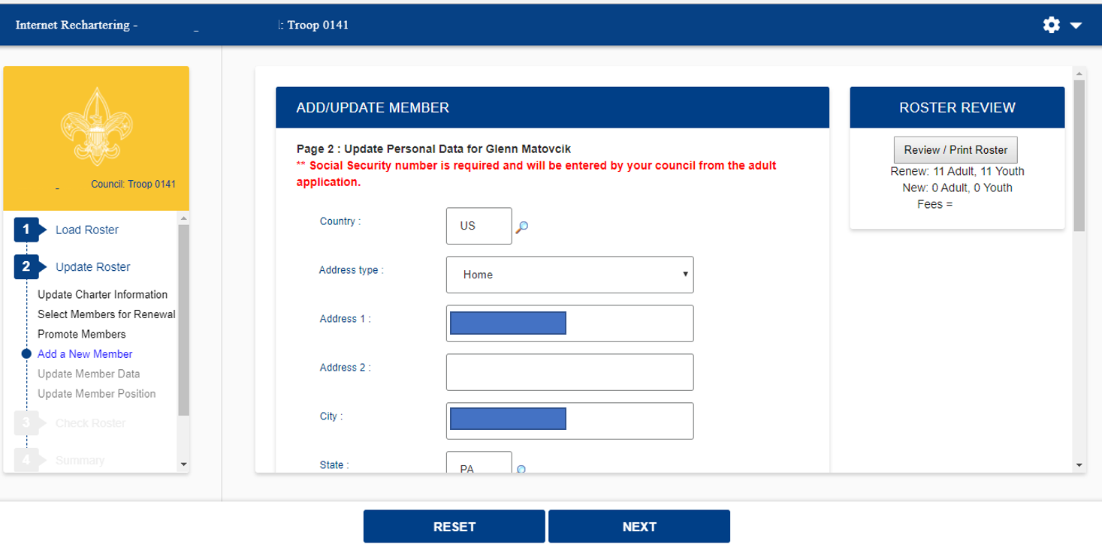
Still updating the member in error. (Sensitive information has been redacted).

Slide 26
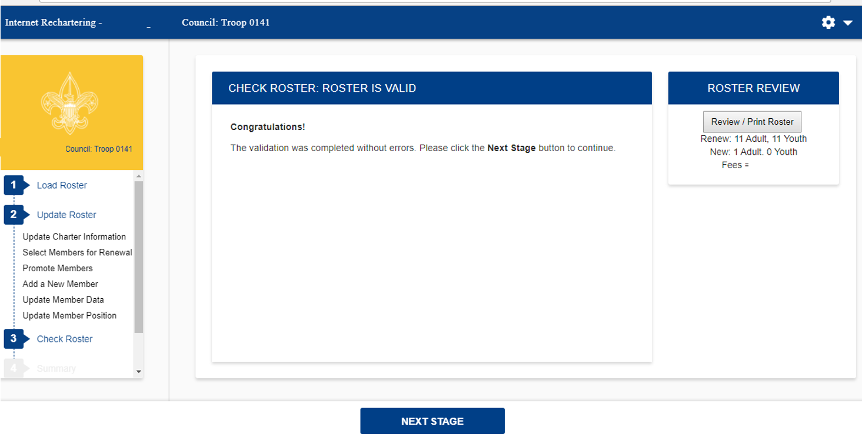
All errors have now been fixed.

Slide 27
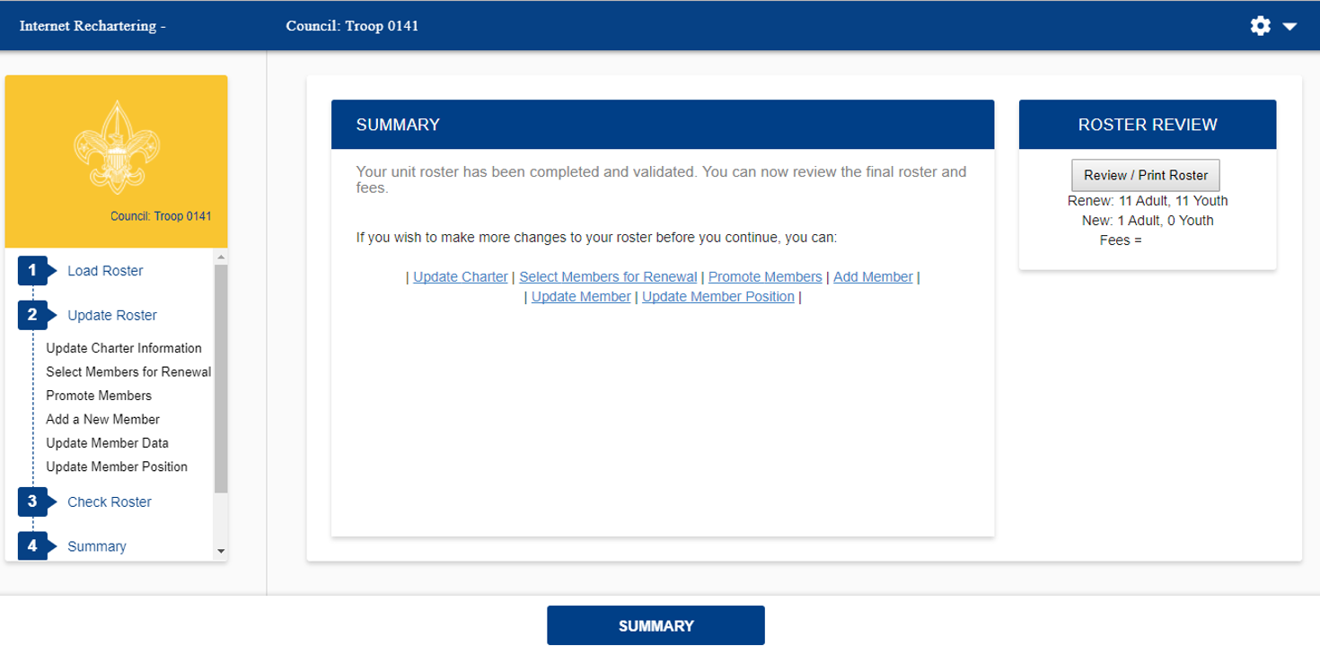
$$$$.$$
Summary Page.

Slide 28
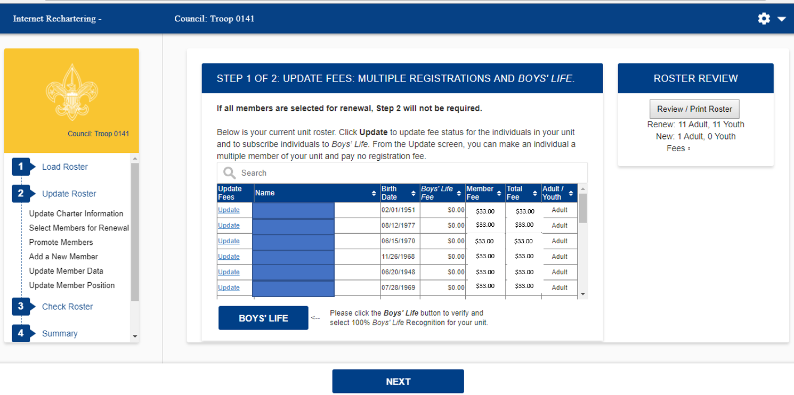
Here is where you make changes to fees.

Slide 29
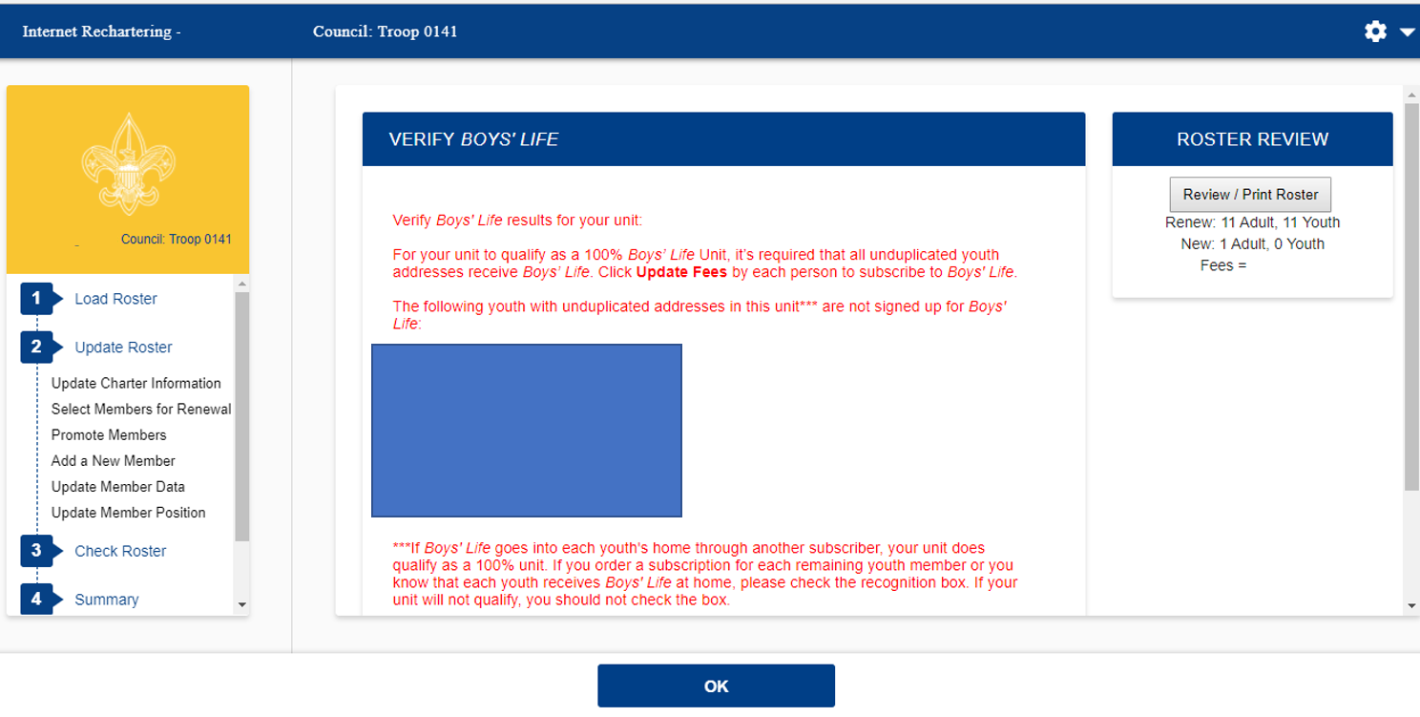
By clicking the Boys Life button on the previous page you will see what you need to qualify to be a 100% Boys Life unit.

Slide 30
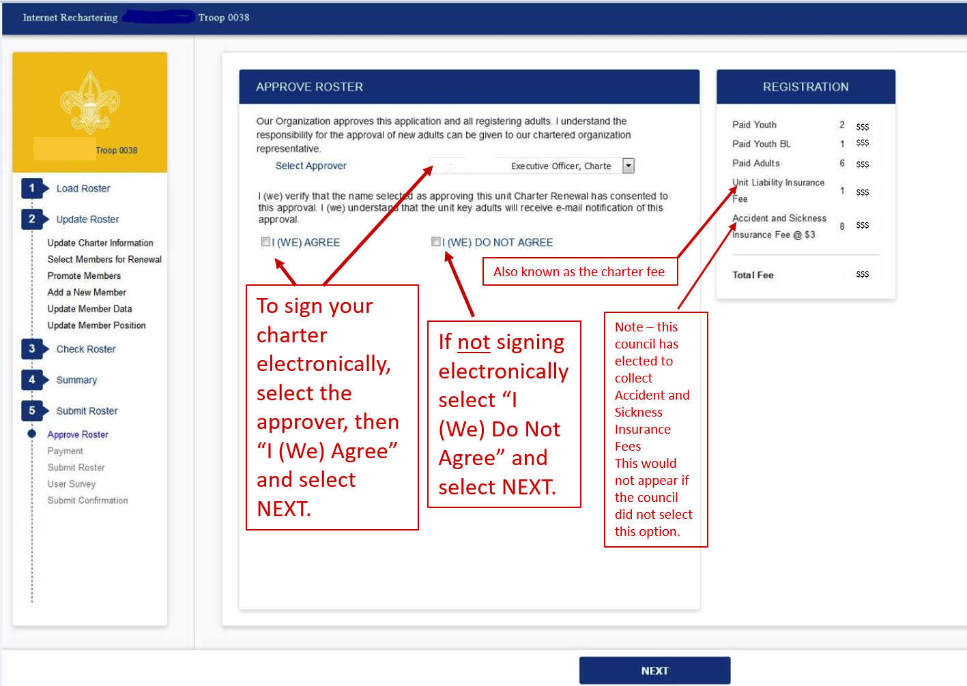

Slide 31
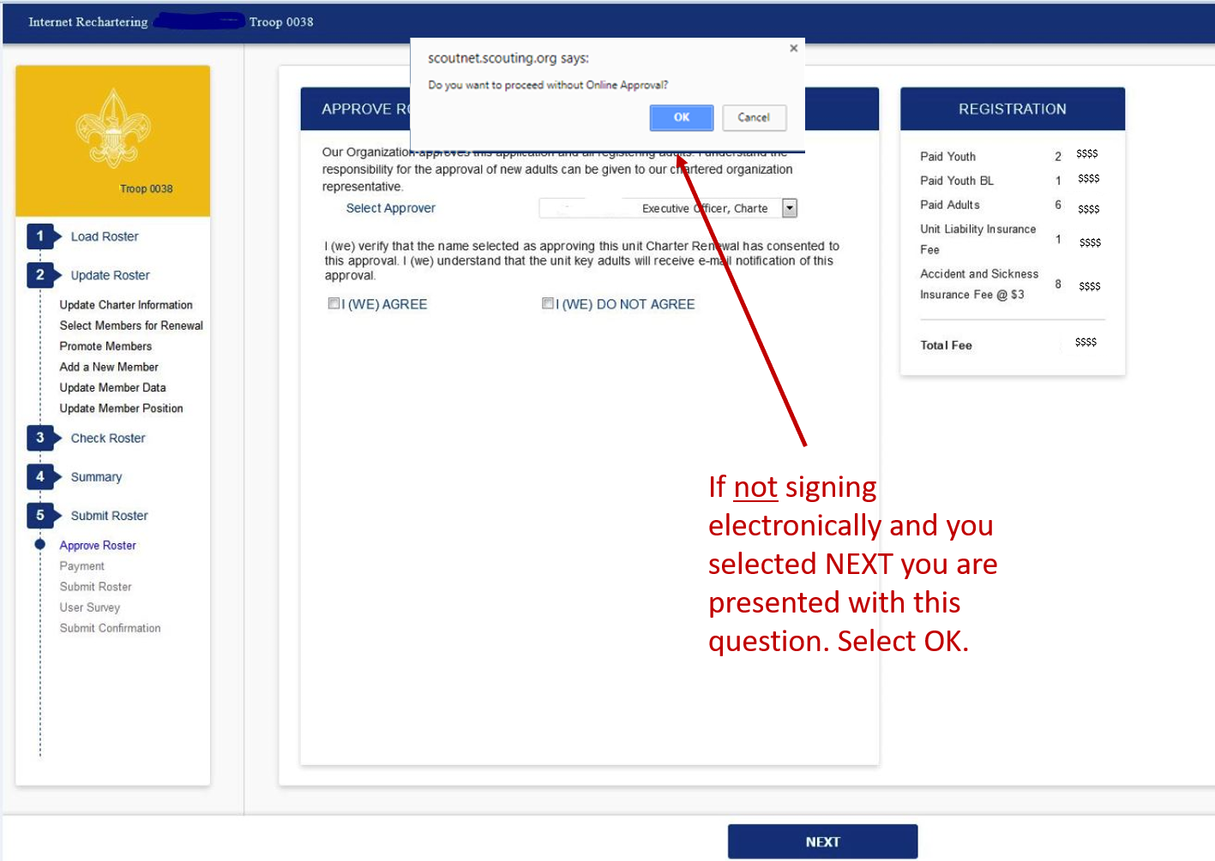

Slide 32
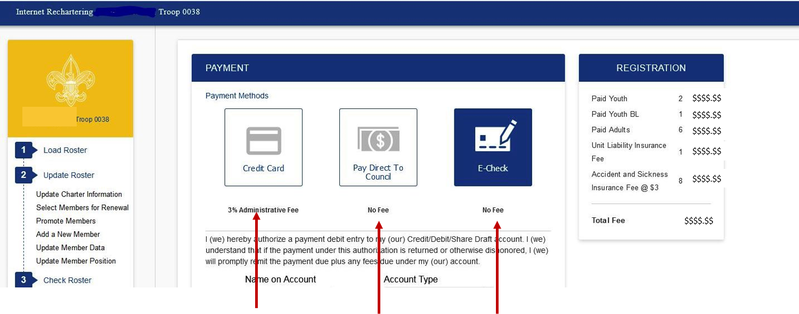
If paying by credit card you enter all of the credit card information.
Note: There is a 3% administrative fee for using the credit card.
If paying cash or through a council unit account, you will need to remit the funds to your council before your recharter will be accepted.
If paying by e-check you will enter the name on the account, account type, routing number, and account number associate with the account.

Slide 33
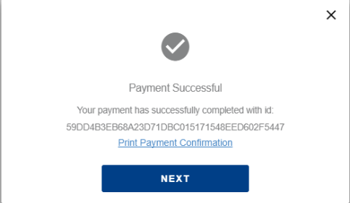
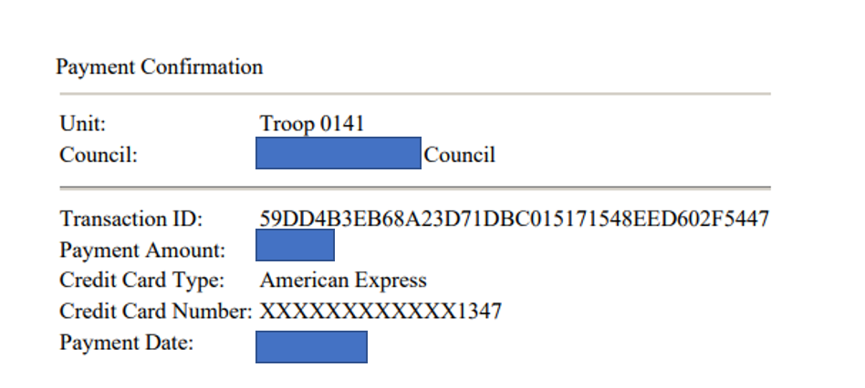
If you selected payment by Credit Card
This is the confirmation you should receive if your payment is successful.

Slide 34
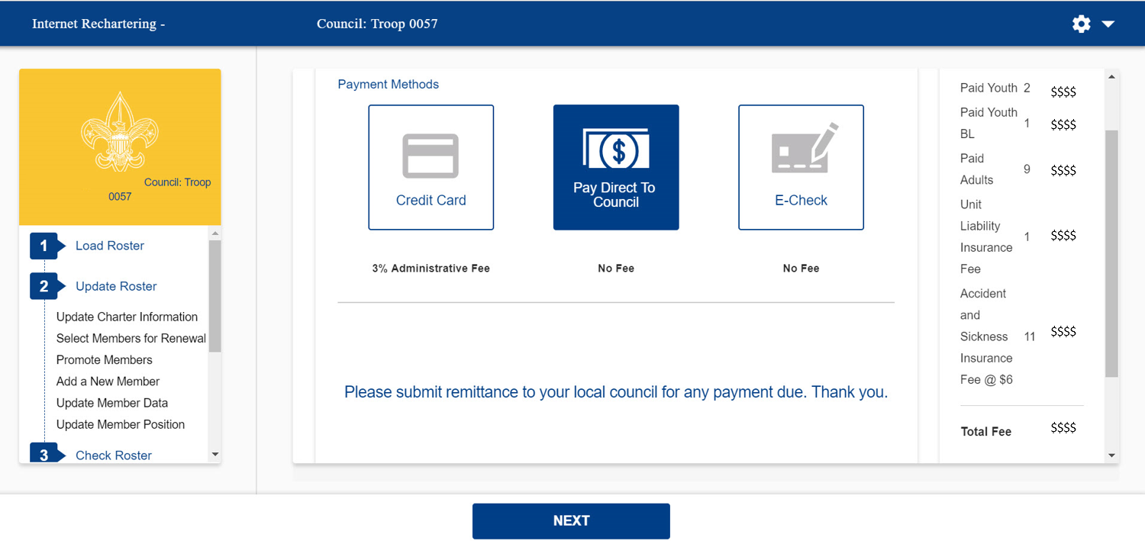
If you selected to Pay Direct to the Council
You should get this payment message.

Slide 35
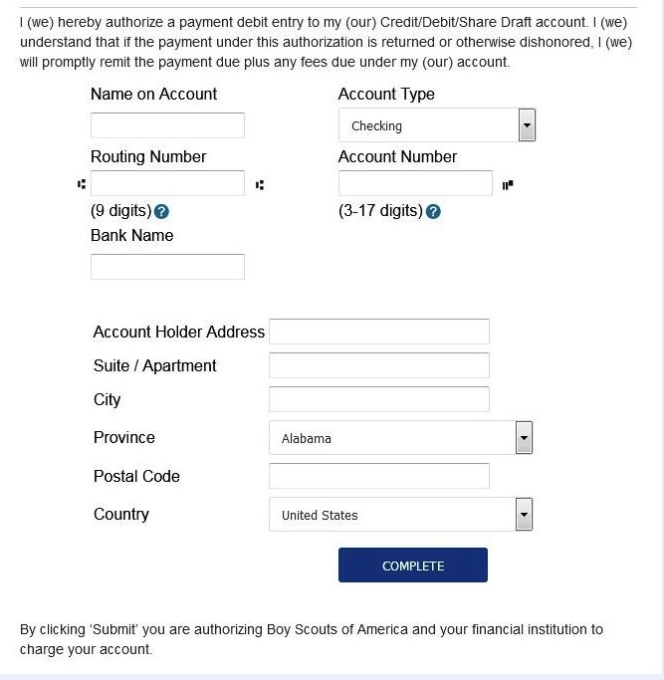
If you selected payment by E-Check
This is the information you will fill out if paying electronically from a checking or savings account.

Slide 36
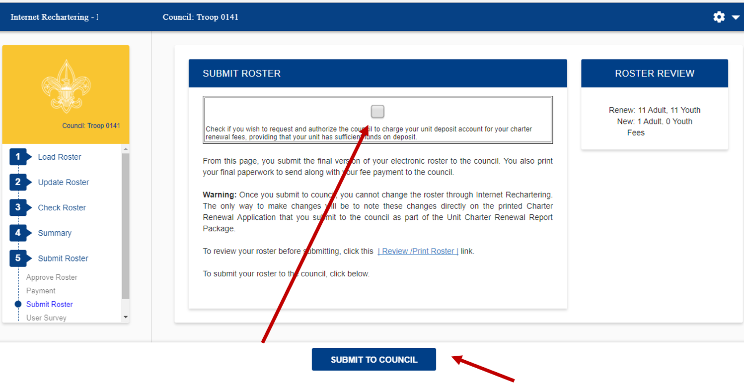
If you are paying by cash you have the option of checking this box, before submitting you roster. The box is greyed out for any other payment option.
When you are satisfied that your roster is complete, click on SUBMIT TO COUNCIL. Note the warning.

Slide 37
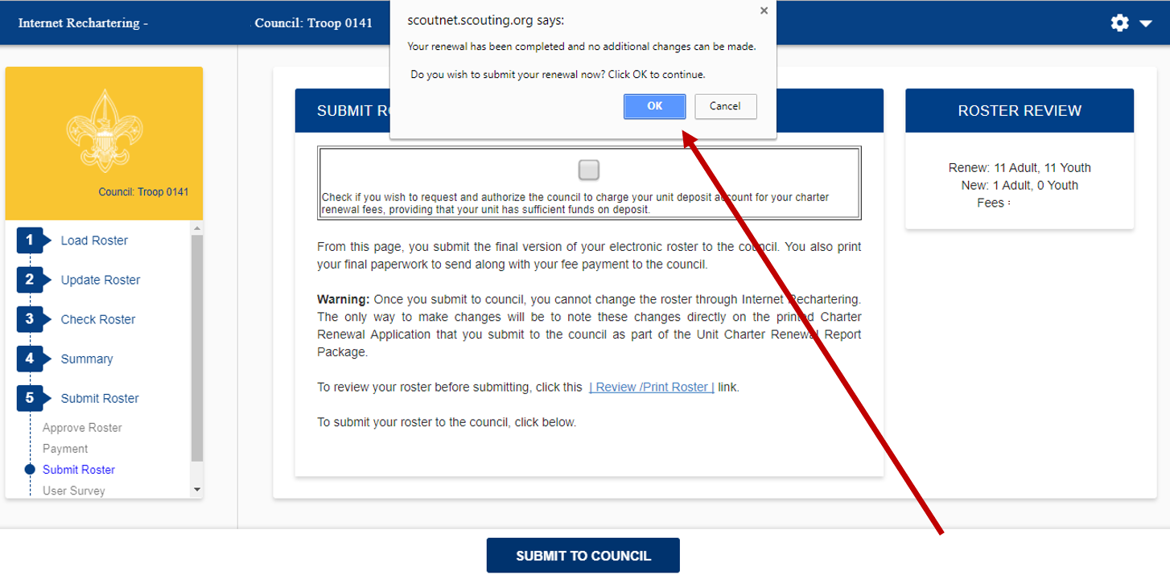
This is the second confirmation that you are submitting your roster.

Slide 38
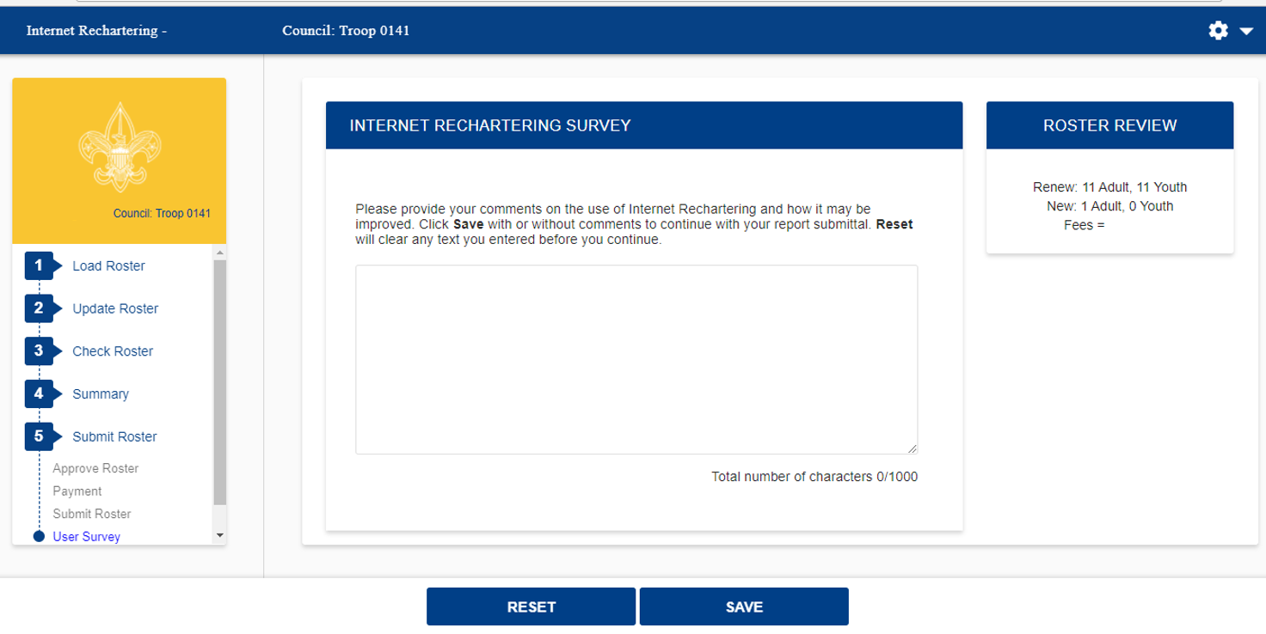
An opportunity to take the survey on using the Internet Rechartering tool.

Slide 39
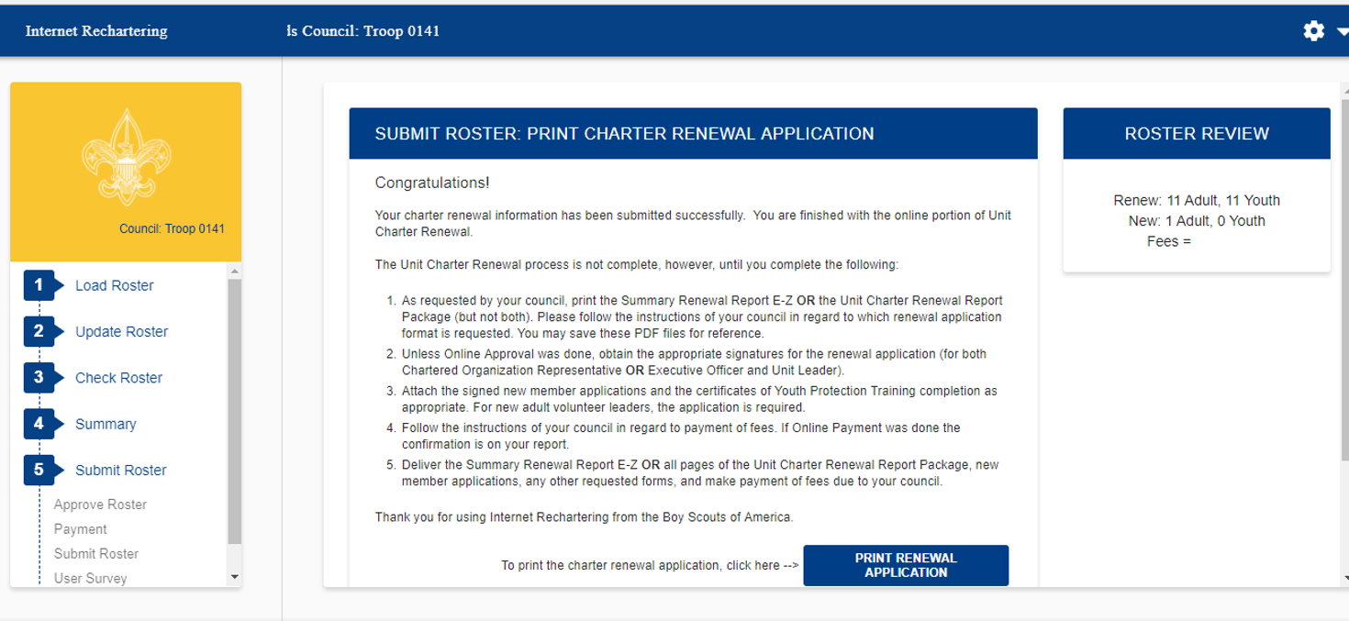
Confirmation of a successful submission.
If you re-enter Internet Rechartering at a later date, you will be presented with this page. This gives you the opportunity to print any required documentation.

Slide 40
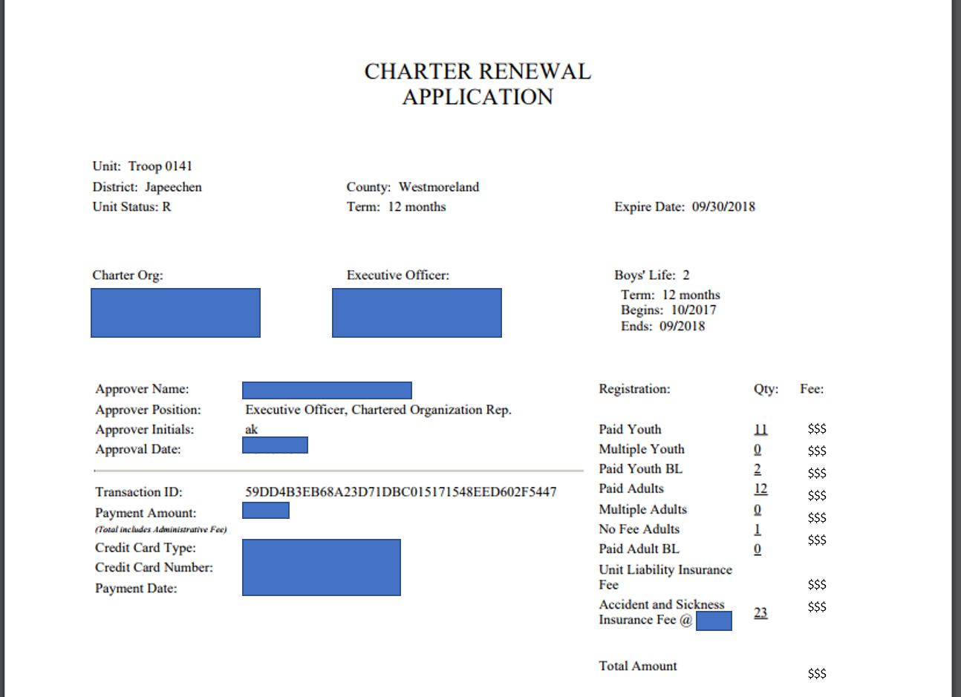
Here is a the charter renewal application, if you clicked on PRINT RENEWAL APPLICATION from the previous slide.

