Slide 1
Personal Management MB

Slide 2
Updated 2019
Eagle Required
Updated 2a, 2b, 4b, 4c, 5, 6, 8d, 10a, 10b
Added 2c, 2d, 4d, 4e

Slide 3
Requirement 1

Slide 4
Requirement 2 (c-d new)
*
*
*
*

Slide 5
Requirement 3

Slide 6
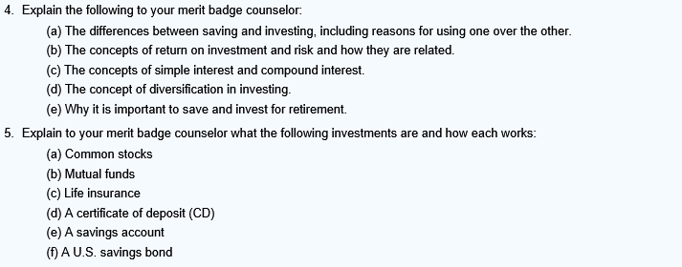
Requirement 4/5 (4d-e new)
*
*
*
*
*

Slide 7
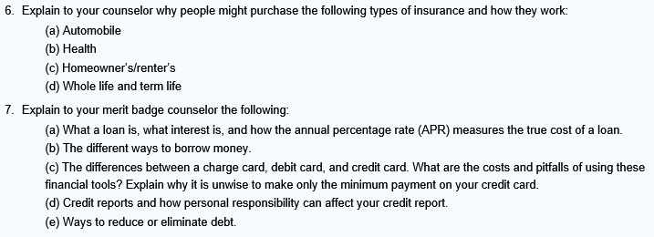
Requirement 6/7
*

Slide 8
Requirement 8
*

Slide 9
Requirement 9

Slide 10
Requirement 10
*
*

Slide 11
Resources
BSA Merit Badge Webpage
https://www.scouting.org/programs/scouts-bsa/advancement-and-awards/merit-badges/
Personal Management MB Requirements
https://filestore.scouting.org/filestore/Merit_Badge_ReqandRes/Personal_Management.pdf

Slide 12
Questions?

