Slide 1
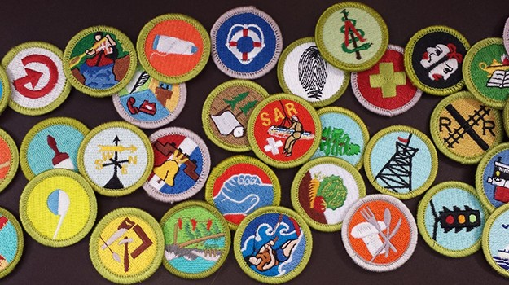
The Merit Badge Process

Slide 2
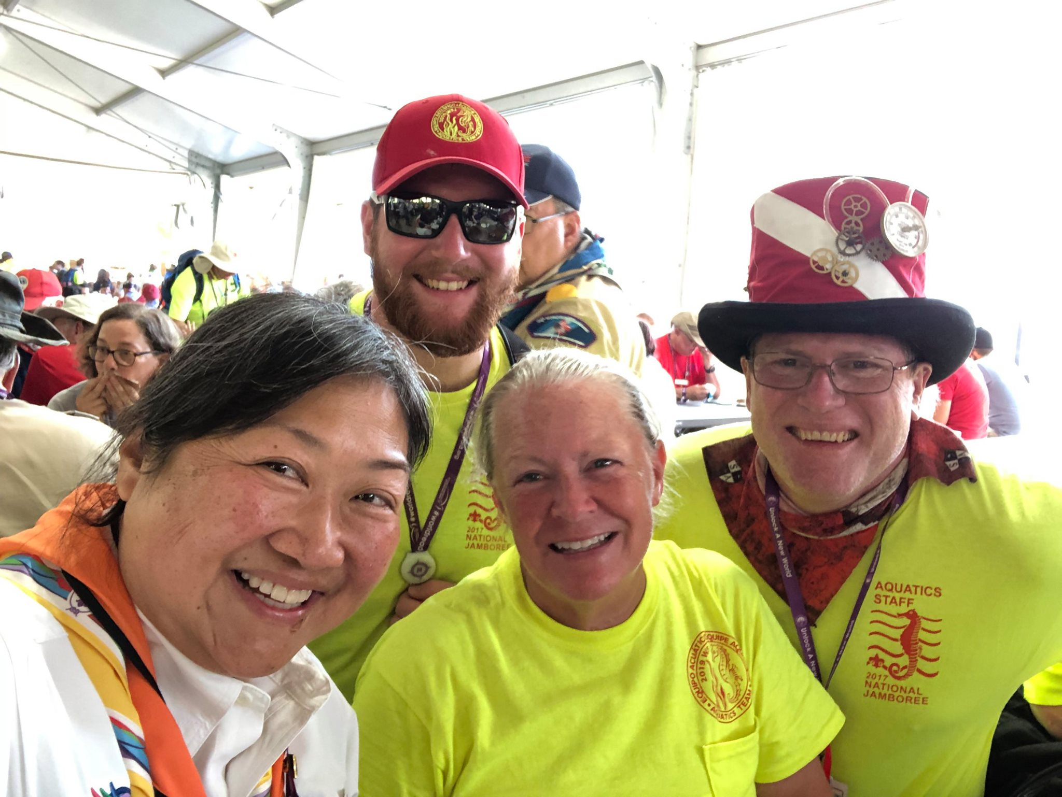

Slide 3
Why Merit Badges?
Introduce potential hobbies
Provide life and scouting skills
Discover career opportunities
The process!!!
Learn to overcome obstacles (procrastination for one)
Improve social skills
Adult Association (Methods of Scouting)
Goal setting
Self reliance
Exposure to role models and mentors

Slide 4
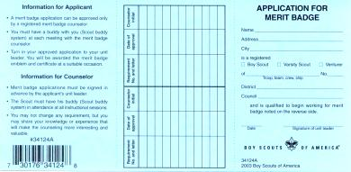
The Merit Badge Process
Scout indicates interest; discusses with unit leader; gets MBC name and blue card
Unit reports advancement and obtains badge for presentation
Scout contacts counselor
Scout returns completed merit badge card to unit leader
Scout/counselor first meeting
Counselor approves completion
Subsequent Scout/counselor meeting
Subsequent Scout/counselor meeting
Subsequent Scout/counselor meetings
Scout completes requirements
Notes:
In review, here’s a chart that outlines the process the BSA considers the best approach to getting the most out of the merit badge program.
[Note to presenter: Give participants a chance to review the chart and invite them to ask questions.]

Slide 5
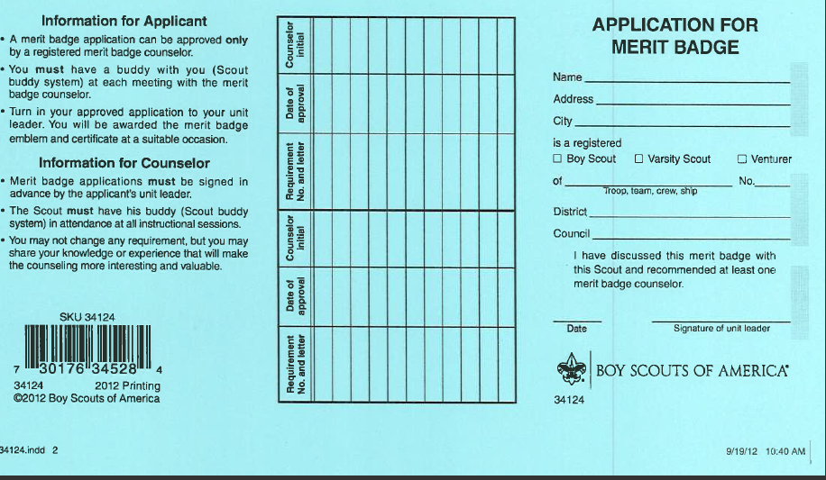
Application for Merit Badge The Blue Card
The unit leader signature:
Required for Scouts to work with counselors
Does not indicate unit leader “approval”
Evidence of discussion between unit leader and Scout
Indicates registered counselor has been recommended
Not required for Scout to get started on requirements
It is required before working with a MB counselor
“I have discussed this merit badge with this Scout and recommended at least one merit badge counselor.”
Guide to Advancement topic 7.0.0.2
Notes:
The unit leader’s signature is required on the application before the Scout begins working with the merit badge counselor. This does not mean the young man must wait for the signature to begin work on the merit badge itself. For example, past campouts count for the Camping merit badge, and coins and stamps already collected count for those badges.
The unit leader’s signature does not necessarily indicate approval. It merely shows that the Scout and the unit leader have had a discussion about the badge and that the unit leader has recommended at least one registered merit badge counselor.
What do you do if a Scout shows up without a signature on his blue card? Ask him where he got the card. If the Scout indicates the unit leader knew of his desire to begin working on the badge, but forgot to sign—or if there are other compelling extenuating circumstances—you may proceed with the initial session and ask him to get his unit leader’s signature prior to the next meeting.
5

Slide 6
Previously Completed Requirements
It is the counselor’s decision whether to accept work or activities completed prior to the issuing of the signed blue card (7.0.0.2)
Common sense should prevail (7.0.0.2)
Nights already camped as a Scout in Scouts BSA or as a qualified Venturer or Sea Scout
Coins or stamps already collected
What about a project requiring MB counselor approval?

Slide 7
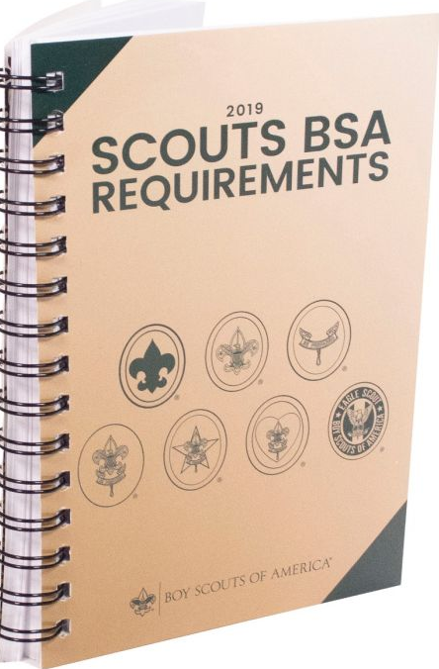
Merit Badge Requirements
Finding current requirements for a merit badge
Scouts BSA Requirements (current edition)
Merit badge pamphlet (latest printing)
www.scouting.org
Are the requirements flexible?
No; they must be fulfilled as written.
Wording matters!
“Show,” “demonstrate,” “describe, “make,” “list,” etc., are to be taken literally.
Notes:
Thanks to the National Advancement Committee’s Merit Badge Maintenance Task Force, most of our 130-plus merit badges have been reviewed and prepared for update. The advancement committee is phasing in the resulting changes as the affected merit badge pamphlets come up for revision and reprint. Then in January each year, the updated requirements appearing in the pamphlets that were reprinted during the previous year actually become effective when they come out in the new edition of Boy Scout Requirements. During the time between when new requirements appear in a merit badge pamphlet and the effective date in January when the requirements book comes out, Scouts have a few options.
Unless otherwise stated in the requirements book or in the merit badge pamphlet, Scouts who have already started on a merit badge when a revised pamphlet is released may switch to the new requirements or continue with the old ones until the badge is completed.
Scouts who have not already started when a revision is introduced may choose to use the new requirements and the new pamphlet, or they may use the old requirements and old pamphlet until the badge is completed.
Once the new requirements book is released, Scouts who have not already begun work on a merit badge must work with the new requirements and the new pamphlet.
It’s important that both you and your Scouts have copies of the current merit badge pamphlets. The content supports each of the requirements and is provided by experts in each subject. Many of the pamphlets also have an introductory “Note to the Counselor” that informs counselors of safety considerations as well as any training or special qualifications that might be needed for presenting merit badge activities. These notes represent part of the Boy Scouts of America’s risk management plan, and counselors are expected to understand and work with them.
Merit badge pamphlets are available at all Scout shops and can also be ordered through the BSA Supply Group at www.scoutstuff.org. Pamphlets may also be found in troop libraries or even public libraries, but the chances of finding out-of-date copies from those sources is high. The National Council has been planning for the production of digital versions of the pamphlets, which would be available for sale online—much like “e-books.” Watch Advancement News for any developments. If you don’t subscribe to the News, you should do so by sending a message to advancement.team@scouting.org.

Slide 8
Merit Badge Requirements (Con’t)
What if new MB requirements are published?
If already working on a merit badge, scouts may continue to use the old requirements and pamphlet. They do not need not start over again and do not need to do any requirements that are added as part of the revision.
If a scout is just starting, they should use the new requirements.
There is no time limit for starting and completing a merit badge, but all work must be completed by the time a Scout turns 18.

Slide 9
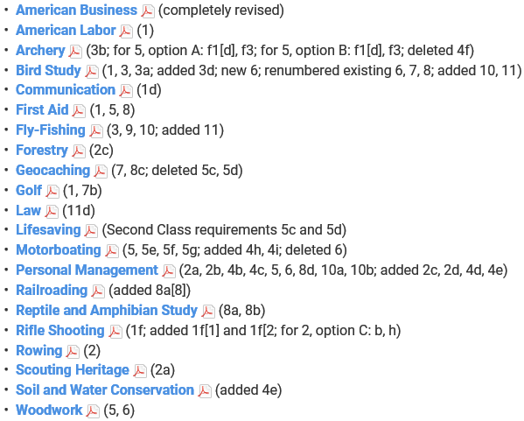
2019 Requirement Updates

Slide 10
Policy on Unauthorized Changes to Advancement Program
No council, committee, district, unit, or individual has the authority to add to, or subtract from, advancement requirements.
There are limited exceptions relating only to youth members with disabilities. For details see section 10, “Advancement for Members With Special Needs.”
–The Guide to Advancement, No. 33088
Notes:
Earlier, we introduced the advancement concept, "no more, no less," and it's worth revisiting. On the screen is the official BSA policy as it appears in the Guide to Advancement. We expect all merit badge counselors to take this very seriously and to apply it in every setting where merit badges are earned—whether at camp, at a merit badge fair or college, or in your living room.
In a nutshell, Scouts are required to actually and personally complete all merit badge requirements as they’re written. No exceptions. If, for example, a requirement uses words like “show”, “demonstrate”, or “discuss”, then every Scout must do just that. Counselors may expand on the material by sharing their experiences, skills, and knowledge, however, they must not add to the current published requirements. Your duty is to help Scouts meet the requirements and certify when they’ve been completed.
Please understand that Scouts coming away from merit badge experiences with merit badges they did not actually earn is far and away the biggest complaint that Scoutmasters and other unit leaders voice to the office of the national Advancement Team in Irving, Texas. It is your duty as a merit badge counselor to see that your Scouts get the “whole meal deal.” If you see situations where the policy on unauthorized changes is not being properly administered, we would ask that you please report these to your council advancement committee.
As you can see, the policy on unauthorized changes does make some limited exceptions for Scouts with special needs. These exceptions, however, do NOT apply to the requirements for individual merit badges.

Slide 11
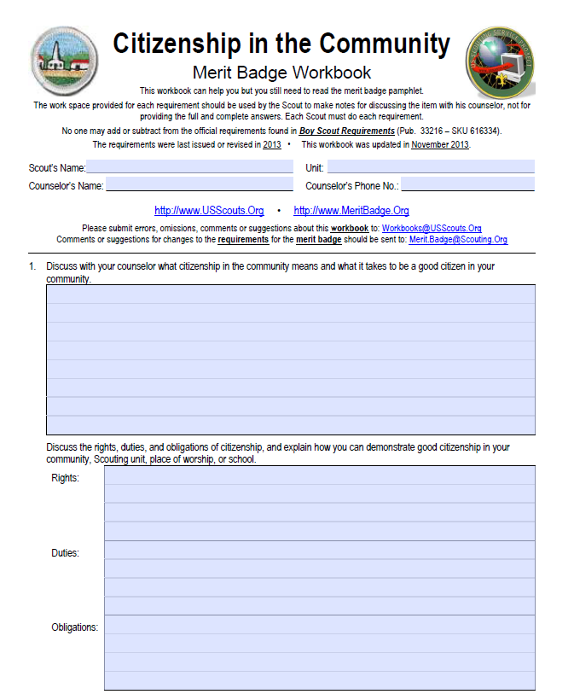

Slide 12
Merit Badge Counselors
Must be registered as a MB Counselor 18yo+
Adhere to YPT requirements
Recognized as having the skills and education in the subjects they cover
Conduct activities IAW “Guide to Safe Scouting” and “The Sweet Sixteen of BSA Safety”
Some Merit Badges have more restrictive counselor qualification requirements (climbing, snow sports, and most aquatics and shooting sports merit badges)

Slide 13
Merit Badge Counselors (Con’t)
Counselor should keep completed blue cards for at least a year
Must submit the Merit Badge Counselor Information sheet with their application
Additions or subtractions may be submitted using the same form
https://filestore.scouting.org/filestore/pdf/34405.pdf

Slide 14
True/False
SM can limit how many MB’s a scout gets from any one MB counselor
Scouts can work on MB’s with their own parents if they are registered MB counselors
There is training for MB counselors
MB counselors work for the council/district
Requirements completed for one MB can be used for another unless stated otherwise
In group instruction settings, scouts who sit during demonstrations or remain silent during discussions should not be awarded the MB
Once it is earned, it’s earned

Slide 15
True/False
SM can limit how many MB’s a scout gets from anyone MB counselor
Scouts can work on MB with their own parents if they are registered MB counselors
There is training for MB counselors
MB counselors work for the council/district
Requirements completed for one MB can be used for another unless stated otherwise
In group instruction settings, scouts who sit during demonstrations or remain silent during discussions should not be awarded the MB
Once It Is Earned, It’s Earned
TRUE (with qualifications) Read the Guide to Advancement

Slide 16
Resources
Scouting.org
https://www.scouting.org/programs/scouts-bsa/advancement-and-awards/merit-badges/
Guide for Merit Badge Counselors
https://www.scouting.org/programs/scouts-bsa/mb-counselor-guide/
Merit Badge Revision Dates
https://meritbadge.org/wiki/index.php/Merit_Badge_revision_dates
NCAC Website
https://www.ncacbsa.org/advancement/merit-badge-counselor/

Slide 17
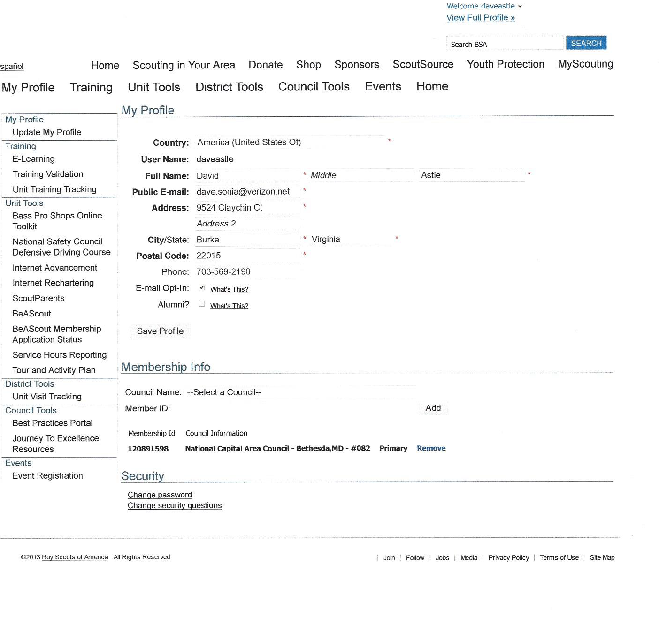
Find/Tie Member IDs Together

Slide 18
Questions?

