Slide 1
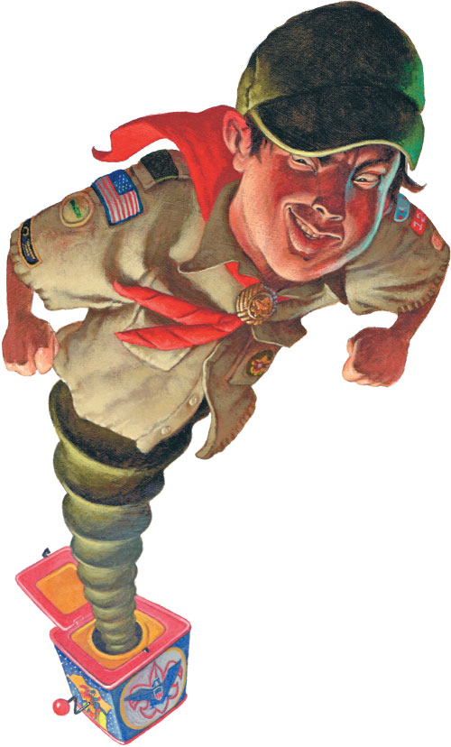
Cyberbullying

Slide 2
Cyberbullying
BSA Policy
What is Bullying?
Forms of Bullying
What is Cyberbullying?
Bullying Prevention Resources
Signs of Cyberbullying
Ways to Address Cyberbullying

Slide 3
BSA Policy
“Bullying is prohibited in Scouting. All forms of bullying violate the Scout Oath and Scout Law. Bullying is incompatible with the principles of Scouting and should be taken seriously whenever and wherever it occurs. Unit leaders should understand how to prevent bullying and be prepared to deal with it proactively and thoughtfully.”
Bullying of any type, including cyberbullying, can devastate the target whether a lone bully participates or others witness or join the attack.

Slide 4
What is Bullying?
Bullying is harassment or aggressive behavior intended to intimidate, dominate, coerce, or hurt another person (the target) mentally, emotionally, or physically. It is not “just messing around,” and it is not “part of growing up.” Bullying is a form of victimization, not conflict. It is no more a “conflict” than is child abuse or domestic violence.

Slide 5
Forms of Bullying
Verbal: name-calling, belittling, taunting
Social: spreading rumors, destroying or manipulating friendships, excluding or ostracizing the target
Physical: hitting, shoving, kicking, using physical coercion, intimidation through gestures
Criminal: assault; sexual aggression
Cyberbullying: using digital technology such as social media, cell phones, etc., to engage in the above kinds of behaviors.

Slide 6
What is Cyberbullying?
This rapidly growing form of bullying uses the power of the Internet, cellular networks, and social media to harass the target. According to NetSmartz, a BSA partner, types of cyberbullying include:
Flaming and trolling: sending or posting hostile messages intended to “inflame” the emotions of others
Happy-slapping: recording someone being harassed or bullied in a way that usually involves physical abuse, then posting the video online for public viewing
Identity theft/impersonation: stealing someone’s password and/or hijacking their online accounts to send or post incriminating or humiliating pictures, videos, or information

Slide 7
What is Cyberbullying? (Con’t)
Types of cyberbullying (con’t)
Photoshopping: doctoring digital images so that the main subject is placed in a compromising or embarrassing situation
Physical threats: sending messages that involve threats to a person’s physical safety
Rumor spreading: spreading gossip through email, text messaging, or social networking sites

Slide 8
Prevention Resources
All BSA youth handbooks feature a section on youth protection that includes a discussion on cyberbullying and other forms of bullying. Parents and Scouts are supposed to read and discuss this material together.
The Troop Leader Guidebook is a two-volume manual that replaces the Scoutmaster Handbook. Volume 1 contains a three-page appendix on bullying, including cyberbullying, plus bullying prevention resources.
Cyber Chip Cyberbullying Prevention Tool

Slide 9
Prevention Resources (Con’t)
BSA webpage on bullying prevention includes 11 PDF documents on various types of bullying (including cyberbullying), bullying prevention, support for bullied children, and obligations to report bullying. www.scouting.org/Training/YouthProtection/bullying.aspx
BSA Social Media Guidelines set forth polices for appropriate use of social media in a Scouting context, including internet safety and online youth protection guidance designed to prevent cyberbullying through unit websites, Facebook pages, etc. www.scouting.org/home/marketing/resources/socialmedia/

Slide 10
Signs of Cyberbullying
The target of cyberbullying may obsess over what is posted, become depressed, avoid school or social activities, or have suicidal thoughts. In extreme circumstances, cyberbullying can lead to suicide. Parents and adults should talk with youth about their online activities and stay alert to signs of cyberbullying.
Signs of cyberbullying include:
Avoiding computer, cell phone, and other technological devices or appearing stressed when receiving an email, instant message, or text
Withdrawing from family and friends, or appearing reluctant to attend school and social events
Avoiding conversations about computer use
Exhibiting signs of low self-esteem including depression and/or fear
Declining grades
Exhibiting poor eating and/or sleeping habits

Slide 11
Ways to Address Cyberbullying
Tell your child not to respond to rude emails, messages, and comments.
Encourage the child to speak up immediately if he or she is the victim of cyberbullying. Assure that a young person has a trusted adult—whether parent, teacher, or Scout leader—in whom to confide.
Block cyberbullies by using available privacy controls such as blocked-sender lists and call-blocking.
If harassment is via email, social networking sites, IM, or chat rooms, instruct your child to “block” bullies or delete your child’s current account and open a new one.

Slide 12
Ways to Address Cyberbullying (Con’t)
If harassment is via text and phone messages, change the phone number and instruct your child to only share the new number with trustworthy people. Also, check out phone features that may allow an incoming number to be blocked.
Do not erase the messages or pictures. Save the evidence, such as email and text messages, and take screenshots of comments and images. Also, take note of the date and time when the harassment occurs.
Contact your Internet service provider (ISP) or cell phone provider. Ask the website administrator or ISP to remove any Web page created to hurt your child.

Slide 13
Ways to Address Cyberbullying (Con’t)
Get your child’s school involved. Learn the school’s policy on cyberbullying and urge administrators to take a stance against all forms of bullying.
Make a report to Cyber Tipline www.cybertipline.com
If the cyberbullying is criminal or you suspect it may be, contact the police. Areas falling under the jurisdiction of law enforcement include threats of violence, extortion, obscene or harassing phone calls or messages, harassment via stalking or hate crimes, child pornography, sexual exploitation, and taking a photo or video image of someone in a place where he or she would expect privacy.

Slide 14
Questions?

