Slide 1
    New Online
    Application
    Procedures

Slide 2
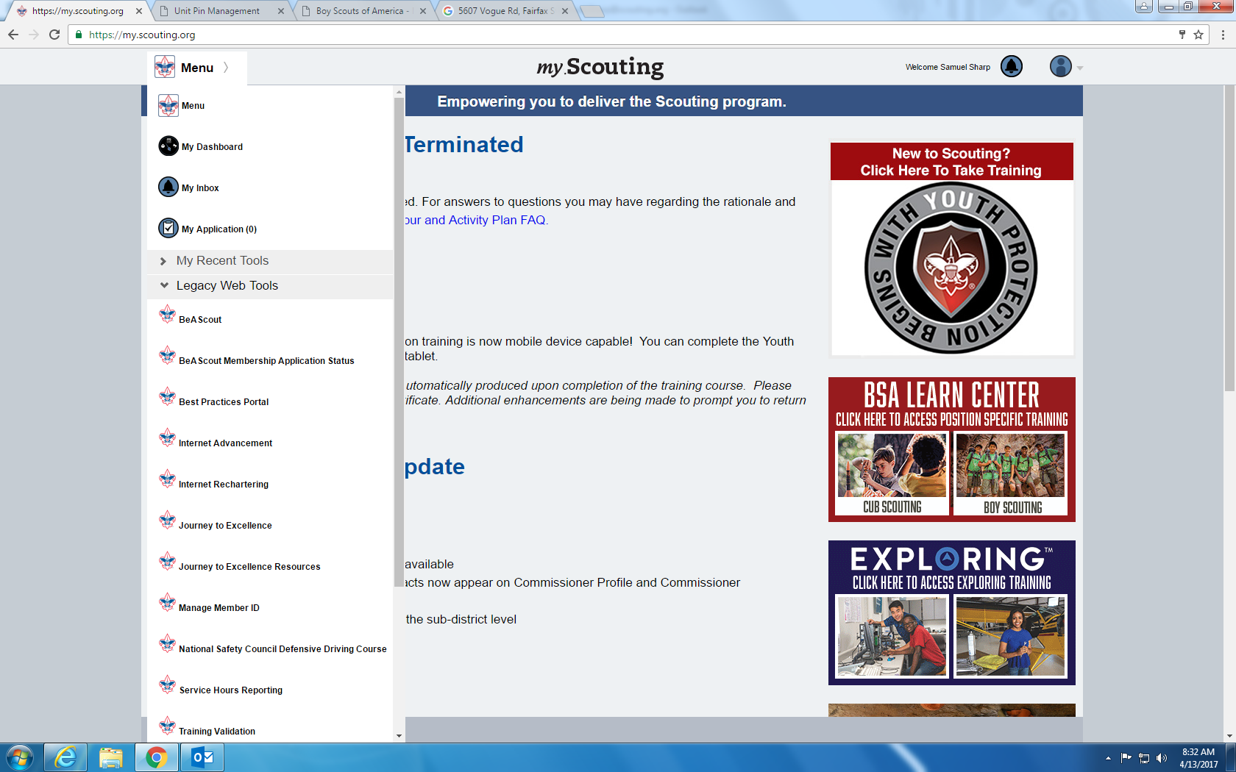
Where to Find Pin Manager

Slide 3
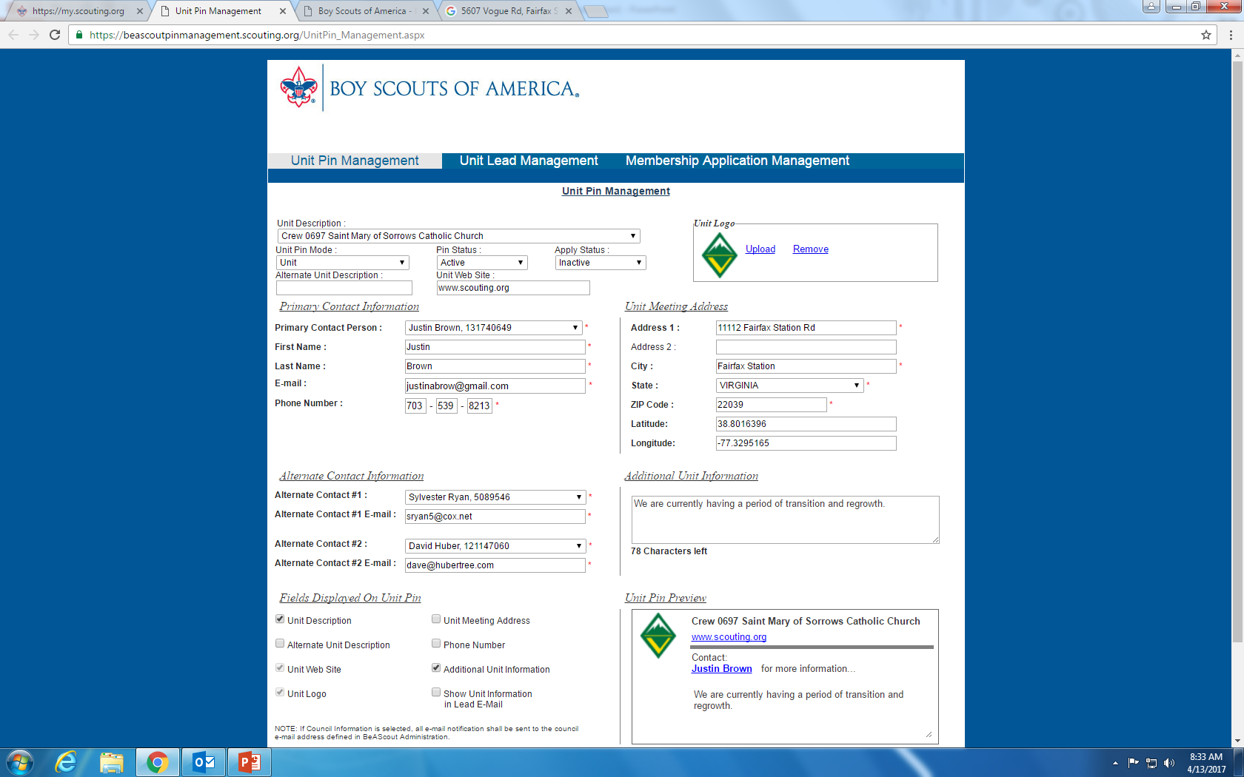
Unit Pin Manager

Slide 4
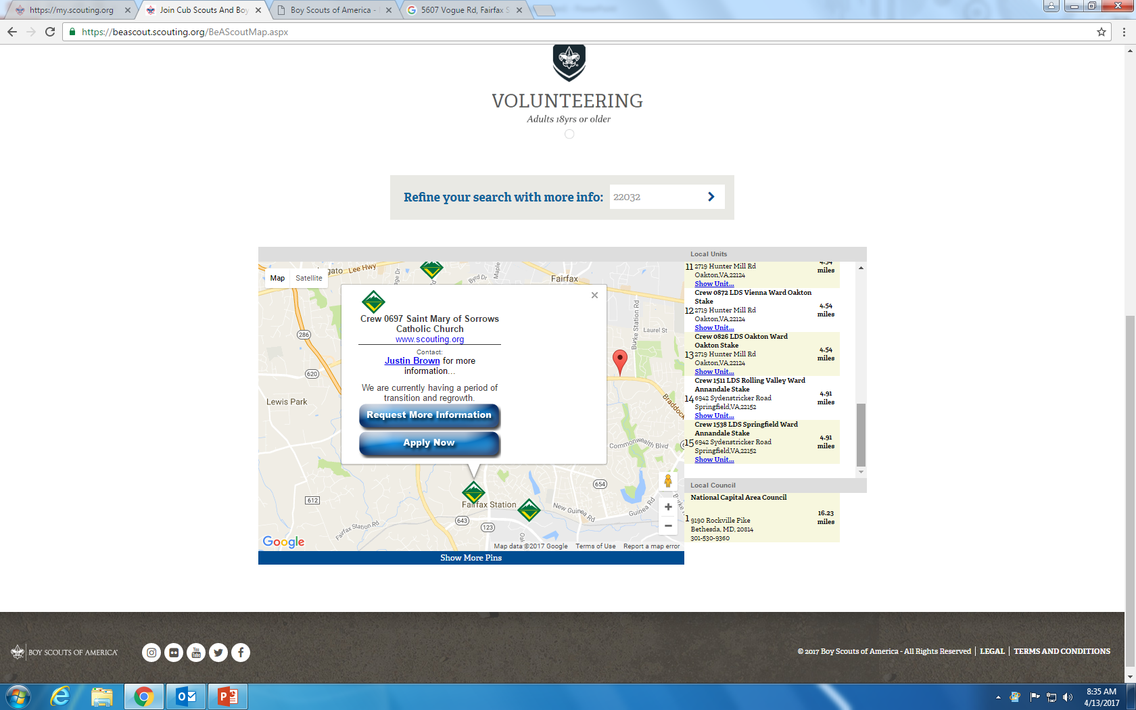
What a Pin Looks Like

Slide 5
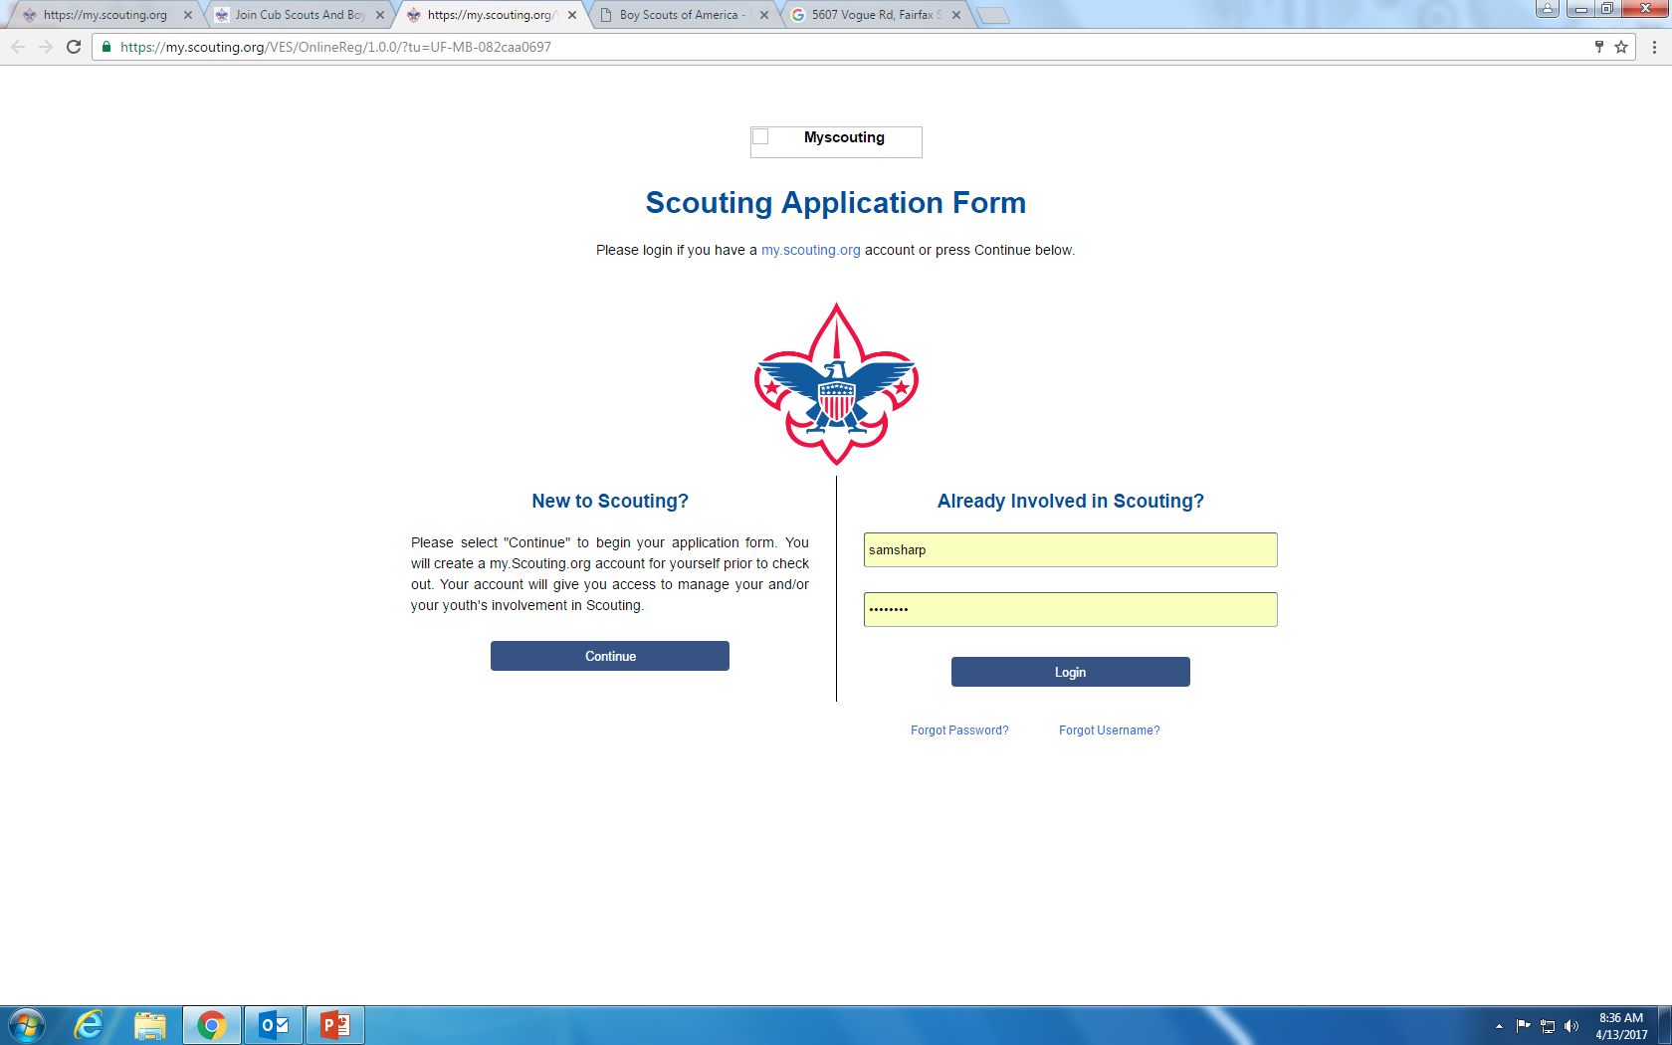
Frontpage of Applicaiton

Slide 6
Invitation Manager
Collects information from potential new Scouts for your unit from BeAScout;
Helps you manage leads from joining nights and from individual referrals; and
Allows you to send invitations directly to interested families with a link to the application that is specific to your unit.

Slide 7
Digital Application
Electronic application that collects all of the data needed to register in a unit;
Allows the applicant (if over 18) or the applicant’s parent to provide a digital signature;
Includes an online credit card payment option or a cash/check option.

Slide 8
Application Manager
Collects completed applications from new youth and adults;*
Allows the unit leader/Key 3 to review the youth application and either accept the application with an electronic signature or send the application to the district so that they can place the youth in a different unit;
Allows the Committee Chair to review the adult application and make recommendations for adult positions; and
Allows the Chartered Organization Representative (CR) to review and accept or reject the application with their electronic signature, or refer the application to the district for placement in a different unit.

Slide 9
Note!
Youth and adults who use this system should be new to Scouting or be currently registered in a unit and applying to multiple in a different unit than the one in which they are currently registered.
This system is not designed to register non-paying adult positions, position changes in the same unit, or youth or adult renewals.

Slide 10
Configuration Options
Payment options – credit and cash (Your council can choose to override this configuration and require cash only or credit cards only. If the council has selected to override this configuration you will not see the drop down box in your configuration options.)
Committee Chair recommendation for adult positions – the Chartered Organization Representative (CR) is the only person in the unit who is authorized to assign positions and accept adults in accordance with the BSA Bylaws. This configuration allows the Committee Chair to recommend the adult positions to the CR for approval. If this option is set to “CC and COR Required” the CC will need to assign the adult positions before the application is available for the COR to accept.
Adult application availability – this configuration allows the unit to turn on or off the availability of the adult application online. The youth application will always be available through the system. Your council can choose to override this option, if so you will not see the drop down box in your configuration options.

Slide 11
Configuration Options (Con’t)
Unit Fee Message – only the national registration fee and Boys’ Life subscription fee is collected through the online payment system. This configuration allows units to inform applicants that the unit has an activity fee, the amount of the fee, and a message about what the fee covers. This message will be sent on the invitation when sent through Invitation Manger.
Automated Welcome Email – the system is configured to send out a welcome email from the BSA National Service Center with a message from the Chief Scout Executive when a youth or adult is accepted by the unit. This configuration sends an automated welcome message from the unit the day after the Chief’s welcome message is sent. There is a place for you to add the message that you would like to send to the new families.

Slide 12
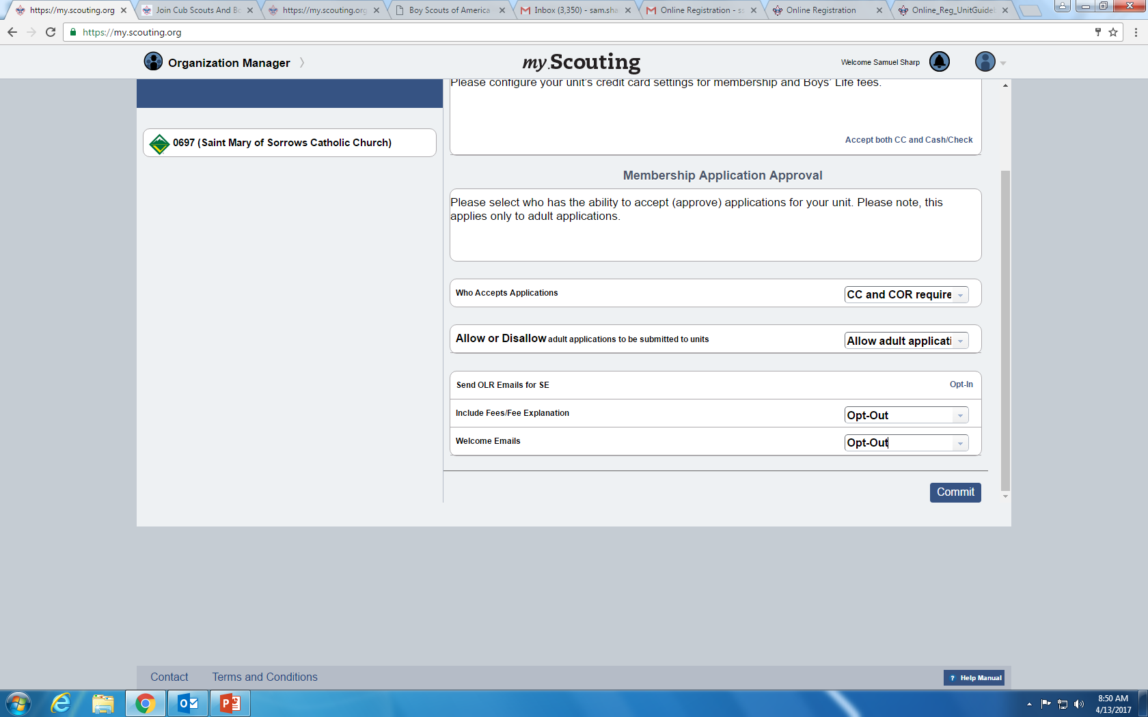
Online Application Settings

Slide 13
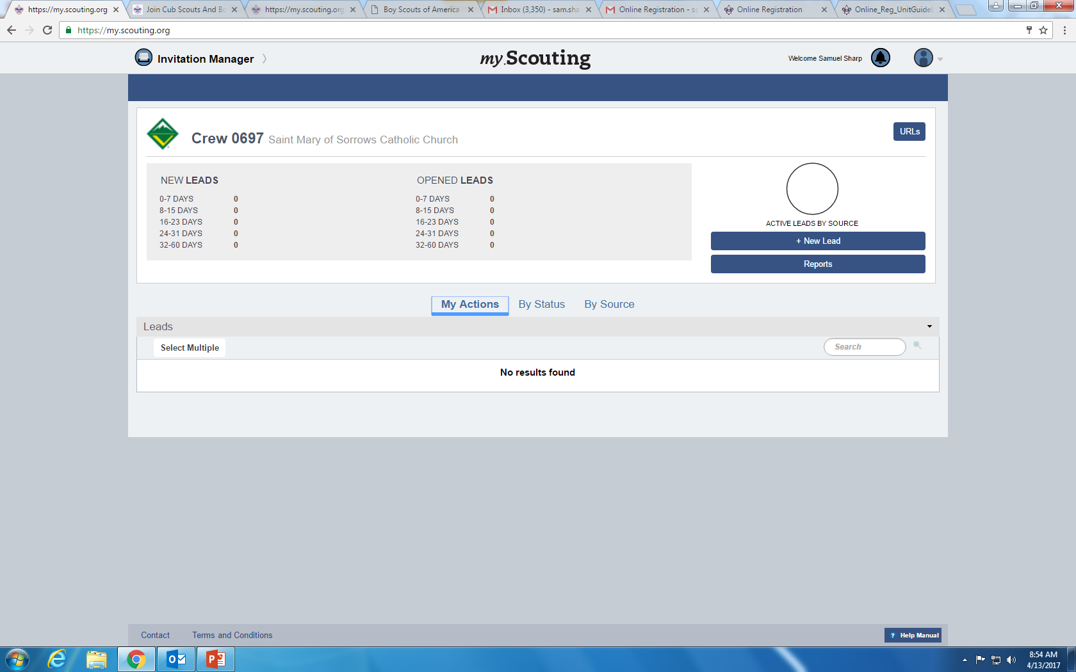
Invitation Manager

Slide 14
Roles with Access to Invitation Manager
The following unit positions have full access to the Invitation Manager Dashboard on My.Scouting where they can add leads, manage inquiries from prospective Scouts, and send joining invitations:
  Chartered organization representative (CR)*
  Committee chair (CC)*
  Unit leader (Cubmaster, Scoutmaster, Crew Advisor, Skipper, Coach)*
  Institutional Head/Chartered Organization Executive Officer (IH)
  Unit membership chair
The Unit Key 3 can assign a “Registration Inquiry” functional role to other unit volunteers who need read only access to view lead status and submitted requests.

Slide 15
Application Manager

Slide 16
Application Manager

Slide 17
Payment
Either Credit or Cash/Check
Credit will process the application immediately
Cash/Check will be put into a different bucket for later completion
Must turn invoice with tracking number in to council

Slide 18
Adults
Process is same as youth
No automatic catch for YPT
  Committee Chair recommendation option can help with this
Only one reference required
COR is the approving authority

Slide 19
Notifications
Twice-weekly to the Key 3
Red bell icon at top of My.Scouting

Slide 20
References
http://www.scouting.org/onlineregistration.aspx
  Online Registration Unit Guidebook
  BeAScout setup instruction
  Position specific checklists
  FAQ
  Training videos

Slide 21
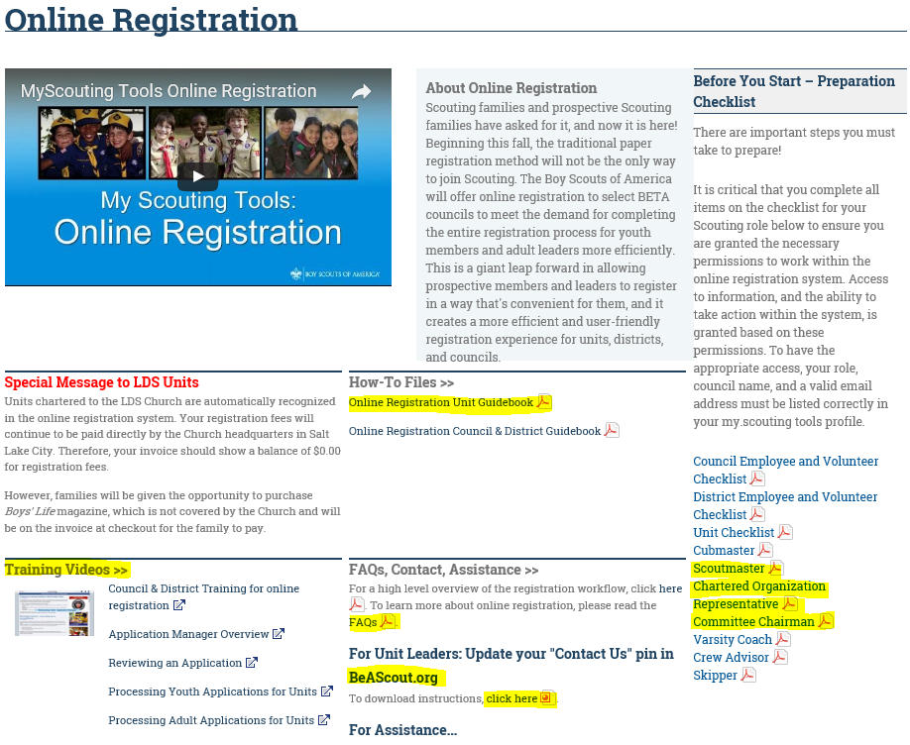
Online Retistration Webpage

Slide 22
    Questions?

