Slide 1
Retention

Slide 2
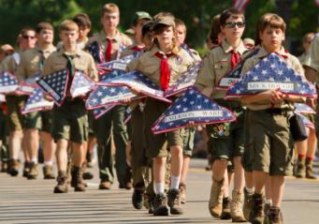
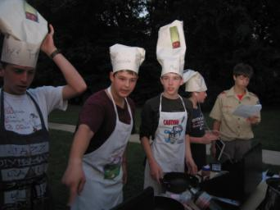
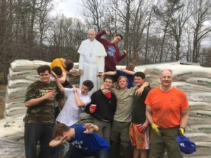
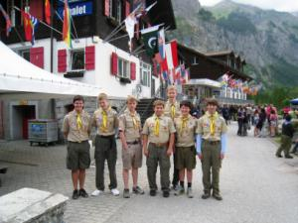
Retention
Retention begins and ends
at the unit level.

Slide 3
Retention
Communication is very, very important. Monthly newsletters to families helps keep them informed and involved. Scouts and their families like to see themselves recognized.
Use advancement as a retention tool. Scouts who advance stay in Scouting longer

Slide 4
Retention
Keeping Scouts active and participating in Scouting over the summer months is important. Scouts and families that enjoy a Scouting summer are more likely to stay involved in the fall. Plan summer High Adventure trips.
Good meetings are a critical tool for retention.

Slide 5
Retention
Poor program planning hurts Scouting! During the late spring or early summer, plan the troop’s annual calendar. Start with everything that occurred last year that you want to do again, and add other things your troop wants to do. Check school calendars, the chartered organization’s calendar, council events, district events, major sporting events, and community events. Share the annual calendar with news Scouts and their families!

Slide 6
Retention
First impressions: As soon as a boy and his parent walk in a room at a join Scouting night, retention begins. Their first impressions are critical, and the stakes are high. You have only 60 minutes to influence a boy’s Scouting career! The first meeting needs to be all about these new parents since they are our primary decision makers at this point, and are potential leaders. Be sure to have a person greet each boy and his parent as they arrive, and welcome them to the troop!

Slide 7
Adult Retention
WHAT KEEPS THEM IN
They Want to Help Boys
“I enjoy seeing the smile on a boy’s face when he finally figures something out.”
“If we don’t help our boys into manhood the right way, who will? The culture? His video game?”
“I want to be a part of a young man’s life and help him become a responsible God loving adult who cares about this country.”

Slide 8
Retention
Perhaps Gerald Ford, 38th President and an Eagle Scout, said it best,
“Boy, do we need Scouting!”

Slide 9
Questions?

