Slide 1
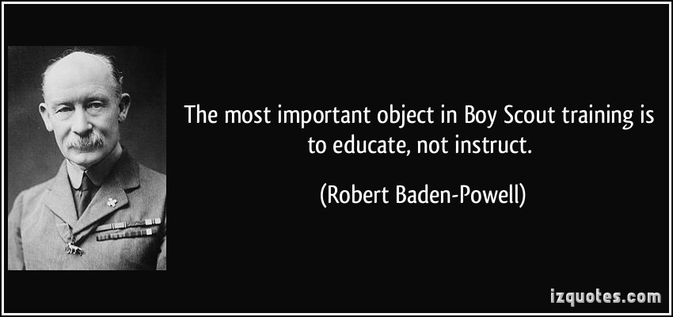
Youth Training

Slide 2
Agenda
Den Chief Training
Introduction to Youth Leadership Skills for Troops (ILST)
National Youth Leadership Training (NYLT ) (aka Empeeza)
NYLT Leadership Academy
National Advanced Youth Leadership Experience (NAYLE)
Kodiak Challenge

Slide 3
Den Chief Training
Online Course
http://www.scouting.org/Training/Youth/DenChiefTraining.aspx
Four Sections
Den Chief’s Role
Understanding Boys in the Den
Den Meeting
How to Lead Activies
Print training card at the end

Slide 4
Youth Training Continuum
Taught at the Regional/National Level
Taught at the Unit Level
Taught at the Council Level
ILST
NYLT
NAYLE
Enables
Enables
Enables
KODIAK
Kodiak is an adventure — to push boundaries and apply leadership skills

Slide 5
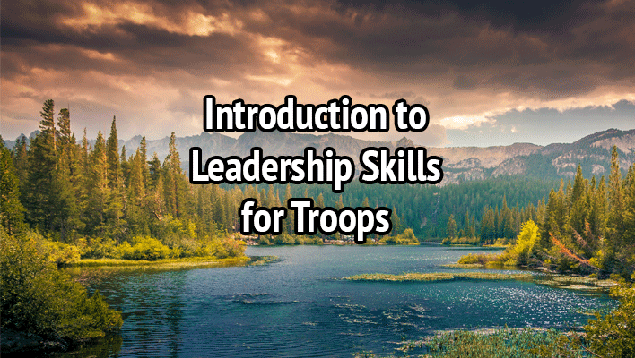
ILST

Slide 6
Intro to Youth Leadership Skills for Troops (ILST)
Taught by the Troop
Intended for all scouts in positions of responsibility (Patrol Leaders Council)
Provides the unit youth leaders the leadership skills they should know
Three modules—Organization, Tools of the Trade, Leadership and Teamwork
Solid 4-5 hours to properly cover the concepts, game, reflect, ... and eat!
Can be broken up by module if necessary

Slide 7
ILST (con’t)
Module One—Troop Organization
covers leadership positions in the troop, roles and responsibilities, troop organization, and introductions to vision and servant leadership
Module Two—Tools of the Trade
covers core skill sets to help the Scout lead (communicating, planning, and teaching)
Module Three—Leadership and Teamwork
discusses teams and team characteristics, stages of team development and leadership, inclusion and using your team, ethics and values of a leader, and a more in-depth review of vision

Slide 8
ILST (con’t)
Full course handbook available at http://www.scouting.org/Training/Youth.aspx
Great resource for a SM who is prepping and coaching new SPLs and their staffs
Helps set expectations for new PLCs
Great games to compliment the discussions
And alternate games to help keep out some of the repetition
Gives you reflection questions and guidance
Use your NYLT graduates to help teach
Requires preparation to be effective (SM, SPL, instructors)

Slide 9
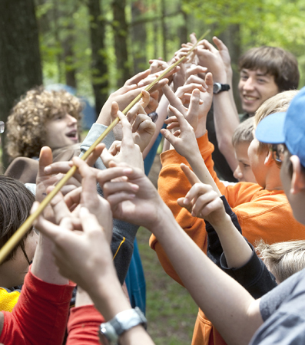
Game Time!

Slide 10
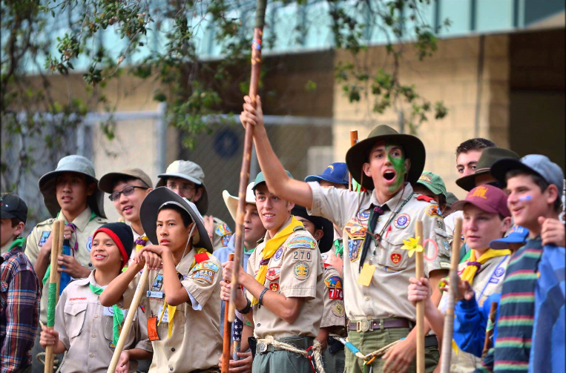
National Youth Leadership Training

Slide 11
NYLT
National Youth Leadership Training (NYLT ) (aka Empeeza)
Boy-led leadership training--outdoor setting!
Six day course (run by NCAC)
Provides leadership skills and experience they can use in their home troops
Emphasis on the concepts of what a leader must BE, what he must KNOW, and what he must DO
Hands on practical applications of skills
SPL/ASPL candidates should attend

Slide 12
NCAC NYLT
SUMMER 2016 NYLT
19 – 24 June 2016
10 – 15 July 2016
31 July – 5 August 2016
Requirements
1st Class and 14 years old by 1 Jun
13 years old with Director approval
Home Unit Leader Approval
Cost: $225 before 1 Jun (then $270)
Register at http://www.ncacbsa.org/training/national-youth-leadership-training/

Slide 13
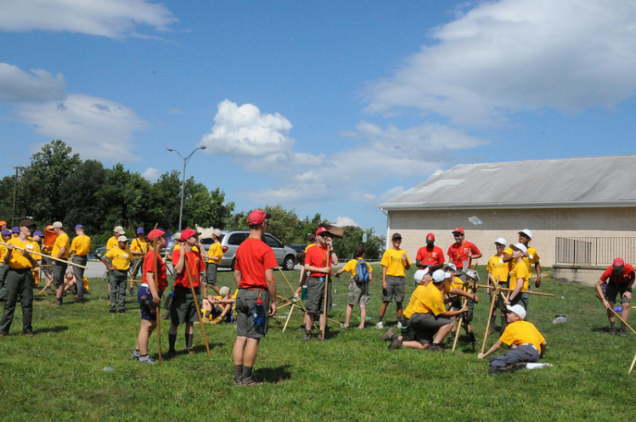
NYLT Leadership Academy

Slide 14
NYLT Leadership Academy
NYLT is run by a scout staff and those scouts need to be trained to be world-class trainers and leaders
NYLT staff often recruited from NYLT course
Provides behind the scenes insight to running the course and trainer training
Staffing run like a PLC
Increased confidence, creativity, and reinvigorated enthusiasm towards servant leadership
Significant boost to college and military academy applications if scouts attend this training and serve on NYLT staffs

Slide 15
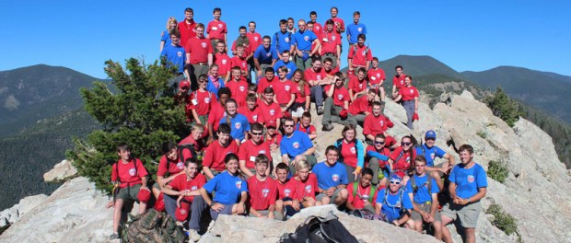
NAYLE
National Advanced Youth Leadership Experience (NAYLE)

Slide 16
NAYLE
National Advanced Youth Leadership Experience (NAYLE)
Taught at the national high adventure bases
Enhances leadership skills and expands upon the team-building and ethical decision-making skills learned in NYLT
Taught in a high adventure environment
Use their NAYLE leadership skills to resolve exciting and challenging issues

Slide 17
Kodiak Challenge

Slide 18
Kodiak Challenge
Unit/District/Council developed leadership trek/adventure with Council approval
Opportunity to apply ILST/NYLT-learned leadership in a unique trek/adventure
It is an adventure with a purpose
During the trek, the program interweaves leadership lessons on communication, team development, inclusiveness, values and ethical decisions, and servant leadership
On-line guidebook and curriculum available to facilitate the development of the staff and the challenge

Slide 19
Youth Training Resources
All of the BSA youth training opportunities and resources can be found at http://www.scouting.org/Training/Youth.aspx
NCAC NYLT course offerings http://www.ncacbsa.org/training/national-youth-leadership-training/

Slide 20
Questions?

