Slide 1



District Commissioner and
Assistant District Commissioner

Slide 2
The Commissioner Concept
The reason for having commissioners is to help units succeed
The commissioner is the liaison between the local council and Scouting units.
The commissioner's mission is to
  Keep units operating at maximum efficiency,
  Maintain regular contact with unit leaders,
  Counsel leaders on where to find assistance,
  Note weaknesses in programs,
  And suggest remedies.
The commissioner is successful when units effectively deliver the ideals of Scouting to their members.
Notes:
Read, explain and discuss the commissioner concept. Amplification is in CF, pp. 10-11.
Introduce the Commissioner Fieldbook as the single most important resource for all commissioners

Slide 3
Administrative Commissioners
There are three Types of Commissioners
  Administrative Commissioners
  Unit Commissioners
  Roundtable Commissioners
Administrative Commissioners
  Give all commissioners a vision of what it means to provide exceptional commissioner service to Scout units throughout the Council
Notes:
Administrative Commissioners
Council Commissioner, Assistant Council Commissioner, District Commissioner, and Assistant District Commissioners
Their primary responsibilities are recruiting, training, guiding, and evaluating Commissioner Staff
Unit Commissioners
are assigned to one or more units, which they person” capable of working with the key personnel of chartered organizations, unit committee people, and unit leaders as well as district and council Scouters.
The unit commissioner’s service is based on a philosophy of friendship and coaching.
Assign experienced unit commissioners to the new units in your district. Typically, they are assigned only one unit.
Roundtable Commissioners
Roundtable commissioners should have a good background in Cub Scout, Boy Scout, Varsity Scout, or Venturing skills as well as a lively teaching ability. coach and mentor to ensure unit success.
Only the finest type of community leader should be considered for a commissioner’s role. That person should be a “people

Slide 4
National/Regional/Area Support to Local Councils
Role of National/Regional/Area Commissioners:
  Provide direct support to councils in their understanding and delivery of service to units
  National Commissioner: Charles W. Dalquist II
  Northeast Region Commissioner: Kenneth King

Slide 5
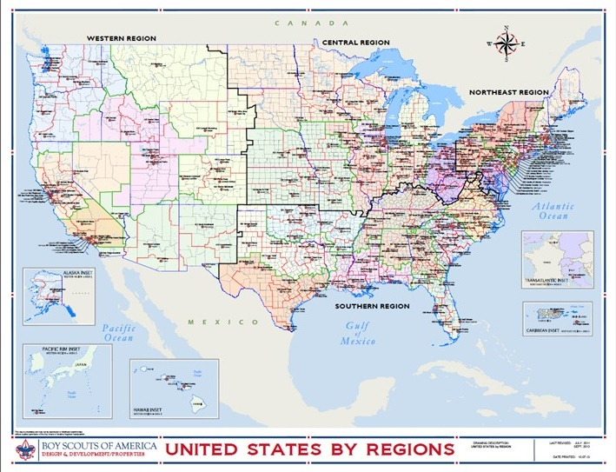

Slide 6
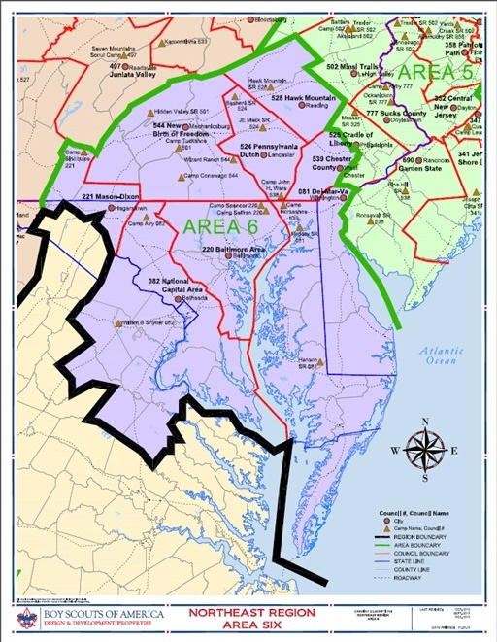
NE Region Area 6
Area 6 Commissioner: Edward Yarbrough

Slide 7
NCAC COMMISSIONER LEADERSHIP
2017
Garry Lewis
Council Commissioner
James Hamlin
Staff
Advisor
Dom Bee
ACC
New-Unit Svc.
Julia Farr
ACC
Cmsr College
Jae Engelbrecht
ACC
Membership
Jon Baake
ACC
Training
Jeff Schweiger
ACC
Exploring + Web
George Costigan
Jim Hardter
ACC Roundtable
Jae Engelbrecht
ACC
Strategic Plan
Vacant
ACC Administration
Gary Garay
ACC Direct Service Units
Bill Schoonmaker
ACC
Mountain West
Drew Mrenna
ACC
Virginia South
Michael McKinney
ACC
Three Rivers
Ben Overbey
ACC
Montgomery
Jim Stewart
ACC
VA Central
Direct Service
Dave Carmichael
DC
Sully
Peyton Brittle
DC
Piedmont
Mark Adams
DC
Prince Georges
Gordon Henley
DC
Seneca
Jack Person
DC
Chain Bridge
DC
USVI
John Witek
DC
Goose Creek
Fred Becker
DC
Mattaponi
John Howlin
DC
Western Shore
Mike Saunders
DC
Potomac
Sasha Loftin
DC
Colonial
Bill Desmond
DC
Francis Scott Key
Mark Chipman
DC
Occoquan
William Hemsley
DC
Washington DC
Rick Manteuffel
DC
White Oak
Dave Astle
DC
Patriot
Ed Yarbrough
ACC at Large
Larry Lawver
DC
Powhatan
Matt Messenger
DC
Bull Run
Mike Nepi
DC
Old Dominion
John Patrick
DC
Aquia
Pat Berney
DC
George Mason

Slide 8
The District Commissioner

Slide 9
District Commissioner Staff Organization
District Commissioner
Assistant District Commissioner
service area
Assistant District Commissioner
service area
Assistant District Commissioner
service area
Assistant District Commissioner
Roundtable
Assistant District Commissioner
Training
Assistant District Commissioner
Administration
Unit Commissioner
Unit Commissioner
Unit Commissioner
Unit Commissioner
Unit Commissioner
Unit Commissioner
Unit Commissioner
Unit Commissioner
Unit Commissioner
Unit
Commissioner
Unit Commissioner
Unit Commissioner
Unit Commissioner
Unit Commissioner
Unit Commissioner
Cub Scout Roundtable Commissioner
Boy Scout Roundtable Commissioner
Venture Roundtable Commissioner
Varsity Huddle Commissioner
Assistant Cub Scout Roundtable Commissioners
Assistant Boy Scout Roundtable Commissioners
Assistant Venture Roundtable Commissioners
Assistant Varsity Huddle Commissioners
Notes:
This is the organization of a typical district commissioner service staff. You will see all 3 types of commissioners on this chart. District Commissioners do have the latitude to organize their service to best fit the needs of their district.

Slide 10
District Commissioner Responsibilities:
Recruiting
Training
Guiding
Evaluating
Notes:
This leader is approved and appointed by the council executive board, with the concurrence of the Scout executive, on the recommendation of the district nominating committee. Working with the district executive, he or she recruits, trains, guides, and evaluates the required commissioner personnel of the district.
Specific responsibilities include:
Identify and recruit enough of the right people as commissioners so that all Scouting units in the district receive regular, helpful service.
Provide opportunities for immediate commissioner orientation through online Fast Start, frequent basic training, and monthly learning experiences for all commissioners.
Supervise and motivate unit commissioners to visit each unit regularly, identify unit needs, and make plans to meet unit needs.
Enlist the help of the District Committee and it’s sub committees to make sure units get all the assistance they require.
Administer the annual commissioner service plan, which gives specific purposes for commissioner contact with units at designated times of the year.
Oversee the unit charter renewal plan so that each unit reregisters on time and with optimum membership.
Guide roundtable commissioners to ensure that monthly roundtables and program forums are well attended, and provide practical and exciting unit program ideas.
Plan and preside at monthly meetings of the district commissioner staff.
Work with the district chair and district executive to stimulate and coordinate the work of the district.
Help meet district goals.
Represent the district as a member of the council commissioner cabinet.
Support local and national Scouting policy, procedures, and practices.
Attend district committee meetings to report on conditions of units and to secure specialized help for units.
The district commissioner must be a proven leader capable of enlisting other effective persons to serve. The district commissioner, or DC, is the chief morale officer of the district: upbeat, personable, determined, and a role model for Scouting ideals. He or she is passionate about the benefits of Scouting and is a champion of the unit to make Scouting happen in the lives of young people.

Slide 11
District Commissioner Responsibilities - Recruiting
Identify and recruit enough of the right people as commissioners so that all Scouting units in the district receive regular, helpful service.
Notes:
This leader is approved and appointed by the council executive board, with the concurrence of the Scout executive, on the recommendation of the district nominating committee. Working with the district executive, he or she recruits, trains, guides, and evaluates the required commissioner personnel of the district.
Specific responsibilities include:
Identify and recruit enough of the right people as commissioners so that all Scouting units in the district receive regular, helpful service.
Provide opportunities for immediate commissioner orientation through online Fast Start, frequent basic training, and monthly learning experiences for all commissioners.
Supervise and motivate unit commissioners to visit each unit regularly, identify unit needs, and make plans to meet unit needs.
Enlist the help of the District Committee and it’s sub committees to make sure units get all the assistance they require.
Administer the annual commissioner service plan, which gives specific purposes for commissioner contact with units at designated times of the year.
Oversee the unit charter renewal plan so that each unit reregisters on time and with optimum membership.
Guide roundtable commissioners to ensure that monthly roundtables and program forums are well attended, and provide practical and exciting unit program ideas.
Plan and preside at monthly meetings of the district commissioner staff.
Work with the district chair and district executive to stimulate and coordinate the work of the district.
Help meet district goals.
Represent the district as a member of the council commissioner cabinet.
Support local and national Scouting policy, procedures, and practices.
Attend district committee meetings to report on conditions of units and to secure specialized help for units.
The district commissioner must be a proven leader capable of enlisting other effective persons to serve. The district commissioner, or DC, is the chief morale officer of the district: upbeat, personable, determined, and a role model for Scouting ideals. He or she is passionate about the benefits of Scouting and is a champion of the unit to make Scouting happen in the lives of young people.

Slide 12
District Commissioner Responsibilities - Training
Provide opportunities for immediate commissioner orientation through online Fast Start, frequent basic training, and monthly learning experiences for all commissioners.
Notes:
This leader is approved and appointed by the council executive board, with the concurrence of the Scout executive, on the recommendation of the district nominating committee. Working with the district executive, he or she recruits, trains, guides, and evaluates the required commissioner personnel of the district.
Specific responsibilities include:
Identify and recruit enough of the right people as commissioners so that all Scouting units in the district receive regular, helpful service.
Provide opportunities for immediate commissioner orientation through online Fast Start, frequent basic training, and monthly learning experiences for all commissioners.
Supervise and motivate unit commissioners to visit each unit regularly, identify unit needs, and make plans to meet unit needs.
Enlist the help of the District Committee and it’s sub committees to make sure units get all the assistance they require.
Administer the annual commissioner service plan, which gives specific purposes for commissioner contact with units at designated times of the year.
Oversee the unit charter renewal plan so that each unit reregisters on time and with optimum membership.
Guide roundtable commissioners to ensure that monthly roundtables and program forums are well attended, and provide practical and exciting unit program ideas.
Plan and preside at monthly meetings of the district commissioner staff.
Work with the district chair and district executive to stimulate and coordinate the work of the district.
Help meet district goals.
Represent the district as a member of the council commissioner cabinet.
Support local and national Scouting policy, procedures, and practices.
Attend district committee meetings to report on conditions of units and to secure specialized help for units.
The district commissioner must be a proven leader capable of enlisting other effective persons to serve. The district commissioner, or DC, is the chief morale officer of the district: upbeat, personable, determined, and a role model for Scouting ideals. He or she is passionate about the benefits of Scouting and is a champion of the unit to make Scouting happen in the lives of young people.

Slide 13
District Commissioner Responsibilities - Guiding
Supervise and motivate unit commissioners to visit each unit regularly, identify unit needs, and make plans to meet unit needs.
Guide roundtable commissioners to ensure that monthly roundtables and program forums are well attended, and provide practical and exciting unit program ideas.
Notes:
This leader is approved and appointed by the council executive board, with the concurrence of the Scout executive, on the recommendation of the district nominating committee. Working with the district executive, he or she recruits, trains, guides, and evaluates the required commissioner personnel of the district.
Specific responsibilities include:
Identify and recruit enough of the right people as commissioners so that all Scouting units in the district receive regular, helpful service.
Provide opportunities for immediate commissioner orientation through online Fast Start, frequent basic training, and monthly learning experiences for all commissioners.
Supervise and motivate unit commissioners to visit each unit regularly, identify unit needs, and make plans to meet unit needs.
Enlist the help of the District Committee and it’s sub committees to make sure units get all the assistance they require.
Administer the annual commissioner service plan, which gives specific purposes for commissioner contact with units at designated times of the year.
Oversee the unit charter renewal plan so that each unit reregisters on time and with optimum membership.
Guide roundtable commissioners to ensure that monthly roundtables and program forums are well attended, and provide practical and exciting unit program ideas.
Plan and preside at monthly meetings of the district commissioner staff.
Work with the district chair and district executive to stimulate and coordinate the work of the district.
Help meet district goals.
Represent the district as a member of the council commissioner cabinet.
Support local and national Scouting policy, procedures, and practices.
Attend district committee meetings to report on conditions of units and to secure specialized help for units.
The district commissioner must be a proven leader capable of enlisting other effective persons to serve. The district commissioner, or DC, is the chief morale officer of the district: upbeat, personable, determined, and a role model for Scouting ideals. He or she is passionate about the benefits of Scouting and is a champion of the unit to make Scouting happen in the lives of young people.

Slide 14
District Commissioner Responsibilities - Continued
Enlist the help of the District Committee to make sure units get all the assistance they require.
Oversee the unit charter renewal process
Plan and preside at monthly meetings of the district commissioner staff.
Represent the district as a member of the council commissioner cabinet.
Notes:
This leader is approved and appointed by the council executive board, with the concurrence of the Scout executive, on the recommendation of the district nominating committee. Working with the district executive, he or she recruits, trains, guides, and evaluates the required commissioner personnel of the district.
Specific responsibilities include:
Identify and recruit enough of the right people as commissioners so that all Scouting units in the district receive regular, helpful service.
Provide opportunities for immediate commissioner orientation through online Fast Start, frequent basic training, and monthly learning experiences for all commissioners.
Supervise and motivate unit commissioners to visit each unit regularly, identify unit needs, and make plans to meet unit needs.
Enlist the help of the District Committee and it’s sub committees to make sure units get all the assistance they require.
Administer the annual commissioner service plan, which gives specific purposes for commissioner contact with units at designated times of the year.
Oversee the unit charter renewal plan so that each unit reregisters on time and with optimum membership.
Guide roundtable commissioners to ensure that monthly roundtables and program forums are well attended, and provide practical and exciting unit program ideas.
Plan and preside at monthly meetings of the district commissioner staff.
Work with the district chair and district executive to stimulate and coordinate the work of the district.
Help meet district goals.
Represent the district as a member of the council commissioner cabinet.
Support local and national Scouting policy, procedures, and practices.
Attend district committee meetings to report on conditions of units and to secure specialized help for units.
The district commissioner must be a proven leader capable of enlisting other effective persons to serve. The district commissioner, or DC, is the chief morale officer of the district: upbeat, personable, determined, and a role model for Scouting ideals. He or she is passionate about the benefits of Scouting and is a champion of the unit to make Scouting happen in the lives of young people.

Slide 15
District Commissioner Responsibilities - Continued
Work with the district chair and district executive to stimulate and coordinate the work of the district.
Help meet district goals.
Support local and national Scouting policy, procedures, and practices.
Attend district committee meetings to report on conditions of units and to secure specialized help for units.
Notes:
This leader is approved and appointed by the council executive board, with the concurrence of the Scout executive, on the recommendation of the district nominating committee. Working with the district executive, he or she recruits, trains, guides, and evaluates the required commissioner personnel of the district.
Specific responsibilities include:
Identify and recruit enough of the right people as commissioners so that all Scouting units in the district receive regular, helpful service.
Provide opportunities for immediate commissioner orientation through online Fast Start, frequent basic training, and monthly learning experiences for all commissioners.
Supervise and motivate unit commissioners to visit each unit regularly, identify unit needs, and make plans to meet unit needs.
Enlist the help of the District Committee and it’s sub committees to make sure units get all the assistance they require.
Administer the annual commissioner service plan, which gives specific purposes for commissioner contact with units at designated times of the year.
Oversee the unit charter renewal plan so that each unit reregisters on time and with optimum membership.
Guide roundtable commissioners to ensure that monthly roundtables and program forums are well attended, and provide practical and exciting unit program ideas.
Plan and preside at monthly meetings of the district commissioner staff.
Work with the district chair and district executive to stimulate and coordinate the work of the district.
Help meet district goals.
Represent the district as a member of the council commissioner cabinet.
Support local and national Scouting policy, procedures, and practices.
Attend district committee meetings to report on conditions of units and to secure specialized help for units.
The district commissioner must be a proven leader capable of enlisting other effective persons to serve. The district commissioner, or DC, is the chief morale officer of the district: upbeat, personable, determined, and a role model for Scouting ideals. He or she is passionate about the benefits of Scouting and is a champion of the unit to make Scouting happen in the lives of young people.

Slide 16
Role of a District Commissioner
Be a proven leader capable of enlisting other effective persons to serve.
Be the chief morale officer of the district: upbeat, personable, determined, and a role model for Scouting ideals. He or she is passionate about the benefits of Scouting and is a champion of the unit to make Scouting happen in the lives of young people.
Notes:
This leader is approved and appointed by the council executive board, with the concurrence of the Scout executive, on the recommendation of the district nominating committee. Working with the district executive, he or she recruits, trains, guides, and evaluates the required commissioner personnel of the district.
Specific responsibilities include:
Identify and recruit enough of the right people as commissioners so that all Scouting units in the district receive regular, helpful service.
Provide opportunities for immediate commissioner orientation through online Fast Start, frequent basic training, and monthly learning experiences for all commissioners.
Supervise and motivate unit commissioners to visit each unit regularly, identify unit needs, and make plans to meet unit needs.
Enlist the help of the District Committee and it’s sub committees to make sure units get all the assistance they require.
Administer the annual commissioner service plan, which gives specific purposes for commissioner contact with units at designated times of the year.
Oversee the unit charter renewal plan so that each unit reregisters on time and with optimum membership.
Guide roundtable commissioners to ensure that monthly roundtables and program forums are well attended, and provide practical and exciting unit program ideas.
Plan and preside at monthly meetings of the district commissioner staff.
Work with the district chair and district executive to stimulate and coordinate the work of the district.
Help meet district goals.
Represent the district as a member of the council commissioner cabinet.
Support local and national Scouting policy, procedures, and practices.
Attend district committee meetings to report on conditions of units and to secure specialized help for units.
The district commissioner must be a proven leader capable of enlisting other effective persons to serve. The district commissioner, or DC, is the chief morale officer of the district: upbeat, personable, determined, and a role model for Scouting ideals. He or she is passionate about the benefits of Scouting and is a champion of the unit to make Scouting happen in the lives of young people.

Slide 17
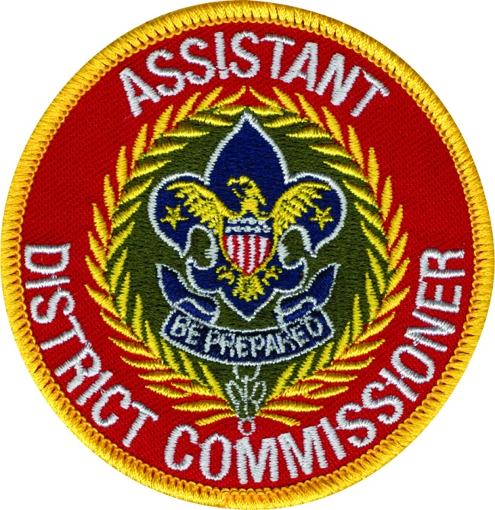
The Assistant District Commissioner
Notes:
Assistant District Commissioners, or ADCs, can make or break a district’s ability to see that every unit receives competent commissioner service. Even the best district commissioner in the council cannot personally train and guide all unit commissioners in the district (in a 60-unit district that is at least 20 people). So, ADCs are assigned certain units in the district, and they supervise the unit commissioners who serve those units. ADCs are appointed by the district commissioners.
A good staff has one ADC for every 15 units. That is one ADC for every five unit commissioners needed. That provides one unit commissioner for every three units. Good ADCs have good people skills.
ADCs work closely with the district commissioner and district executive. This team must have a vision of effective Scouting, and they must communicate that vision—through unit commissioners—to every unit leader in the district.
When a unit commissioner resigns, or cannot adequately fulfill the responsibilities of the position, the assistant district commissioner temporarily assumes the vacant position. However, immediate action must be taken to provide a replacement. Administrative commissioners are not unit commissioners. Their responsibility is to find unit commissioners.
Assistant district commissioners measure people’s progress, not in the number of meetings those people attend but in the way they handle their responsibilities. The ADC’s role is accomplished largely on a personalized basis. At monthly district commissioner staff meetings, they help their unit commissioners plan how to help meet priority needs of units. They hold their staff accountable for the previous months’ plans and assignments

Slide 18
ADC Responsibilities
Distribute and/or lighten the load of the DC
Normally one for every five UCs or 15 units
Perform as the UC when the UC position is unfilled
Often assigned to a geographic area or group of like units
Additional ADCs to perform staff functions

Slide 19
Staff ADC Responsibilities
  ADC for Roundtables. Responsible for a robust RT program for all programs. Recruits and oversees Cub Scout, Boy Scout, and Venturing RT commissioners. Encourages RT commissioners to recruit a support staff.
  ADC for New-Unit Service. Recruits new-unit commissioners. Ensures new-units (less than three years tenure) have an active and committed UCs trained in new-unit support. May serve as a new unit commissioner if a new-unit UC cannot be recruited)

Slide 20
Staff ADC Responsibilities (cont.)
  ADC for Training. Ensures UCs and ADCs are properly trained, Responsible for Training topics for District Commissioner Meetings and recruiting UCs to present them. Hosts CBT periodically when asked to do so.
  ADC for Administration. Provides record keeping and other administrative support to the DC

Slide 21
Area ADC Major Responsibilities
Recruit and develop your staff to ensure there are enough UCs to serve their assigned units
  Ensure your UCs are trained
Maintain regular contact with their UCs to provide guidance in unit service needs
Serve units with no assigned UC
Help UCs to evaluate and improve their unit service performance

Slide 22
Good DCs/ADCs Have Good People Skills
Recruit the right people
Clear instructions, specific ideas
Listen
Don’t play favorites
Coach UCs in real problem-solving situations
Treat everyone with dignity
Praise often
Don’t take over, help them be successful
Notes:
Good ADCs have good people skills.
They help recruit the right people
They provide clear instructions and specific ideas for their staff.
They listen to what people say and what people feel.
They never play favorites.
They coach unit commissioner through real unit problem-solving situations.
They treat all Scouters with courtesy and dignity.
They praise each commissioner often for specific achievements.
They don’t try to take over for their staff but are always ready to support or assist them to be successful.

Slide 23
Unit Commissioners
Help units succeed:
  UC is the person who actually contacts and visits the unit and works with it.
  With a few exceptions such as reorganizing a unit, or planning a specialized training session, it is the UC who is the backbone of the Commissioner service
Main task of other Commissioners is to assist the UC in doing the job well

Slide 24
Roles of the DC / ADC
Questions?
Comments?

Slide 25
Unit Service Assessment
What tools are available?
Journey to Excellence
Voice of the Scout
Commissioner Tools
Council Reports
Notes:
There are several tools that can help District Administrative Commissioners determine where District units and Commissioner staffs stand in relation to defined National standards.
A first step in determining where your district stands is to do a district self assessment. Page 10 of the Self-Evaluation Guide for Successful District Operations is useful in helping to establish a baseline to start from.
Frank discussions with Assistant District Commissioners about existing unit commissioners should also occur. Ask commissioners to take a self assessment to examine themselves to determine how they can improve their service to their units.
Ask commissioners to work with their units in conducting a unit self assessment and have them discuss the results with their Assistant District Commissioners.

Slide 26
Journey To Excellence
What it brings to units:
Framework for Planning
Method of Evaluation
Provides Guidance
Guidelines and standards
Early Warning
Recognition
Benchmarking
Notes:
When unit leaders ask why they should participate in the Journey to Excellence. Tell them that it provides a framework for planning the year. The Journey to Excellence standards are based on what successful units do to continually improve and If your unit works to achieve gold or silver Journey to Excellence, you’ll have a strong and active program.
Let them know that it is a method for evaluating their unit. The Journey to Excellence provides tangible measurements based on things they are likely already tracking, such as how many campouts they have, how many youth are advancing, etc., and uses simple ways to calculate your performance.
The JTE also provides Guidance in areas where the unit might do better. As they track their performance against the Journey to Excellence standards, they can easily see where they could do better.
JTE establishes specific guidelines and standards of what is considered good performance. Journey to Excellence has specific, simple measures to help them. They can easily compare what they are doing against the standards.
JTE is a great tool that provides Early warning of potential problem areas. They can track any areas where the unit is not performing as they might like and have plenty of time to make corrections.
The Journey to Excellence is a Recognition for good Scouting. They can proudly receive their bronze, silver, or gold recognition for their Scouting unit for the year.
The Journey to Excellence is a great Benchmarking tool to get ideas and tips from other good units. They can receive help and best practices in areas where other units have met the gold standard. In the areas where they are doing well, they can give help and ideas to other units.

Slide 27
District Success
District JTE Criteria
Aligned to Council JTE
Unit Success in JTE
Key 3 tracks
Notes:
The measure of District success is shown in achieving the Journey to Excellence benchmarks for each criteria.
District JTE benchmarks match up well with Council JTE criteria.
The JTE site provides all forms and the electronic application to make record keeping easier throughout the year.
JTE status review should be part of each monthly District Committee Meeting.
Review the District Journey to Excellence form. If possible show the record keeping application on the site.

Slide 28
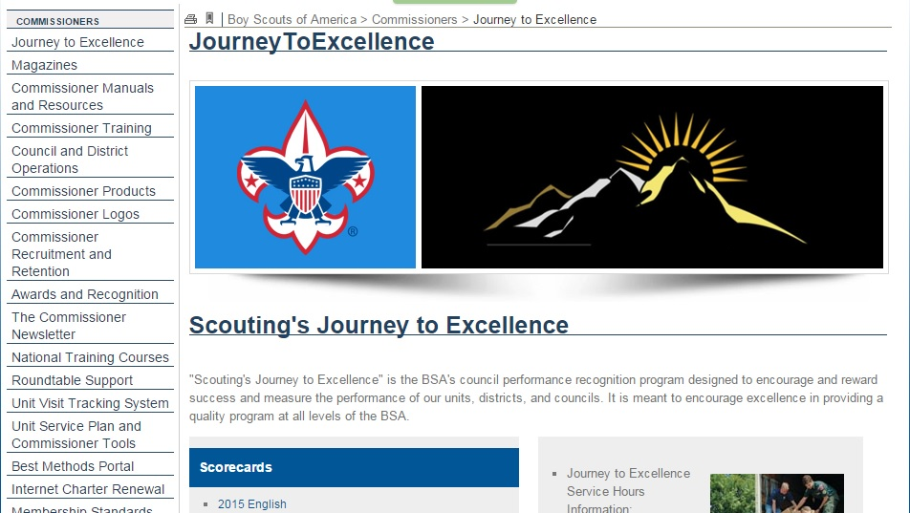
JTE Scorecards

Slide 29
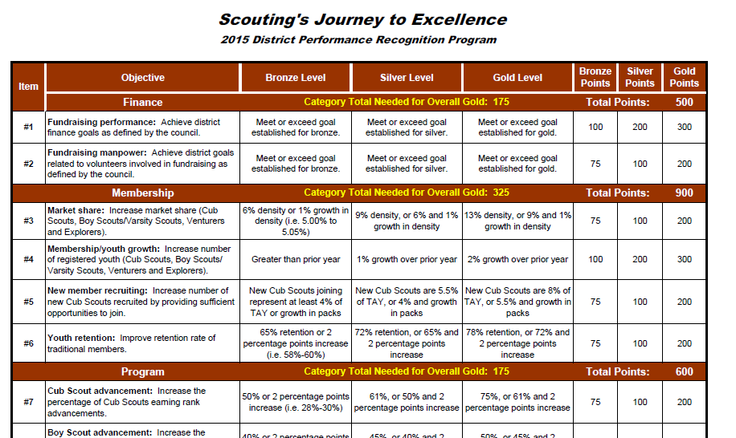
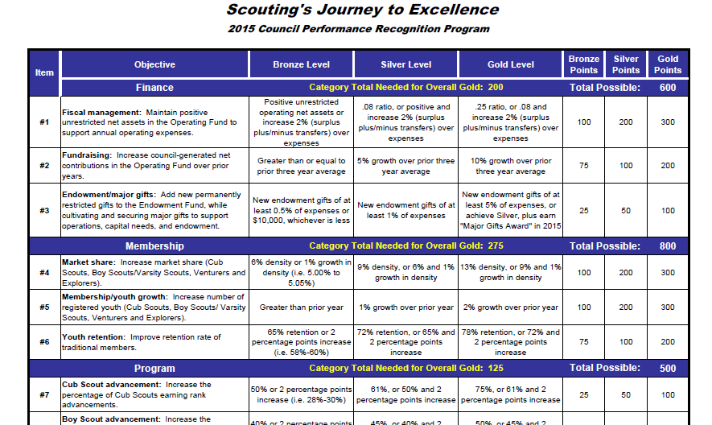
District/Council Scorecard

Slide 30
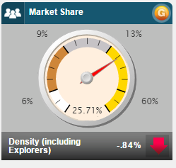
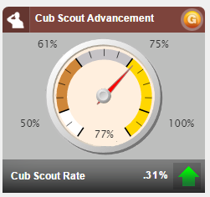
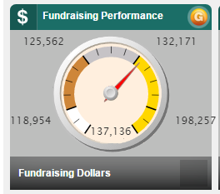
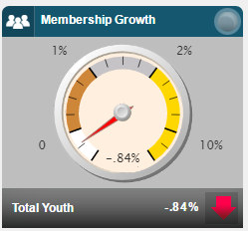
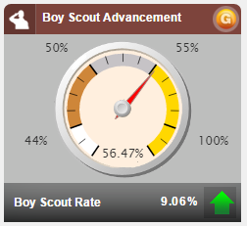
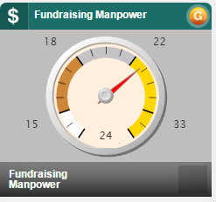
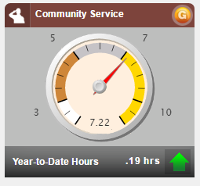
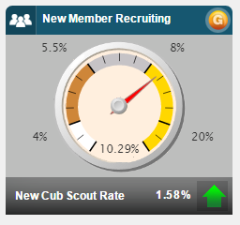
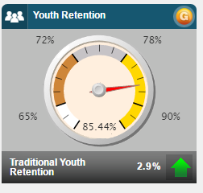
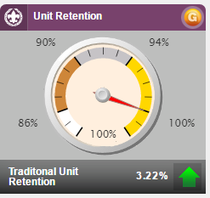
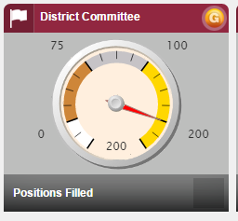
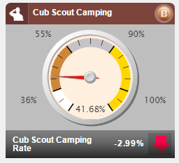
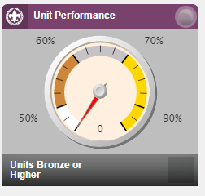
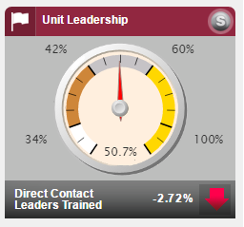
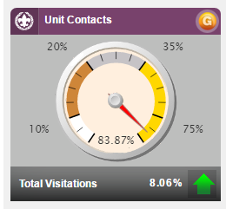
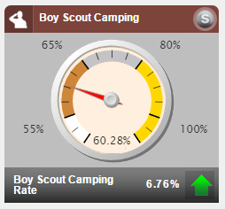
District JTE Measurement
Automatic
Units Input
District Committee Input
Commissioner Input
Council & District Input

Slide 31



District/Council Point Levels
To earn Gold: Earn at least 1,650 total points plus minimums in every category.
To earn Silver: Earn at total of 1,350 points.
To earn Bronze: Earn a total of 1,000 points.

Slide 32

Notes:
The Voice of the Scout is one more tool that a unit has to evaluate their program.
Have you received a survey?
Did you answer it?
Have you heard any feedback?

Slide 33

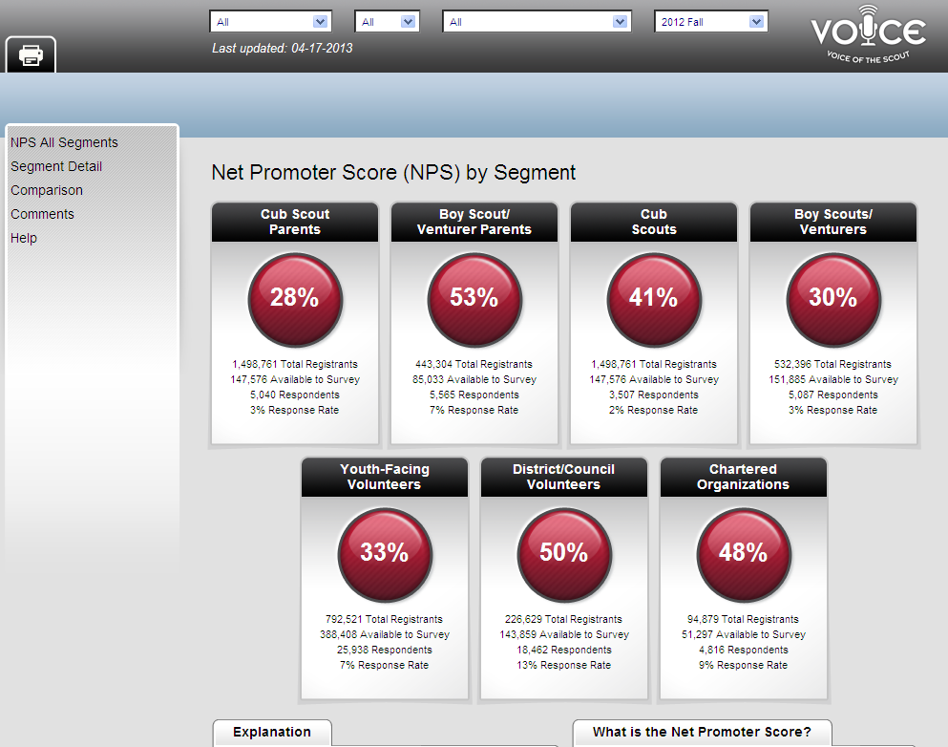
Notes:
There are 7 surveys sent out twice a year, usually in the spring and fall. The surveys are a random sampling of scouting’s customers. Everyone does not get a survey.
Cub Scouts
Cub Scout Parents
Boy Scouts/Venturing
Boy Scout Parents
Youth Facing Volunteers
District/Council Volunteers
Charter Organizations

Slide 34

Three Levels of the Program
  The Survey
  Feedback
  Analysis and Action
Notes:
The VoS Program is built on 3 levels.
Survey
Feedback
Action
Feedback goes to the Council in the November-December timeframe and in the April-May timeframe.
The Council delivers feedback to the Districts who pass it to the Unit Key 3.
Each level analyzes the information and makes improvements.

Slide 35
Unit Commissioner’s Role
JTE
Educate Units
Meet JTE visit requirements
Voice of the Scout
Encourage unit participation
Notify units about surveys
Notes:
Commissioner Role:
Make sure the Unit is current in its understanding of the Journey To Excellence criteria and how to meet those standards. A good program makes everyone’s job easier.
Encourage Voice of the Scout participation.
Educate your unit in understanding the VOS and the importance of taking the survey.
Units may feel threatened.

Slide 36

Commissioner Tools
&
The Unit Service Plan
The Future of Commissioner
Service

Slide 37
Commissioning Four Areas of Focus
Supporting unit growth through the Journey to Excellence
Contacting units and capturing their strengths and needs in Commissioner Tools
Linking unit needs to district operating committee resources
Supporting timely charter renewal
Notes:
These are the areas on which commissioners must be focused.
While these should be familiar (the National Commissioner’s Support Staff established these in the spring 2012 issue of The Commissioner), they remain fundamental to achieving excellence in unit service.
But there are changes worth noting:
We now speak of contacts rather than visits, recognizing there are now a broad spectrum of ways for commissioners to have meaningful interaction with units. Commissioners should have personal meetings in a variety of settings to become familiar with a unit’s program and operations and contemporary tools enable electronic communications to be both timely and meaningful.
Capturing unit strengths and needs speaks directly to the significance of the Unit Service Plan and the changes it makes to our approach to unit service.
We now speak of contacting units first and then linking their needs to district operating committee resources, another reference to the Unit Service Plan and its focus on developing collaborative assessments of unit health.

Slide 38
The Unit Service Plan
Key element of Commissioner Tools design
Replaces all other unit assessments
Enables collaborative unit health assessments
Enables service customized to unit needs
Supports all 4 elements of excellent unit service
Notes:
We’ll discuss the Unit Service Plan in more detail later, but it is important to remember that, like Journey to Excellence, it is a key element of the design of Commissioner Tools.
The Unit Service Plan is a better way to provide unit service. It supports all four elements of excellent unit service and our approach to starting and sustaining high-performing units (detailed in the Unit Performance Guide).
Based upon a collaborative assessment of unit health, commissioners develop a service plan that is customized to respond to a unit’s strengths and needs and draws upon resources available within the unit, its charter organization, and through the district operating committee.
Through ongoing unit contacts, commissioners capture periodic updates of the collaborative assessment of unit health and ensure the plan for improvement is moving forward.

Slide 39
A Functional Unit Key 3
COR
Unit
Leader
Committee Chair
Unit Service
Youth
Youth
Youth
Youth
Notes:
The members of an effectively functioning Unit Key 3 interact much the same as the members of any other Key 3 and the youth the unit serves remain the primary focus of their interactions. Unit service – a unit commissioner – supports the efforts of a Unit Key 3. The unit commissioner isn’t a member of, but an advisor to, a Unit Key 3.
Both engagement and collaboration are necessary for this model to be successful.

Slide 40
Strong Linkage
The Unit
The District
Operating
Committee
The Unit Commissioner
Notes:
We also know that commissioners can’t be experts in everything, and they can’t fix everything.
But strong district operating committees have experts in all elements of Scouting and unit commissioners can be most effective if they link unit needs to that expertise. How best to do that? We’ll get back to that…

Slide 41
So Far We Have Discussed
Significant Part of Commissioner Tool
Replaces Older Measuring Methods
How the USP Supports JTE and Units
Linkage to District Committee
Unit Key 3
Questions To This Point?

Slide 42
Commissioner Tools Overview
Multiple Releases Scheduled
Contacts replaces visits
Records simple and detailed assessments
The Unit Service Plan
Reports and Dashboards
The Scoring Matrix and Detailed Assessments
Notes:
The CT’s will be introduced in several releases. Several additional items have been identified to be included in releases 2 and 3. They will follow as other information outside of CT’s is developed and we are able to “link” that information to the CT’s.
Release 1 will be out when it is fully developed and working, likely in the fall of 2014.

Slide 43
THE UNIT SERVICE PLAN
UNITS
IMPLEMENTATION
UNIT ASSESSMENT
DISTRICT COMMITMENT
UNIT
SERVICE PLAN
Notes:
The Unit Service Plan is a tool to strengthen a unit and enable it to offer the best possible program to the youth it serves. A collaborative effort between the unit’s leaders, its charter organization, unit commissioner, and the district operating committee, it establishes a customized annual plan that is periodically reviewed and updated to provide continuing improvement. One of the methods utilized for this is the Unit Assessment, which will be covered more later.
Remember the four areas of focus discussed earlier….the Unit Service Plan enables commissioners to focus on their four primary responsibilities:
1. Supporting unit growth in the Journey to Excellence.
2. Contacting units and logging visits in Commissioner Tools.
3. Linking district operating committee resources to the unit.
4. Supporting on-time charter renewal.
Engagement of the Unit Key 3 is essential to the development and execution of an effective Unit Service Plan. The Unit Key 3 (unit leader, committee chair, and charter organization representative) may be a new concept for many units. It was developed as a best practice for new units following the Unit Performance Guide [http://www.scouting.org/filestore/membership/pdf/522-025_WB.pdf] methodology. Its use has shown that all units employing the Unit Key 3 concept are stronger and have an easier time making decisions. Examples of a “unit leader” would include a Cubmaster, Scoutmaster, or Crew Advisor; note that the unit commissioner is not a member of the Unit Key 3, but serves as an advisor to them. More on the Key 3 in a few minutes.
This is also where the new term “Linkage” starts to come into play. More on that as well in a minute.
The Unit Service Plan provides transparency: working together, unit leadership, Unit Service, and District Operations identify how best to deliver the best possible program to the kids, served by a unit commissioner and working together to accomplish the plan they develop.
And remember…
…it’s a cycle…as the current Scouting year draws to a close and the charter renewal process begins, it is time for another Unit Assessment…
…and things can and do change during the course of the Scouting year and may require that the Unit Service Plan be revised….

Slide 44
The Unit Service Plan
UNIT ASSESSMENT
The Process:
  Review JTE performance
  Hold unit assessment meeting
  Complete assessment
  Identify opportunities
Resources:
  JTE objectives & scores
  Unit contacts logged in Commissioner Tools
  Unit Assessment Scoring Matrix
Notes:
UNIT ASSESSMENT
A Unit Assessment can be a first step in supporting unit growth on the Journey to Excellence.
The Process:
Units benefit from assessments at least twice each year at six month intervals. Around charter renewal is a great option as that often occurs at about the same time units are reviewing JTE achievements for the current year. A third assessment may be valuable when there is a change in unit leadership.
It may be helpful for the unit commissioner to coordinate a Unit Assessment Meeting with the Unit Key 3 and other unit leaders who can add value to the planning process. Possible agenda items would include:
Review of the unit’s JTE performance for the current year.
Completion of a Unit Assessment.
Identification of key opportunities to strengthen the unit and the program it offers during the coming year.
Resources:
1. The Unit Assessment is based upon JTE Objectives (for example, Advancement, Retention, Trained Leadership, etc.) JTE scores will help identify the unit’s strengths and opportunities for improvement.
Journey to Excellence standards are updated each year in August and are posted at http://www.scouting.org/jte.aspx Units that are successful in the JTE Objectives areas attract and retain more youth.
Familiarity with current JTE standards will provide a common perspective for everyone involved in developing and executing a Unit Service Plan.
3. Unit visits made by the unit commissioner and logged in the Commissioner Tools can also provide valuable perspective in the assessment process.
The information developed during the Unit Assessment Meeting is the foundation of the Unit Service Plan, which will be captured in Commissioner Tools, where it will be available for ongoing reference by the unit commissioner.

Slide 45
What Do You Measure?
PACKS | TROOPS | CREWS
Budget | Budget | Budget
Retention | Retention | Retention
Building Cub Scouting | Building Boy Scouting | Building Venturing
Annual Charter Renewal Process | Annual Charter Renewal Process | Annual Charter Renewal Process
Webelos-to-Scout Transition | Webelos-to-Scout Transition | Activities
Advancement | Advancement | Super Activity
Outdoor Activities | Short Term Camping
Day/Resident/Family Camp | Long Term Camping
Service Projects | Service Projects | Service Projects
Fitness | Fitness | Fitness
Pack & Den Meetings | Courts of Honor/Parents Meeting
Trained Leadership | Trained Leadership | Trained Leadership
Leadership Planning | Patrol Method | Youth Leadership
Notes:
In the Commissioner Tools, we measure many of the same areas that are covered in JTE. We measure Finance using the methods in the green colors, Membership in the yellow colors, Program in the Orange colors and Leadership and Governance in Blue. Again, this is a way we measure what matters.
The guideposts on the Journey to Excellence aren’t all that different for our units. Think about our Packs, Troops, and Crews (the framework is similar for our Ships and Teams). They are the beneficiaries of Unit Service, so it isn’t a JTE category for them. But they all have goals related to Finance, Membership, Program, and Leadership & Governance. Those goals are customized for each program, but there are obvious similarities. And the concept is the same: these are the things that are essential for units to deliver the promise of Scouting. These are the things units must do well if they want to attract and retain more youth and adults.
As you will see, there are many parallel connections between JTE and Commissioner Tools.

Slide 46
Unit Assessment Scoring Matrix
RELATIVE RANKING | SCORE | COLOR | DEFINITION | PROGRAM PLAN
HIGH | 5 | GREEN | NEARLY AN IDEAL SITUATION | PLAN CREATED AND DISTRIBUTED
MEDIUM-HIGH | 4 | LIME | MAKING PROGRESS TOWARDS THE IDEAL UNIT | PLAN COMPLETED
MEDIUM | 3 | YELLOW | TYPICAL UNIT; COULD BE IMPROVED | MEETING SCHEDULED
MEDIUM-LOW | 2 | ORANGE | NEEDS IMPROVEMENT; WATCH CAREFULLY | UNIT WILL SCHEDULE
LOW | 1 | RED | WEAK SITUATION; NEEDS IMMEDIATE ACTION | NO MEETING PLANNED
50
Notes:
A Unit Assessment doesn’t have to be difficult process. Unit leaders and engaged commissioners know, intuitively, a unit’s strengths and its opportunities to improve.
Take a look at this unit assessment scoring matrix…it’s pretty simple…
A Unit Key 3 and unit commissioner can use it in conducting the unit assessment that is the foundation of a Unit Service Plan. Whether the scale is “Low-Medium-High,” “Red-Yellow-Green,” or “1-2-3-4-5,” the matrix provides a simple approach to assessing a unit’s performance in key areas such as Finance, Membership, Program, and Leadership & Governance. The next logical step in the process, once opportunities for improvement are identified, is to prioritize them. It may not be practical to attack all of them at the same time; prioritizing them will enable the best possible use of available resources to improve unit performance.
The definitions provide a frame of reference: a “High”/”Green”/”5” assessment indicates the unit is nearly ideal in an area, for example.
Unit Assessments should always include the unit’s program plan. Our best units, those with the highest retention of youth and adults, invariably create and maintain an annual program plan that ensures the unit’s program is relevant to the youth it serves.

Slide 47
The Unit Service Plan
UNIT
SERVICE PLAN
The Process:
  Develop action plans
  Identify responsibility
    Unit volunteer?
    Charter Org?
    District resource?
  Establish target dates
  SMART goals
Resources:
  Unit Program Plan
  District/Council activities schedule
  District charter renewal plan
Notes:
UNIT SERVICE PLAN
The Process:
Using the results of the Unit Assessment Meeting, the Unit Key 3 and unit commissioner should work together to develop the Unit Service Plan, a list of action items that will strengthen the unit and the program it offers to the youth it serves. In addition, they should establish completion target dates and assign responsibility for each. Finally, resources needed to accomplish specific action items should be identified (some resource needs, such as funding or training, might result in the identification of other action items).
The Unit Service Plan should be based upon the Unit Assessment.
As the Unit Service Plan is developed, it will become apparent that some action items will be the responsibility of unit leadership (for example, recruiting new youth members or adult volunteers), some will be the responsibility of the unit’s charter partner (for example, providing additional meeting space or equipment storage), and others will be the responsibility of the unit commissioner to coordinate by linking unit needs to district resources (for example, delivery of position-specific training for unit leaders or participation in the district’s fall membership roundup).
Resources:
1. The Unit Program Plan may help identify unit needs and action items (for example, Scouts wanting high adventure who belong to a troop with little back-packing experience may need support from the district camping committee).
2. The district schedule and plans for charter renewal can help in developing action items that support on time unit charter renewal

Slide 48
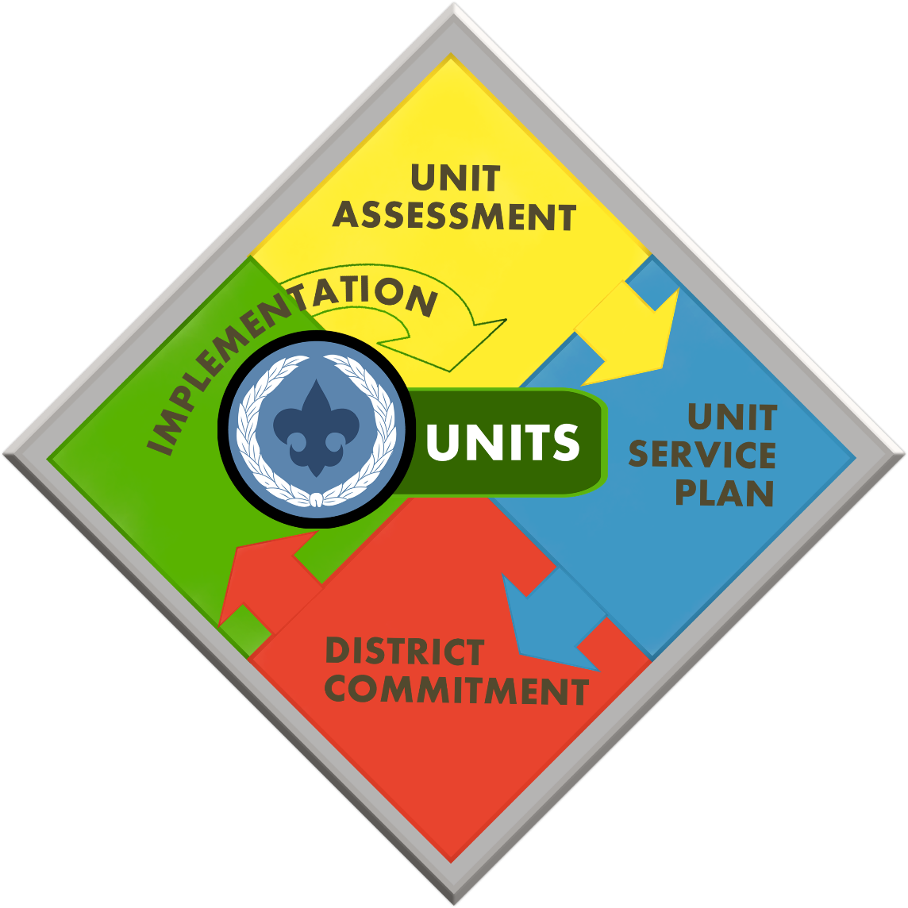
A Better Way
Collaboration
Focus
Actionable Information
Linkage
Efficiency
Metrics
Notes:
The Unit Service Plan enables commissioners to fulfill their mission to help units better serve more youth through Scouting. And in the process, it enables improved retention of units and improves the performance rating of units using Journey to Excellence metrics.
A Unit Service Plan will have greatest impact when it is built upon a collaborative assessment of the unit’s strengths and needs.
Developing and executing a Unit Service Plan in Commissioner Tools touches every metric we currently use to help Unit Service continually improve and also every metric we currently use to help our units continually improve, too.
It truly is a better way to provide Unit Service!

Slide 49

Key Benefits
Focus
Unit Service Plan
Efficiency
Actionable Information
Linkage
Notes:
Finally, the Simple Assessment function in Commissioner Tools provides a quick and easy was to document plan progress. Simple Assessments document regular, monthly contacts by a unit commissioner. Unit contacts recorded in Commissioner Tools should involve substantive interaction with unit leaders that ensure Unit Service Plan progress or address some other significant unit need.

Slide 50
District Level Reports & Dashboards
District
Reports | Dashboard
Commissioner Activity Unit Health Commissioner Contact Stats Unassigned Units District Contact Stats, Priority Units Commissioner Recruitment Expired Units Youth Protection Training Aging Report Trained Leaders Report Youth Member Age Report | Resources (Council Key-3) Registered Units (count); % Gained Unit Retention % Youth Retention % Total Unit Commissioners (count) Commissioner-to-Unit Ratio Unit Health Green units (count & percent) Yellow units (count & percent) Red units (count & percent) Priority Need Units Priority units (count); Action Plans (count) Unit-Assessments Count of unit contacts with completed unit-assessment; percent of unit contacts with a unit-assessment Count of unit contacts without a unit-assessment; percent of unit contacts without a unit-assessment Unit Contacts Total # of units contacted; Percent of units contacted Total # of units not contacted; Percent of units not contacted Roundtable Contacts (Scheduled, In progress, Completed)
Notes:
To save space only the Release 1 reports are displayed.

Slide 51
Unit Reports & Dashboards
Unit
Reports | Dashboard
Unit Rosters (Calling List, Member List, and Mailing List) | Resources (District Key 3) Assigned Commissioner Unit Contacts (Scheduled, In progress, Complete) Unit Health Green units (count & percent) Yellow units (count & percent) Red units (count & percent) Conduct Discussions Add Comments Archive Visits (UVTS Historical Contacts)
Notes:
To save space only the Release 1 reports are displayed.

Slide 52
Exception Reports
Exception Reports
Performance | Report/Dashboard | Location
No Email Address in Profile | Email Saturation Report | Reports Button
Invalid Contact information | Invalid Contact Information Report | Reports Button
Units without a UC | Unassigned Units Report | Reports Button Commissioner Tools Units Dashboards (Council, District, and Unit)
UCs without a Unit | Commissioner Contact Stats Report, Commissioner Activity Report | Reports Button Commissioner Admin Tool Dashboard
New Unit UCs | Unit Health Report | Reports Button
New Unit UCs without a Unit | Commissioner Contact Stats Report, Commissioner Activity report | Reports Button Commissioner Admin Tool Dashboard
Commissioner Awards Status | Dashboard | Commissioner Admin Tool Dashboard
Priority Units | Priority Units Report | Reports Button Commissioner Tools Units Dashboards (Council, District, and Unit)
Unit Health | Unit Health Report | Reports Button Commissioner Tools Units Dashboards (Council, District, and Unit)
Unit without an Assessment | Unit Health Report | Reports Button Commissioner Tools Units Dashboards (Council, District, and Unit)
Units not attending Roundtable | Unit Health Report | Reports Button Commissioner Tools Roundtable Dashboards (Council, SA, District)
Units without a Contact All By color code | Unit Contact Report | Reports Button Commissioner Tools Units Dashboards (Council, District, and Unit)
Notes:
To save space, only the Release 1 reports are displayed.

Slide 53
Key Concepts
Commissioner Tools design foundation:
  Just 4 things…
  Supporting the unit’s Journey to Excellence
  Recording unit contacts, strengths and needs
  Linking unit needs to district operating committee resources
  Timely charter renewal
  Journey to Excellence
  The Unit Service Plan
  Data collection
  Information reporting
Notes:
There are 5 key elements to the design of Commissioner Tools:
The 4 things upon which unit commissioners must be focused to achieve excellence in unit service.
Scouting’s continuous improvement process, our Journey to Excellence. But note that, although JTE is fundamental to Tools’ design, we don’t use JTE terminology or metrics in Tools. This enables commissioners to help units implement a continuous improvement process even if they are resistant to the formal JTE process and record keeping. And once users become familiar with Tools, they will find the Commissioner Tools is fully supportive of JTE.
The Unit Service Plan enables commissioners to provide service that is customized to a unit’s needs and based upon a single, collaborative assessment of a unit’s strengths and needs.
Commissioners are able to quickly and easily collect data about unit contacts, roundtables and Unit Service Plan progress. Administrative commissioners can quickly and easily input and update unit assignment data.
Through screen displays and on-line reports which can be printed if needed, Tools converts data input and available from other BSA sources (e.g., leader training), into actionable information (e.g., which unit leaders need training, what units are attending roundtables, which units don’t have an assigned commissioner, which commissioners don’t have assigned units, etc.)

Slide 54
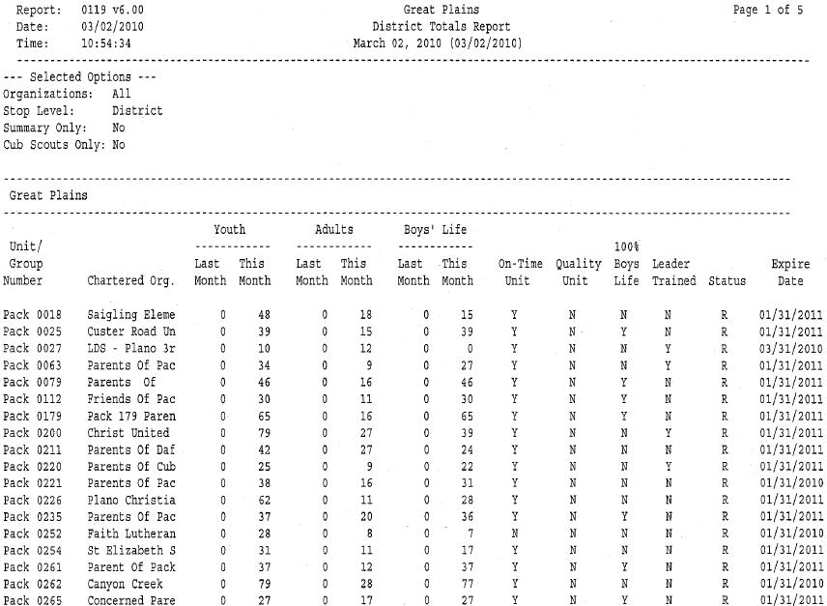
District Totals Report
Notes:
This is a report that can be provided to you by your district executive. It gives you a picture of unit membership month to month. It also shows which units are in your district so that you can make sure you have a commissioner assigned to each unit.
If possible provide copies of this report for their district to each person present.

Slide 55
Unit Service to Exploring
In NCAC, Explorer Post unit service is provided by the district commissioner staffs
  Commissioners provide Unit service similar to traditional units:
  Annual Post Registration Renewal (‘Rechartering’)
  JTE
Commissioner Tools is scheduled to provide Explorer support effective January 1, 2017. In the interim, NCAC has developed local Explorer Service Tools:
  http://www.ncacbsa.org/exploringtools

Slide 56
Recruiting Commissioners

Slide 57
Know who you are looking for
All kinds of people
What qualities do commissioners need?
Notes:
The key to a strong commissioner core is diversity. You need men and women of different backgrounds and ethnicity. Why?
Typically we look for commissioners in the ranks of very experienced Scouters. But should we be? You need people with different levels of Scouting skills--we can teach the skills, but they need to come to commissioner service with a commissioner’s heart. Active unit leaders should not be recruited as commissioners. Their unit needs them.

Slide 58
Once you find one…
Don’t ask them--YET
Build a relationship
Find out what others think about them
Notes:
To recruit a new commissioner and keep him/her and make him/her effective Takes more than a simple “Will you?”
Make a relationship with them. Without asking them directly, figure out some of the following.
Where did you meet them?
What besides an interest in Scouting do you have in common with them?
What do they like best about Scouting?
What do they want their legacy to be?
If they are not involved in Scouting, what do they have in common with Scouting?
Do they currently have an outlet for that interest?
What are their connection points with commissioner service?
Other things to think about:
Why would they want to do this?
What will they get out of it?
Why do you want this person to do this?
Are there any advantages to their job/life outside of Scouting?
Make a note of how long you want them to serve.
Reflect on what you have observed or discovered in conversations with others about this individual. Jot down your thoughts.

Slide 59
Prepare to ask
Review the information you have
Notes:
Choose 3 things from your homework phase to focus on during your visit. Choose a couple more--Plan B, Plan C. During your visit, you’ll need to go with the flow of conversation. You may find yourself hopping from Plan A to Plan C and back again.
When phrasing your close the sale, remember that people do things for influence, achievement, fellowship and what they can get out of it. Include all of those elements in your closing. They will only hear the one that hooks them, the others will just fly over their head. And just think, if they respond to achievement and you told them only how much fun it would be. . .
It is important to take along someone that is respected by your candidate and has a good relationship with them. Go over your plans, ask for input. Be prepared.

Slide 60
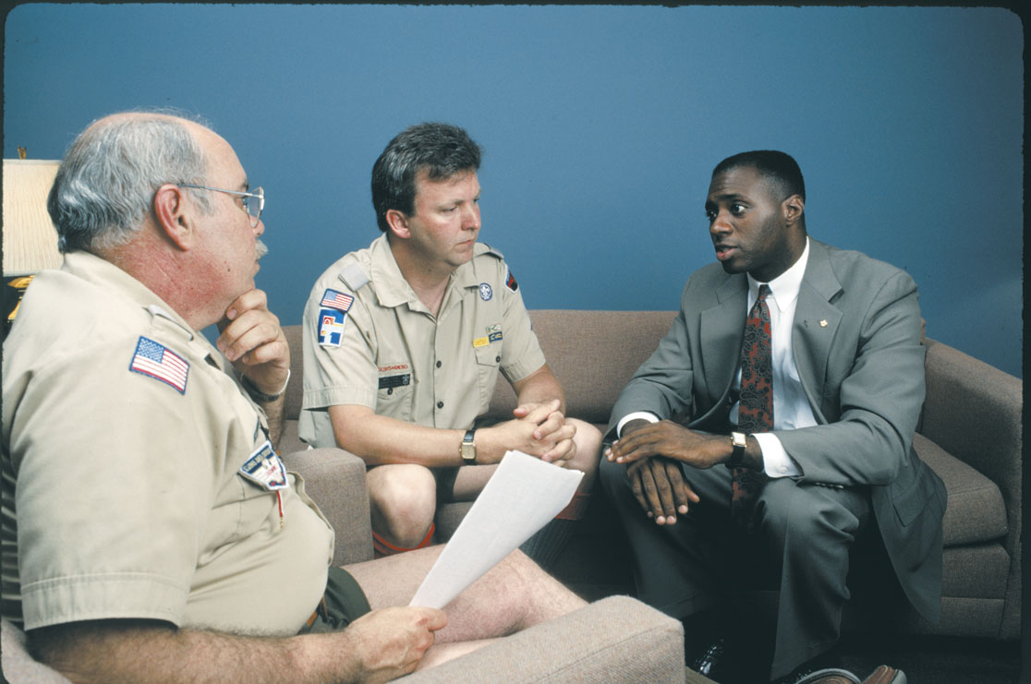
Make the Ask
Notes:
Make the appointment--hopefully not at work. Take along the person you have asked to help you.
Take plenty of time--go with the flow of conversation
Focus on them, what they will get out of this and how they can influence others, have fun and get something worthwhile accomplished.
Be honest and specific about this--don’t sugar coat it but don’t overwhelm your candidate. Be clear about the time commitment.

Slide 61
What’s next?
If they say “no”
If they say “maybe”
If they say “yes”
Notes:
If they say no--keep relationship alive--make a call, send an email. Consider if this is the right person, wrong time or it they would be better suited to a different job. If so, pass their name along.
If they say “maybe” begin the go-along: invite them to a cabinet meeting. Take them to a unit meeting; The best thing would be to take them to a unit would ant to match them with. Introduce them to the people they might be working with. Get them to take Fast Start Training and assign them to a mentor. Get them to help complete a unit visitation report.
After the prospect says yes, give the new recruit the details of how and where to go online to access the Unit Commissioner Fast Start. Provide a reference to the website (ww.scouting.org/commissioners) for additional details about the role of a commissioner, but don’t let them be overwhelmed by all they see there. It can work as a reference to other resources available to them in the future as they begin their new position.

Slide 62
Questions?
Comments!
Notes:
62

Slide 63
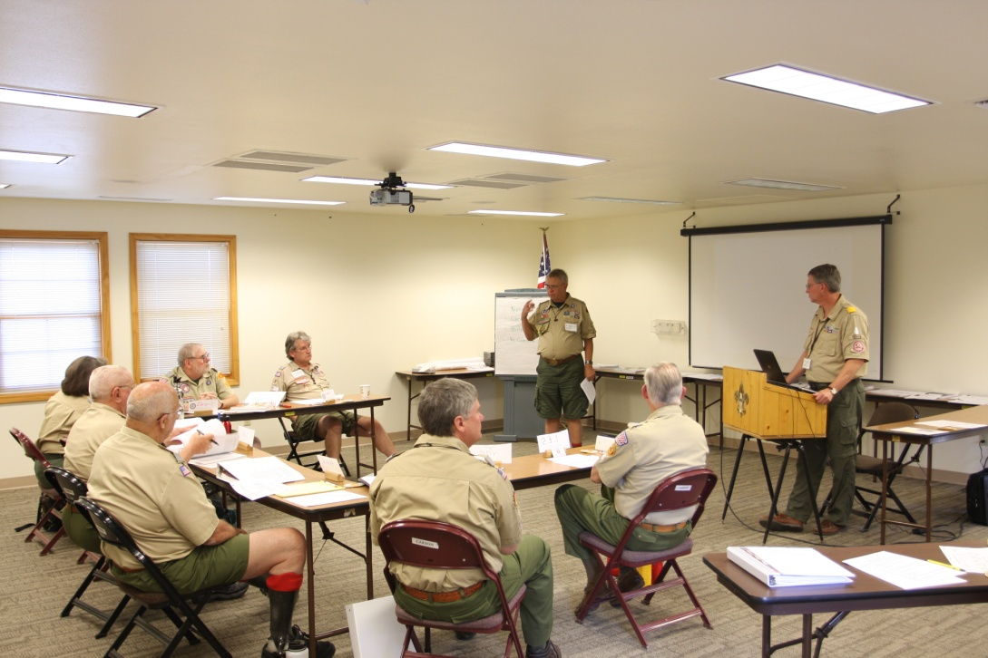
Commissioner Training

Slide 64
Basic Training
Commissioners Basic Training (Commissioners Fieldbook for Unit Service #33621)
Roundtable Commissioner Basic Training (Cub Scout/Boy Scout Roundtable Commissioner Training Manuals #33013 and #34256)
District/Assistant Commissioner Basic Training (Administration of Commissioner Service #34501)
Notes:
The new commissioner should participate in the commissioner basic training within two months of being recruited. The training should involve actual visits to Scouting units.
At the end of the commissioner basic training session, the training certificate is awarded along with the Trained Leader emblem which may now be worn below the badge of office.
Commissioning ceremonies should take place throughout the year so that a new commissioner receives his or her commission promptly after completing Commissioner Basic Training. These ceremonies should take place at district or council commissioner staff meetings. The ceremony is conducted by an administrative commissioner, usually the District Commissioner or Assistant District Commissioner.
A commissioning ceremony can be found at appendix H in the
Administration of Commissioner Service manual.

Slide 65
Continuing Education for Commissioners
Monthly
Annually
Online
Notes:
Continuing education includes the annual council commissioner conference, the College of Commissioner Science or similar opportunity. Annual training at College of Commissioner Science should be a priority for all Commissioners. If the Council you are in doesn't offer a college, consider attending the College in a neighboring Council that offers one. Earning your Doctorate in Commissioner Science should be a goal of every Commissioner. Even after earning the Doctorate, Commissioners should plan to attend the college as faculty or to attend advanced studies courses.
Of course a short training topic should be taught at each district commissioner meeting. Commissioners may also participate in advanced unit program training such as Wood Badge. The Philmont Training Center also offers a complete curriculum of Commissioner Courses. It is no longer a requirement to be invited by your Council. Any Commissioner is welcome to attend and may register on their own.
Another valuable training resource is the Unit Problem Solving for Commissioners part of the Commissioner Service and District Operation Support DVD. This video helps commissioners increase their skills in handling common, often unit life-threatening problems. For each of the problems, the video sets up the problem, instructs the group to discuss their ideas for a solution, and then adds video solutions to the group’s ideas. Sessions don’t need to last more that 5 to 15 minutes.
Just as every Scout deserves a trained leader, Every unit deserves a trained Commissioner

Slide 66
Continuing Education
Monthly Education
  Occur every month at Commissioner Staff Meetings
  Example Topics:
    Unit Stops Meeting
    No Unit Leader or Active Committee
    Untrained Leader
    Not Attending Roundtable
    How to use Commissioner Tools
    Unacceptable JTE scores
    Creating the Unit Service Plan
    Defect Free, On-time, Recharters
Notes:
Should occur every month at district commissioners staff meetings. The district commissioner and district executive select a topic each month that best matches the current skill needs of their commissioner. Parts of the training outlines in Continuing Education for Commissioners, provide ready-to-go training topics for the district commissioner staff meetings.

Slide 67
Commissioner Conference
Yearly meeting for all Commissioners in Council
Highlights the Council’s plan for Unit Service
Agenda
  Advanced Training
  Information on latest scouting program
  Fellowship
  Inspiration
Notes:
Should occur every year at the annual council commissioner conference. Agenda includes:
50% of the session for Advanced Training
30% of the session regarding information on the latest changes to the scouting program
10% of the session for fellowship
10% of the session for inspiration.

Slide 68

Commissioner College
Type of Commissioner Conference
Offers curriculum based programs
  Associate
  Bachelor
  Masters
  Doctors
Additional Non-Curriculum Training
Notes:
This is how our council implements the annual commissioner conference. At the college each participant as the opportunity to earn their next degree in Commissioner Science.

Slide 69
National Training Centers
Conferences at National Training Centers (Philmont, Sea Base, Summit)
  Quality Venturing Roundtables
  Cub Scout Roundtables
  Boy Scout Roundtables
  The Unit Commissioner
  Administration of Commissioner Service
  District Key Three
  Council Key Three
Notes:
Discuss Philmont Training Conference. Best opportunity for a family vacation and to gain knowledge about scouting. This knowledge is gained while having fellowship with scouters across the United States. Philmont is located in Cimarron New Mexico at the BSA National High Adventure base.
To attend Philmont you must be a registered scouter and recommended by your District Training Chairman and the Council Executive.

Slide 70
Online Commissioner Tools Training
The following online training modules are now available at my.scouting.org by going to the BSA Learn Center (see link on the main sign-in page) and clicking on the Commissioner link.
These modules are generally under 10 minutes in length and explain in greater detail how to use Commissioner Tools.

Slide 71
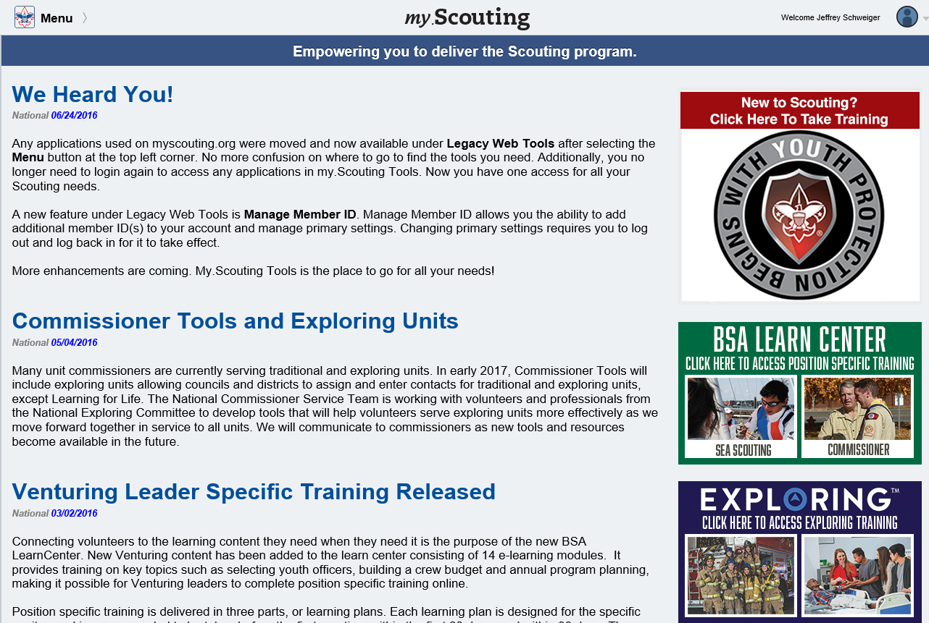

Slide 72
Online Commissioner Tools Training Modules
Accessing Commissioner Tools - demonstrates how to access the tools and provides a brief overview of the Commissioner Tools
The Units Tab in Commissioner Tools - describes the specifics of the features found on the Units Tab and how to navigate this tab and the records of contacts for units.
Entering a Unit Contact in Commissioner Tools - discusses the basic contact information and the entry point for creating either a Simple Assessment or a Detailed Assessment.

Slide 73
Online Commissioner Tools Training Modules
Unit Assessment Scoring Matrix in Commissioner Tools - defines the scoring parameters used to complete an assessment.
Entering a Simple Assessment in Commissioner Tools - shows the shortest and simplest entry to report a unit contact.
The Detailed Assessment for Commissioners Tools - This video will discuss the how, why, and when to complete a Detailed Assessment and its variations, including a collaborative assessment

Slide 74
Online Commissioner Tools Training Modules
The Collaborative Assessment for the Unit Key 3 in Commissioner Tools - describes to the Unit Key 3 the process involved with the Collaborative Assessment creation, steps and procedures. It should be reviewed by Commissioners and Unit Key 3 PRIOR to beginning the Collaborative Detailed Assessment process.
The Reports Button for Commissioner Tools - covers reports that commissioners can choose to view and download a variety of district-level reports.
Using the Discussion Tab in Commissioner Tools - discusses the dialogue capability for collaboration among commissioners at the same organizational level.

Slide 75
Online Commissioner Tools Training Modules
The Roundtable Tab in Commissioner Tools - discusses planning future roundtables and documenting unit roundtable attendance and participation
Using the Commissioner Profile Tab - discusses the summary of assigned units, contacts made in the previous four months and unit contacts made by a specific commissioner.
Creating Pivot Tables - covers creating Pivot Tables which provide an interactive way to summarize, analyze, and explore large amounts of data.
Commissioner Tools Pivot Table Documentation - provides written support for the Creating Pivot Table module

Slide 76

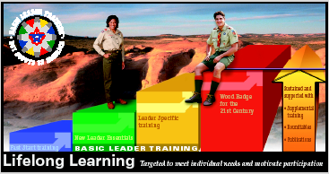



Other Training
Trained
New Leader Essentials
Leader Specific
New Leader Essentials
Leader Specific
Introduction to Outdoor Leader Skills
21st Century Woodbadge
New Leader Essentials
Leader Specific

Slide 77
Commissioner Awards and Recognition
Requirements online and in the Administration of
Commissioner Service Manual, No. 34501
Notes:
Why do we have these meetings?
To motivate commissioners to do their job
To support them and provide feedback
To hold commissioners accountable for high level of quality service
To plan, train and report status of units
Work toward the vision of success

Slide 78

Arrowhead Honor
Commissioner’s wear the Arrowhead
Requirements
  Fill out Unit Commissioner’s Worksheet
  Conduct membership and leadership inventory for assigned units
  Attend six staff meetings
  Participate in Charter renewal process
  Participate in Charter presentation
Completed within 1 year
Notes:
Only commissioners may wear the Arrowhead. It is a visible sign of competence. Arrowhead Honor projects are measurements of performance. Successful completion is the result of good training. The Arrowhead Honor signifies a high level of performance and the ability to put training into practice.
Review the latest requirements for the Arrowhead honor and projects.
Should be completed within a year of being recruited
Roundtable staff members earn the Scouter’s Training Award.

Slide 79

Commissioner’s Key
Requirements
  Complete Basic Leader Training
  Complete personal coaching orientation
  Earn the Arrowhead Honor Award
  Complete 3 years as a registered Commissioner over a 5 year period
Notes:
Requires 3 years of tenure as a Commissioner
Discuss requirements for Award.

Slide 80
Commissioner Certificate of Commendation
Official recognition of a commissioner who has performed in a commendable manner
Has earned the Arrowhead Honor
Approved by the administrative commissioner with best knowledge of the nominees work
May be awarded multiple times
Notes:
Requires 3 years of tenure as a Commissioner
Discuss requirements for Award.

Slide 81

Commissioner Award of Excellence in Unit Service
Be Knowledgeable of and use Commissioner Tools
Using the CT Unit Service Plan to improve Unit Performance over two years
Accomplish on-time recharter for two years
Improve Youth Retention percentages over two years
Meet Unit Contact requirements using Commissioner Tools
Attend one commissioner continuing education event as a participant or staff
Notes:
Requires 3 years of tenure as a Commissioner
Discuss requirements for Award.

Slide 82

Distinguished Commissioner Service Award (DCSA)
The Distinguished Commissioner Service
Award is the highest recognition that can
be given to a commissioner.
  It recognizes an individual who has consistently engaged in distinguished and exceptional commissioner service resulting in significant, positive impact on youth, units, and a district and/or council.
  It recognizes outstanding and exceptional service beyond the expectations for that commissioner position.
Notes:
Requires 3 years of tenure as a Commissioner
Discuss requirements for Award.

Slide 83
Distinguished Commissioner Service Award (DCSA) (cont,)
  The candidate recipient must be nominated
  by a currently registered adult member of the BSA. Commissioners may not nominate themselves.
  The candidate recipient must be currently registered as a commissioner or have served as a commissioner within the last five years.
  The candidate recipient shall possess the Commissioner Key.
Notes:
Requires 3 years of tenure as a Commissioner
Discuss requirements for Award.

Slide 84
Unit Charter Renewal Process (effective Jan 1, 2017)
Units not rechartered by the end date on the charter will be Separated from Scouting
A separated unit ceases to exist, CANNOT legally operate
Members are dropped from the BSA
BSA insurance ceases
Advancement, achievements, and recognitions cannot take place including the Eagle rank
Tenure in rank for leadership positions stopped
Youth and adults no longer registered as members of the BSA
Notes:
Requires 3 years of tenure as a Commissioner
Discuss requirements for Award.

Slide 85
Unit Charter Renewal Process
Unit no longer appears on membership reports
Access to records retained for 30 days only to facilitate restoring the unit
Separated units will have 12 months to become re-established as a separated-reregistered unit
Notes:
Requires 3 years of tenure as a Commissioner
Discuss requirements for Award.

Slide 86
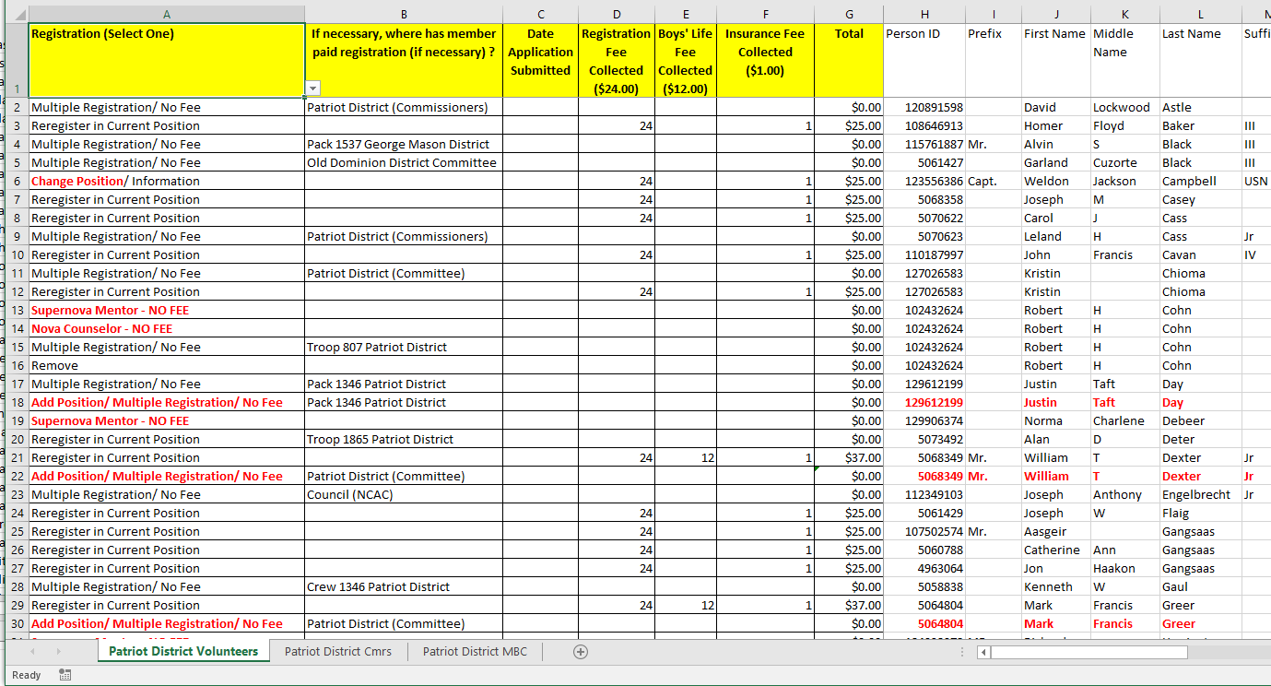
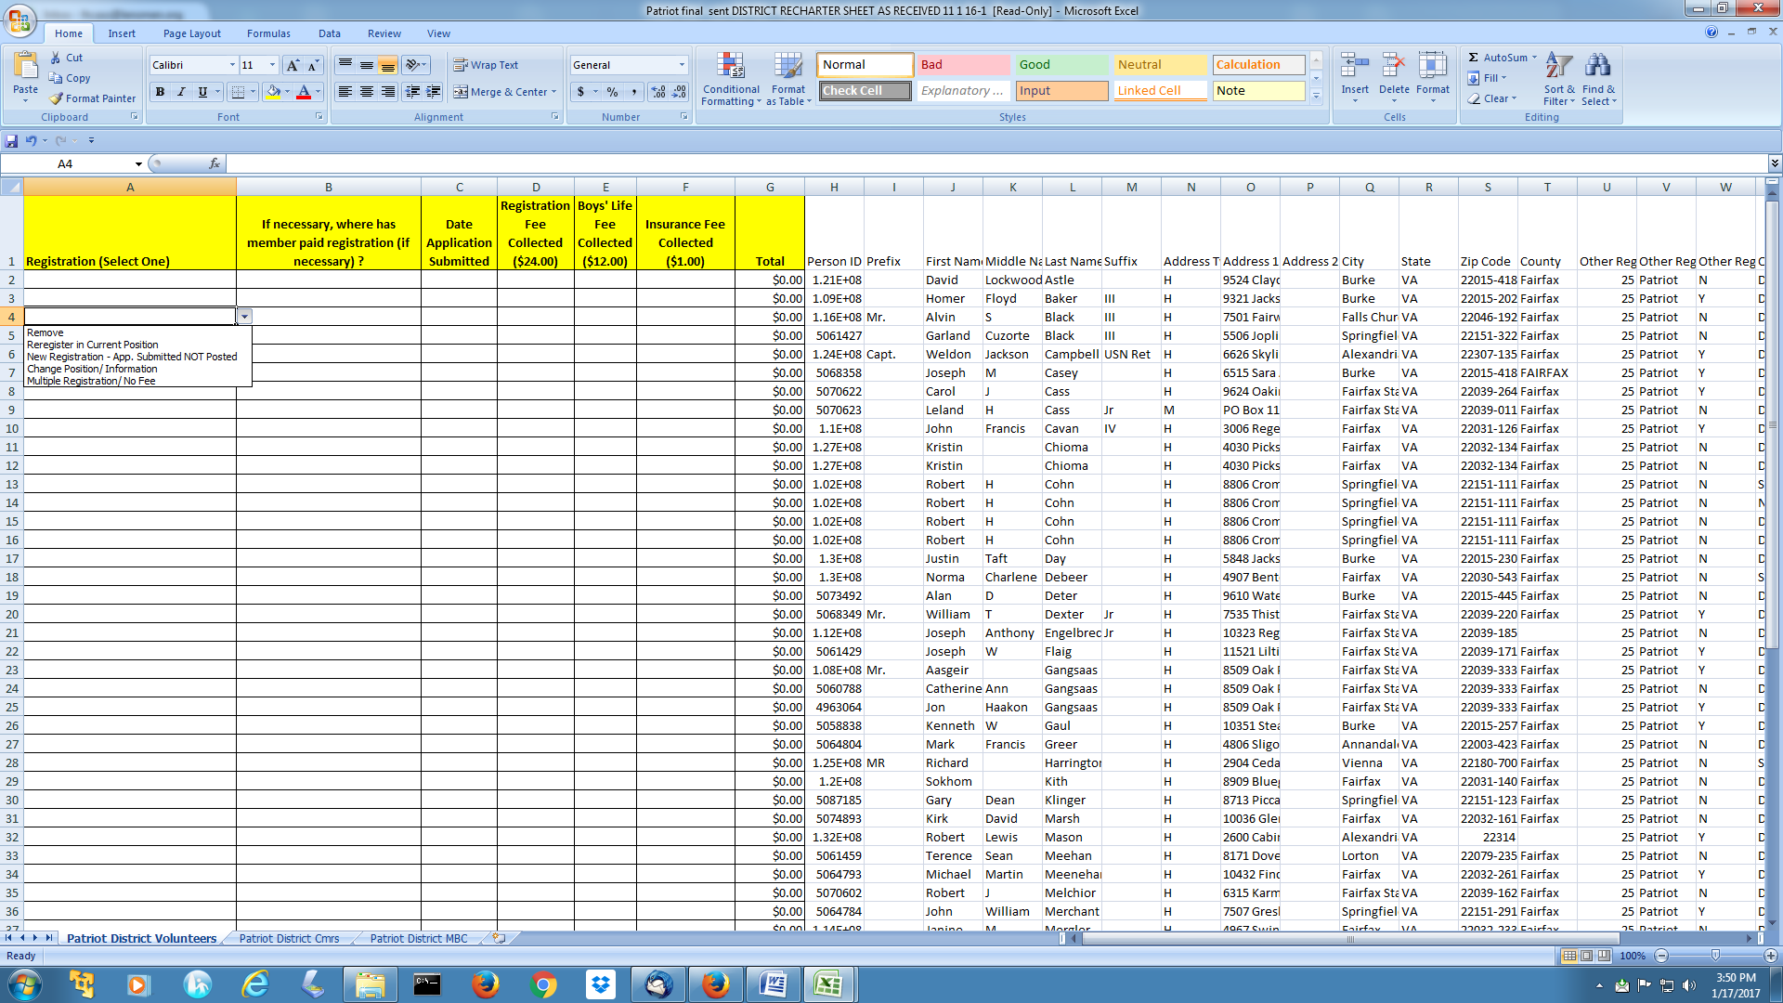
District Non-Unit Renewal
Renewal Responsibility:
District Chair
Normal Leads: Vice Chair – Committee
District Commissioner or ADC – Commissioners
MB Dean – Counselors
Key Tasks:
Synch with Nominating Committee
Identify leaders (VC, Chairs, ADC’s, UC’s
Update YPT
Pay on-line (or check)
Confirm paid position
Confirm all positions
Complete/submit spreadsheet (Changes in red)
Committee Lead
MB Dean Lead
Commissioner Lead

Slide 87
Commissioner Meetings
Most of the business of the BSA is conducted in meetings
Notes:
Why do we have these meetings?
To motivate commissioners to do their job
To support them and provide feedback
To hold commissioners accountable for high level of quality service
To plan, train and report status of units
Work toward the vision of success

Slide 88
Commissioner meetings
Council Commissioner’s Cabinet
Council Key 3 Meeting
Commissioner Service Area Meeting
District Key 3 Meeting
District Commissioner Staff Meeting
District Committee Meeting
Roundtables
Notes:
These are the main meetings a District Commissioner needs to attend. Assistant District Commissioner’s need to be aware of these meetings as well sot that they can fill in if the District Commissioner is unable to attend.

Slide 89
Council Commissioner’s Cabinet Meeting Agenda
  The Agenda may include:
    Training
    District by district reviews
    Discussion of Council activities
    Reports on health of units
    Roundtable activities
    Review of potential dropped units
    Problem solving
Council calendar--youth events, council events like FOS, basic commissioner
Notes:
The Agenda may include:
Training
District by district reviews
Discussion of Council activities
Reports on health of units
Roundtable activities
Review of potential dropped units
Problem solving
Training--how do you decide your training topic?
Analyze district and assign that DC a topic his district needs to improve in--ask that it be in ppt so that each district can use it. Keep a library of them so that they can be reused as needed. Don’t forget the annual commissioner orientation or other trainings that national might send.
Review of work in progress--UC recruiting, re-charter, Journey to Excellence status, unit visits
Council calendar--youth events, council events like FOS, basic commissioner training among districts
Problem solving--once a year ask DC to come up with a list of problems they have encountered. Divide into groups to brainstorm possible solutions and share results
Work toward vision of success--working on the action plan you created

Slide 90
Commissioner meetings
District Key 3
  Meet on a regular basis – at least monthly
  Includes District Executive/Director, District Chairman, District Commissioner
Notes:
A typical Key 3 meeting is an informal meeting to plan, strategize, and openly share needs and concerns of the district. One or more of these topics may be discussed:
• Balanced membership and unit growth
• Promised help to units to achieve the Journey to Excellence Award
• Training of unit and district personnel
• Camp promotion and outdoor program
• Advancement in packs, troops, and crews
• Unit problems
• Unit rechartering
• Setting plans and reviewing the district plan book (on a regular basis)
• Friends of Scouting (finance)
• Current activities
• Chartered organization relationships
• Personnel needs of the commissioner staff and district committee
• Planning the district meeting agenda
• Reviewing A Self-Evaluation Guide for Successful District Operation (annually)

Slide 91
Commissioner meetings
District Commissioner Staff Meeting
  Do not hold in conjunction with the District Committee Meeting or other district meetings
  Normally 90 minutes, never more than two hours
  Is sharply focused on unit needs, not district/council needs and projects
  ADC breakout sessions to focus on individual unit needs
  Validate RT attendance
Notes:
Chaired by the District Commissioner. This is your meeting this where you set the stage for how Unit Commissioners and Assistant District Commissioners perform their duties in service to their units. Make sure there is time in the meeting for the Assistant District Commissioner and the Unit Commissioners to review the health of EVERY unit they work with. The most important 60 minutes of this meeting is the meeting between the ADC and his/her UCs. There they can work on individual unit problems, share successes. The ADC provides support, encouragement, positive feedback (do the negative in private). Feedback should be a regular part of the ADC-UC relationship--powerful motivator. The ADC holds the UC accountable for visits. UVTS is a good tool and can reduce the amount of reporting time allowing more time for trouble spots.
A Training topic is also a critical part of this meeting. Make sure you have one every month!
Fellowship and recognition among commissioners is important and are critical to retention of commissioners. Many people feel this is a thankless job--let’s not forget to do it here!
Calendar information—Make sure that they have a copy of the District calendar. Put reminders of significant events for the month on your agenda.

Slide 92
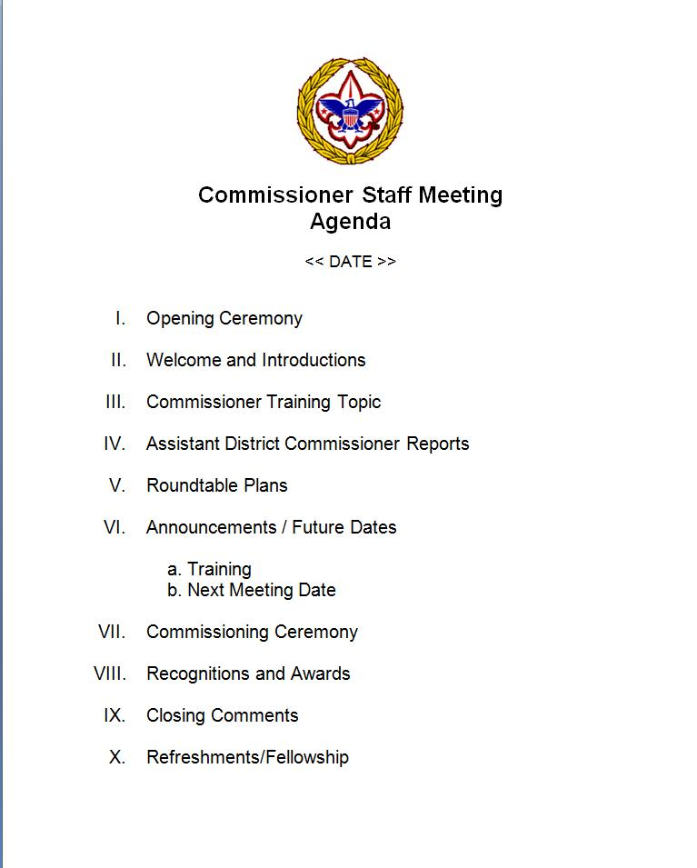
Some Best Practices
Notes:
Have Assistant District Commissioners assist with Opening and closing
ALWAYS have a training topic –
Have Assistant District Commissioners or Unit Commissioners present
ALWAYS have a breakout and then have the ADCs give a summarized report
Make a big deal out of recognitions and awards
Consider having food and refreshments at the meeting

Slide 93
Evaluation
How is commissioner work measured?
  Units have effective unit leaders?
  Boys involved in good program?
  Active unit committees?
  Chartered organization relationships?
  Reregister on time?
  Membership increase?
  Happy to see me come?
  Active in district events?
  Quality Unit?
Notes:
Evaluation.
How is commissioner work measured? ADCs measure both their own and their unit commissioners’ effectiveness by asking these questions:
Do my units have effective unit leaders?
Do my units have boys enthusiastically involved in a good unit program?
Do my units have active unit committees?
Do my chartered organizations feel a sense of ownership for their units, and do unit volunteers have good relationships with their chartered organizations?
Do all units reregister on time?
Do units show membership increases?
Are my unit leaders happy to see me visit, or are they counting the minutes until I leave?
Are my units reasonably active in district events?
Have my units met the Quality Unit criteria?

Slide 94
Evaluating District Commissioners
NCAC Goal: Deliver World-Class Unit Service
Leadership: You set expectations, measure performance & attain service goals
Contacts:
100% Units contacted (100% Detailed Assessments)
100% New Units contacts (100% DA’s)
>50% Units JTE Gold contacts
JTE: District Unit Performance & District Gold
Articulate unit needs for District Committee - monthly

Slide 95
Evaluating District Commissioners
Charters & Registrations:
100% to Registrar 30 days prior to expiration
Defects cleared <30 days
Commissioner Recruitment & Training
100% Units with Commissioner
100% with position specific CBT (<45 days)
Effective Roundtables with >unit attendance
Commissioner Recognition increase
Unit’s: Retention, Membership Growth, Unit Leaders Trained increase

Slide 96
Information is Essential
To do any job, you need information.
  Commissioner Tools Reports
  Council and District Reports
  Websites –National, Council, NCAC Commissioner
  Email networks and blogs

Slide 97
District Totals Report
Notes:
This is a report that can be provided to you by your district executive. It gives you a picture of unit membership month to month. It also shows which units are in your district so that you can make sure you have a commissioner assigned to each unit.
If possible provide copies of this report for their district to each person present.

Slide 98
Know Your Area
Geography
Demographics
  Age Distribution
  Economic Status
  Ethnicity
  Religious Organizations
Locating the Boys

Slide 99
Understanding Your Units
  Special Needs
    High turn-over area
    Largely single parent area
    Non-English speaking parents
    Special needs youth
    Church youth group

Slide 100
Early Warning Signs
Good Signals
Meetings well attended
Program planned in advance
Good advancement
Fully uniformed unit
Constant membership growth
Unit recharters on time
…
Unit commissioner always there if needed
Danger Signals
Irregular meetings
No written program
Little advancement
Few in uniform
No new members
Unit charter lapses
…
Commissioners? What’s a commissioner?

Slide 101
Program Response
COLOR | DEFINITION | PROGRAM PLAN
GREEN | NEARLY AN IDEAL SITUATION | KEEP DOING WHAT YOU ARE DOING; WORK THE PLAN
LIME | MAKING PROGRESS TOWARDS THE IDEAL UNIT | PLAN COMPLETED; NEEDS TO BE WORKED
YELLOW | TYPICAL UNIT; COULD BE IMPROVED | COMPLETE THE PLAN; COMMISSIONER INVOLVEMENT ESSENTIAL
ORANGE | NEEDS IMPROVEMENT; WATCH CAREFULLY | MEET WITH UNIT TO DEVELOP THE PLAN
RED | WEAK SITUATION; NEEDS IMMEDIATE ACTION | URGENT – COMMISSIONER INTERVENTION REQUIRED

Slide 102
Wrap up

Slide 103
DC/ADC Responsibilities:
Recruit
Instruct
Listen
Coach
Recognize
Notes:
The Assistant District Commissioner helps recruit the right people as Unit Commissioners.
An Assistant District Commissioner also provides clear instructions and specific ideas for their staff.
They listen to what people say and feel. They don’t play favorites.
Assistant District Commissioners are responsible for coaching unit commissioners through real unit problem solving situations and make sure that all Scouters are treated with courtesy and dignity.
Assistant District Commissioners find ways to praise each unit commissioner as often as they can for specific achievements.
Most importantly, the Assistant District Commissioner does not try to take over for their unit commissioners but is always ready to support or help them to be successful. In instances where there is a shortage of Unit Commissioners, The Assistant District Commissioner should be ready to serve units as a Unit Commissioner as well.

Slide 104
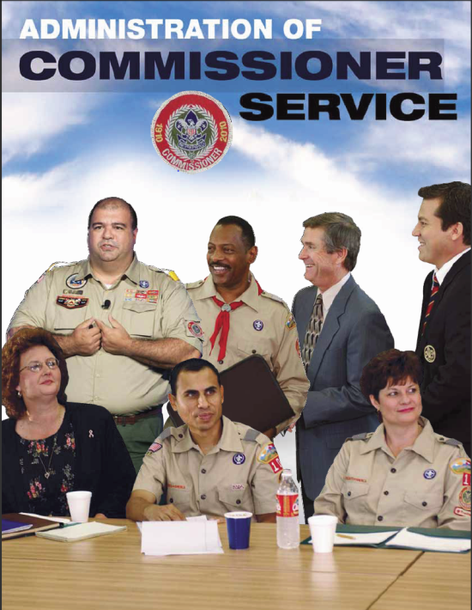
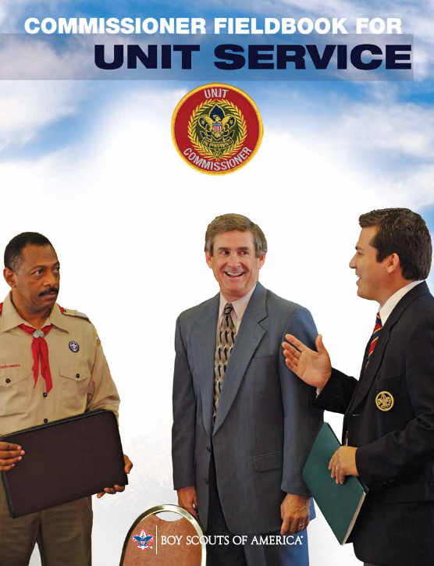
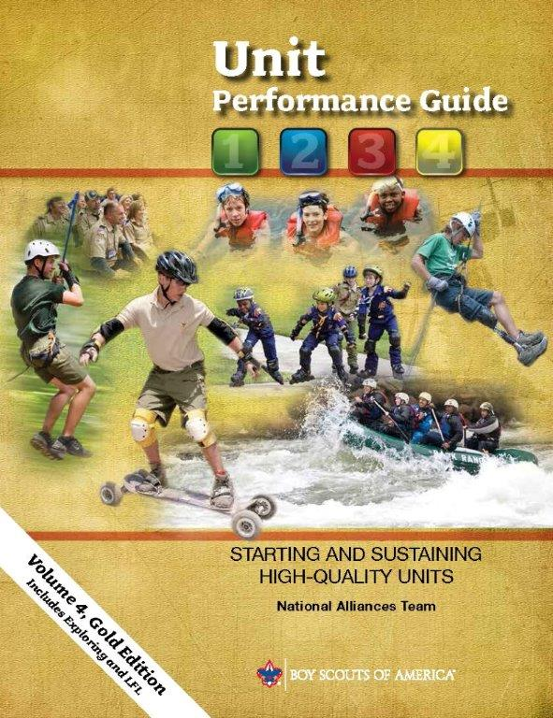
References for this training
Notes:
These resources are tools that every commissioner should have to help them serve their units. They can be found on the commissioner resources page of the national website. Download them, read them and refer to them often,

Slide 105
Questions?
Comments!

Slide 106


