Slide 1

Welcome!
Make yourself comfortable.
We will start soon.
Notes:
Put this up as a lead-in slide until about 15 minutes before starting.
Put all the staff’s names on the instructors slide (#6)
CF = Commissioner Fieldbook, the commissioner’s Bible.
Version 3.5, November 2016 – Enhanced JTE and Commissioner Tools Slides. Added information on online Commissioner Tools training
Version 3.4, October 2016 – Updated JTE slides to 2017. Enhanced slides on Commissioner support to Exploring. Rewrote slides on Commissioner Awards
Version 3.3, October 2015 – Updated JTE example to 2016. Included slides on Commissioner support to Exploring.
Version 3.2, August 2015 – Minor changes made to rechartering section.
Version 3.1, April 2015 – Rewritten to be based on and enhance the January 2015 of the National Council CBT deck. with JTE, and annual commissioner service plan with Unit Service Plan. Revised rechartering section to reflect current rechartering program.
Version 2.0, December, 2014 – updated to show Scout Oath and Laws to be effective for Cub Scouts, June 1, 2015. Updated section on Commissioner Tools/Unit Service Plan.
Removed UVTS section. Added references to Explorer Post support (rechartering and JTE) as implemented in NCAC. Revised Commissioner responsibilities to replace quality unit award
with JTE, and annual commissioner service plan with Unit Service Plan. Revised rechartering section to reflect current rechartering program.
Version 1.3d, September, 2014 – Updated JTE to 2015, section on Commissioner Tools/Unit Service Plan added, Commissioner Training/Service Awards/Resources revised.
Version 1.2, December, 2014 – updated to show Scout Oath and Laws to be effective for Venturing January 1, 2014.
Version 1.1, October, 2013 – Updated JTE info to 2014.
Version 1.0. This PowerPoint presentation is authored by Jeff Schweiger, who initially started his commissioner service as an assistant scout roundtable commissioner in the Great Dan Beard District, Suffolk County Council, NY, prior to the position being renamed scout roundtable staff. He has also served as a unit commissioner and assistant district commissioner for the George Washington District, National Capital Area Council (NCAC) and presently serves as the assistant district commissioner (training) for the Colonial District, NCAC, commissioner training coordinator, Virginia Central Service Area, NCAC, and as an assistant council commissioner for NCAC. This presentation is a major enhancement of the Unit Commissioner Basic Training presentation published by the National Council, BSA in 2012. He was assisted by Jon Baake, assistant council commissioner for training, NCAC. He can be reached at jschweig@ix.netcom.com.
Many of the enhancements were based on an earlier Commissioner Basic Training presentation used throughout the US authored by George Crowl, who has served as a neighborhood commissioner (he’s old!), assistant district commissioner for training, district commissioner, council commissioner, Scout roundtable staff, and district commissioner again, and now a unit commissioner in the Rising Star District in Houston, TX. If you have comments or questions, please contact him at George@Crowl.org.
Various updates to George Crowl’s presentation are acknowledged from Robert M.”Bob” Shockley, Assistant Council Commissioner, Commissioner College Dean, Doctor of Commissioner Science, Los Angeles Area Council, Rick Hillenbrand, National Capital Area Council, Old Dominion District Commissioner, NCAC, Greg Bird, Mattaponi Assistant District Commissioner, NCAC and Robert F Naples, Assistant Council Commissioner, Occoneechee Council.

Slide 2
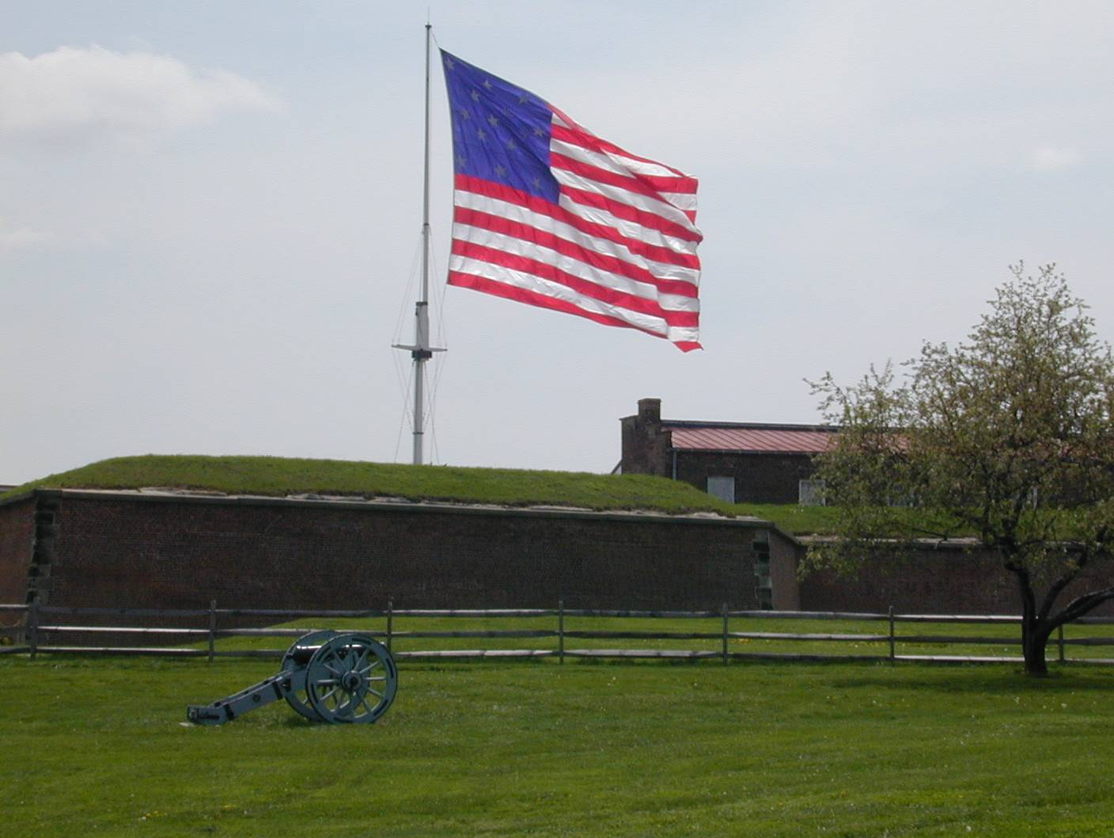







Commissioner
Basic
Training
Notes:
This is the view of Ft McHenry which might have helped inspire the writing of the Star Spangled Banner. Please stand and join in the Pledge of Allegiance.

Slide 3

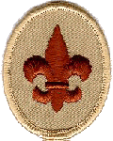




The Scout Oath
  On my honor I will do my best
  To do my duty to God and my country
  and to obey the Scout Law;
  To help other people at all times;
  To keep myself physically strong,
  mentally awake, and morally straight.
Effective June 1, 2015 for Cub Scouts
Notes:
Do we have someone who’s familiar with this Oath?
_____________________
Thank you, and now we’re ready to begin the day!
You each have been provided a schedule for the day. It’s our intention to try to deliver punch and value within the time specified but please do ask questions or pose issues as we work through the day. We’ll either answer the issue immediately or place it in parking for discussion during the planned open forum periods.

Slide 4
Scout Law
A Scout is:
Trustworthy,
Loyal,
Helpful,
Friendly,
Courteous,
Kind,
Obedient,
Cheerful,
Thrifty,
Brave,
Clean,
and Reverent
Notes:
Is there a Boy Scout Leader here who’ll lead us through the Law?

Slide 5
Introductions
Teaching Staff
  Commissioner ➢ Commissioner
  Commissioner ➢ Commissioner
  Commissioner ➢ District Executive
  Commissioner
Admin Staff
  TBD
Notes:
Introduce the staff
Name
What they do in Scouting
Commissioner experience, tenure, training experience
Ask the students to introduce themselves
Name
What they do in Scouting
Scouting experience
Point out that we will all learn from each others’ experience during this training
We want to share our knowledge, pool our resources

Slide 6
Introductions
Name
Present job/Commissioner position in Scouting
Previous positions held
Tenure
Awards earned
Notes:
Ask the students to introduce themselves
Name
What they do in Scouting
Scouting experience
Point out that we will all learn from each others’ experience during this training
We want to share our knowledge, pool our resources

Slide 7

Basic Training
January 2015

Slide 8
Why We Are Here
To help units serve more youth better, through Scouting!
Notes:
The mission of unit service is to help units serve more youth better through Scouting. This is why we are here.
So, at the end of this training you should:
Understand the 4 objectives of unit service
Understand the four-function concept of council and district operations
Understand the commissioner’s role in supporting units
Understand the primary tools available to unit commissioners
> The Unit Performance Guide methodology
> The Unit Key 3
> The Unit Service Plan
> Commissioner Tools
Understand the methods and steps of good unit program planning
Understand commissioner priorities and how to be an effective leader yourself
This training will examine:
What a Commissioner is
What a Commissioner does
How a Commissioner does it.

Slide 9
Commissioner Historical Dates
1908 Baden-Powell appoints the first volunteer commissioners.
1910 Daniel Carter Beard is named national commissioner.
1911 A national field commissioner is named.
1914 The wreath of service is added to the commissioner insignia.
1931 The district commissioner position is introduced.
1943 A commissioner’s training course is introduced.
  The Commissioner Service manual is introduced.
1951 First commissioner training at Philmont Training Center.
1952 Commissioner Arrowhead award introduced.
1989 The Distinguished Commissioner Award is introduced.
2003 The national commissioner Web site is activated.
2008 Tico Perez is named national commissioner.
  Area and regional commissioner positions are established.
  The College of Commissioner Science doctorate square knot is introduced.
2010 Commissioners celebrate 100 years of service to units!
Notes:
This slide summarizes many of the historical milestones of BSA Commissioners Service.

Slide 10
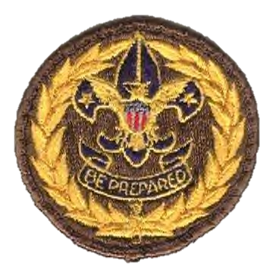

Commissioner Service
Notes:
In the early days of the BSA, units were organized by resourceful individuals who sometimes had to acquire the materials from England and other places to make scouting happen. These first organizers were commissioners.
In 1916 some of these commissioners were asked to become Scout Executives. A few accepted the position and the Field Executive position was born. This shift eventually led to the separation of the roles of the executive and the commissioner. This began a partnership between volunteers and professionals that exists still today.
The position of Commissioner is one of the oldest in Scouting and is the origin of the professional Scouting positions, which is why professional Scouters wear the Wreath of Service as well.
As councils grew, more help was needed. The councils began to divide the workload into manageable districts where the district commissioner structure emerged.
In the 1940's a need for unit serving commissioners was apparent. The workload on District commissioners and Deputy DC's was too heavy, and a more personal touch was needed. The position of Neighborhood Commissioner was created to fill this gap. These Neighborhood Commissioner s would usually serve only up to four units.
By the 1960's the terminology changed as did the structure. Neighborhood Commissioners were now known as Unit Commissioners and only served a maximum of three units. All Deputy positions were changed to Assistant. Commissioner Service as we know it today began to take shape.
Positions today include the National Commissioner, Regional and Area Commissioners. Each Council has a Council Commissioner and Assistant Council Commissioners. At the District level you will find most of BSA's Commissioners serving, whether as District Commissioner, Assistant District Commissioners, Roundtable Commissioners, or Unit Commissioners. The Unit Commissioner being the most important of all the rest because of the unit service they provide. Without that service, we would have no reason to have the other positions.

Slide 11
Simple and Unified Approach
Notes:
Sometimes, in this age of new technology and new initiatives, we don’t always see the forest for the trees. A while back, the National Commissioner Service task force met to focus on where we have been as a commissioner corps and, more importantly, what could be done to make the duties of unit commissioners and the administrative commissioners who support them easier.
The theme that they kept coming back to was the need to make the expectations for volunteers more manageable and easier to achieve. In other words, there needed to be a simple and unified approach to supporting the commissioner corps. That approach begins with our vision for Unit Service:
Unit Service will enable units to serve more youth better by providing an adequate number of trained commissioners who provide a link to district operating committees in support of a quality unit program.
Remember that. Everything else we talk about during our time together will be related to that vision.

Slide 12
Our Four Objectives
Supporting unit growth through the Journey to Excellence
Contacting units and capturing their strengths and needs in Commissioner Tools
Linking unit needs to district operating committee resources
Supporting timely charter renewal
Notes:
During an analysis by the National Commissioner Service Task Force, they identified at least 38 different tasks that were asked of unit commissioners. That’s hardly a simple job description. After all was said and done, it was concluded that the BSA needs to have unit commissioners focus on four primary areas:
Supporting unit growth in Journey to Excellence: JTE measures performance characteristics that unlock the door to a successful unit. We should analyze the unit’s program and identify JTE areas where help is needed to move the unit to a higher level of JTE success. As we will discuss later, a new and revised Annual Service Plan will help support this task.
Contacting units and capturing their strengths and needs in Commissioners Tools: Our core task remains making significant contacts with units over the course of a year. Commissioner Tools enables commissioners to develop a customized Unit Service Plan to address identified needs.
Support unit growth in Journey to Excellence criteria: JTE measures performance characteristics that unlock the door to a successful unit. We should analyze the unit’s program and identify JTE areas where help is needed to move the unit to a higher level of JTE success. As we will discuss later, the Unit Service Plan will help support this task.
Linking unit needs to district operating committee resources: The concept of linkage is critical to our execution mission. In the best of worlds, the unit commissioner is a link to the subject matter experts and resources who reside at the district committee level. Where those subject matter experts do not yet exist, our commissioners should support the efforts of the district Key 3 to recruit and deploy the right resource specialists. The Unit Service Plan captures the specifics of the linkages that will be established.
Supporting timely charter renewal: Commissioners own unit retention. A quality program attracts youth and adults to Scouting and also is a key factor in retaining them. So in fulfilling our mission, helping units serve more kids better through Scouting, we support the district operating committee’s efforts to build membership and meet our responsibility to increase unit retention. In addition, effective and timely charter renewal is also a key part of retaining units.
We will be talking about how commissioners actually do these four things.

Slide 13
Supporting Unit Growth
In the Journey to Excellence.
Notes:
The first objective is Supporting unit growth in the Journey to Excellence. As unit commissioners, we need to be sure we fully understand the Journey to Excellence and what it can do for units.
Fundamentally, “Journey to Excellence” is simply the name we’ve given to a process that helps units continually improve the quality of the program they deliver to the youth they serve.

Slide 14
Journey To Excellence
"Scouting's Journey to Excellence" is the BSA's council performance recognition program designed to encourage and reward success and measure the performance of our units, districts, and councils. It is meant to encourage excellence in providing a quality program at all levels of the BSA.

Slide 15
Journey To Excellence
Performance measurement and recognition program that provides:
  A method for RECOGNITION
  A framework for PLANNING
  A source of GUIDANCE
Quality program, sustainability, and growth must all be in balance for success to truly be achieved.

Slide 16
What is its Purpose?
Encourage continuous improvement
Measures performance vs. process
Rewards unit success
Achieves BSA mission
Help unit leaders understand
Notes:
What is its Purpose?
Encourage continuous improvement.
Measures performance vs. process.
Rewards unit success
Achieves the BSA mission of serving more youth through a higher‐quality program.
Help unit leaders understand the key factors that improve program.

Slide 17
Journey To Excellence
Utilizes a balanced scorecard approach
Key performance indicators to measure outcomes versus process
Not only measures growth, but looks at the kind of experience the youth are having
Explorer Posts are included in JTE

Slide 18
What JTE brings to a Unit
Framework for planning for the year
Method for evaluating the Unit
Provides guidance in areas where they might do better
Specific guidelines and standards of what is good performance
Early warning of potential problem areas
Recognition for good performance
Benchmarking to get ideas and tips from other good units
Notes:
When unit leaders ask why they should participate in the Journey to Excellence. Tell them that it provides a framework for planning the year. The Journey to Excellence standards are based on what successful units do to continually improve and If your unit works to achieve gold or silver Journey to Excellence, you’ll have a strong and active program.
Let them know that it is a method for evaluating their unit. The Journey to Excellence provides tangible measurements based on things they are likely already tracking, such as how many campouts they have, how many youth are advancing, etc., and uses simple ways to calculate your performance.
The JTE also provides Guidance in areas where the unit might do better. As they track their performance against the Journey to Excellence standards, they can easily see where they could do better.
JTE establishes specific guidelines and standards of what is considered good performance. Journey to Excellence has specific, simple measures to help them. They can easily compare what they are doing against the standards.
JTE is a great tool that provides Early warning of potential problem areas. They can track any areas where the unit is not performing as they might like and have plenty of time to make corrections.
The Journey to Excellence is a Recognition for good Scouting. They can proudly receive their bronze, silver, or gold recognition for their Scouting unit for the year.
The Journey to Excellence is a great Benchmarking tool to get ideas and tips from other good units. They can receive help and best practices in areas where other units have met the gold standard. In the areas where they are doing well, they can give help and ideas to other units.

Slide 19
Journey To Excellence
  Gives national standards
  Advancement
  Camping
  Service projects
  Training
  Membership
  Retention
  Leadership
  Budget
Bronze, Silver, and Gold award levels
And did the Unit show improvement?
Assessment made annually in December
Notes:
Pass out and share the National Quality Unit Award score sheets for pack, troop, team and crew operation. Participants must recognize, from the discussion, that they represent desirable and important standards for quality unit operation.
ALL UNITS:
*1. Trained unit leader (CM, SM, VC, NL). For Cub Scouts: 50% of DL/WL trained.
*2. Trained assistant unit leader (CA, SA, VA, NA). One leader appointed in charge of youth protection training.
*4. Recharter on time.
7,6,6,7. Conduct a service project for the sponsoring institution or the community.
10,9,9,9. Renew the charter with equal or greater membership than last year.
The remainder of the requirements vary by program. They are:
CUB PACKS:
*3. Attend council Cub Day Camp, Resident Camp, family camp, Webelos overnighters, or other approved outdoor activity.
5. Nine pack meetings per year, Summertime Pack Award.
6. Have an active Tiger Den in the pack.
8. Have 70% of the boys advance during the year (or 10% more than last year).
9. 100% of the boys receive Boy's Life, or increase by 10% over last year.
SCOUT TROOPS:
*3. Have six outdoor activities and attend a BSA summer camp.
5. Prepare, publish and present an annual plan.
7. Have 60% of the boys advance during the year (or 10% more than last year).
8. 100% of the boys receive Boy's Life, or increase by 10% over last year.
10. Conduct troop JLT and monthly Patrol Leader's Council meetings.
VARSITY TEAMS:
*3. Participate in an organized league sport, or an Ultimate Adventure.
5. Prepare, publish and present an annual plan.
7. 100% of the boys receive Boy's Life, or increase by 10% over last year.
8. 50% of the boys earn the Varsity letter.
10. Conduct youth leadership training for the team officers.
VENTURE CREWS:
*3. Conduct an elected officer's seminar.
5. Conduct a super activity.
6. Conduct a minimum of two meetings or activities per month.
8. Conduct a open house, first-nighter or other recruiting effort.
10. Crew committee meets at least four times each year.

Slide 20

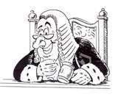


Journey To Excellence
Your Role in JTE as a Commissioner
  You’re not an Umpire
  You’re not a Judge or the police
  You are a friend, a mentor and a coach
  And maybe help a bit with scorekeeping
20
Notes:
You’re not an Umpire
You’re not a Judge or the police
You are a friend, a mentor and a coach
And maybe help a bit with scorekeeping
Hand out and share the current Journey to Excellence Performance Award commitment forms for units. Participants must recognize, from the discussion, that they represent desirable and important standards for quality unit operation.
Discuss how a Unit Commissioner can assist the unit in achieving the bronze level for each of the items of the JTE and to strive for the Silver or Gold levels The final step is for them to understand the importance of recognizing the unit in a public setting of their accomplishments. (See the reference to the award process on the commissioner website at www.scouting.org/commissioners.)
The final step is for them to understand the importance of recognizing the unit in a public setting of their accomplishments.

Slide 21
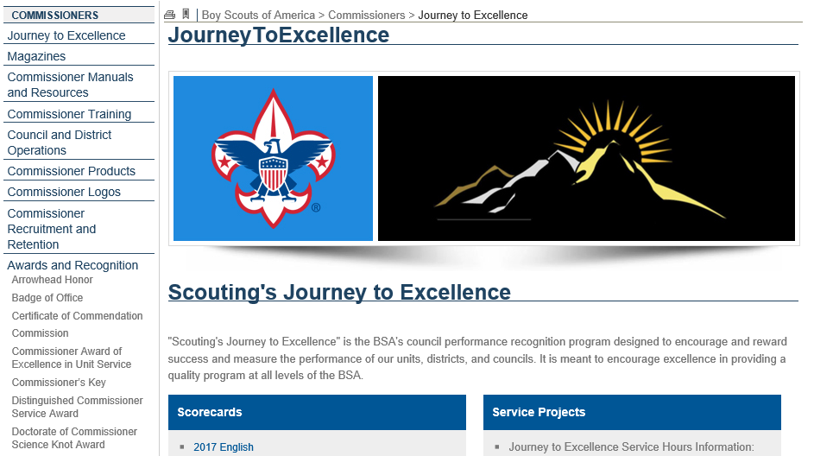
JTE Scorecards
Notes:
On the National Commissioner’s website, you will find much more information on the Journey to Excellence and can download the latest scorecards for the units you serve. Check out this page and all the other pages on the national website as often as you can so that you have the latest information at your disposal.
And as we’ll see, the Unit Service Plan and Commissioner Tools were both designed to support continuous improvement and our Journey to Excellence process.

Slide 22
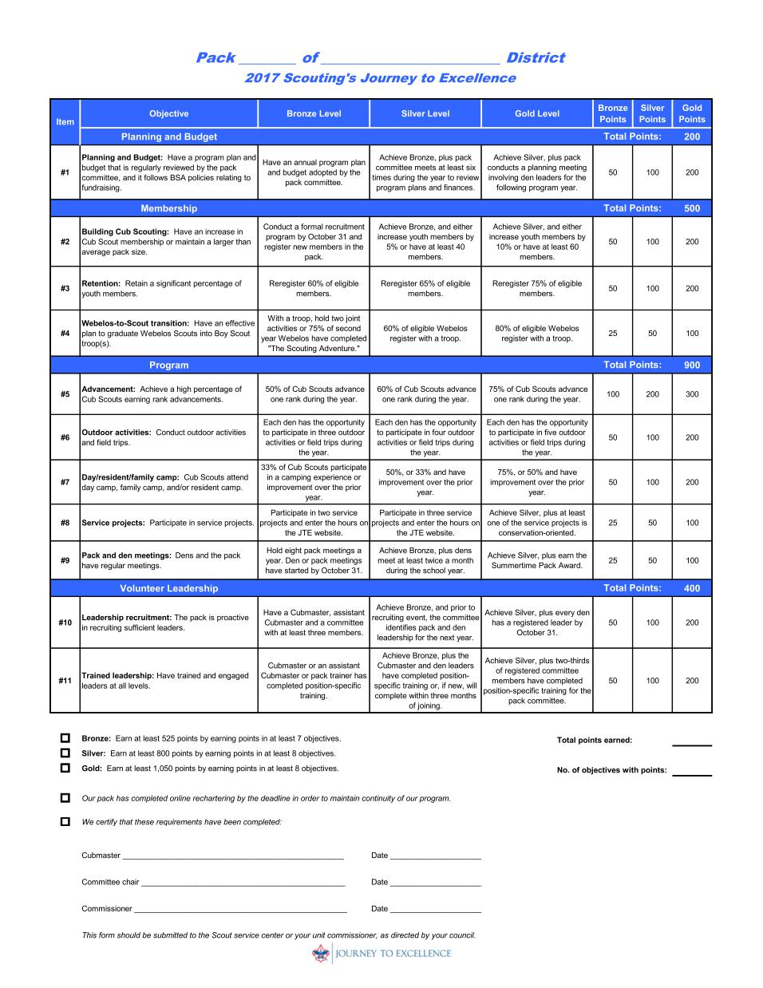
Journey to Excellence - Pack
Notes:
Pass out and share the JTE score sheets for pack, troop, team and crew operation. Participants must recognize, from the discussion, that they represent desirable and important standards for quality unit operation.

Slide 23
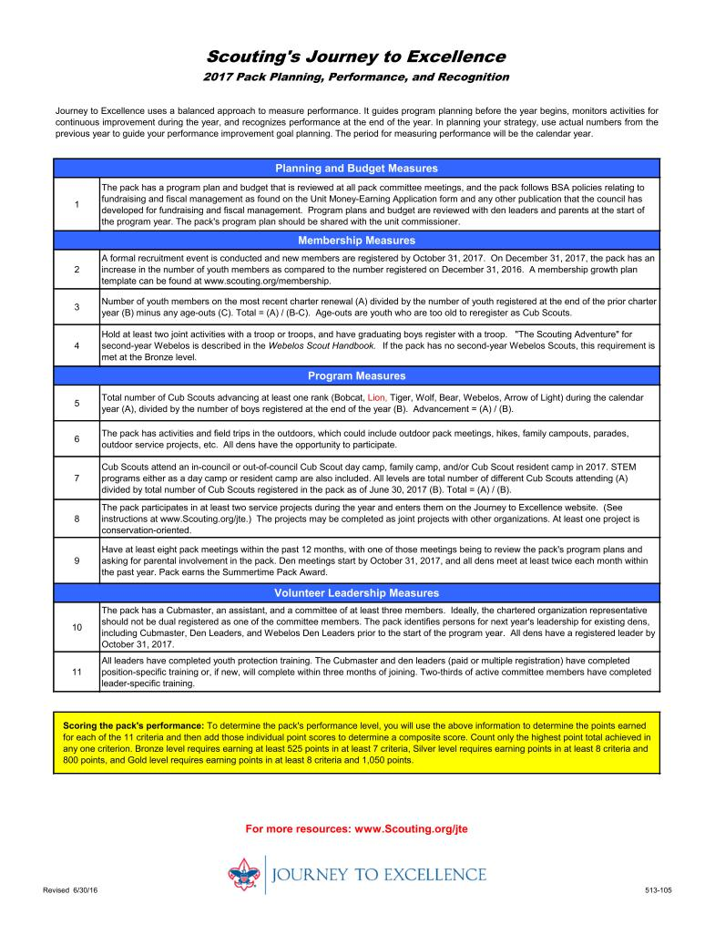
Journey to Excellence – Pack, pg.2
Notes:
Pass out and share the JTE score sheets for pack, troop, team and crew operation. Participants must recognize, from the discussion, that they represent desirable and important standards for quality unit operation.

Slide 24
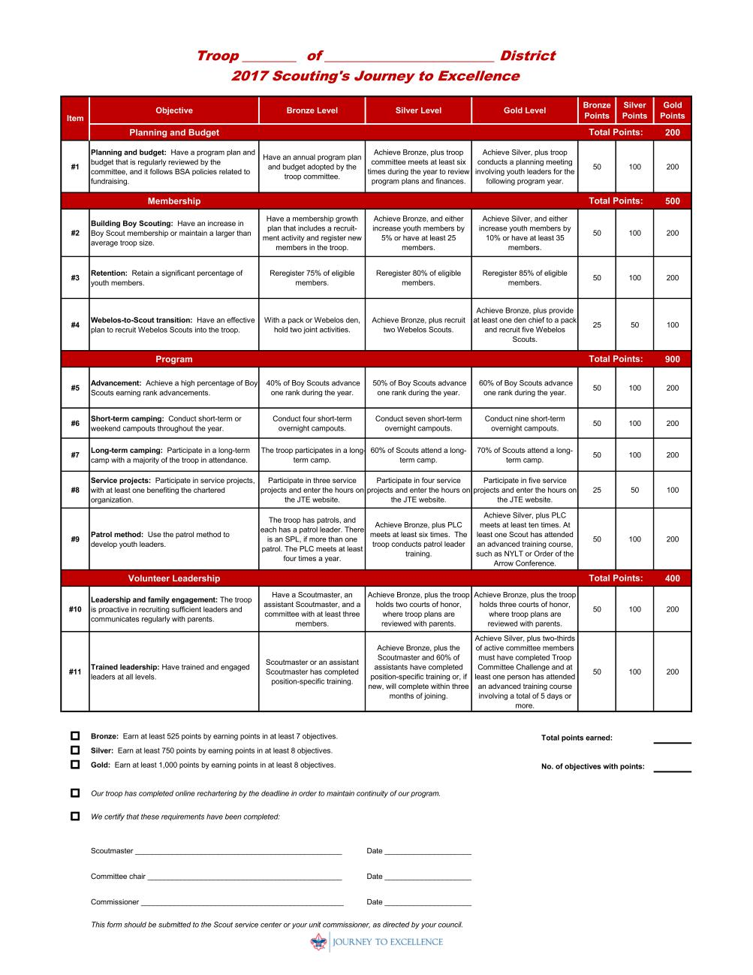
Journey to Excellence - Troop
Notes:
Pass out and share the JTE score sheets for pack, troop, team and crew operation. Participants must recognize, from the discussion, that they represent desirable and important standards for quality unit operation.

Slide 25
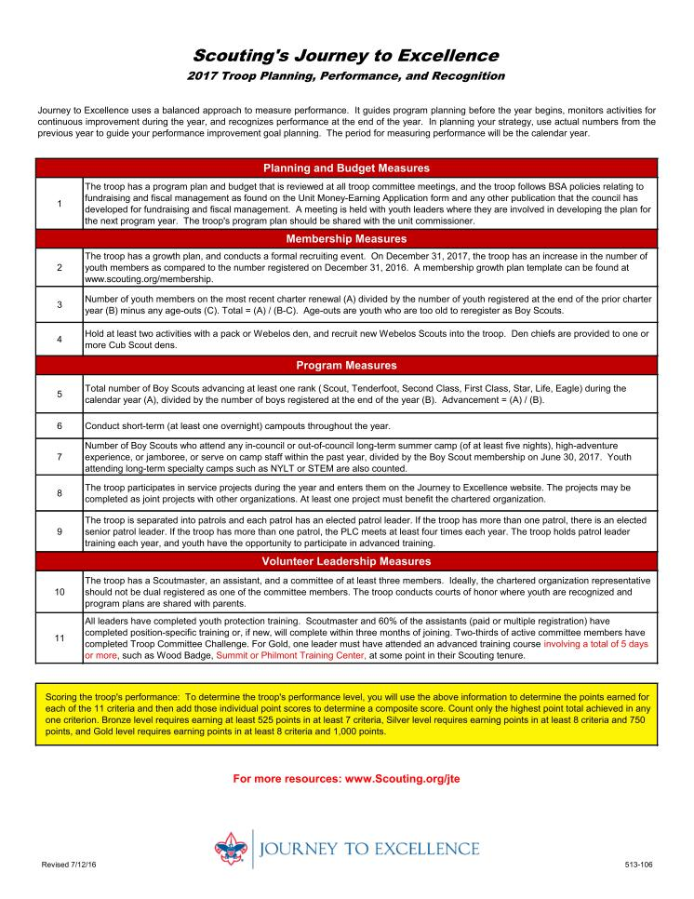
Journey to Excellence – Troop, pg.2
Notes:
Pass out and share the JTE score sheets for pack, troop, team and crew operation. Participants must recognize, from the discussion, that they represent desirable and important standards for quality unit operation.

Slide 26
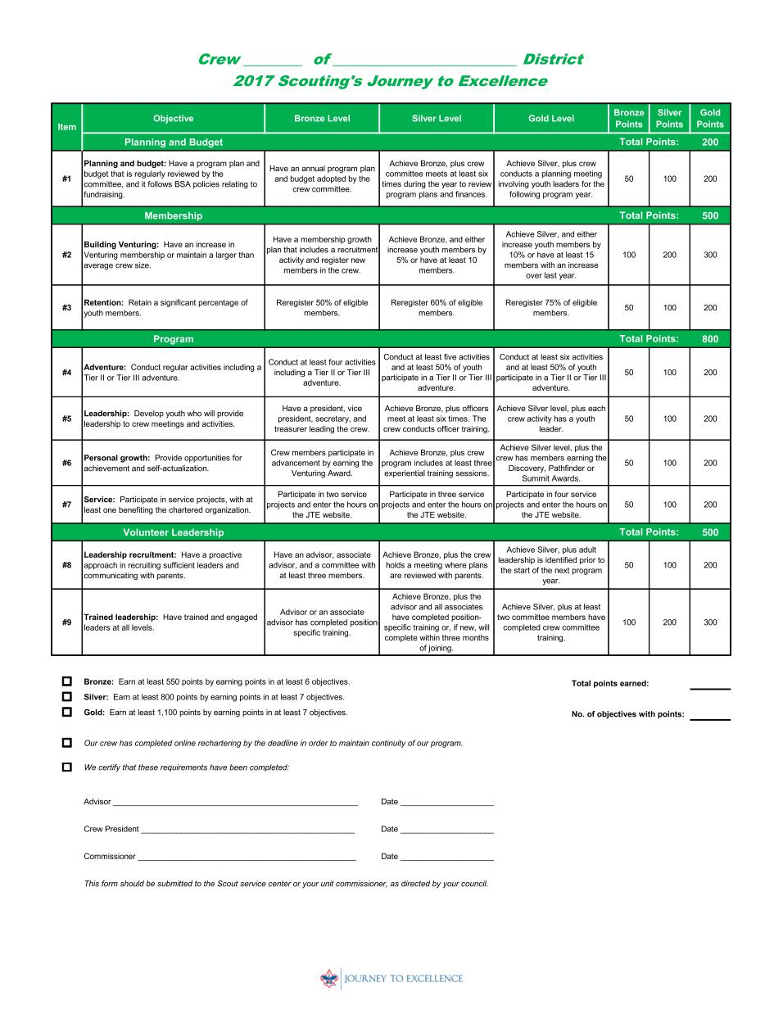
Journey to Excellence - Crew
Notes:
Pass out and share the JTE score sheets for pack, troop, team and crew operation. Participants must recognize, from the discussion, that they represent desirable and important standards for quality unit operation.

Slide 27
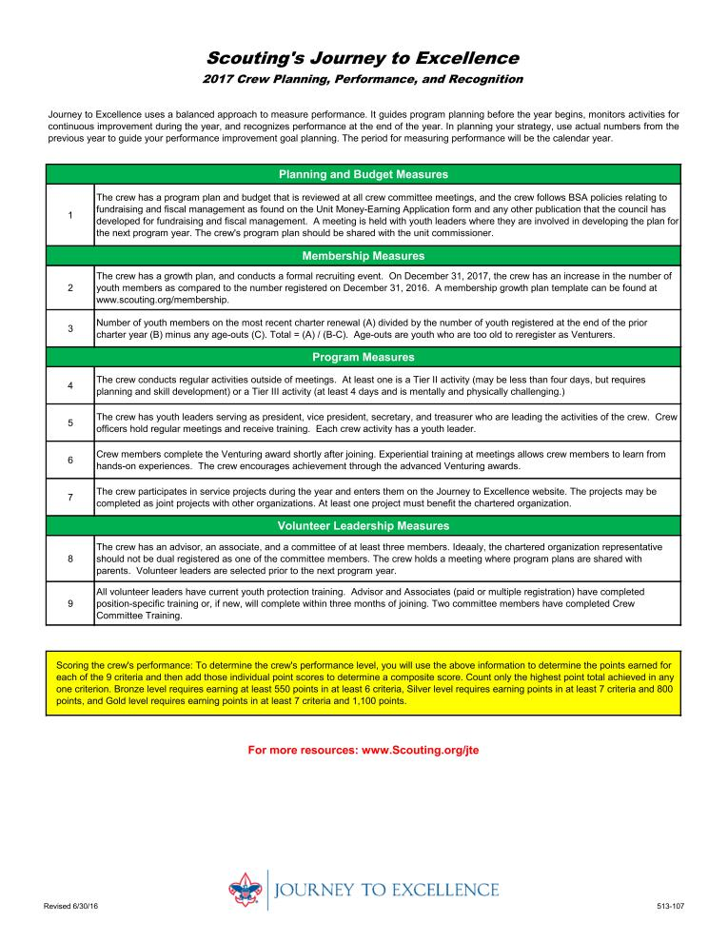
Journey to Excellence – Crew, pg.2
Notes:
Pass out and share the JTE score sheets for pack, troop, team and crew operation. Participants must recognize, from the discussion, that they represent desirable and important standards for quality unit operation.

Slide 28
Emphasis of Journey to Excellence
Continuous Improvement is a Goal
  Did the Unit do measurably better in key areas than last year?
  OR are they already performing at a high level in those areas?
Either way, the Unit can qualify for the standard

Slide 29
Emphasis of Journey to Excellence
Program and Participation in the Unit (Membership) are most important factors
Administrative factors are considered
Factors which are early indicators of Unit strength and health are identified and assessed

Slide 30
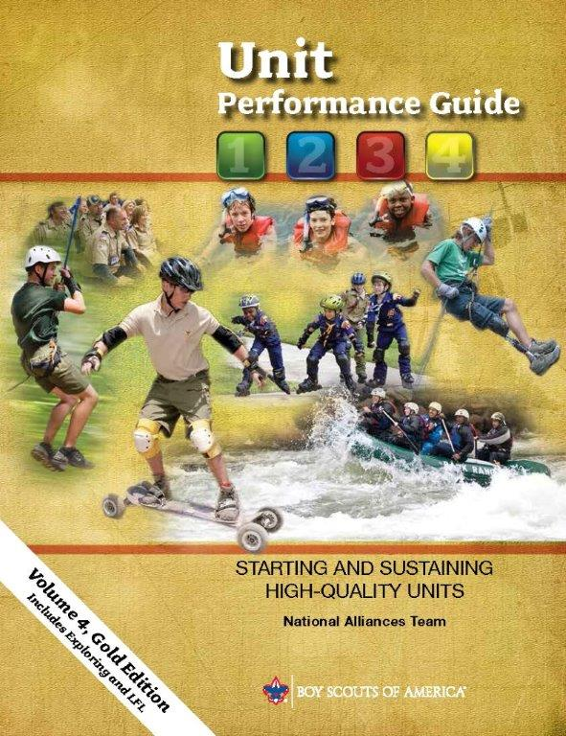
Unit Performance Guide
Notes:
This is a great time to talk about one of the primary tools we use as commissioners, the Unit Performance Guide.
The process of building sustainable units requires purposeful thought, study, and investment of time and people for success. The Unit Performance Guide presents unit development and growth as four pillars of high-performing units. Patterned after the stages of team development taught in National Youth Leadership Training (NYLT) and Wood Badge courses, each pillar has a purpose and all are required collectively for success.
The Unit Performance Guide is only available in electronic format, either pdf or e-pub. The most current edition is always available at www.scouting.org/commissioners/manuals
Chapters 3 and 4 contain information of particular interest to commissioners, including information about our primary contact points in the units we serve.

Slide 31
Contacting Units and Capturing Their Strengths and Needs in Commissioner Tools
Notes:
This is the second of our four objectives as commissioners.
But, who do we contact? We can and will work with many if not all of a unit’s leaders but working with a Unit’s Key 3 is critical to our success and the unit’s success.

Slide 32
The Unit Key 3
COR
Unit Leader
Committee Chair
Unit Service
YOUTH
Notes:
The Unit Key 3 is another of our primary Unit Service tools.
We find a “Key 3” at every level of Scouting, from our national council to our local units. From our national council through our districts, each Key 3 is comprised of a professional Scouter and representatives of unit service and Scouting’s operational functions (Finance, Membership and Program).
Developing an effective Key 3 isn’t easy. But experience has taught us one thing: wherever we have an engaged, effective Key 3, we do a better job of delivering the promise of Scouting.
The members of an effectively functioning Unit Key 3 interact much the same as the members of any other Key 3 and the youth that the unit serves remain the primary focus of their interactions. Unit service – a unit commissioner – supports the efforts of a Unit Key 3.
The Unit Key 3 is a relatively new concept and it has a slightly different composition, but every Key 3 is ultimately focused on the youth our movement serves. It is comprised of the unit leader, unit committee chair, and charter organization representative.
While the Unit Key 3 was initially established to help us more effectively establish new units, its success has demonstrated that it can be an equally effective tool for sustaining existing units. A functional Unit Key 3 will help improve overall unit operation.

Slide 33
Linking Unit Needs to District Operating Committee Resources
Notes:
This is the third of our four objectives.

Slide 34
Linkage
The Unit
The District
Operating
Committee
The Unit Commissioner
Notes:
We also know that commissioners can’t be experts in everything, and they can’t fix everything.
But strong district operating committees have experts in all elements of Scouting and unit commissioners can be most effective if they link unit needs to that expertise. How best to do that? We’ll get back to that…

Slide 35
10 Minute Break

Slide 36
The Unit Service Plan
Key element of Commissioner Tools design
Replaces all other unit assessments
Enables collaborative unit health assessments
Enables service customized to unit needs
Supports all 4 elements of excellent unit service
Notes:
And the Unit Service Plan is our primary tool that enables us to link unit needs to district operating committee resources. It was also a key element in the design of Commissioner Tools.
The Unit Service Plan is a better way to provide unit service. It supports all four elements of excellent unit service and our approach to starting and sustaining high-performing units (detailed in the Unit Performance Guide).
Based upon a collaborative assessment of unit health, commissioners develop a service plan that is customized to respond to a unit’s strengths and needs and draws upon resources available within the unit, its charter organization, and through the district operating committee.
Through ongoing unit contacts, commissioners capture periodic updates of the collaborative assessment of unit health and ensure the plan for improvement is moving forward.

Slide 37
THE UNIT SERVICE PLAN
UNITS
IMPLEMENTATION
UNIT
ASSESSMENTS
DISTRICT COMMITMENT
UNIT
SERVICE PLAN
Notes:
All of a commissioner’s unit contacts need not be in person or at unit meetings. Telephone conversations, emails, text message exchanges and casual meetings can all result in significant contacts. The key is this: a significant contact ends in an actionable conclusion that furthers the unit service plan.
Engagement of the Unit Key 3 is essential to the development and execution of an effective Unit Service Plan. The Unit Service Plan provides transparency: working together, unit leadership, Unit Service, and District Operations identify how to deliver the best possible program to the youth served by a unit and work together to accomplish the plan they develop.

Slide 38
The Unit Service Plan
UNIT
ASSESSMENTS
The Process:
  Review JTE performance
  Hold a detailed assessment meeting
  Complete assessment
  Identify opportunities
Resources:
  JTE objectives & scores
  Unit contacts logged in Commissioner Tools
  Unit Assessment Scoring Matrix
Notes:
ASSESSMENTS
A Unit Assessment is a first step in supporting unit growth on the Journey to Excellence.
The Process:
Units benefit from assessments at least twice each year at six month intervals. Around charter renewal is a great option as that often occurs at about the same time units are reviewing JTE achievements for the current year. A third assessment may be valuable when there is a change in unit leadership.
It may be helpful for the unit commissioner to coordinate a Unit Assessment Meeting with the Unit Key 3 and other unit leaders who can add value to the planning process. Possible agenda items would include:
Review of the unit’s JTE performance for the current year.
Completion of a Unit Assessment.
Identification of key opportunities to strengthen the unit and the program it offers during the coming year.
Resources:
1. The Unit Assessment is based upon JTE Objectives (for example, Advancement, Retention, Trained Leadership, etc.) JTE scores will help identify the unit’s strengths and opportunities for improvement.
Journey to Excellence standards are updated each year in August and are posted at http://www.scouting.org/jte.aspx Units that are successful in the JTE Objectives areas attract and retain more youth.
Familiarity with current JTE standards will provide a common perspective for everyone involved in developing and executing a Unit Service Plan.
3. Unit visits made by the unit commissioner and logged in the Commissioner Tools can also provide valuable perspective in the assessment process.
The information developed during the Unit Assessment Meeting is the foundation of the Unit Service Plan, which will be captured in Commissioner Tools, where it will be available for ongoing reference by the unit commissioner.

Slide 39
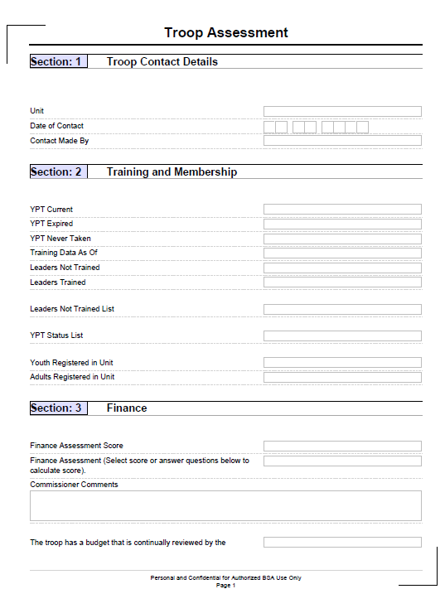
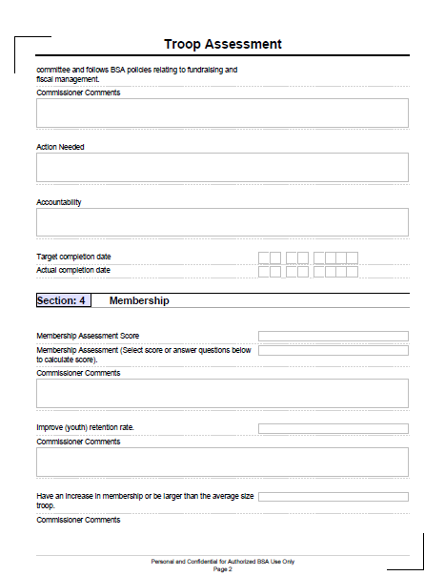
Sample of A Typical Detailed Troop Assessment
Notes:
An example of what a typical Unit Assessment looks like. Similar detailed assessments are available for Packs, Troops, Crews, Ships and Teams. The wording is specific to that type of Unit.
Section 1 and 2 will be pre-populated with information for that specific Unit.
When the form is emailed to a Unit, it will be able to be completed online. This will include pull down tabs for scoring that have 1-5 increments in 0.5 increments.
This detailed assessment is what would be completed by a Commissioner but is identical to the version completed by a Unit. The difference being that this asks for Commissioner comments and the Unit version asks for Unit comments. This is also how to determine who should be completing which assessment.
There will also be a description of the scoring matrix on this sheet.

Slide 40
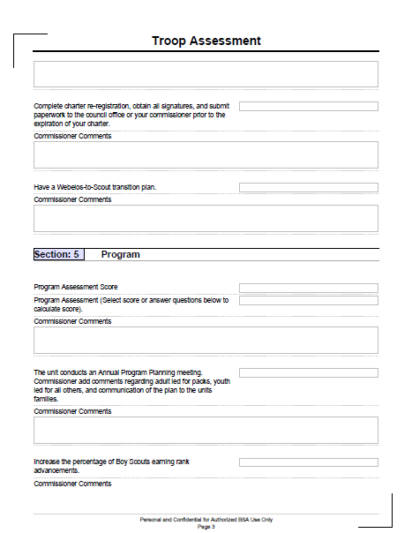
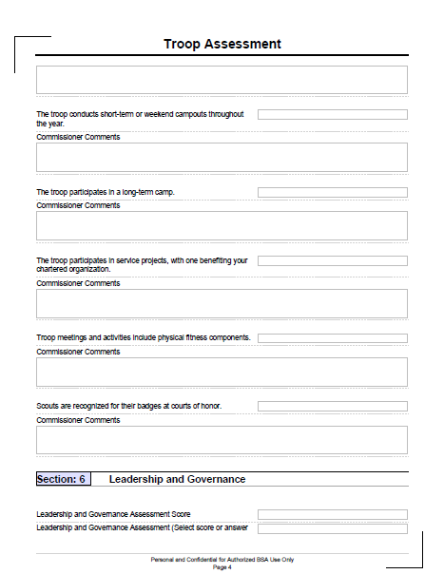
Sample of A Typical Detailed Troop Assessment (cont.)

Slide 41
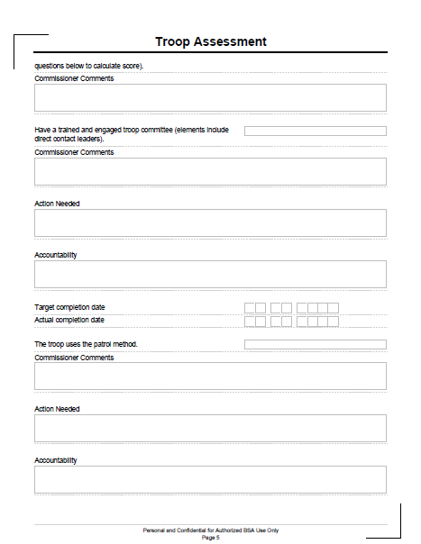
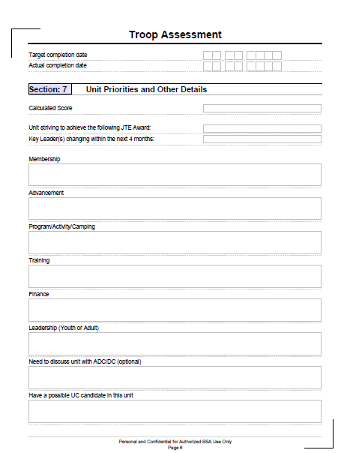
Sample of A Typical Detailed Troop Assessment (cont.)

Slide 42
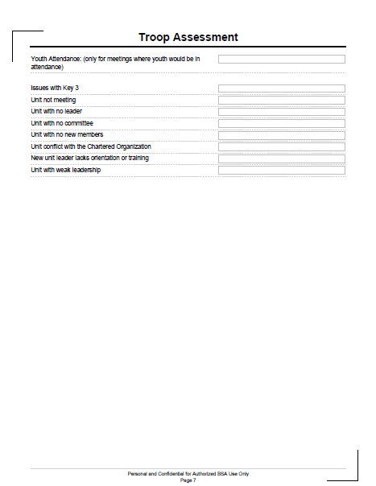
Sample of A Typical Detailed Troop Assessment (cont.)

Slide 43
The Unit Service Plan
UNIT
SERVICE PLAN
The Process:
  Develop action plans
  Identify responsibility
  Establish target dates
  SMART goals
Resources:
  Unit Program Plan
  District/Council activities schedule
  District charter renewal plan
Notes:
UNIT SERVICE PLAN
The Process:
Using the results of the Unit Assessment Meeting, the Unit Key 3 and unit commissioner should work together to develop the Unit Service Plan, a list of action items that will strengthen the unit and the program it offers to the youth it serves. In addition, they should establish completion target dates and assign responsibility for each. Finally, resources needed to accomplish specific action items should be identified (some resource needs, such as funding or training, might result in the identification of other action items).
The Unit Service Plan should be based upon the Unit Assessment.
As the Unit Service Plan is developed, it will become apparent that some action items will be the responsibility of unit leadership (for example, recruiting new youth members or adult volunteers), some will be the responsibility of the unit’s charter partner (for example, providing additional meeting space or equipment storage), and others will be the responsibility of the unit commissioner to coordinate by linking unit needs to district resources (for example, delivery of position-specific training for unit leaders or participation in the district’s fall membership roundup).
Resources:
1. The Unit Program Plan may help identify unit needs and action items (for example, Scouts wanting high adventure who belong to a troop with little back-packing experience may need support from the district camping committee).
2. The district schedule and plans for charter renewal can help in developing action items that support on time unit charter renewal

Slide 44
The Unit Service Plan
DISTRICT COMMITMENT
The Process:
  Identify district resources
  Link resources to unit needs
  Monitor plan progress
Resources:
  District Committee organization chart
  Contact information
Notes:
DISTRICT COMMITMENT
The Process:
Finalizing a Unit Service Plan requires commitment from the district operating committee. While the method of gaining commitment may vary from one district to another, the goal is to identify resources on the district operating committee that can help meet unit needs and complete action items on the Unit Service Plan (for example, the district’s training committee might supply training needed by unit leaders while its membership committee might coordinate unit participation in the fall membership roundup). Unit commissioners will find the members of an effective district operating committee willing to offer resources to meet unit needs as they understand no one, including a unit commissioner, can be an expert on everything.
District commitment enables the unit commissioner to link district operating committee resources to unit needs and identify accountability for the related action items on the Unit Service Plan. With those commitments, the Unit Service Plan can be finalized.
The unit commissioner and the Unit Key 3 should monitor the plan throughout the year and identify when adjustments are needed. Unit contacts will provide an opportunity to monitor progress, too, and visit reports in Commissioner Tools will provide valuable information for the next Unit Assessment.
Resources:
A district committee organizational chart, including contact information, may be useful in accessing resources to help meet unit needs.

Slide 45
The Unit Service Plan
IMPLEMENTATION
The Process:
  Execute the plan
  Maintain accountability
  Update as needed
Resources:
  Unit Service Plan
  Unit contact reports in Commissioner Tools
Notes:
The Process:
An unexecuted plan is of no value.
The unit commissioner is an essential element of the Unit Service Plan’s success. An engaged unit commissioner works closely with the Unit Key 3 to continually assess progress and help the unit and the district operating committee maintain accountability and make course corrections when necessary.
Updating the Detailed Unit Assessment (in Commissioner Tools) at 6 month intervals (or when unit leadership changes) will help ensure the unit continues to grow and provide the best possible program to the youth it serves.
Resources:
1. The Unit Service Plan (available in Commissioner Tools).
2. Unit contact reports (available in Commissioner Tools).

Slide 46
THE UNIT SERVICE PLAN
UNITS
IMPLEMENTATION
UNIT ASSESSMENTS
DISTRICT COMMITMENT
UNIT
SERVICE PLAN
Notes:
And remember…
…it’s a cycle…as the current Scouting year draws to a close and the charter renewal process begins, it is time for another Unit Assessment…
…and things can and do change during the course of the Scouting year and may require that the Unit Service Plan be revised….

Slide 47
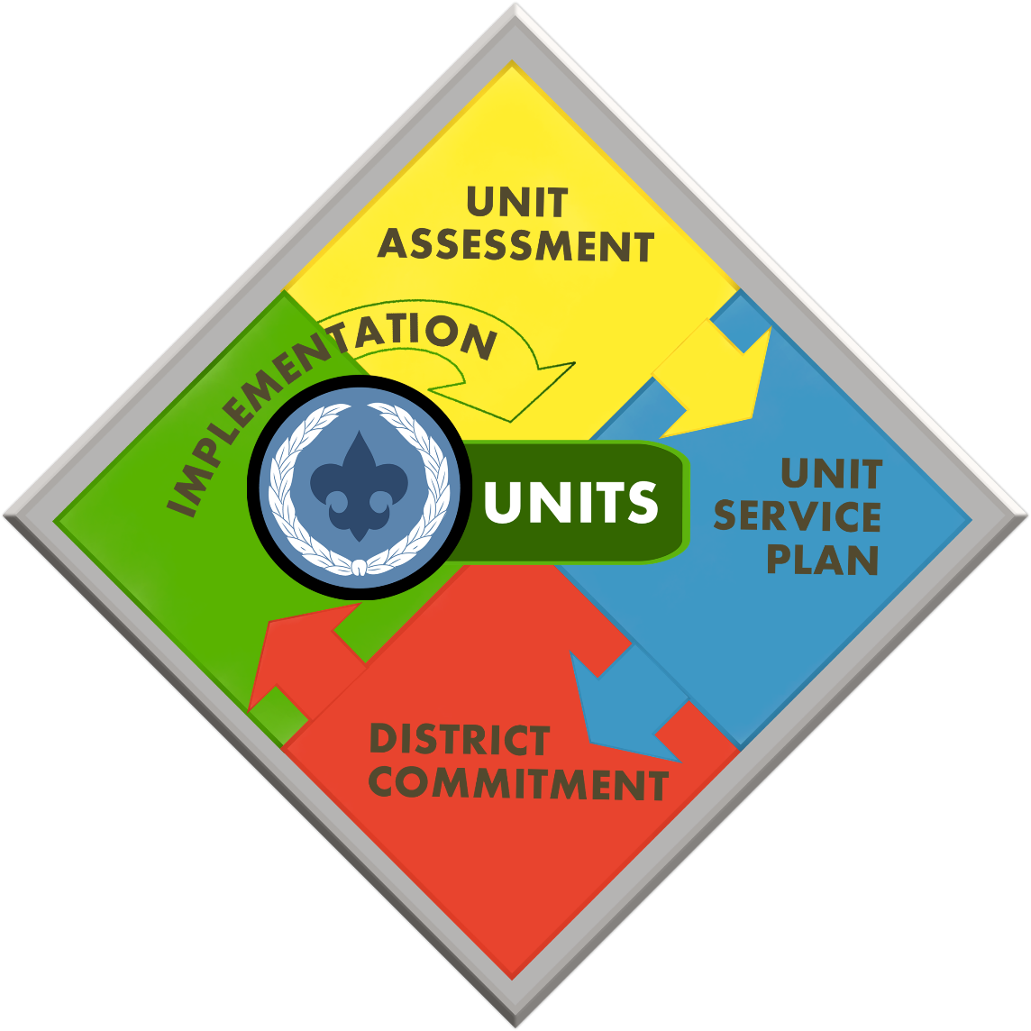
A Better Way
Collaboration
Focus
Actionable Information
Linkage
Efficiency
Metrics
Notes:
The Unit Service Plan enables you to fulfill your mission to help units better serve more youth through Scouting. And in the process, it enables improved retention of units and improves the performance rating of units using Journey to Excellence metrics.
A Unit Service Plan will have greatest impact when it is built upon a collaborative assessment of the unit’s strengths and needs.
Developing and executing a Unit Service Plan in Commissioner Tools touches every metric we currently use to help Unit Service continually improve and also every metric we currently use to help our units continually improve, too.
It truly is a better way to provide Unit Service!

Slide 48
Key Benefits
Unit Service Plan
Notes:
The Unit Service Plan offers four key benefits to a unit’s leaders and you:
Focus
Actionable Information
Linkage
Efficiency

Slide 49
Key Benefits
Focus
Unit Service Plan
Notes:
A Unit Service Plan provides Focus.
The most effective Unit Service Plans are built upon a collaborative assessment of a unit’s strengths and needs. That collaborative assessment enables unit leaders and you to identify and prioritize tasks that will strengthen the unit most quickly. Since collaborative assessments and Unit Service Plans should be updated at least twice each year, the tasks should be sufficiently limited in scope to enable completion within six months. That enables unit leaders and their unit commissioner to remain focused and best supports continuous improvement of the unit.
Before attempting a collaborative assessment, you must establish a solid relationship with a unit’s leaders based on mutual respect and an understanding of one another’s motivation for involvement in Scouting and vision of future success for the unit. Collaborative assessments are a new approach to Unit Service; not all unit leaders are going to immediately understand, or perhaps, accept it. Unit commissioners should do their best to gain acceptance (their relationship with unit leaders will be an asset in that), but each unit will be best served through a customized plan.
Sometimes, the only alternative will be to build that plan based on the unit commissioner’s assessment of the unit’s strengths and needs. Done well, that should ultimately cause unit leaders to think more highly of Unit Service and increase their acceptance of a collaborative approach to unit assessment and plan development.
Unit Service Plans based on a collaborative assessment will have the greatest impact as they provide the greatest focus to everyone involved.

Slide 50
Key Benefits
Focus
Unit Service Plan
Actionable Information
Notes:
A Unit Service Plan is action-oriented; as a result, it provides Actionable Information.
It includes a limited number (typically, five to seven) SMART goals;. Remember, one of the benefits of a Unit Service Plan is the focus it provides to a unit’s leaders and its unit commissioner. Limiting the scope of the plan – the number of goals it includes and the time in which they will be completed – helps ensure focus.
SMART goals are Specific, Measurable, Actionable, Relevant and Resource-oriented, and Time based. They identify specifically what is going to be done, who is accountable for the task, and when it is expected to be completed.
One example of a SMART goal might be, “All registered unit leaders will be current on youth protection training by March 1 of this year.” The unit’s committee chair, or a designated member of the committee, might be the individual responsible for that task being completed by the established target date.
And remember, Commissioner Tools will provide the unit commissioner with the youth protection training status of each of the unit’s registered leaders, so the unit commissioner can provide additional actionable information to help sharpen the focus on the work to be done.

Slide 51
Key Benefits
Focus
Unit Service Plan
Actionable Information
Linkage
Notes:
A Unit Service Plan enables Linkage to other resources needed to ensure success.
Neither unit leaders nor unit commissioners are experts in every element of Scouting. But unit commissioners can provide access to subject matter experts that serve on our district operating committees. If the collaborative assessment identifies, for example, specific needs for training of youth and/or adults, a member of the district training committee would be able to assist in coordinating the delivery of that training. District membership committee members could be a resource in developing new approaches to growing the unit; district camping committee members could assist a unit interested in developing a high adventure program for its older youth, and so on.
Once the need is identified, the unit commissioner can facilitate linkage. Individual districts will have different approaches to the best way to gain operating committee support commitments. Once established, the unit commissioner can coordinate and monitor the efforts of everyone responsible for completion of tasks included in the current plan.

Slide 52

Key Benefits
Focus
Unit Service Plan
Efficiency
Actionable Information
Linkage
Notes:
Integrating the Unit Service Plan process and Commissioner Tools’ technology provides efficiency.
The collaborative assessment and the resulting plan can both be captured in Commissioner Tools using the Detailed Assessment function. Once completed, the information is easily accessible by the unit commissioner, all members of the district’s Unit Service team, and also district professionals. In addition, members of the council’s Unit Service team and field service professionals can also review the plan if their support is needed. And, the Unit Service Plan offers the opportunity to replace the variety of other, uncoordinated unit assessment and unit service planning tools with a single, coordinated approach to helping units better serve youth through Scouting.

Slide 53
Key Benefits
Focus
Unit Service Plan
Efficiency
Actionable Information
Linkage
Notes:
Finally, the Simple Assessment function in Commissioner Tools provides a quick and easy was to document plan progress. Simple Assessments document regular, monthly contacts by a unit commissioner. Unit contacts recorded in Commissioner Tools should involve substantive interaction with unit leaders that ensure Unit Service Plan progress or address some other significant unit need.

Slide 54
A Better Way
Notes:
Why do a Unit Service Plan?
The simple answer to the question remains: a Unit Service Plan enables commissioners to fulfill their mission to help units better serve more youth through Scouting. And in the process, it enables improved retention of units and improves the performance rating of units using Journey to Excellence metrics.
Think about it: that means developing and executing a Unit Service Plan in Commissioner Tools touches every metric we currently use to help Unit Service continually improve and also every metric we currently use to help our units continually improve, too.
It truly is a better way to provide Unit Service!

Slide 55

Notes:
This project began in September of 2013 and was first introduced to the National Commissioner Support Team at the National meetings that were held in Utah in October of last year.
Commissioner Tools is now live and online. The initial group of councils that were not part of the testing phase went live on the system on November 1st 2014. Councils were given options as to when they would adopt Commissioner tools. Councils started adopting tools on the 1st of the month beginning with November of 2014. All councils will have adopted tools by 1 March 2015.
Once a council adopts Commissioner Tools, their access to UVTS ends.

Slide 56
Development - Initial Approach
Dashboard incorporates JTE metrics
Alerts
Robust and easy-to-use
Mobile platform
Notes:
As the tool was being developed, the question to answer was: What do commissioners need to best perform their Scouting role? The new tool reports metrics on unit contacts, calculating a score based on unit health measures.
The new tool provides robust and easy to use report forms for commissioners and it is planned to be mobile platform friendly so that commissioners can use handheld devices to access data and enter data. (Make sure you check the National Commissioners Website for the latest updates on Commissioner Tools.)
The best way to access Commissioner Tools is to use Google Chrome as your browser.

Slide 57
Concept
Accessed via my.scouting.org
Natural Context sensitive
Reporting
Intuitive presentation
Supports existing “Simple and Unified”
commissioner mission
Notes:
Commissioner tools will be accessed via My.Scouting.org. The system is sensitive to the natural context of the person using it. For instance if you are a District Commissioner you will see all the data and visits pertinent to your District.
Here Commissioners will be able to record their contacts which hopefully provide useful information on the health status of units. The data will be presented more intuitively to support the commissioner mission.

Slide 58
Capabilities Required
Record unit contacts
Support unit growth in JTE criteria
Link units to district resources
Unit Charter Renewal
Notes:
Commissioner Tools has an improved capability to record unit contacts and support Unit Commissioners in helping unit growth in JTE criteria.
It also helps Unit Commissioners link district resources to unit needs, and finally provides tools to aid in on-time charter renewal.
You will notice that the required capabilities are the same as the commissioner tasks laid out in the simple and unified approach to commissioner service.

Slide 59
Commissioner Tools Views
Notes:
This is a static look at Commissioner Tools.
When you gain access to the tool, “go and play.”
As much as possible, the tool has been built to be intuitive, so it shouldn’t require detailed manuals on how to do something. When you get into the tool, should you need help, the first thing you should do is look for the “on screen” help which depending on your machine, may be accessed by manipulating your pointing device such as “right clicking” the mouse. Additionally there will be e-mail and telephonic help available, although the telephone help will only be during regular business hours and may not last indefinitely.
Commissioner Tools has a 60 day time limit to make a unit contact entry. If a contact isn’t recorded within 60 days, it’s time to move on.
Tools also has the ability for a commissioner to easily make entries “on behalf” of another commissioner.
Remember the new 1 to 5 scoring scale developed by the Unit Service Plan where 1 is low and 5 is high The Commissioner Tools incorporates that scoring scale, and presents those scores as a decimal number rounded to the nearest tenth. As you will see in the following slides, we have added some text to help commissioners decide how to score a unit, and they are:
1 – weak situation; needs immediate action
2 – needs improvement; watch carefully
3 – typical unit; could be improved
4 – making progress toward the ideal unit
5 – nearly an ideal situation

Slide 60
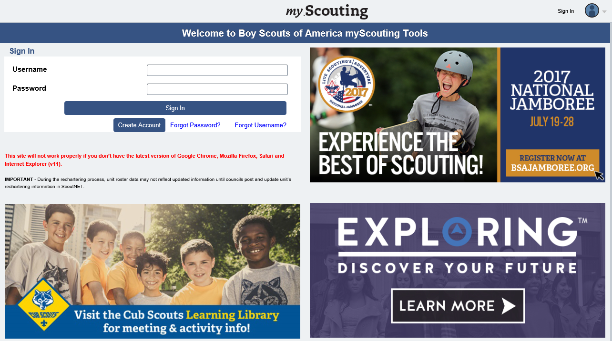
Logon Page
Notes:
As you log into my.scouting.org to access commissioner tools, this is the the sign in pagelanding page you will see. This is an excellent place to see updates as they are posted to all of the tools that are available on line not just to commissioners but to key 3 members at all levels from unit level to the national level.

Slide 61
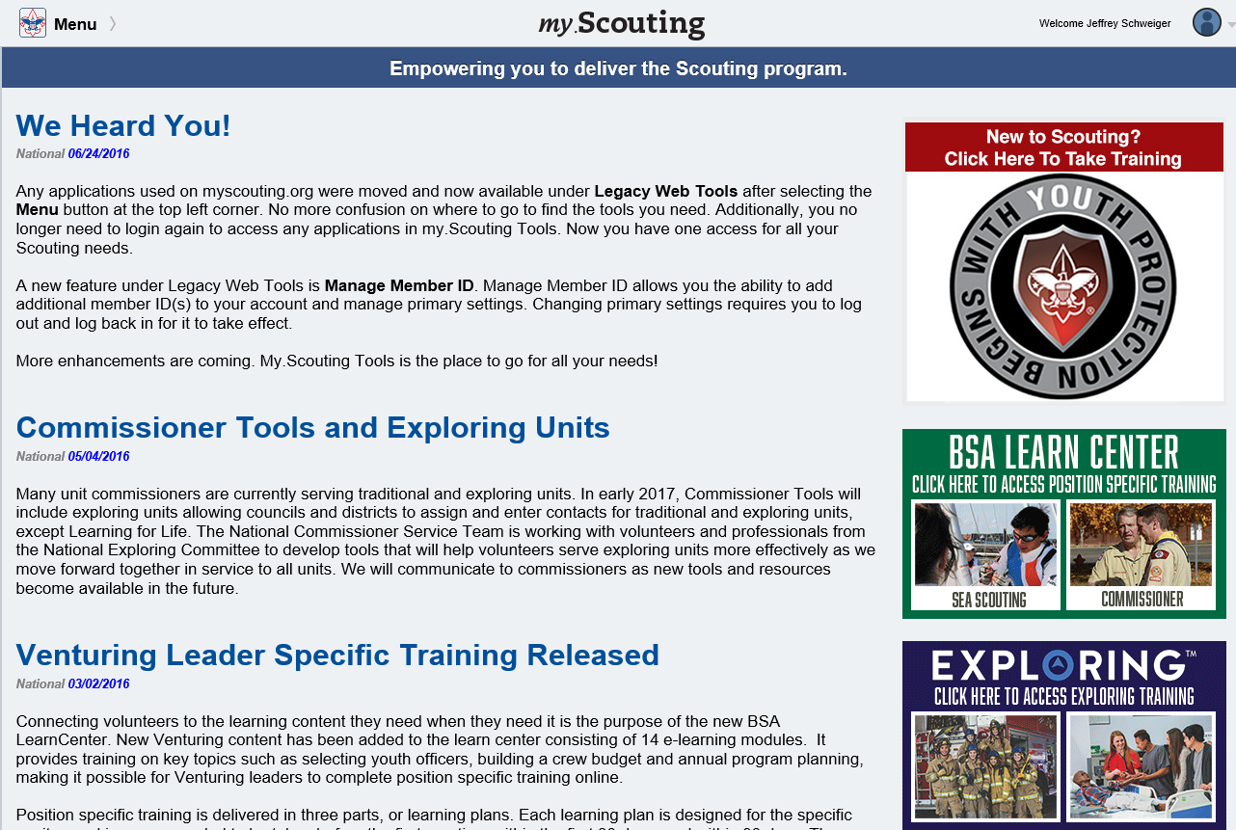
Landing Page
Notes:
As you log into my.scouting.org to access commissioner tools, this is the landing page you will see. This is an excellent place to see updates as they are posted to all of the tools that are available on line not just to commissioners but to key 3 members at all levels from unit level to the national level.

Slide 62
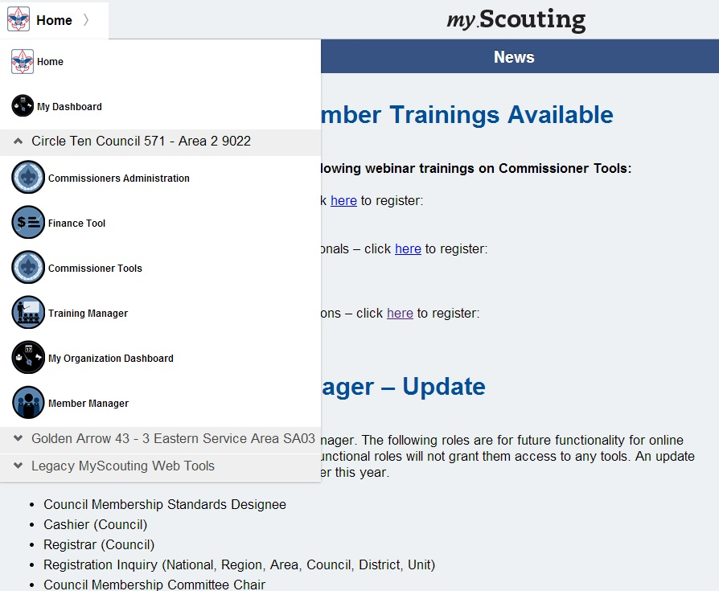
Pull Down Menu
Notes:
To begin using Commissioner Tools feature, click on the home icon (scout logo green arrow). When the drop down appears, select Commissioner Tools (red arrow).

Slide 63
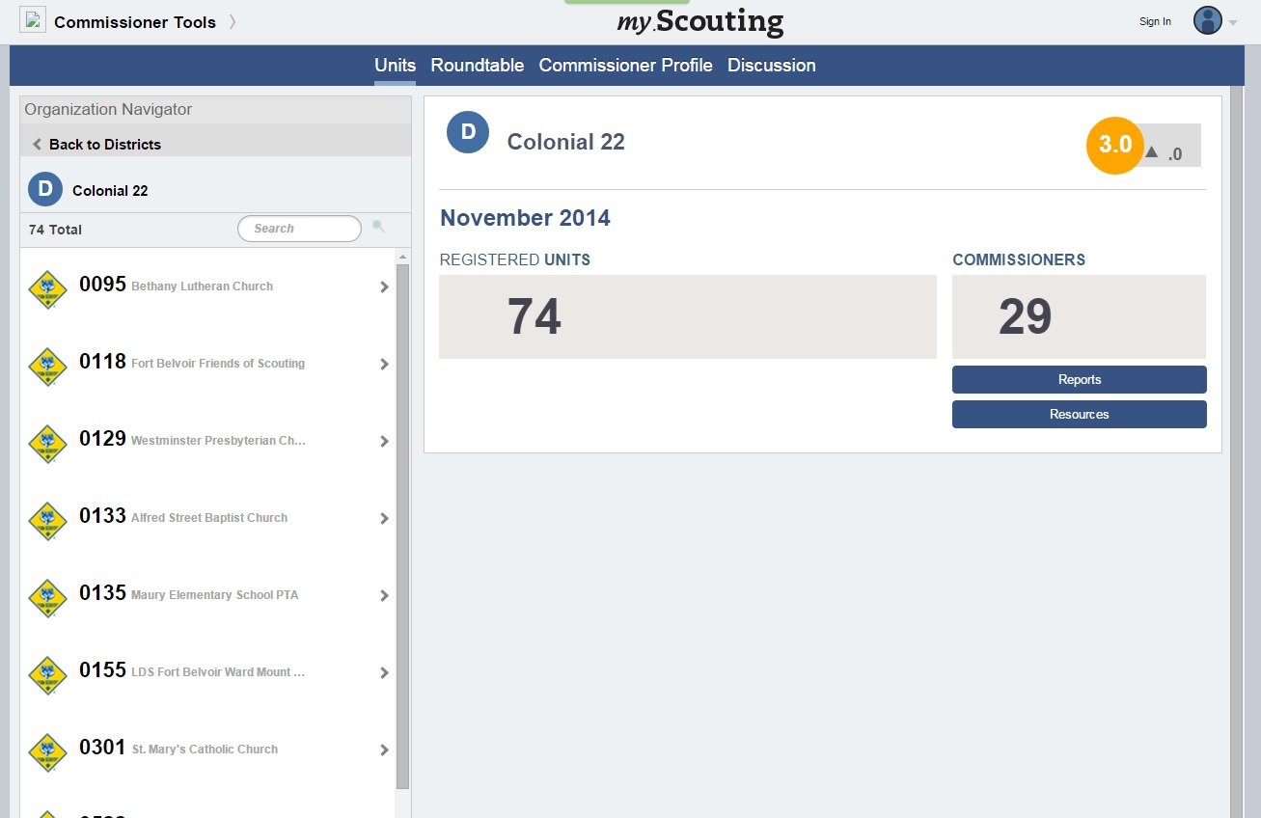
Look for Unit
Notes:
This view shows how the commissioner can look for their units and if they perhaps want to look for another unit because maybe they were a guest at a function and wanted to add a contact. Now they can.

Slide 64
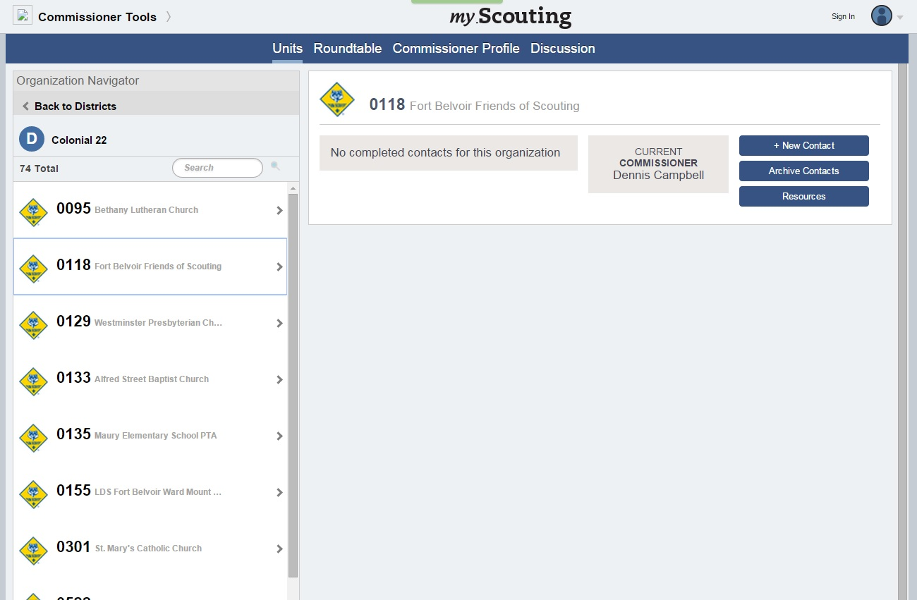
Add a Contact
Notes:
Now we will add a Contact. See the New Contact button in the upper right.

Slide 65
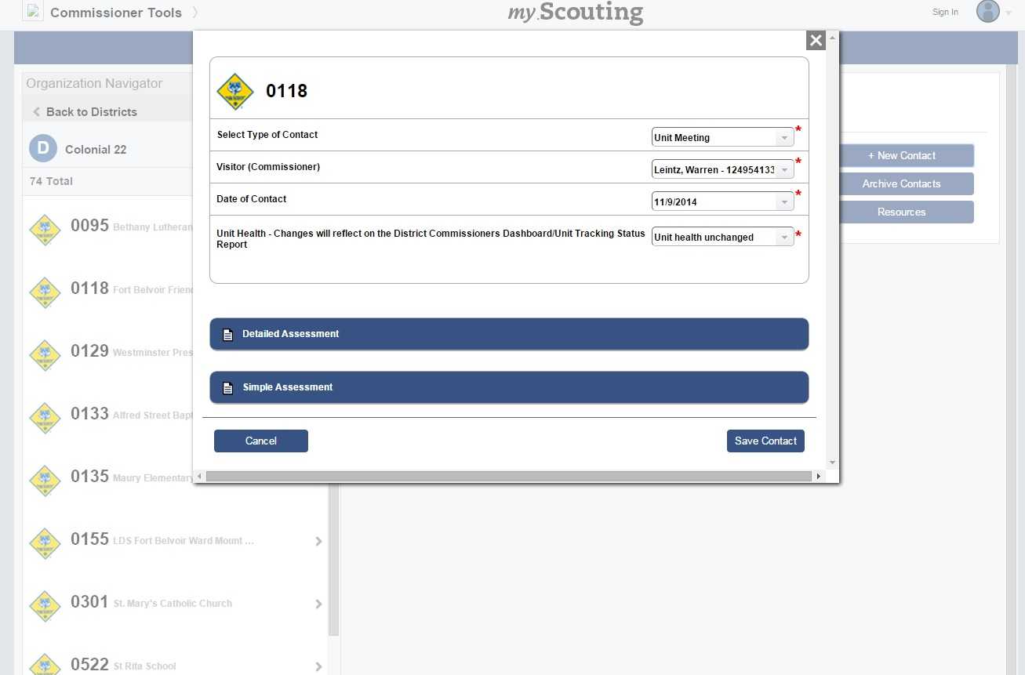
Choose Type of Assessment
Notes:
This is the initial entry screen where you can see the pull down menu allows you to select the type of contact.
The Commissioner name comes in based on your login, however you can change this if you are making the entry on someone's behalf.
The Date comes in automatically, but again you can change it.
You have an opportunity to pick a Unit Health indicator.
Here we have the ability to do a Simple Assessment or a Detailed Assessment.

Slide 66
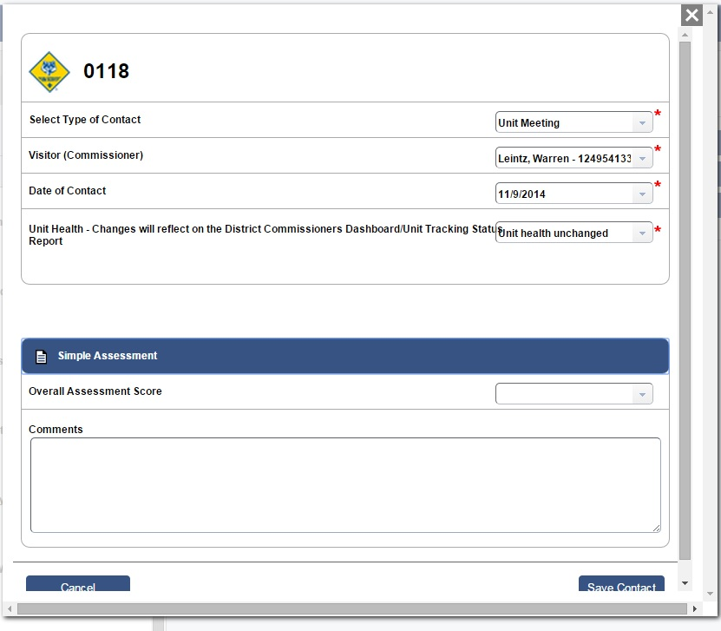
Simple Assessment
This type of contact can be completed in less than 75 seconds starting at the login page!!
Remember to save the contact
Notes:
This is the view for a simple assessment.
From the pull down menu on the right, Select a numerical value from 1 to 5 that in your assessment represents the current status of the unit.
In the comments block, make as detailed a comment as you can, providing actionable information. For example, followed up with the Cubmaster to see if the district advancement team contacted the pack’s advancement coordinator to show them how to use the online advancement tools. Found out that the meeting had not occurred yet. Need to follow up.

Slide 67
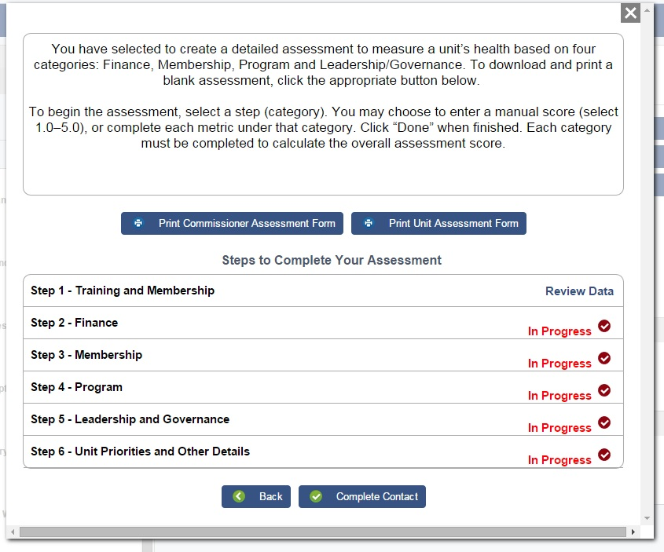
Detailed Assessment
Notes:
This is the first page of Detailed Contact Summary.
Here we have the ability to print blank Unit Commissioner Assessment form (to be filled out by the commissioner about the unit) and a Unit Assessment form (to be filled out by the unit). They are slightly different, but cover the same areas.
It is important to read the guidance at the top of the page. It reads “You have selected to create a detailed assessment to measure a unit’s health based on four categories; Finance, membership, Program and Leadership/Governance. To download and print a blank assessment, click the appropriate button below.
To begin the assessment, select a step (category). You may choose to enter a manual score, or complete each metric under that category. Click “Done” when finished. Each category must be completed to calculate the overall assessment score.”
It is important to note that at this point that there is no requirement to fill out ALL the data entry fields. You can leave any field that you want blank.
Here you can see the sections of the detailed assessment and the progress for completion.
(hand copies of the commissioners assessment and the units assessment)

Slide 68
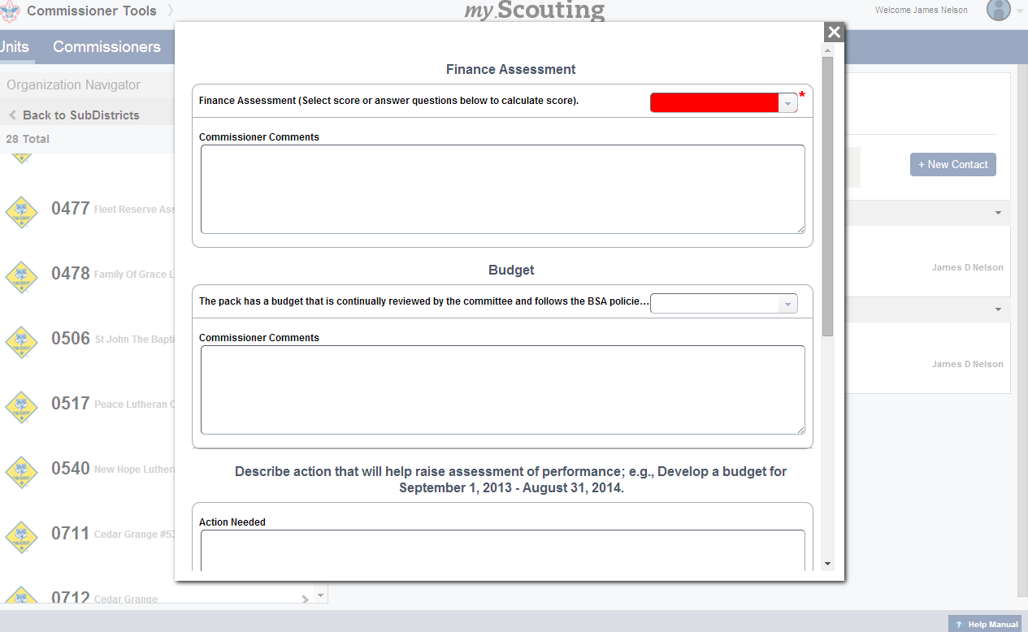
Detailed Assessment
Notes:
Here is the Finance section of the Detailed Assessment.
There are 2 ways to complete a detailed assessment
Full Automatic – this is where each of the four Unit Service Plan evaluation areas (Finance, Membership, Program and Leadership) AND their associated sub-elements are scored. For the full automatic you would begin at the assessment box under the Budget and complete all of the sub categories, which would then yield a score in the red box when completed.
In Between – this is where the Commissioner only subjectively scores the four Unit Service Plan evaluation areas at the top level.
The weighting of all scoring elements and sub elements is equal. That is, Finance is as important as Membership, etc. and within any evaluation area, each sub-element is equally weighted. Note the red area this is where the in-between assessment happens. If a score is manually entered here you need to go no further in the Finance Section.
So here, going back to the Unit Service Plan, you see the detail beneath the Financial Assessment, the first of the four assessment areas.
Again, the commissioner can simply put a manual score in the box provided, or the commissioner can go through the detailed questions, adding comments as appropriate, and an score for the Financial Assessment will be automatically calculated.
Each of the other three assessment areas have sub-elements.

Slide 69
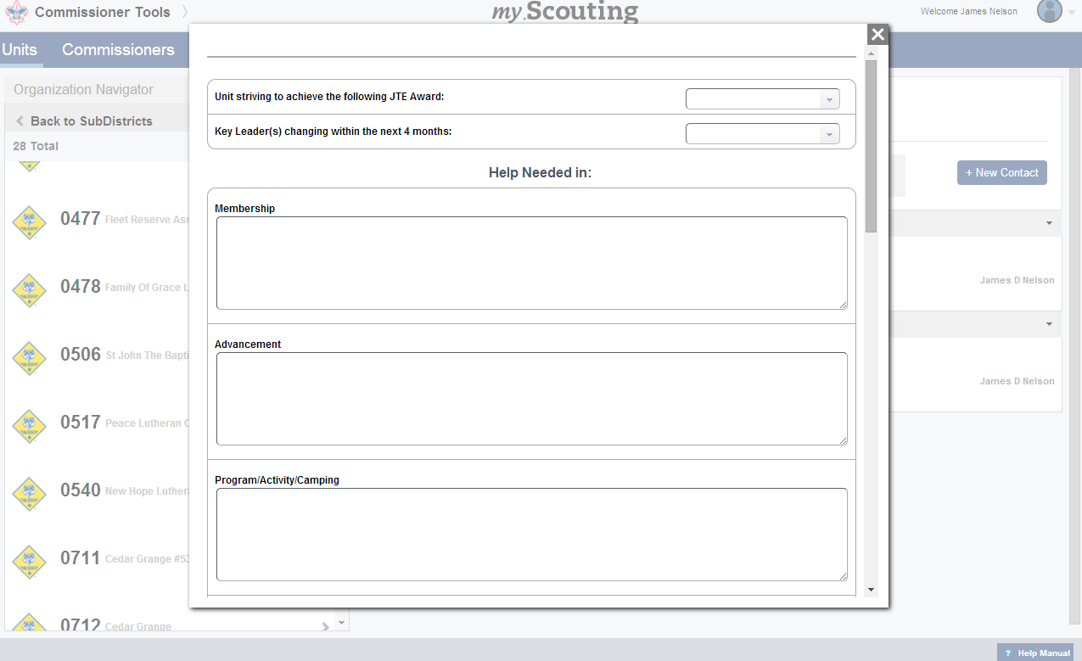
Detailed Assessment
Notes:
This screen has Additional details such as indicating which JTE indicator the unit is striving for; a place to indicate possible need for leadership change; and a place for the commissioner to describe in what areas a unit may need help.

Slide 70
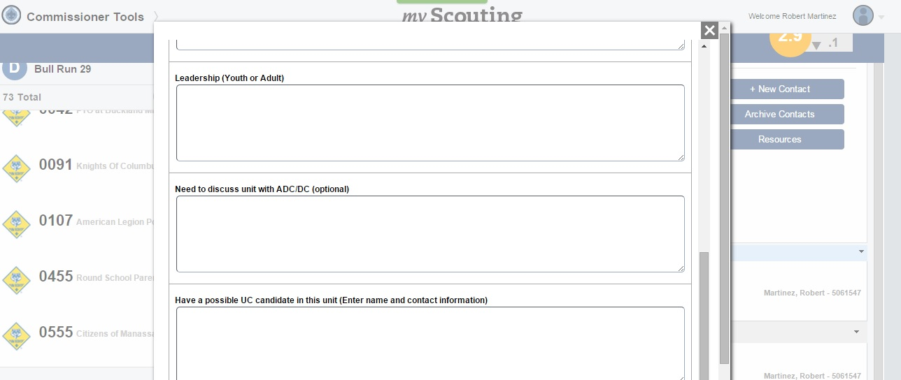
Recommending a Commissioner

Slide 71
Online Commissioner Tools Training
The following online training modules are now available at my.scouting.org by going to the BSA Learn Center (see link on the main sign-in page) and clicking on the Commissioner link.
These modules are generally under 10 minutes in length and explain in greater detail how to use Commissioner Tools.

Slide 73
Online Commissioner Tools Training Modules
Accessing Commissioner Tools - demonstrates how to access the tools and provides a brief overview of the Commissioner Tools
The Units Tab in Commissioner Tools - describes the specifics of the features found on the Units Tab and how to navigate this tab and the records of contacts for units.
Entering a Unit Contact in Commissioner Tools - discusses the basic contact information and the entry point for creating either a Simple Assessment or a Detailed Assessment.

Slide 74
Online Commissioner Tools Training Modules
Unit Assessment Scoring Matrix in Commissioner Tools - defines the scoring parameters used to complete an assessment.
Entering a Simple Assessment in Commissioner Tools - shows the shortest and simplest entry to report a unit contact.
The Detailed Assessment for Commissioners Tools - This video will discuss the how, why, and when to complete a Detailed Assessment and its variations, including a collaborative assessment

Slide 75
Online Commissioner Tools Training Modules
The Collaborative Assessment for the Unit Key 3 in Commissioner Tools - describes to the Unit Key 3 the process involved with the Collaborative Assessment creation, steps and procedures. It should be reviewed by Commissioners and Unit Key 3 PRIOR to beginning the Collaborative Detailed Assessment process.
The Reports Button for Commissioner Tools - covers reports that commissioners can choose to view and download a variety of district-level reports.
Using the Discussion Tab in Commissioner Tools - discusses the dialogue capability for collaboration among commissioners at the same organizational level.

Slide 76
Online Commissioner Tools Training Modules
The Roundtable Tab in Commissioner Tools - discusses planning future roundtables and documenting unit roundtable attendance and participation
Using the Commissioner Profile Tab - discusses the summary of assigned units, contacts made in the previous four months and unit contacts made by a specific commissioner.
Creating Pivot Tables - covers creating Pivot Tables which provide an interactive way to summarize, analyze, and explore large amounts of data.
Commissioner Tools Pivot Table Documentation - provides written support for the Creating Pivot Table module

Slide 77
Questions?

Slide 78
10 Minute Break

Slide 79
Commissioner
Service Role
Notes:
8:30—30 Minutes

Slide 80
The Commissioner Concept
The commissioner is the liaison between the local council and Scouting units.
The commissioner's mission is to
  Keep units operating at maximum efficiency,
  Maintain regular contact with unit leaders,
  Counsel leaders on where to find assistance,
  Note weaknesses in programs,
  And suggest remedies.
The commissioner is successful when units effectively deliver the ideals of Scouting to their members.
Notes:
Read, explain and discuss the commissioner concept. Amplification is in CF, pp. 10-11.
Introduce the Commissioner Fieldbook as the single most important resource for all commissioners

Slide 81
Commissioner Service
Keep Units Operating
Regular contact
Counsel Leaders
Help Fix Problems
Notes:
The commissioner is the liaison between the local council and Scouting units. The commissioner’s mission is to:
keep units operating at maximum efficiency
maintain regular contact with unit leaders
counsel leaders on where to find assistance
note weaknesses in programs and suggest remedies
The commissioner is successful when units effectively deliver the ideals of Scouting to their members.

Slide 82
Commissioner Overview
Three Types of Commissioners
Administrative Commissioners
Unit Commissioners
Roundtable Commissioners
Notes:
Administrative Commissioners
Council Commissioner, Assistant Council Commissioner, District Commissioner, and Assistant District Commissioners
Their primary responsibilities are recruiting, training, guiding, and evaluating Commissioner Staff
Unit Commissioners
are assigned to one or more units, which they coach and mentor to ensure unit success.
Only the finest type of community leader should be considered for a commissioner’s role. That person should be a “people person” capable of working with the key personnel of chartered organizations, unit committee people, and unit leaders as well as district and council Scouters.
The unit commissioner’s service is based on a philosophy of friendship and coaching.
Roundtable Commissioners
Roundtable commissioners should have a good background in Cub Scout, Boy Scout, Varsity Scout, or Venturing skills as well as a lively teaching ability.

Slide 83
Commissioner Staff Organization
District Commissioner
ADC
service area
ADC
service area
ADC
service area
ADC
Roundtable
ADC
Training
ADC
Administration
Unit Commissioner
Unit Commissioner
Unit Commissioner
Unit Commissioner
Unit Commissioner
Unit Commissioner
Unit Commissioner
Unit Commissioner
Unit Commissioner
Unit Commissioner
Unit Commissioner
Unit Commissioner
Unit Commissioner
Unit Commissioner
Unit Commissioner
Cub Scout Roundtable Commissioner
Boy Scout Roundtable Commissioner
Venture Roundtable Commissioner
Varsity Huddle Commissioner
Assistant Cub Scout Roundtable Commissioners
Assistant Boy Scout Roundtable Commissioners
Assistant Venture Roundtable Commissioners
Assistant Varsity Huddle Commissioners
Notes:
This is the organization of a typical district commissioner service staff. You will see all 3 types of commissioners on this chart. District Commissioners do have the latitude to organize their service to best fit the needs of their district.

Slide 84
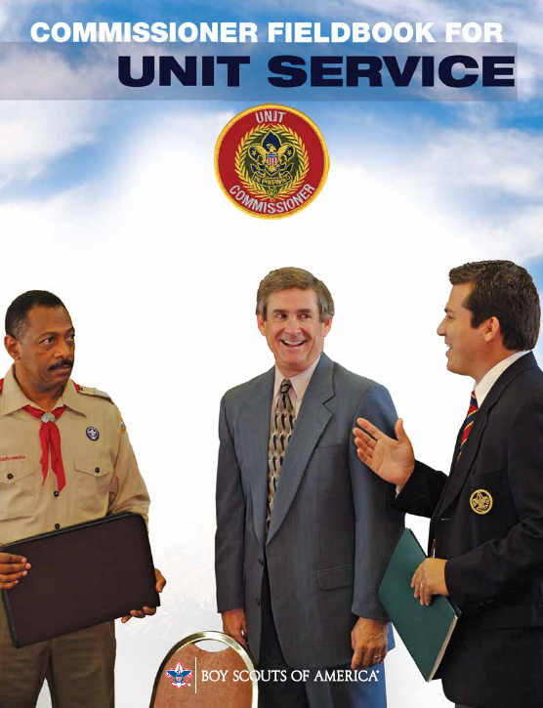
Most Important Resource
Notes:
Introduce the Commissioner Fieldbook for Unit Service book as the single most important resource for all commissioners. Note that the Fieldbook contains:
Commissioner Orientation
Orientation Projects
The Commissioner Concept
The District Commissioner Staff
Providing Unit Service
Your Commissioner Style
Be a Lifesaving Commissioner
How to remove a Volunteer
Counseling
Youth Protection
Unit Charter Renewal
Unit Commissioner Training
Resources
Self-Evaluation
Distinguished Commissioner Service Award

Slide 85
Commissioner’s Service Role
Friend
Representative
“Doctor”
Teacher
Coach
Notes:
A commissioner plays several roles, including being a friend, a representative, a unit “doctor” or paramedic, a teacher, and a coach.
The commissioner is a friend of the unit. Of all your roles, this one is the most important. It springs from the attitude, “I care, I am here to help you, what can I do for you?” Caring is the ingredient that makes commissioner service successful. Be an advocate of unit needs. A commissioner who makes himself or herself known and accepted with the unit leadership will be called on to help in times of trouble.
The commissioner is a representative. The average unit leader is totally occupied in working with kids. Some have little if any contact with the Boy Scouts of America other than your visits to their meeting. To them, you may be the Boy Scouts of America. Be a good example. Show that you believe in the ideals, the principles, and the policies of the Scouting movement. Represent it well!
The commissioner is a unit “doctor” or a paramedic. In your role as “doctor,” you know that prevention is better than a cure, so you try to see that your units make good “health practices” a way of life. Sometimes being a paramedic and performing triage on a unit to keep its program going or providing support to their leadership is critical. When problems arise, and they will even in the best unit, act quickly. Observe symptoms, diagnose the real ailment, prescribe a remedy, and follow up on the patient.
The commissioner is a teacher. As a commissioner, you will have a wonderful opportunity to participate in the growth of unit leaders by sharing your knowledge with them. You teach not just in an academic environment, but where it counts most—as an immediate response to a need to know. That is the best adult learning situation since the lesson is instantly reinforced by practical application of the new knowledge.
The commissioner is a coach. As a Scouting coach, you will help guide units in solving their own problems. Coaching is the best role for you when unit leaders don’t recognize a problem and where solutions are not clear-cut. Everyone needs coaching or assistance from time to time, even experienced leaders. You provide them with different “plays” that might be the right one for them to move ahead or succeed at solving a problem.

Slide 86
Commissioner Priorities
Good Unit Service
Takes precedence over all other Scouting efforts
Notes:
Unit Commissioners should not fall into the trap of doing everything else in Scouting except for the appointed job: Unit Service – this does happen
Commissioners are wonderful Scouters and may be asked to do many things.
While these other Scouting activities might be important, they are often NOT the primary responsibility of commissioners.
Although some commissioners may be registered on a unit committee because they have a child in the unit or because of previous personal history in the unit, their principal Scouting obligation should be to their commissioner responsibilities.
Concentrate your Scouting time on helping specific unit needs and helping each unit become more effective with its program and operation. Hopefully , your primary registration is that of a commissioner, but it does not have to be. You can have a multiple registration as a commissioner. There are many reasons to make your registration as a commissioner your primary registration.
Good unit service is created when the commissioner believes that unit service is so critical to the success of Scouting that it takes precedence over all his or her Scouting time.

Slide 87
Unit Commissioner
Responsibility Card
Report to the district commissioner or assistant district commissioner as assigned
Help each unit with Journey to Excellence program*
Use the unit service plan
Know each phase of Scouting and its literature. Be able to describe how each works.
Visit meetings of or be in contact with assigned packs/troops/teams/crews regularly, at least 6
times per year
*Includes Explorer Posts
Notes:
The Unit Commissioner
Using the preopening quiz and Commissioner Responsibility Cards, lead a discussion on the job of the unit commissioner. Cover all items on the card. Be sure participants have the right quiz answers.

Slide 88
Unit Commissioner
Responsibility Card
Visit regularly with the unit leader
  Be aware of unit leader concerns and challenges
  Serve as the unit leader’s coach and counselor
  Build a strong, friendly relationship
  Using the literature and profile sheet, help the leader see opportunities for improvement
  Encourage unit participation in district and council events

Slide 89
Unit Commissioner
Responsibility Card
Work to ensure effective unit committees
  Visit with the unit committee periodically
  Observe the committee, offer suggestions for improvement, and work to solve problems
See that adult leaders have adequate training
Make certain that proper techniques are used to select and recruit unit leaders

Slide 90
Unit Commissioner
Responsibility Card
Facilitate on-time charter renewal of all units*
  Help the unit conduct a membership inventory of youth and adults
  Help the unit committee chairman conduct the charter renewal meeting
  See that a completed charter renewal application is returned to the council service center
  Make arrangements to present annually each unit charter at a meeting of the chartered organization
*Includes Explorer Posts

Slide 91
Unit Commissioner
Responsibility Card
Attend all meetings of the commissioner staff
Become trained
  Initial orientation and basic training
  Arrowhead Honor and Scouter’s Key
  Annual council commissioner’s conference
Know the resources available to the unit in the neighborhood, district, and council

Slide 92
Unit Commissioner
Responsibility Card
Set the example
  Adopt an attitude of helpfulness
  Keep promises
  Be concerned about proper uniforming
  Be diplomatic
  Be a model of Scouting ideals
Conduct own Self-Evaluation on page 55 of the Commissioner Fieldbook

Slide 93
Commissioner Quiz
The Unit Commissioner: (true / false)
1. Reports to the district executive
2. Must be an expert in training adults and youth
3. Is only concerned with reregistering a unit on time
4. Should be familiar with the official literature used by units for program
5. Only visits the unit committee, and on a regular basis
6. Must know the unit program planning process
7. "Sells" the unit leader on district and council functions, as a primary responsibility
Notes:
Put this up as a lead-in slide until about 10 minutes before starting.
COMMISSIONER QUIZ
The unit commissioner:
F 1. Reports to the District Executive.
F 2. Must be an expert in training adults and youth.
F 3. Is only concerned with reregistering a unit on time.
T 4. Should be familiar with the official literature used by
units for program.
F 5. Only visits the unit committee, and on a regular basis.
T 6. Must know the unit program planning process.
F 7. "Sells" the unit leader on district and council
functions, as a primary responsibility.
This quiz can be posted as a pre-opening activity.

Slide 94
Commissioner Quiz (cont.)
8. Periodically communicates with the chartered organization representative to offer help
9. Regularly attends Roundtables
10. Guides the unit through the annual service plan
11. Should earn the Commissioner’s Key
12. Attends monthly meetings of the district committee
13. Is not involved in the presentation of the unit charter
14. Must be familiar with the monthly program themes
15. Encourages assigned packs, troops, teams, and crews to earn the Journey to Excellence Performance Award
Notes:
Put this up as a lead-in slide until about 5 minutes before starting.
T 8. Periodically communicates with the chartered
organization representative to offer help.
T 9. Regularly attends Roundtables.
T 10. Guides the unit through the annual service plan.
T 11. Should earn the Commissioner’s Key.
F 12. Attends monthly meetings of the District Committee.
F 13. Is not involved in the presentation of the unit charter.
T 14. Must be familiar with the monthly program themes.
T 15. Encourages assigned packs, troops, teams, and
crews to earn the Journey to Excellence Performance Award.

Slide 95
Lunch Break
30 Minutes

Slide 96

Commissioner Support to Exploring
Camping and Outdoor
Activities and Civic Service
Advancement and Recognition
Training
Health & Safety
Notes:
Discuss the points made on the slide about program functions

Slide 97
Unit Service to Exploring
In NCAC, Explorer Post unit service is provided by the district commissioner staffs
  Commissioners provide Unit service similar to traditional units:
  Annual Post Registration Renewal (‘Rechartering’)
  JTE
Commissioner Tools is scheduled to provide Explorer support effective January 1, 2017. In the interim, NCAC has developed local Explorer Service Tools:
  http://www.ncacbsa.org/exploringtools

Slide 98
A Little History
1940’s Sea Scouting, Exploring & Air Scouts
1950’s Youth automatically an Explorer at age 14
1960’s Career Exploring introduced
‘s Women joined Exploring as adult leaders and youth Members. National Youth Officers
1980’s 17 Career and Traditional Program Clusters
In school Learning for Life Program started
1998 Career Exploring Clusters Move to LFL.
Venturing started with 5 traditional Clusters

Slide 99
WHAT IS EXPLORING ?
A career education program for young men and women
Helps them make more informed decisions about future careers

Slide 100
Post vs Crew
Post = Careers (Vocation)
  Law Enforcement
  Nursing
  Mechanical Engineer
  Architecture
Crew = Hobbies (Avocation)
  Geocaching
  Astronomy
  Skiing / Snowboarding
  Genealogy

Slide 101
Explorer Post/Explorer Club
Explorer Post
  Sponsored by a participating community business, association, or government agency.
  14 and have completed eighth grade OR 15 years of age but not yet 21 years old
  Youth led with adult mentors (advisors)
Explorer Club (New in 2013)
  In school, middle school program similar to an Explorer post.
  Sponsored by the school system or a participating community business, association, or government agency.
  6th – 8th graders, no age req.
  Youth led with adult mentors

Slide 102












Twelve Career Fields

Slide 103
Methods of Exploring
Voluntary association between youth and adults
Ethical decision making
Group activity
Recognition of achievement
Democratic process
Exploring is about curiosity, exploration, and adventure

Slide 104
Explorer Post Organization
PRESIDENT
ADVISOR
POST
COMMITTEE
COMMITTEE
CHAIRMAN
VICE
PRESIDENT
ADMINISTRATION
ASSOCIATE
ADVISOR
ADMINISTRATION
VICE
PRESIDENT
PROGRAM
ASSOCIATE
ADVISOR
PROGRAM
TREASURER
TREASURER
SECRETARY
CONSULTANTS
ACTIVITY
CHAIRS
PARTICIPATING ORGANIZATION

Slide 105
Unit Contact / Visitation Basics

Slide 106
Unit Contacts
Commissioners contact each unit monthly (JTE goal is 6 times per year, minimum)
  Visit Unit Meetings &
  Unit Committee Meetings
  Phone calls
  E-mail
Notes:
Normally you should make a visit to your units monthly. However, unit contacts must be made often enough to accomplish your mission. Only you can say how often that needs to be. You should be close enough to your units to know what is happening and help strengthen their capabilities to deliver a quality program.
When you visit, watch and listen. Don’t disrupt the program. You are a guest and observer. Make note of attendance; is it near 75% of registered scouts?
Planning; Do things move smoothly? Adult leadership; Are they actively involved? Do they seem to enjoy the meeting?
Other types of Contacts:
Telephone calls- to give or receive information or to follow up. Visit informally with unit leaders at roundtable. Encourage attendance and participation. Attend a unit event. Visit your unit as they participate in a District or council event When you need quick contact, e-mail works very well but, don’t let email substitute for personal interaction.
Don’t feel that just because you made contact that you are successful as a commissioner. When your unit is moving toward completion of their Journey to Excellence criteria and have a good unit program, then you are successful as a commissioner.

Slide 107
Unit Contact Basics
Contacts provide knowledge of how to help a unit improve its program
Contacts allow you to find out about problems before the unit fails, weakens or members leave.
Notes:
Commissioners need to become familiar with all resource material to be able to make better evaluations and to understand the total situation in a unit.
Some units will need more frequent visits—new or troubled units, for example. Outstanding units need visits, too. Even Tiger Woods needs a coach.

Slide 108
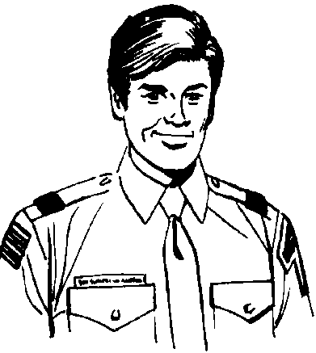
The First Unit Visit
Make appointment to visit an assigned unit
Go with your observer-coach
Take your resource kit
Observe for the entire meeting
Do not participate beyond introductions
Both new commissioner and coach fill out independent unit assessment worksheets
Wear your complete Field Uniform
  Except for Exploring
Notes:
[If this is a three-session training, follow the outline below. If this is a one-session training, adapt it to be performed after the training.]
The first unit visit — Explain that, before the next training meeting, each participant will be given an opportunity to visit a unit and use the worksheet.
Explain the ground rules.
A unit is selected from the ones assigned to the commissioner-trainee.
The commissioner-trainee must call the unit leader to be sure that the visit is convenient.
Each trainee will be accompanied by an observer-coach, perhaps the unit commissioner’s ADC.
Each trainee will be given a prepared kit.
Unit commissioner worksheets are not to be brought out during the visit, but must be filled out later.
The visit should extend through the entire meeting.
Neither the trainee nor the observer-coach is to make an effort to participate in the meeting, except to be introduced.
Independent reports will be prepared by trainee and observer-coach and presented at the next training session. [For one session courses, the trainee and coach compare reports.]
Uniforms are to be worn and must conform to the appropriate uniform inspection form.
[Many participants will have never filled out a worksheet. Encourage them to do so on their next visit to the unit meeting. (Have them take their filled out worksheet(s) to their ADC or DC.)
After they have made their visit, discuss ways to help with the unit leader. Use the “Some ways to help” column.
During the committee meeting, be ready to discuss “Some ways to help” but do not bring out the worksheet.]

Slide 109
Unit Contact Considerations
Call
Unit Assessments
Observe
Uniform
Notes:
Basic ground rules for making your unit contacts include:
The new commissioner should call the unit leader to be sure that the visit is convenient.
Unit commissioner worksheets are not to be brought out during the visit, but should be filled out later.
The visit should extend through the entire meeting.
The commissioner should not make an effort to participate in the meeting, except to be introduced.
Uniforms are to be worn and must conform to the appropriate uniform inspection sheet

Slide 110
Council and District Mission

Slide 111
Council Mission
Voluntary association of citizens & chartered organization representatives
Promotes Scouting within a geographical area
Guides & supports districts to
  Make Scouting available to youth
  Provide adequate funds
  Maintain standards and policies
  Serve organizations using the Scouting programs
NCAC also supports the Exploring Program
  Part of the Learning for Life Program
Notes:
Use The Council, #33071E, pp. 1-2.
Explain briefly that the council is a voluntary association of citizens, including representatives of organizations chartered by the BSA, which promotes the Scouting program within a geographical area. Explain that the purpose of council is to guide and support districts for the achievement of Scouting’s purpose.

Slide 112
District Mission
Ensures growth & success of Scouting units within the district's territory
Works through chartered organizations and community groups to organize and support successful units
Notes:
Reference, The District, #33070E, pp. 2-9. The purpose of the district is to organize and support successful units.

Slide 113
Membership
Fund Development
Program
Administration
District Committee
Four Functions:
Membership
Fund Development
Program
Unit Service
Notes:
Provide a good understanding of the resources available in the district committee to ensure the success of the unit
Explain that the commissioner is like the country doctor or general practitioner. The district committee includes specialists whom the commissioner can call in for consultation or specialized treatment.

Slide 114
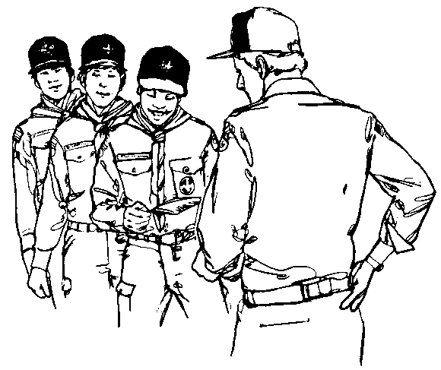
Membership Functions
Fall Roundup
Spring Roundup
Special membership rallies
Advice and help to units with membership problems
Notes:
Details used only if instructor is comfortable, time permits, and students are inquisitive.
The membership function strives for growth through the organization of new Scouting units, and growth through new members joining existing units. Its tasks include:
Gather Information
Develop new-unit and membership growth plans
Conduct boy-fact surveys
Conduct career interest surveys
Identify underserved areas
Track membership growth
List potential chartered organizations
Cultivate Relationships with Community Organizations
Encourage use of the Scouting program
Conduct relationships conferences
Organize New Units
Recruit and train organizers
Conduct new-unit campaign
Organize new units
Involve a commissioner with each new unit
Help Youth Join Existing Units
Conduct roundups
Recruit youth year-round

Slide 115
Membership Functions
Gather information
Cultivate relationships with community organizations
Organize new units
Help youth join existing units
Notes:
Details used only if instructor is comfortable, time permits, and students are inquisitive.
The membership function strives for growth through the organization of new Scouting units, and growth through new members joining existing units. Its tasks include:
Gather Information
Develop new-unit and membership growth plans
Conduct boy-fact surveys
Conduct career interest surveys
Identify underserved areas
Track membership growth
List potential chartered organizations
Cultivate Relationships with Community Organizations
Encourage use of the Scouting program
Conduct relationships conferences
Organize New Units
Recruit and train organizers
Conduct new-unit campaign
Organize new units
Involve a commissioner with each new unit
Help Youth Join Existing Units
Conduct roundups
Recruit youth year-round

Slide 116
Fund Development
Friends of Scouting
Trust Funds (James E. West)
Advice to units
Notes:
The fund development function of the district committee is responsible mostly for the Friends for Scouting campaign. They do provide information and support for those wishing to contribute to the James E. West trust, however, only a small portion of trust fund money goes to council operating expenses. This committee can also provide budgeting and fund raising guidance to the units in the district.

Slide 117
Program Functions
Camping and Outdoor
Activities and Civic Service
Advancement and Recognition
Training
Health & Safety
Notes:
Discuss the points made on the slide about program functions

Slide 118
Camping & Outdoor
Promote resident camping for all packs, troops, and teams
Develop and promote Cub Scout day camps
Promote year-round camping by all units
Provide guidance on health and safety
Use camperships
Guide the Order of the Arrow
Notes:
Camping and Outdoor
Promote resident camping for all packs, troops, and teams
Develop and promote Cub Scout day camps
Promote year-round camping by all units
Provide guidance on health and safety
Use camperships
Guide the Order of the Arrow

Slide 119

Activities & Civic Service
Recruit teams to carry out district activities
Involve the district in community service projects
Promote and help with council events
Notes:
Activities and Civic Service
Recruit teams to carry out district activities
Involve the district in community service projects
Promote and help with council events

Slide 120
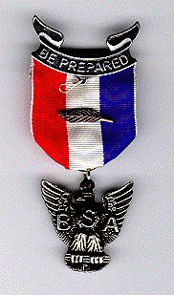
Advancement & Recognition
Help unit leaders with advancement procedures
Monitor unit advancement progress
Recruit merit badge counselors
Approve Eagle Scout service project plans
Recommend youths and adults for special awards
Notes:
Advancement and Recognition
Help unit leaders with advancement procedures
Monitor unit advancement progress
Recruit merit badge counselors
Approve Eagle Scout service project plans
Recommend youths and adults for special awards

Slide 121
Training
Determine who needs training
Build annual training program
Develop plans for specific courses
Promote courses
Provide training recognition
Notes:
Training
Determine who needs training
Build annual training program
Develop plans for specific courses
Promote courses
Provide training recognition

Slide 122
Health & Safety
Monitor district events

Slide 123
Unit Committee Functions
Notes:
Participants must understand that they can best help a unit leader if they also understand what a unit leader should have in the way of help from the unit committee.
Familiarize the participants with Fast Start and how it helps a new leader get off to a good start.

Slide 124
Pack and Troop Committee Functions
Fast Start for a good start

Slide 125
Pack Committee
Advancement
Finance
Outings
Training
Membership & reregistration
Record keeping & correspondence
Public relations
Friends of Scouting
Notes:
Refer to the Cub Scout Leader Book, pages 23-5 to 23-7
Be sure they understand that there might not be formally organized subcommittees, but the pack chairman should assign certain jobs to committee members on either a permanent or an “as needed” basis.

Slide 126
Troop Committee
Advancement
Finance
Equipment
Outdoor program
Transportation
Leadership selection
Membership & reregistration
Friends of Scouting
Notes:
Using the Scoutmaster Handbook (p. 157) and Troop Committee Guidebook as resources, point out the functions of the troop committee, including [slide items]
The organization of the committee depends on the size of the troop.
See pp. 18-19 of the Venturing Leader Manual for the crew committee.

Slide 127
Crew Committee
Membership
Finance
Training
Camping & Outdoor
Activities & Civic Service
Advancement & Recognition
Service

Slide 128
Post Committee
Adult leadership recruiting
Finance
Resources
Program

Slide 129

Membership Management
Notes:
Now that the trainees have been introduced to many ways they can help leaders to grow and committees to function, with good budgeting and a good program for boys, it is also essential that they help units to add membership, so that more boys can have the advantages of a sound Scouting experience

Slide 130
Membership Management
Buzz groups for 10 minutes
  Topics:
    Unit with mostly older boys
    Inventories of active boys
    Year-round recruiting
    Preventing dropped units
1 minute reports
Notes:
Divide into buzz groups, one to each topic. The staff guides them to an understanding:
A unit encounters problems when most members graduate in the same year, especially a small unit. A pack with mostly 9- and 10-year-olds or a troop with a majority of 12- and 13-year-olds needs a recruiting program.
Continuous inventories are necessary to keep unit committees aware of the membership situation. How many members are active and which members are inactive and need follow-up are important to know. A quick follow-up will often save a member. An inventory might also point out a program or administrative function as the cause for absenteeism.
Year-around recruiting ideas and plans are essential. With boy-fact surveys and lists of Webelos Scouts ready to graduate, commissioners can suggest candidates for membership.
Birthday greetings inviting boys to join when they reach the right age are effective. Phone calls and person-to-person invitations are welcome.
Roundup programs are suggested by councils and districts and should be joined in by all units. Cub Scouts recruited to attend day camp and resident camps, and Boy Scouts to attend long-term camp, are given an exciting introduction to the program.
Preventing dropped units is essential for good membership management.
Membership for membership’s sake is not the name of the game. A growing unit is a going unit; recruiting will ensure continuation of the unit, with more boys enjoying the benefits. Good program is the key to attracting boys. Boys having fun and excitement in Scouting are our best recruiters.
Suggested responses from manual are in following slides.

Slide 131
Membership Management
Unit with mostly older boys
  Recruit
Inventories of active boys
  Committee Involvement for inactive boys
  Program or Administrative issue

Slide 132
Help Units Grow
Year-round recruiting
  Birthday greetings
  Phone Invitations
  Personal Invitations
  Webelos-Scout transition
Preventing dropped units
  Assigned to unit
  Assigned while organizing new units
Notes:
Membership for membership’s sake is not the name of the game. A growing unit is a going unit; recruiting will ensure continuation of the unit, with more boys enjoying the benefits. Good program is the key to attracting boys. Boys have fun and excitement in Scouting are our best recruiters.

Slide 133
Unit Program Planning
Notes:
9:25—30 Minutes
There is an old saying, “Plan your work and work your plan.” Everything that happens in a program year starts with a plan.

Slide 134
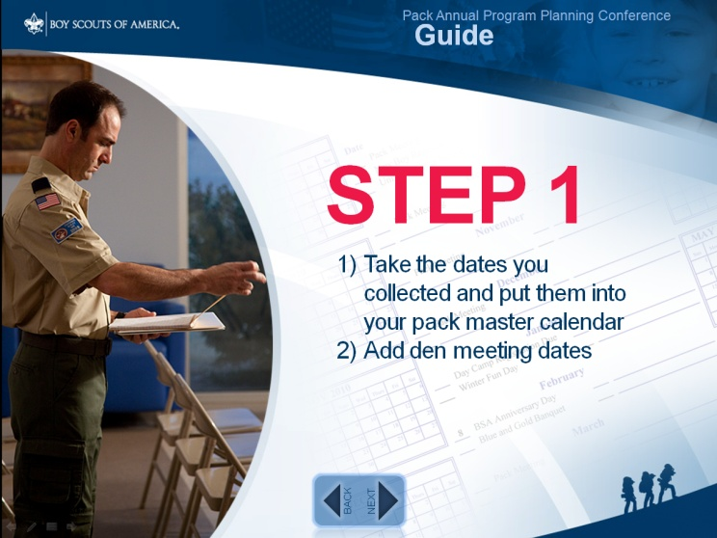
Pack Program Planning
Notes:
Old saying – Plan your work and work your plan. One of the three critical factors in the success of a Scouting unit is a planned program that is communicated with members and families.
Everything that happens in a program year starts with a plan.
There are a great many resources for packs to plan their program. The place to start is the Pack Annual Program Planning Conference Guide on Scouting.org. (If possible, go to the site and let them watch the first few parts, if not urge them to take a look at it when they get home.)
Unit Commissioner can be a great resource to a Cubmaster and a pack committee if they understand the program planning process and tools

Slide 135
Pack Program Planning
Unit commissioners should understand process and tools
Pack Annual Program Planning Conference Guide on Scouting.org
Program Helps and Pack Planning Chart
  Cub Scout Leader Program Notebook
  Council calendar
  Chartered organization needs
Annual program planning conference
Monthly pack leaders meeting
Den Chief – Den Leader meeting
Notes:
Unit commissioners can be a great resource to a Cubmaster and a pack committee if they understand the program planning process and tools. See Cub Scout Leader Book (Chapter 24) for process.
Planning normally starts with the Cub Scout and Webelos Scout Program Helps and the Pack Program Planning Chart.
Discuss (and display, where applicable)
Cub Scout and Webelos Scout Program Helps
Pack Program Planning Chart
Cub Scout Program Notebook
Council program calendar
Chartered organization program needs
The annual pack program planning conference. Who attends (Cubmaster, assistant Cubmasters, pack committee, den leaders, den chiefs, interested parents, and the unit commissioner.
The monthly pack leaders planning meeting
The monthly den chief-den leader meeting

Slide 136
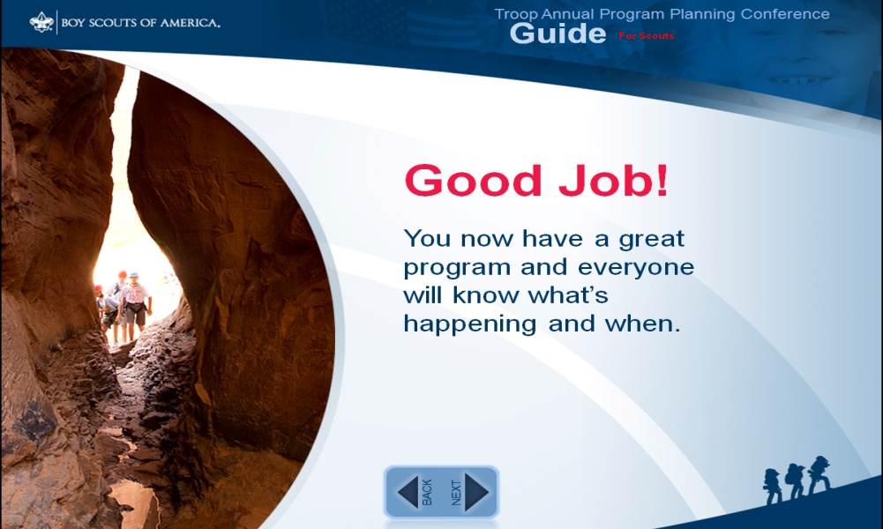
Troop and Team Program Planning
Notes:
Troop planning follows a process, as does the pack planning, but it involves the boys in much more of the planning.
Again, there are many resourced that can help with planning, but the place to start is the Troop Annual Program Planning Conference Guide
Teams can also use this planning tool along with the Varsity Scout resources.
Mention to participants that they can get better understanding of team program planning at Varsity Leader Basic Training.

Slide 137
Troop and Team Program Planning
Tools
  Troop Annual Program Planning Conference Guide
  Troop Program Features — 4 volumes
  Program Planning Chart
  Boy Scout Leader Program Notebook
Planning steps
  Homework (get ready)
  Find out what Scouts want (patrol leaders)
  PLC annual planning, SPL presiding
  Secure troop committee support
  Pass the word. Publicize.
Notes:
Explain that troop program planning follows a pattern, as does pack planning, but it involves the boys in much more of the planning. (See Chapter 8 of the Scoutmaster Handbook.)
Familiarity with these tools is imperative: (see slide)
Share the plan with every Scout, his family, chartered organization, and unit commissioner.
This is a good time to mention that, for those trainees who need a better understanding of program planning, a session from Cub Scout Leader or Boy Scout Leader Basic Training can be arranged.

Slide 138
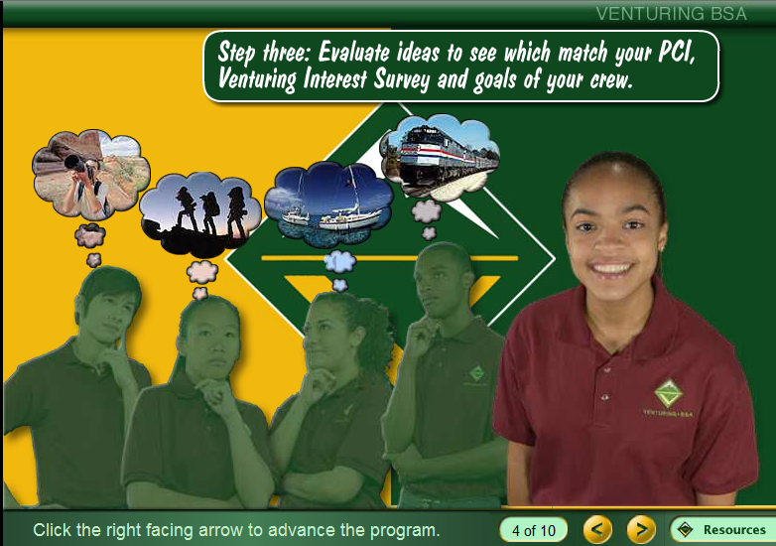
Crew Program Planning
Notes:
In Crew program planning, elected crew officers play a central role with as many crew members as possible involved.
A crew planning tool is also available on Scouting.org and there are many resources in the Venturing literature.

Slide 139
Crew Program Planning
Crew plans program
  Crew Planning Guide
  Program capability inventory (adult resources)
  Adult hobbies, interests, skills, careers, and Ideas from PCI to program planning forms
  Venturing activity interest survey
Planning steps
  Brainstorm activities
  Discuss and evaluate each idea
  Select activities and calendarize
  Plan details each month in advance
Notes:
Point out that in crew program planning, elected crew officers play the central role with as many crew members as possible involved in (1) suggesting ideas for activities, (2) planning the activities, and (3) participating in the activities.
Show Chapter 3, Planning Your Crew’s Program, from the Venturing Leader Manual.
PCI (Program Capability Inventory) form is filled out by all adults related to the crew, by parents, and by other people in the chartered organization.
Adult hobbies, interests, skills, careers, and ideas from the PCIs are then organized and transferred to program planning forms.
All Venturers complete the Venturing activity interest survey.
Using the above information, crew officers brainstorm all ideas for crew activities—without judging their merits for the moment.
Officers next discuss and evaluate each idea in relation to the PCI, Venturing activity interest survey responses, and the goals of the crew.
Officers select specific activities and place them on the crew’s annual program calendar.
Each month, officers plan the details for the next month’s individual activities.
Group Meeting Sparklers feature

Slide 140
Post Program Planning
Post plans program
  Adult resource survey
  Explorer activity interest survey
Planning steps
  Brainstorm activities
  Match activity interests with resources
  Fill in the gaps
  Schedule the activities
  Select activity chairs and consultants
  Follow-up
Notes:
Point out that in crew program planning, elected crew officers play the central role with as many crew members as possible involved in (1) suggesting ideas for activities, (2) planning the activities, and (3) participating in the activities.
Show Chapter 3, Planning Your Crew’s Program, from the Venturing Leader Manual.
PCI (Program Capability Inventory) form is filled out by all adults related to the crew, by parents, and by other people in the chartered organization.
Adult hobbies, interests, skills, careers, and ideas from the PCIs are then organized and transferred to program planning forms.
All Venturers complete the Venturing activity interest survey.
Using the above information, crew officers brainstorm all ideas for crew activities—without judging their merits for the moment.
Officers next discuss and evaluate each idea in relation to the PCI, Venturing activity interest survey responses, and the goals of the crew.
Officers select specific activities and place them on the crew’s annual program calendar.
Each month, officers plan the details for the next month’s individual activities.
Group Meeting Sparklers feature

Slide 141
10 Minute Break

Slide 142
Counseling
Notes:
Noon—10 Minutes

Slide 143
Counseling
Best way to help a unit to strengthen its leadership through effective counseling
Notes:
Point out that the best way to help a unit is to strengthen its leadership and that the most effective method of helping a leader develop his potential is counseling.
Commissioners must be good counselors to do their jobs well.
Counseling can be defined as the ability to listen to someone in such a way that they will solve their own problems.
Here are some fundamentals:
Carefully select a time and place where there will be no interruptions
Understand what the leader is saying
Let the leader know that you hear and understand
Do not give advice. Guide him, by questioning, in such a way that he solves his own problems. If he cannot find a solution, plant several possibilities in his mind, but let him select the one he thinks might work for him.
Summarize from time to time to keep him on track
Support his thinking with information. (know difference between information and advice)
Refer to the Commissioner Fieldbook – Counseling chapter

Slide 144
Counseling Defined
“The ability to listen to someone in such a way that they will solve their own problems."
Notes:
(CF pp. 34-35)
It must be pointed out that the best way to help a unit is to strengthen its leadership and that the most effective method of helping a leader develop his potential is counseling. Commissioners must be good counselors to do their jobs well.

Slide 145
Fundamentals of Good Counseling
Time and place with no interruptions
Understand what the leader is saying
Let the leader know you hear and understand
Do not give advice!
  Guide the discussion through questions
  Leader solves their own problem
  If they don't solve their own problem:
    Give information
    Propose possible alternatives
    Let leader pick best solution
Notes:
These are some fundamentals of good counseling
Carefully select a time and place where there will be no
interruptions
Understand what the leader is saying
Let the leader know that you hear and understand
Do not give advice. Guide, by questioning, in such a way that they solve their own problems. If they cannot find a solution, plant several possibilities in their mind, but let them select the one which they think might work for them.
Summarize from time to time to keep on track
Support thinking with information. Know the difference between information and advice.
Refer to the Commissioner Fieldbook, “Counseling,” pp. 34-35
Trainer Development Conference, “Counseling”

Slide 146
Fundamentals of Good Counseling Continued
Summarize from time to time to keep on track
Support thinking with information
  Know the difference between information and advice
Resources:
  Commissioner Fieldbook, Counseling
Notes:
These are some fundamentals of good counseling
Carefully select a time and place where there will be no
interruptions
Understand what the leader is saying
Let the leader know that you hear and understand
Do not give advice. Guide, by questioning, in such a way that they solve their own problems. If they cannot find a solution, plant several possibilities in their mind, but let them select the one which they think might work for them.
Summarize from time to time to keep on track
Support thinking with information. Know the difference between information and advice.
Refer to the Commissioner Fieldbook, “Counseling,” pp. 34-35
Trainer Development Conference, “Counseling”

Slide 147
Unit Charter Renewal Process
All Scout units
  Different, but similar system used for Explorer Posts
Re-register unit
  On time
Maximum membership
Good leadership (two deep trained leadership)
Notes:
This is our philosophy of service. If we do our jobs right all year long, all we have to do is complete a few papers. Unit Commissioners are the direct contact, but the ADC, DC, ACC, and CC are part of the plan also.
Chapter 12 in Fieldbook.

Slide 148

Charter Renewal
"If commissioners are providing regular visitation and doing their job as in the Unit Service Plan, then rechartering becomes a minor paperwork exercise."
  George Crowl, 1982
Notes:
(CF pp. 37-47)
This was my initial statement to district commissioners when I became Conquistador Council Commissioner in 1982. It is a philosophy of service. If we do our jobs right all year long, all we have to do is complete a few papers.

Slide 149
Unit Charter Renewal
2015 Changes
Units not rechartered by the end date on the charter will technically no longer exist.
A unit that does not recharter CANNOT legally operate
In time, members are dropped from the BSA
BSA insurance ceases
Advancement, achievements, and recognitions cannot take place including the Eagle rank
Tenure in rank for leadership positions stopped
Youth and adults no longer registered as members of the BSA
Notes:
Requires 3 years of tenure as a Commissioner
Discuss requirements for Award.

Slide 150
Unit Charter Renewal
2015 Changes (cont.)
In time, the unit will drop off membership reports
For NCAC, registration is handled centrally by National.

Slide 151
Unit Charter Renewal Process
At Least One Hundred Twenty Days Before:
District Commissioner sets recharter timeline, including dates for Recharter Training and District Wide turn in opportunities
Unit commissioners visit units to help identify major concerns with might impact charter renewal

Slide 152
Unit Charter Renewal Process
At least Ninety Days Before:
Membership inventory
Unit Key 3 leaders plus three other registered leaders can use tools at http://my.scouting.org to review and update:
  Unit roster information
  Leader training records
  Youth Protection Training records
Notes:
Ask for an actual inventory. Now is the time to reactivate boys, and know where every dropout has gone, and why.
Set up a charter review meeting
Usually regular committee meeting
Arrange for a uniform inspection
Give plenty of notice so boys (and adults) can prepare

Slide 153
Unit Charter Renewal Process
At least Ninety Days Before (cont.):
Charter renewal package is mailed to the unit leaders
Notes:
Ask for an actual inventory. Now is the time to reactivate boys, and know where every dropout has gone, and why.
Set up a charter review meeting
Usually regular committee meeting
Arrange for a uniform inspection
Give plenty of notice so boys (and adults) can prepare

Slide 154
Unit Charter Renewal Process
Ninety Days Before:
UCRS access window opens
Unit committee chair picks
adult designated to go online
and access UCRS
Set unit charter renewal meeting date
Notes:
To be a Quality District, the DE must visit each institution head
Is a relationships-building exercise
Sometimes is just “glad it is going well”
Sometimes is an opportunity to find out about problems
Decide on a plan of action to solve the problems
Find additional people to help serve
Unit roster should be put in the hands of the “right person”
Easiest to go to the unit leader, not always “right”
Unit leader should not have to do the paperwork!
Committee secretary or advancement person is best
Make sure it gets there, on time!

Slide 155
Unit Charter Renewal Process
Ninety Days Before:
  District Commissioner Team holds recharter training
Unit commissioners track and advise of any issues which could hold up timely
rechartering
Notes:
To be a Quality District, the DE must visit each institution head
Is a relationships-building exercise
Sometimes is just “glad it is going well”
Sometimes is an opportunity to find out about problems
Decide on a plan of action to solve the problems
Find additional people to help serve
Unit roster should be put in the hands of the “right person”
Easiest to go to the unit leader, not always “right”
Unit leader should not have to do the paperwork!
Committee secretary or advancement person is best
Make sure it gets there, on time!

Slide 156
Unit Charter Renewal Process
Sixty to Forty-five Days Before:
Unit Renewal Processor accesses UCRS, completes all steps of the process (except submittal) and prints Renewal Application for review with Unit Leaders
Notes:
Ask for an actual inventory. Now is the time to reactivate boys, and know where every dropout has gone, and why.
Set up a charter review meeting
Usually regular committee meeting
Arrange for a uniform inspection
Give plenty of notice so boys (and adults) can prepare

Slide 157
Unit Charter Renewal Process
At least Thirty Days Before:
Charter renewal packet, including forms
and fees, is given to UC
or taken to district’s
charter renewal turn-in
meeting
Notes:
Charter turn-in nights may vary by council, as much as 45 days in advance.
Charters must be complete, with signatures and fees, on turn-in night.
NOTE: A ScoutNet charter must be printed final with the signature page, and signed, before it may be turned in. Allow time to get the IH and unit leader signature. Corrections after the final printing may be made as on the manual charter.
A knowledgeable commissioner must audit each charter when it is turned in.

Slide 158
Charter Presentation
Thirty Days After
Commissioners Role/Responsibility
  Chartered organization head
  COR
  Unit Leader
  Unit Committee Chair
  The unit
Sample presentation in Commissioner Fieldbook
Notes:
The Charter presentation should occur at a regular meeting or activity of the Chartered Organization. This serves to accentuate the relationship between the unit and Chartered partner.
The presentation really belongs in the hands of the organization rather than the unit itself. It is important to attract the interest of as many members of the organization as possible. They will be more likely to attend if the event is put on by the organization more that the unit.
The Charter should be presented to the head of the chartered organization unless that person directs otherwise.
There is a presentation ceremony in the Commissioner’s Fieldbook.

Slide 159
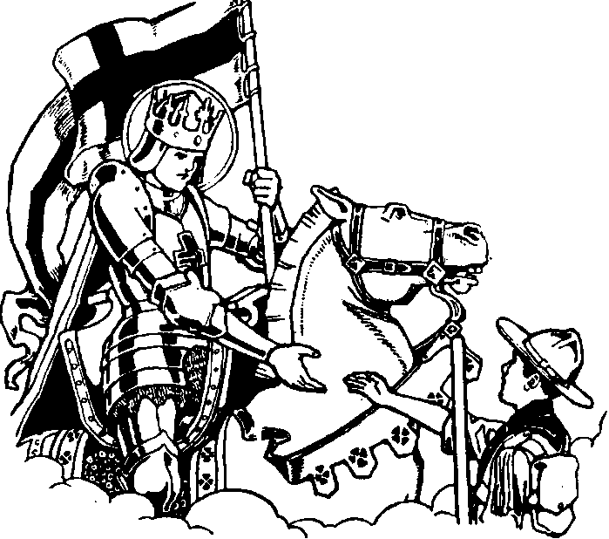
Lifesaving Commissioner
Notes:
(CF pp. 28-31)
Sometimes a commissioner is called on to save the life of a unit
How does he / she know when that needs to be done?
How do you go about it?

Slide 160
Danger Signals
Style of leadership
  Leader wants to keep authority
  Lacks faith in boys / leaders
  Leader trains only by mass instruction
  Leader does not grasp possibilities of patrol method
Unit is not meeting
Unit is without adult leaders
Notes:
As the student buzz groups report, ask them what action might be taken to correct the item

Slide 161
Danger Signals
Unit has no committee
No new members being added
Low attendance at meetings
Weak or poorly organized program
No advancement
No participation in day camp or summer camp
No unit budget
Notes:
As the student buzz groups report, ask them what action might be taken to correct the item

Slide 162
Vital Signs
What are they?
Notes:
Ask the students to identify what they are
List them on a flip chart or chalkboard
The BSA answers are on the next slide

Slide 163
Vital Signs
Youth dropping out
No youth recruiting or poor recruiting methods
No adult leader
No planned program
No youth leaders
No discipline
Unit stops meeting
Charter lapses
Chartered organization leader unhappy
Only one active adult
No parents involved
Adult conflicts / poor communications
Notes:
These are the vital signs the BSA has identified
Some of those you identified are probably also valid

Slide 164
Indicators of Unit Health: Pack
-Leadership -Family attendance
-Webelos dens -Den chiefs
-Tiger Cub dens
-Advancement
-Youth attendance
-Membership

Slide 165
Indicators of Unit Health: Troop
-Meeting operation -Boy leadership
-Attendance -Patrol activity
-Budget Plan -Outdoor program
-Membership -Adult assistance
-Skills instruction presentation
-Skills instruction levels

Slide 166
Indicators of Unit Health: Crew/Post
-Adult Advisors -Membership
-Elected officers -Meeting operation
-Planned program -Service projects
-Adult assistance -Program capability
inventory

Slide 167
Unit Condition
Know the condition of the unit at all times:
Is the program fun & challenging for the youth
Do leaders find the program rewarding
Is there a membership growth plan
Will the unit register on time.

Slide 168
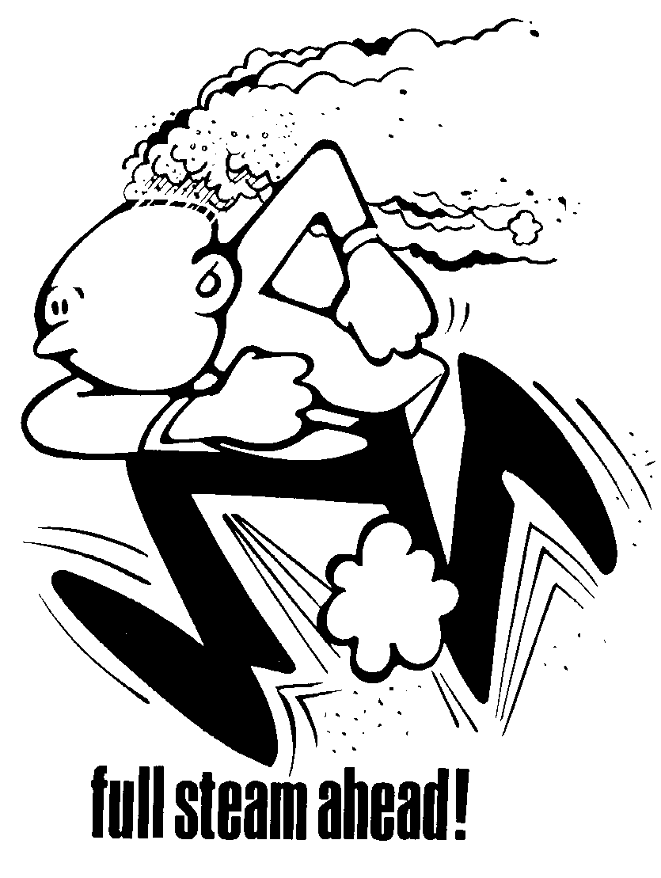
TAKE ACTION FAST
Consult ADC / DC
Ask some basic questions
  What are the problems?
  What are possible solutions?
  What do we do first?
  Who do we involve?
  How do we know when unit is saved?
  What is “plan B”?
Be enthusiastic
Apply "first aid“
Apply “second aid”
Promote teamwork

Slide 169
Hurry Cases
Unit not meeting
No leader
No committee
No new members
Conflict with chartered organization
New untrained leader
Weak leadership
Notes:
Lapsed / dropped charter — Complete the paperwork, if a paperwork problem. If there are deeper causes, solve those problems.
Not meeting “Stopped breathing” — Meet with unit leader and committee chairman, try to start meetings again, contact youth
No leader “No heartbeat” — Meet with committee chairman, committee and parents to find a new leader
No committee “Choking” — Discuss prospects with unit leader and committee chairman. Coach Committee Chairman in recruiting. Personally recruit people to committee positions. Contact parents.
No new members “Severe bleeding” — Help unit leader understand need for new members. Set up school rally. Provide incentives for boys to recruit.
Conflict with chartered organization “Poisoning by mouth” — Try to determine the cause of the conflict. Seek ways to defuse conflict. Counsel leadership of both on ways to work together.
New untrained leader “Blue baby” — Conduct Fast Start training immediately. Invite (take) leader to next basic training. Identify additional training opportunities.
Weak leadership “Comatose” — Counsel leaders. Coach leaders. Identify new, stronger leaders.

Slide 170
Lifesaving Team
Ad hoc, or organized
Bring appropriate skills to bear on the problem
Adapt to the individual problems
Notes:
Most lifesaving teams are probably ad hoc, made up of the UC, the ADC, a member of the training team, and/or a member of the membership team. The DE should often be involved.
If there are sufficient resources to do this, some people could specialize in this function.
Each team will have a little different emphasis, depending on the nature of the problem. Some may need crisis resolution, others need recruiting skills, others may just need training.

Slide 171
Commissioner Training/Service Awards/Resources

Slide 172
Additional Commissioner Training
Supplemental training at monthly
District Commissioner meetings
Annual Training Event:
  College of Commissioner Science
  Commissioner Conference
National Level Commissioner Training
  Philmont Training Center
  Seabase
Wood Badge
Notes:
Remember that commissioner training is continuous; it never stops. Continue your self-development after basic training. Know that training will be continuous and that you can always get other help if you need it.

Slide 173




Commissioner Awards
The Arrowhead Honor recognizes proficiency in the contemporary tools and techniques commissioners use to provide effective unit service
The Commissioner Award of Excellence in Unit Service is awarded to a commissioner who provides exemplary unit service, focusing on unit performance as measured in JTE and through the use of the Unit Service Plan and Commissioner Tools
The Commissioner’s Key encourages and recognizes continuing training, performance, and tenure by commissioners.
The Doctorate of Commissioner Science Knot Award recognizes completion of a standardized training program including a thesis or project, the awarding of the Doctorate of Commissioner Science from a College of Commissioner Science, and the achievement of performance objectives to improve unit service

Slide 174



Commissioner Awards
The Distinguished Commissioner Service Award is the highest recognition that can be given to a commissioner who has consistently engaged in distinguished and exceptional commissioner service resulting in significant, positive impact to youth, units, and a district and/or council.
The Certificate of Commendation is for use by a local council to recognize a commissioner who has performed in a commendable manner.
The NCAC Outstanding Commissioner Council Shoulder Patch (CSP) is awarded to unit commissioners, administrative commissioners, and/or roundtable commissioners who render outstanding commissioner service beyond the expectations of their position-specific areas of responsibility.

Slide 175
Commissioner Resources
National Commissioner Website:
http://www.scouting.org/Home/Commissioners.aspx
Manuals and resources:
http://www.scouting.org/Home/Commissioners/Manuals.aspx
National Commissioner Newsletter:
http://www.scouting.org/Home/Commissioners/newsletter.aspx
NCAC Commissioner Website:
http://www.ncacbsa.org/commissioners
NCAC Commissioner References and Resources:
Notes:
Remember that commissioner training is continuous; it never stops. Continue your self-development after basic training. Know that training will be continuous and that you can always get other help if you need it.

Slide 176
Open Forum:
Questions and Concerns

Slide 177
Summary
As a Commissioner,
You have made a personal commitment..
Notes:
Close with the following statement –
“As a leader, you have made a personal commitment to Scouting. It’s a commitment of time, effort, and knowledge. It’s a commitment of patience and understanding. It’s a commitment to be a living example for unit leaders, and to lend a helping hand to fellow Scouters.

Slide 178

Graduation
(If you have a current Youth Protection card)
Notes:
The author recommends that those who have Youth Protection Training completed (the 1 hour full certification) be graduated now, if they wish. The remainder is redundant for them.
Present the training card, the “Trained” strip, and a copy of the scorecard for the Arrowhead and Commissioner’s Key (CF p. 47). Some councils have other special certificates available.
Remind participants that the Arrowhead projects are those that really train a commissioner to do the job. The immediate goal is to be a friend to unit leaders. You improve your capability to do that by working your Arrowhead projects.
The final goal for all commissioners is to see that more youth have a better Scouting experience.

