Slide 1
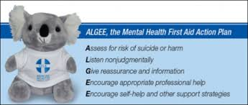
What is Mental Health First Aid?
Youth Mental Health First Aid USA is an 8 hour public education program which introduces participants to the unique risk factors and warning signs of mental health problems in adolescents, builds understanding of the importance of early intervention, and teaches individuals how to help an adolescent in crisis or experiencing a mental health challenge. Mental Health First Aid uses role-playing and simulations to demonstrate how to assess a mental health crisis; select interventions and provide initial help; and connect young people to professional, peer, social, and self-help care.
WHAT WILL PARTICIPANTS LEARN?
The course teaches participants the risk factors and warning signs of a variety of mental health challenges common among adolescents, including anxiety, depression, psychosis, eating disorders, AD/HD, disruptive behavior disorders, and substance use disorder. Participants do not learn to diagnose, nor how to provide any therapy or counseling – rather, participants learn to support a youth developing signs and symptoms of a mental illness or in an emotional crisis by applying a core five-step action plan:
Assess for risk of suicide or harm
Listen nonjudgmentally
Give reassurance and information
Encourage appropriate professional help
Encourage self-help and other support strategies
When: Saturday, January 27, 2018
Where: Grace United Methodist Church
9750 Wellington Rd, Manassas, VA
Time: 8:00AM – 4:30 PM
Cost: $10
Please sign up by Dec 6, by contacting Wally Skaja at walter_skaja@verizon.net or at https://scoutingevent.com/082-BRDMentalHealthFA. We need a minimum of 12 and can have up to 30 students. If there are more than 30 will work to arrange additional sessions.
Sometimes, first aid isn’t
a bandage,
or CPR,
or the Heimlich,
or calling 911.
Sometimes, first aid is YOU!

