Slide 1
BSA Online Application
System Nationwide Rollout
to
National Capital Area Council
April 3, 2017

Slide 2
Concept
Long Term Goal –
1 platform for all membership processing.
This version:
Major rollout nationally of new system piloted last year by 22 councils.
Big step forward, but incomplete to date
Should be valuable to Packs and Crews/Ships

Slide 3
Optional for Many
Paper applications still accepted. Most don’t need to scramble.
BUT some Units already accepting BeAScout online applications → AUTOMATIC change-over.
They’ll have to learn it (preferred), or turn-off online applications.
NCAC Incentive: Waiver of $1 insurance fee for Online Applications

Slide 4
White Oak Units Already Using Online Apps (BeAScout)
They automatically changed over to New System on April 4.
Packs | Troops
23 | 33
33 | 433
96 | 1012
492 | 4316
493
759
763

Slide 5
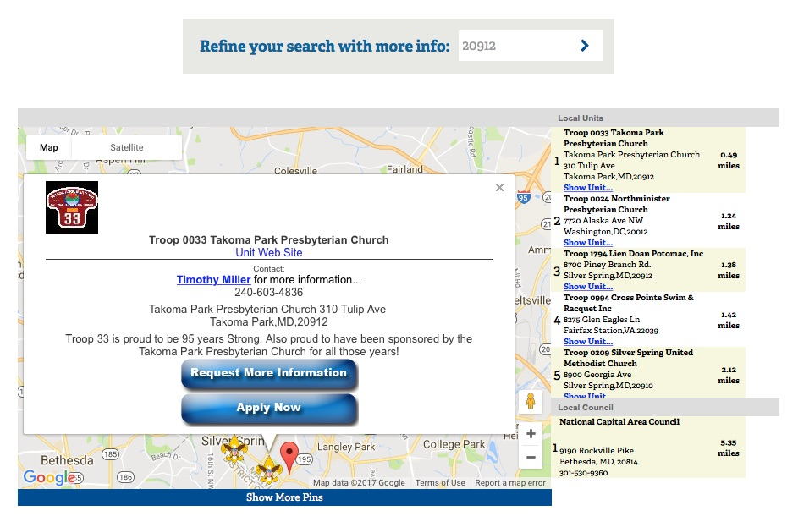
Example BeAScout Map Pin (Good)

Slide 6
Access On/Off Switch – via BeAScout
In accounts of registered Unit Key3:
Cubmaster
Committee Chair
COR
ACCESS control authority updates at rechartering BUT pin settings do not

Slide 7
BeAScout Updating – Automatic vs. Manual
AUTOMATIC update when Registering processed
Who has control = registered Unit Key 3
NOT updated at Rechartering – the pin settings
Which registered leaders receive notice from BeAScout

Slide 8
Detailed View of On Switch - BeAScout
Both should be Active for New System to Work

Slide 9
Use for - Youth & Adults
Mainly:
New to BSA
Registration Payment due
Traditional Scouting
Or:
Multiple (ex. Join a Venturing Crew while also a Boy Scout)
BUT NOT for:
Transfers (ex. Webelos to Boy Scouts)
Lions
Explorers or Learning for Life
Rechartering

Slide 10
New Tool #1 – Invitation Manager
Enter prospect leads or Prospect may request app. (via BeAScout)
Send unit-specific application link
Works with mobile
Track responses

Slide 11
New Tool #2 – Digital Application
Unit-specific data filled out by system
Unit can send 3 ways:
BeAScout map pin
QR code (unit specific)
Link (unit specific), ex. on unit’s website
Parent completes – can do mobilely
Payment can be DIRECTLY to BSA (CC) (registration, optionally Boys Life) or for LDS, invoice registration to LDS

Slide 12
New Tool #3 – Application Manager
Youth app. may be approved by ONE:
Unit leader (Cubmaster, Scoutmaster, etc.)
Committee Chair
COR
Adult app. may be approved by:
COR only (Unit may set-up to require Committee Chair to recommend first, but only COR may approve.)
No payments to/from Unit

Slide 13
Unit Personnel – Invitation Manager
via their My.Scouting accounts
Write/ Read access:
Unit leader (Cubmaster, Scoutmaster, etc.)
Committee Chair
COR
Institutional Head
Unit Membership Chair (BSA registered, then assigned position in My.Scouting by Committee Chair)
Read access:
Registration Support Committee Member (BSA registered, then assigned position in My.Scouting by Committee Chair)

Slide 14
Unit Personnel – Application Manager
Write (Approve or not) / Read access:
COR – Adults & Youth
Committee Chair – Youth & option to recommend (or not) Adults
Unit Leader – Youth
Read access:
Unit Membership Chair
Registration Support Committee Member

Slide 15
Differences from Paper System:
Far fewer left-blank fields on applications
Depth of status knowledge much wider
Exchanges between people much faster
Time limits:
Invitation Manager – 60 days to send invite
Application Manager – 30 days to approve or not
Unit doesn’t have to handle BSA registration or Boys Life payments (on joining)
Unit collect Unit-specific payment separately.

Slide 16
Adult Applications & Youth Protection
RECOMMENDED: COR withholds approval until get confirmation of YPT completion.
But new system won’t check YPT.
Unclear what will happen when it gets to BSA if not completed.
Per BSA regs, have 30 days to complete YPT after application approved.

Slide 17
Not Accepting Application:
“Reassign” → sends up to district to reassign to another unit. Give reason why.
“Do Not Accept” → Recommend to Council NOT to accept application to ANY Scouting unit Council will contact unit why.

Slide 18
District Action Decision:
Specifically who will Reassign applications to other units? Options:
District professionals
District Membership Chair
District Chair
District Commissioner

Slide 19
Training:
Unit Guidebook 2017 http://www.scouting.org/filestore/pdf/Online_Reg_UnitGuidebook.pdf
FAQs http://www.scouting.org/filestore/pdf/OnlineRegistrationFAQs.pdf
Training videos on YouTube:
How to Use Application Manager on My.Scouting https://www.youtube.com/watch?v=FXpB9XEucsk&feature=youtu.be
How to Review an Application https://www.youtube.com/watch?v=BmPyc_nGh5Q
How to Process a Youth Application https://www.youtube.com/watch?v=7rYuLswbPnE
How to Process Adult Application https://www.youtube.com/watch?v=3s_7O9WuTqE

Slide 20
BeAScout References:
By default, only access by Unit Key3
They can add other registered adults
How to use & customize Unit BeAScout: http://www.scouting.org/filestore/membership/ppt/beascoutsettingunitpin.ppt

Slide 21
Applicability to Types of Units:
Venturing – can use for most
Cub Scouts similar -- just not Lions
Boy Scouts – not Webelos cross-overs
Explorers – coming this fall

Slide 22
Unit Money Decision – Preferred?
Credit Card only option
→ Unit no longer handles BSA registration fee & Boys Life subscription for NEW members until charter year-end Everyone still recharters, and unit would collect & pay those fees for all.

Slide 23
Unit Money Decision – Traditional
Cash or Check only option → Similar to paper process now Unit collects money, then submits to NCAC with applicant’s voucher Everyone still recharters, and unit would collect & pay those fees for all.

Slide 24
Next Steps: Units
Registered Unit Key3 leaders got direct emails from BSA
System went online to Units – April 4.
Registered Unit Key3 leaders have the major roles
Beneficial to update unit’s BeAScout map info
Beneficial to have a Unit Membership Chair
Can learn how to use system – online training videos & guide.
OR Attend Roundtable or Program Launch training.
Decide whether or not to opt-in

Slide 25
Recommendations to Packs & Crews
New systems probably very beneficial:
Invitation Manager should work for all cases
Application Manager should work for many.
If applicable, register incoming Cubmaster and Committee Chair at end of school year – don’t wait until recharter.
Recruit at least 1 new Scout or adult – so that can learn system before fall mad-rush
Consider allowing payment of BSA registration (and Boys Life) for NEW members directly to BSA (credit card option).
Unit still has to collect its own unit dues payment, but streamlines transaction with council and BSA
Payment to BSA at rechartering will not change – payment by unit

Slide 26
Recommendations to Explorers & Troops
Explorers – system upgrade expected this fall for Exploring use
Troops – limited use until 2018 release?
Invitation Manager might be helpful for multi-user tracking on contacts
Application system – does not do Transfers (ex. Webelos-to-Boy Scouts) Can only use for new-to-Boy Scouts

Slide 27
Promotional Video
https://www.youtube.com/watch?v=LMIlTe5-yV0
Scouting Magazine's Promotional Video

Slide 28
QUESTIONS?

