Slide 1



LIFE TO EAGLE
SEMINAR for Scouts
(2018 Version 1.1)
National Capital Area Council
Sully District
Notes:
1
Version 3.0
Incorporated Updated version provided by NCAC (Version 2.0 was Sully District produced presentation)
Moved several NCAC slides to backup as part of effort to stay within time constraints
Version 3.0.1
Made formatting changes for display appearance
Updated graphic of GTA to reflect 2015 version (original slides contained earlier version)
Added bumper sticker on slide with NCAC reference material to indicate updated 2015 GTA, ESSP and ESRA available

Slide 2
Why Are We Here?
Learn about the Life to Eagle process
  Service Project, Eagle Scout Rank Application (ESRA), and Board of Review
  District Advancement Chair and Eagle Representative’s (DER) responsibilities
Help Eagle Scout Candidates succeed
Maintain the high quality of our District’s Eagle Advancement Program
Notes:
1.General Changes
a. Change in page numbering methodology from Section # - Page # (e.g., 2-1, 4-2) to just Page 3, Proposal Page C, Final Plan Page A, etc. When enough text is added to move a block to a new page, the new page is labeled Proposal Page C-2, Final Plan Page A-2, etc.
b. Text boxes - some text boxes were made larger to, in my opinion, encourage additional content or make use of available space on the page.
c. When a cursor is in a date field, a drop down box, indicated by an arrow, appears on the right side of the field for selecting a date.

Slide 3
References
Guide to Advancement 2017, Boy Scouts of America
https://www.scouting.org/filestore/pdf/33088.pdf

Slide 4
References
Eagle Scout Procedures Guide, October 2017, National Capital Area Council, Boy Scouts of America
http://www.ncacbsa.org/wp-content/uploads/ 2015/10/Eagle_Scout_Procedures_Guide-1.pdf

Slide 5
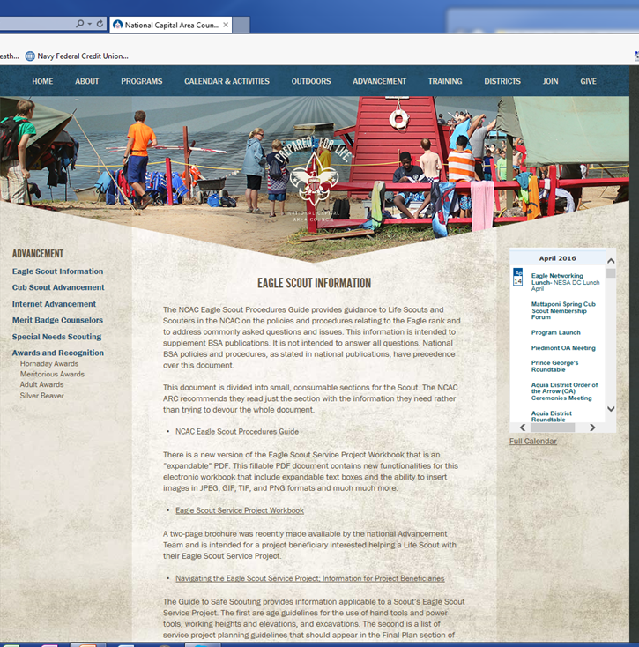
NCAC Web Site
http://www.ncacbsa.org/advancement/eagle-scout-information/

Slide 6
Life to Eagle
Primary Requirements
  Active Participation (Registered Scout)
  Merit Badges
  Position of Responsibility
  Eagle Scout Service Project
  Scoutmaster Conference
Eagle Scout Rank Application (ESRA) Package
  Coordinate with Scoutmaster, Advancement Chair or Eagle Advisor
Eagle Board of Review (EBOR)
Eagle Court of Honor (ECOH)

Slide 7
Getting Started
This is one approach that’s been proven to work; but is by no means a requirement
Set up a folder on your computer
  Download the Eagle Scout Service Project (ESSP) Workbook
  Download the Eagle Scout Rank Application (ESRA)
Get a 2 inch binder and create 5 sections:
  Eagle Scout Service Project
  Eagle Scout Rank Application
  Pictures
  Record log of hours worked
  Miscellaneous
Skim the ESSP Workbook and ESRA
  Read the “Message to Scouts and Parents or Guardians”
Make contact with your Unit Eagle Coach

Slide 8
Eagle Scout Service Project (ESSP)
While a Life Scout, plan, develop, and give leadership to others in a service project helpful to any religious institution, any school, or your community.
  The project must benefit an organization other than Boy Scouting
A project proposal must be approved by the organization benefiting from the effort, your unit leader and unit committee, and the council or district before you start.
You must use the Eagle Scout Service Project Workbook, No. 512-927, in meeting this requirement.
GTA §9.0.2.0
Notes:
8

Slide 9
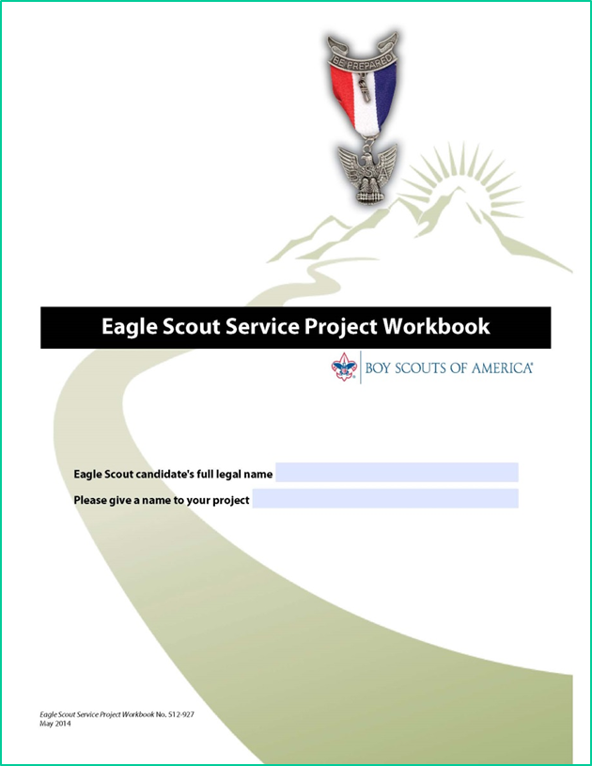
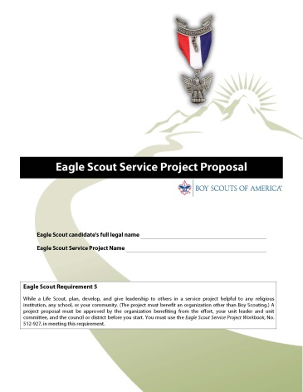
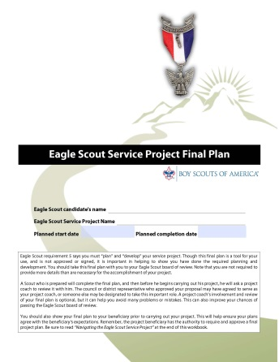
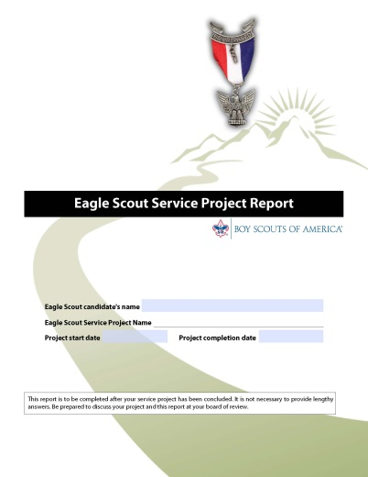
Service Project Process
Propose It
Plan It
Report It
Do it
Notes:
This shows the progression the scout will take to complete the project.

Slide 10
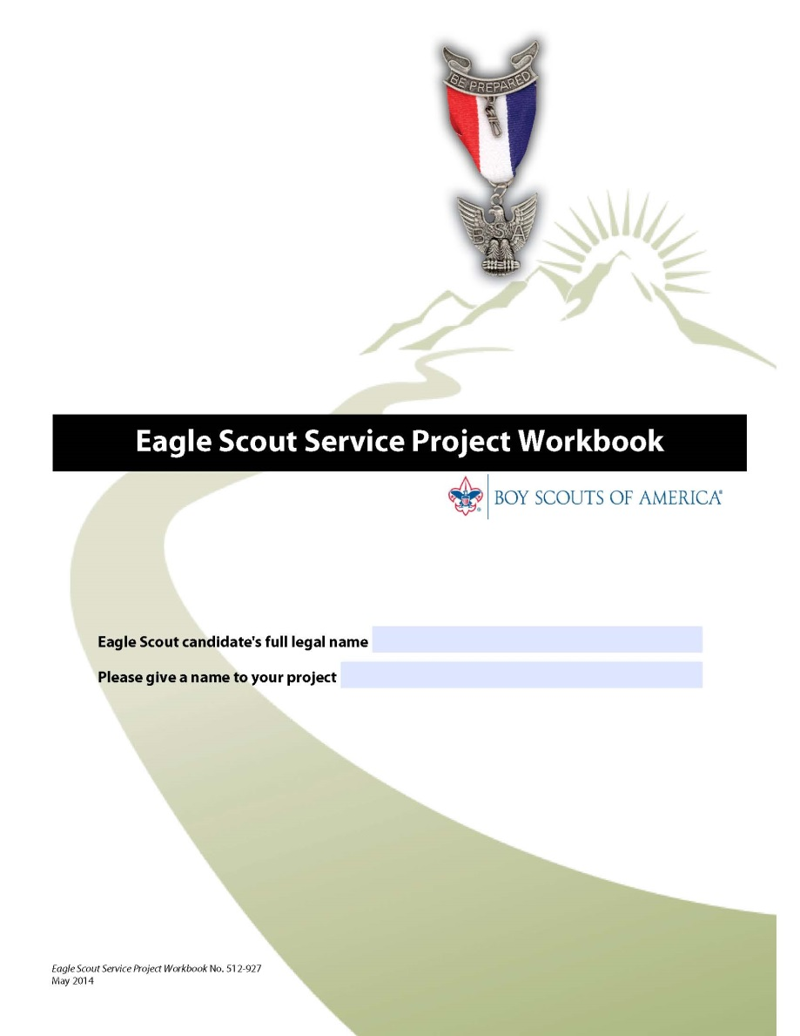
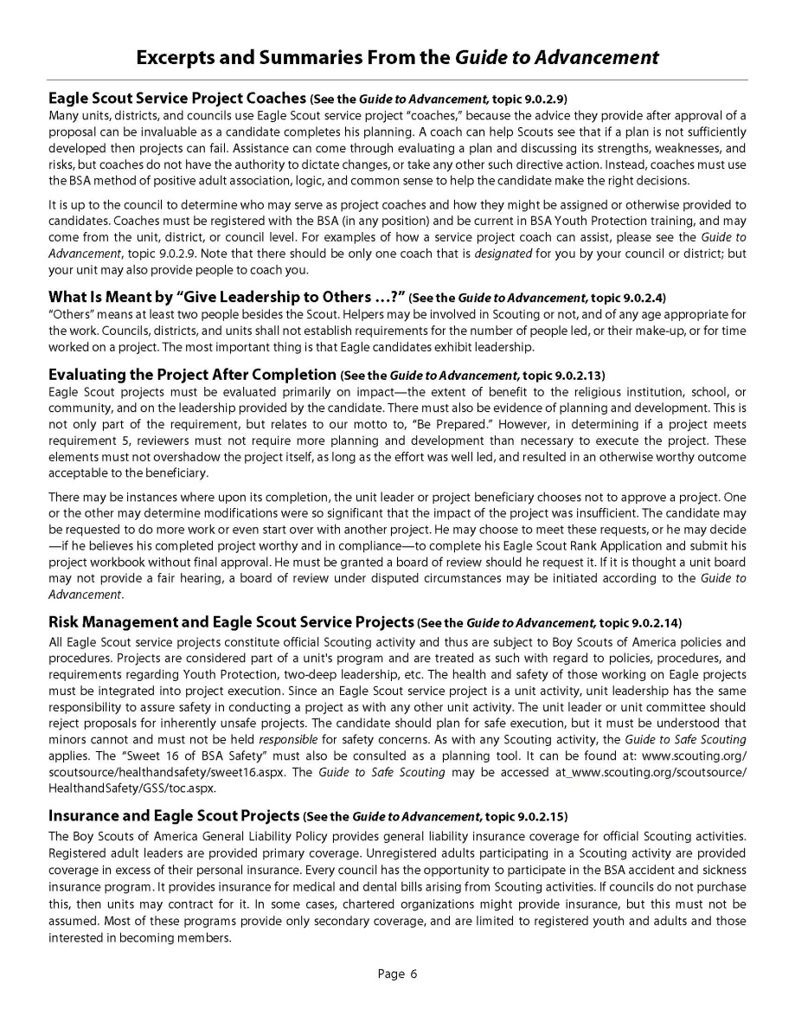
The Workbook
Fillable and expandable
PDF
Must fill in all relevant information
Available online:
NCAC web page,
https://www.scouting.org/Home/BoyScouts/AdvancementandAwards/EagleWorkbookProcedures.aspx
Must read and use
entire workbook
GTA §9.0.2.0
GTA §9.0.2.8
Notes:
“How to Use This Workbook” simplified and moved from page 5 to this page. Parts of this section are also included in the “Eagle Scout Service Project Proposal” section under “Instructions for Completing Your Proposal”. Hyperlinks added to this page that take a Scout to appropriate section.

Slide 11
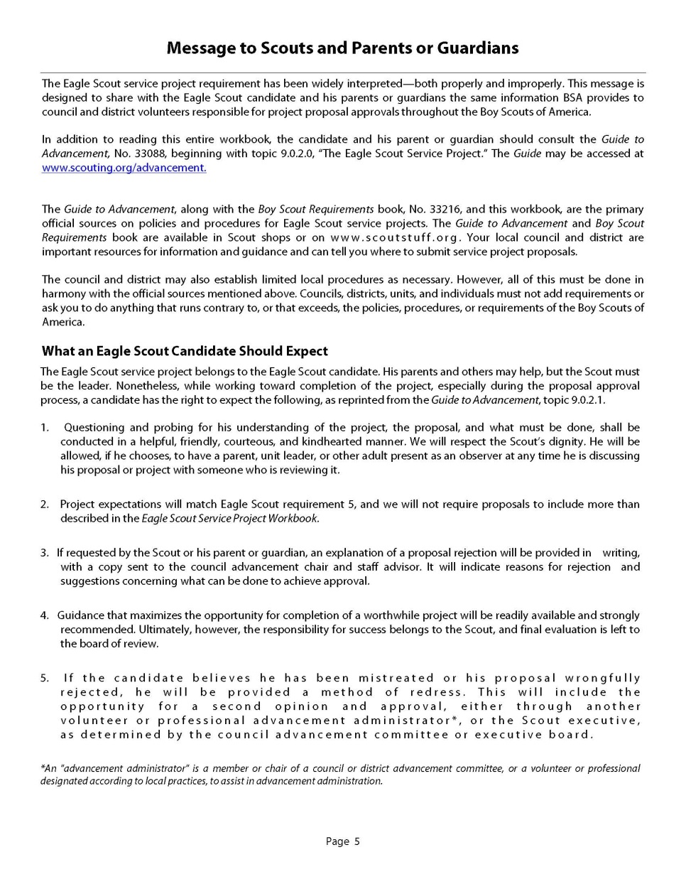
Expectations
Message to Scouts and Parents or Guardians
Establishes expectations for Scouts, parents (or guardians), and other adults
Page 5
Notes:
a. There is a new “Message From the Chief Scout Executive” and picture.
b. “Scouts and Parents or Guardians” box updated.
c. Other two boxes (“Only the Official Workbook May Be Used”, “Attention: Unit, District, and Council Reviewers”) moved to this page, from Contents page and updated.
d. Section on “Completing This Workbook” removed and integrated into other areas

Slide 12
Keeping Track of Time
From the time you begin looking for a project to completion, you should be keeping track of time
A small pocket notebook, a spreadsheet on a laptop, a notepad on a smartphone, or a loose leaf page in the project workbook are all acceptable
Each entry should include: person’s name, date, hours or fractions of hours, purpose
  Accumulated data will be entered in the Project Report
Time includes such things as research, making phone calls, participating in meetings, completing the Eagle Scout Service Project Workbook
Record not only the time you spend on the project, but also the time others spend helping you on the project
  Time spent meeting with an adult on the project
  Time a parent spends driving you to and from a home improvement store
  Time friends spend actually working on the project

Slide 13
Photographs
Project photos add an important perspective to the workbook
  However, they are optional!
If the candidate elects to include photos, he is encouraged to include:
  Before pictures
  Pictures of project work
  Completion pictures
Captions are helpful to describe who or what are in the photos
Notes:
13

Slide 14
Selecting a Project
Responsibility of the Eagle Candidate
  Find a project
    The project should be the Scout’s idea
    Something he believes in, enjoys doing, and is potentially good at accomplishing
    There is no limitation as long as it meets service and leadership requirements
  Work with the project Beneficiary and the Beneficiary’s Representative
    Share the information sheet for project beneficiaries
Notes:
14

Slide 15
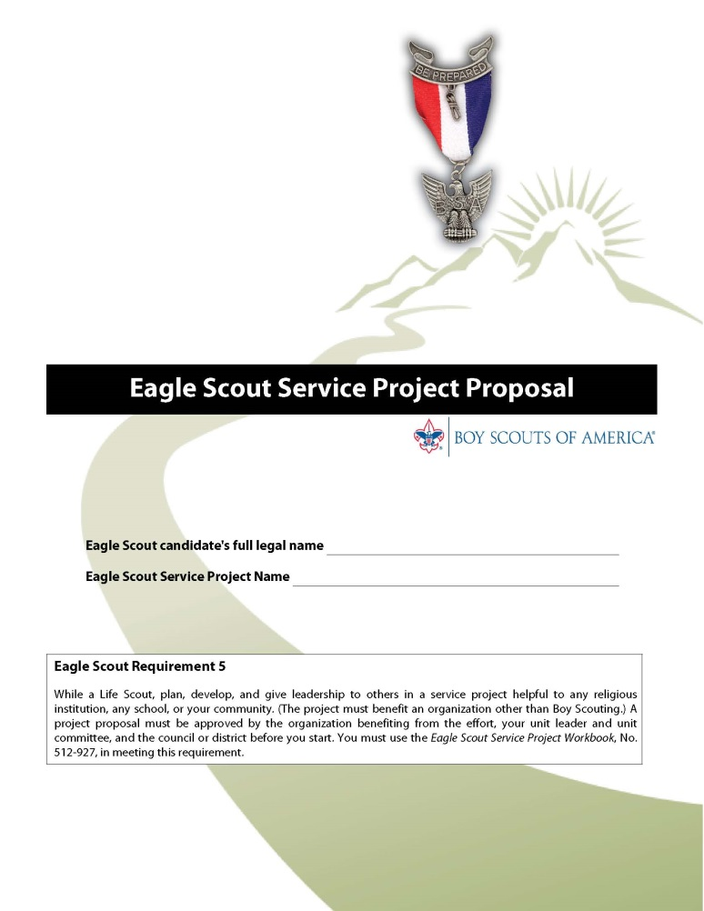
Project Proposal

Slide 16
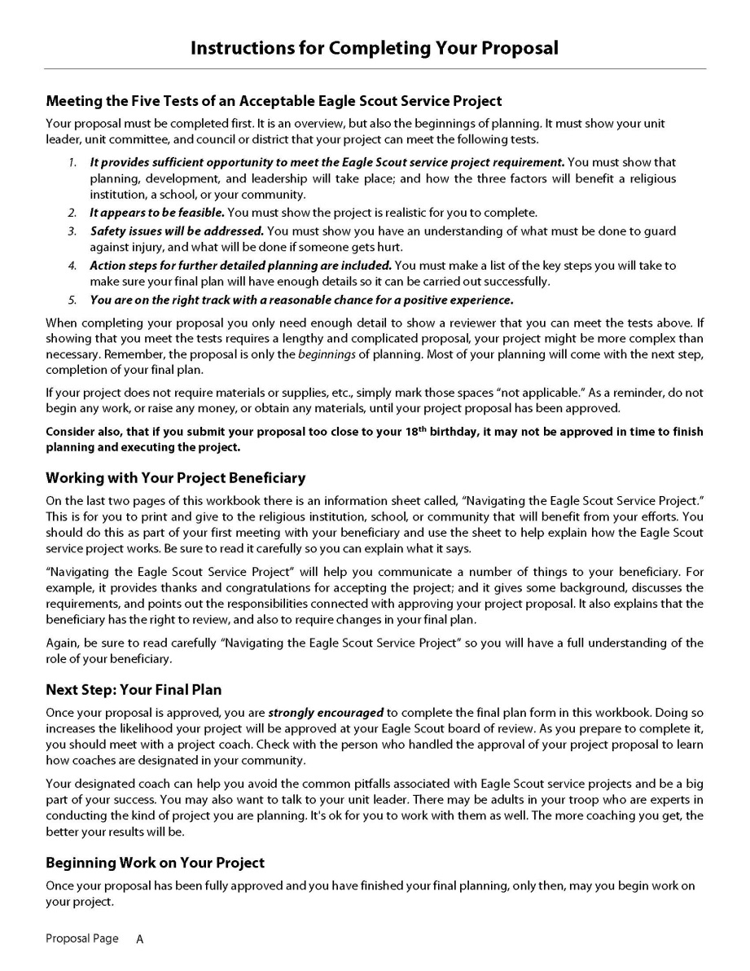
Proposal Page A
Instructions for Completing Proposal
Must Read Carefully and Completely
Meets the Five Tests of an Acceptable ESSP
Work with Your Project Beneficiary
Next Step: Your Final Plan
Beginning Work on Your Project
Notes:
New page (previously outside the proposal section) describing the five tests of an acceptable Eagle Scout Service Project, advice on working with the project beneficiary, developing the final plan, and beginning work on the project.

Slide 17
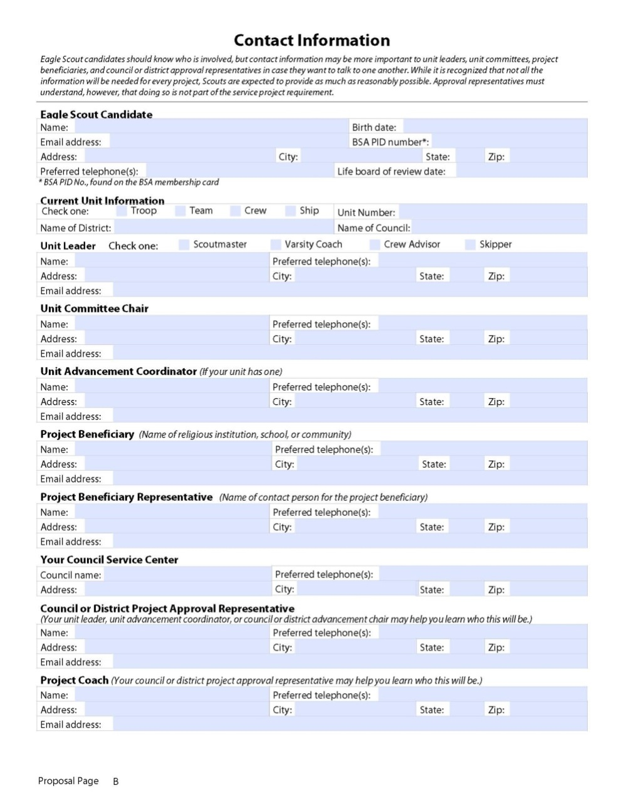
Proposal Page B
Contact Information
Scout’s Name
Unit
Unit Leader
Committee Chair
Advancement Coordinator
Project Beneficiary
Project Beneficiary Representative
Council Service Center
District Approval Representative (this is the District Eagle Representative (DER))
Project Coach
Should Be Completely Filled In
Expandable
Notes:
- New page (previously outside the proposal section) with all the contact information for the project.
Note added to the top of the page regarding importance of this information but that it is not part of the service project requirement.
BSA PID number entries removed from Unit Leader and Unit Committee Chair blocks.
E‑mail address removed from Your Council Service Center block.
This page MUST be filled out completely. The large letters in the block on the right are the titles of the blocks on the page.

Slide 18
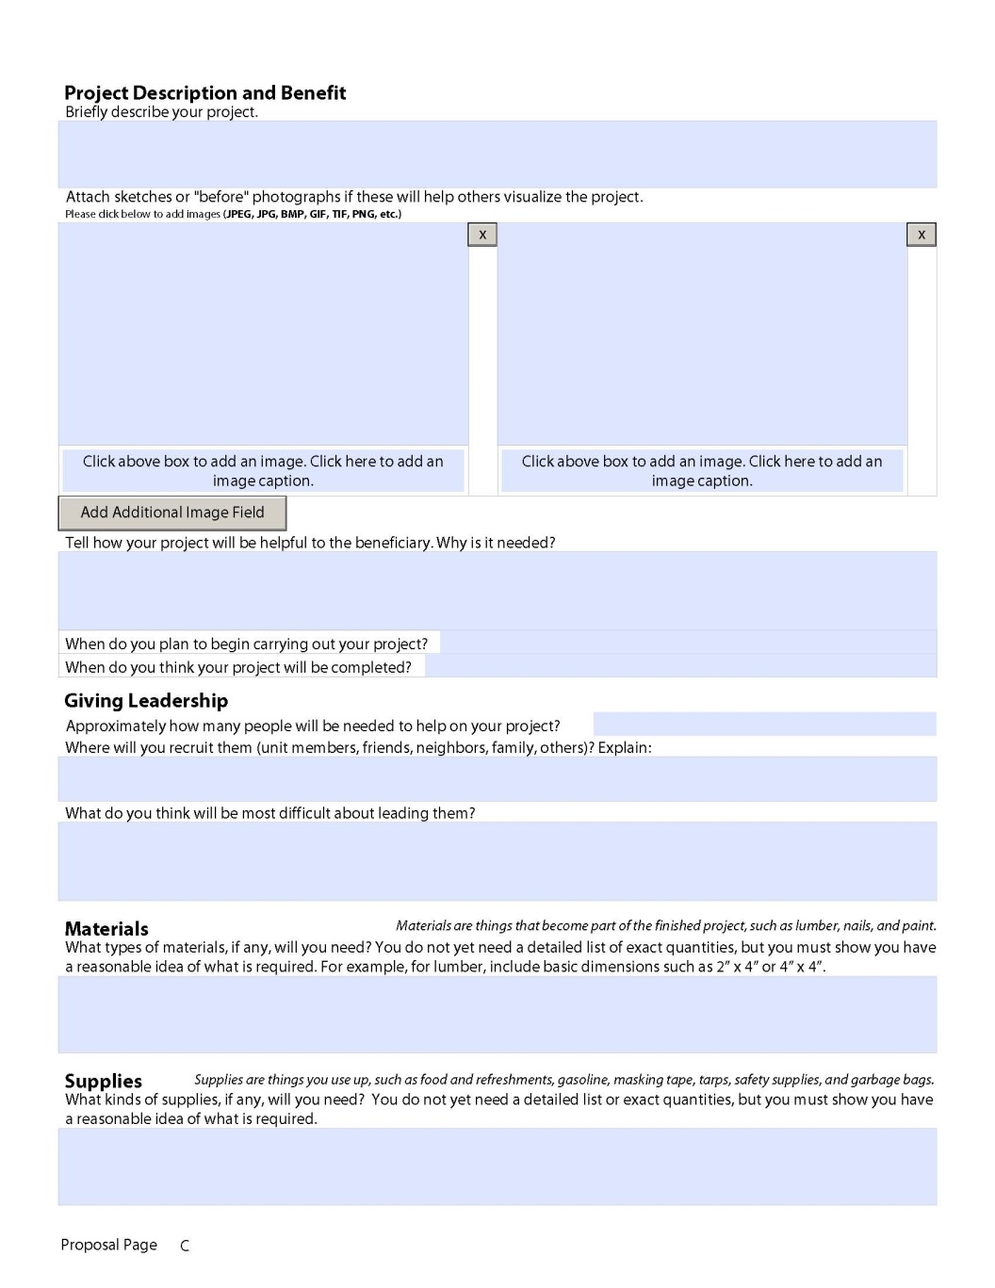
Proposal Page C
Description & Benefit
Pictures and Captions
Giving Leadership
Materials
Supplies
Notes:
Picture boxes are larger (two across versus three across).
Example added to Materials section indicating a little more detail should be added in order to show the Scout has a reasonable idea what is required without going into exact quantities. This idea replicated in Supplies and Tools sections,
Added Other Needs section for items that don’t fit in the other three categories.
Preliminary Cost Estimate - expanded notes to include guidance on donated materials, loaned tools/items, and the fundraising application.

Slide 19
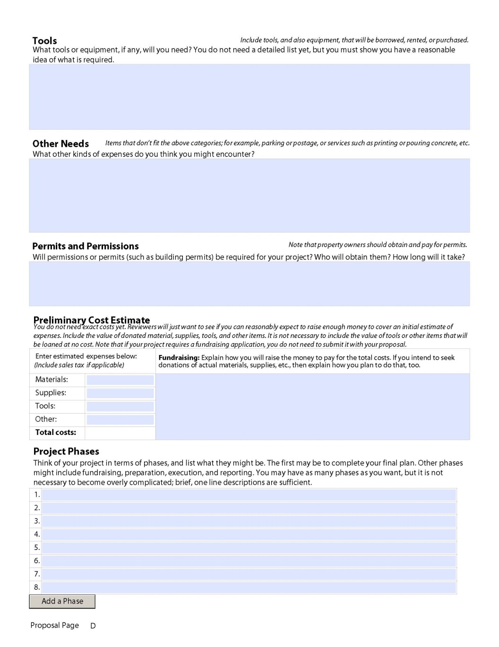
Proposal Page D
Tools
Other Needs
Permits & Permissions
Preliminary Cost Estimate
Project Phases
Notes:
Picture boxes are larger (two across versus three across).
Example added to Materials section indicating a little more detail should be added in order to show the Scout has a reasonable idea what is required without going into exact quantities. This idea replicated in Supplies and Tools sections,
Added Other Needs section for items that don’t fit in the other three categories.
Preliminary Cost Estimate - expanded notes to include guidance on donated materials, loaned tools/items, and the fundraising application.

Slide 20
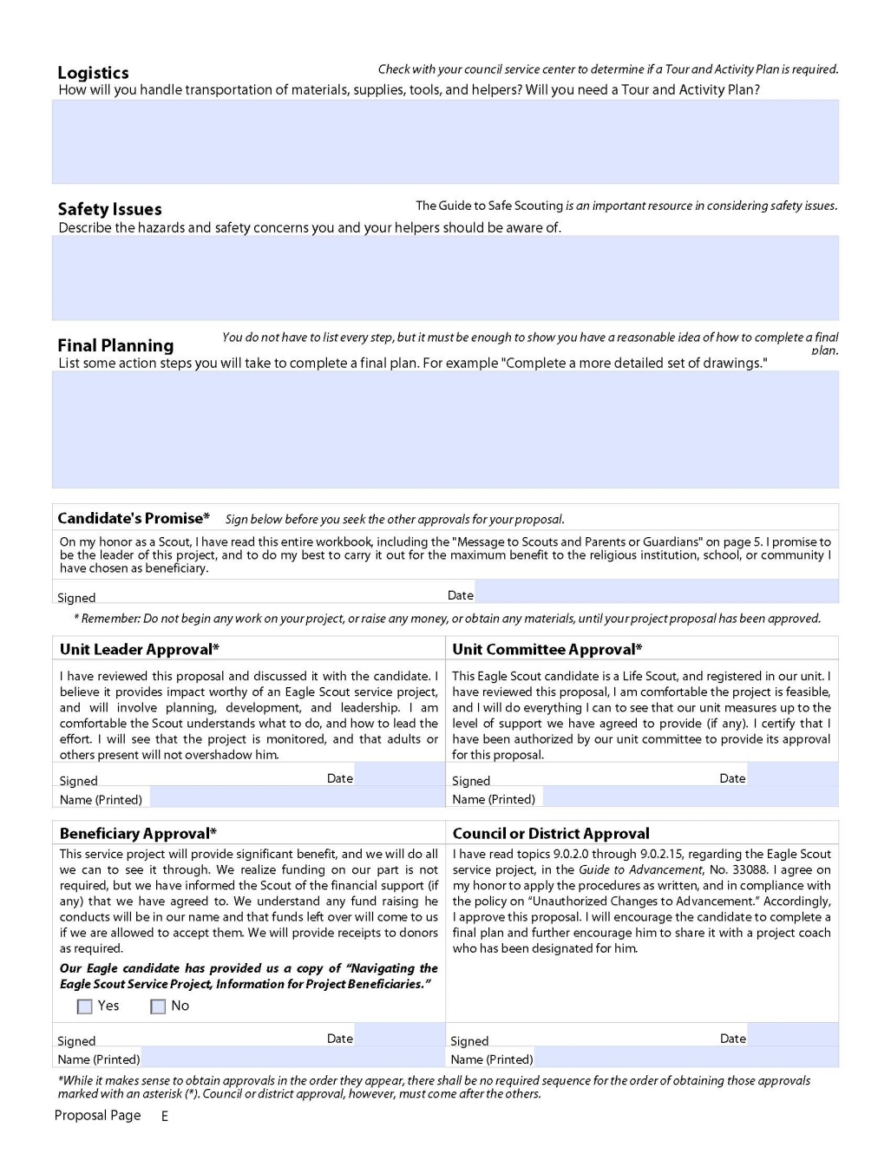
Proposal Page E
Logistics
Safety Issues
Final Planning
Candidate’s Promise
Approval Signatures
Notes:
Candidate’s Promise - reminder added to not begin work on the project, or raise money, or obtain materials until after proposal approval.
When enough text is added to add a page, the entire set of signature blocks moves to the next page.
Name (Printed) blocks added below each Signed block in the approval section.
Check box added in Beneficiary Approval block to indicate whether the “Navigating the Eagle Scout Service Project, Information for Project Beneficiaries” flier was provided to the beneficiary. This flier is now provided at the end of the workbook.

Slide 21
Candidate’s Promise
Proposal Page E
(Signed before approvals below are granted)
*Remember: Do not begin any work on your project, or raise any money, or obtain any materials, until your project proposal has been approved.
“On my honor as a Scout, I have read this entire workbook, including the "Message to Scouts and Parents or Guardians" on page 5. I promise to be the leader of this project, and to do my best to carry it out for the maximum benefit to the religious institution, school, or community I have chosen as beneficiary.”
Notes:
Should emphasis that the scout has read the entire workbook and that he is the Leader of the project.
Candidate’s Promise - reminder added to not begin work on the project, or raise money, or obtain materials until after proposal approval.
When enough text is added to add a page, the entire set of signature blocks moves to the next page.
Name (Printed) blocks added below each Signed block in the approval section.
Check box added in Beneficiary Approval block to indicate whether the “Navigating the Eagle Scout Service Project, Information for Project Beneficiaries” flier was provided to the beneficiary. This flier is now provided at the end of the workbook.

Slide 22
Proposal Page E
Approvals
Last
“*While it makes sense to obtain them in the order they appear, there shall be no required sequence for the order of obtaining approvals marked with an asterisk (*). However, Council or District Approval must come after the others.”

Slide 23
Project Fundraising
Fundraising is permitted only for securing materials and otherwise facilitating a project
Fundraising can be done without Council approval from:
  The beneficiary
  The candidate
  The candidate’s parents or relatives
  The candidate’s unit
  The unit’s chartered organization
  Parents or members of the candidate’s unit
NCAC is the approving authority on the Eagle Scout Service Project Fundraising Application
  Completed forms are faxed to 240-395-0610 or
  e-mailed to: ncaceaglefunds@scouting.org for approval

Slide 24

Project FINAL PLAN
Notes:
Under “The Final Plan”, an important sentence was added: “No one approves it, although your project beneficiary has the authority to review it and require changes in it.”
Text added that covers handling, development, and potential beneficiary approval of the final plan.

Slide 25
Words About Planning - 1
Eagle Scout Rank Requirement #5 requires the Scout to plan and develop his service project
Though this final plan is a tool for your use, and is not approved or signed, it is important in helping to show you have done the required planning and development
You should take this final plan with you to your Eagle Scout board of review
  You are not required to provide more details than are necessary for the accomplishment of your project

Slide 26
Words About Planning - 2
A Scout who is prepared will complete the final plan, and then before carrying out his project, have a project coach review it
  A project coach's involvement and review of your final plan is optional, but it can help you avoid many problems or mistakes
  Improves your chances of passing the Eagle Scout board of review
You should also show your final plan to your beneficiary prior to carrying out your project
  Helps ensure your plans agree with the beneficiary's expectations
  The project beneficiary has the authority to require and approve a final project plan
  Be sure to read “Navigating the Eagle Scout Service Project”

Slide 27
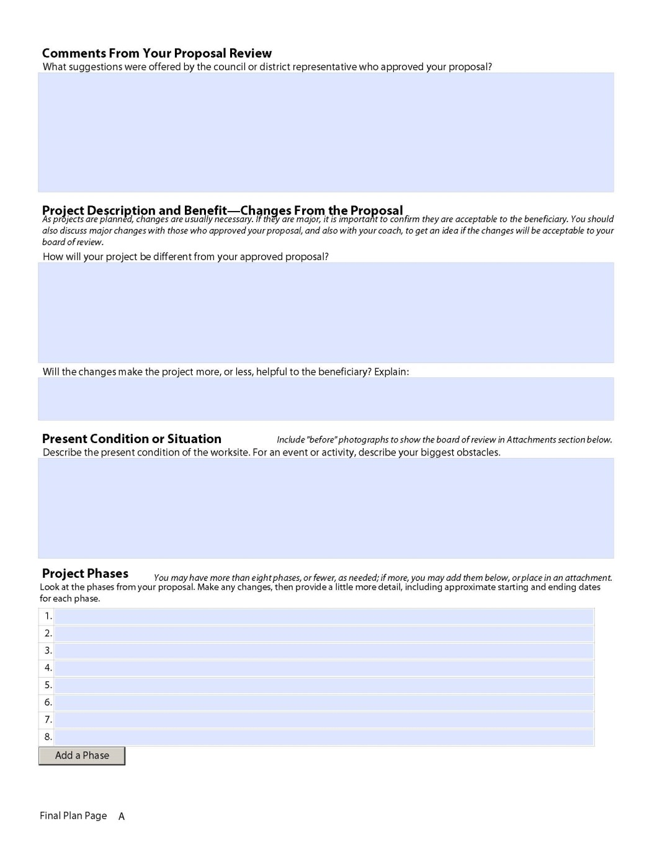
Final Plan Page A
Comments From Your Proposal Review
Completed by Eagle Candidate following Proposal Approval
Project Description and Benefit – Changes From the Proposal
Will the changes make the project more, or less, helpful to the beneficiary? Explain:
Present Conditions or Situation
Project Phases
Notes:
Text added that covers handling, development, and potential beneficiary approval of the final plan.
Attachments - section added to encourage Scouts to attach or insert separate documents (e.g., plans, drawings, maps, pictures, etc) that support their project and which should be sent along with the workbook.
Permits and Permissions - separate line provided for the Scout to indicate whether a Tour and Activity Plan will be needed to comply with local policies.

Slide 28
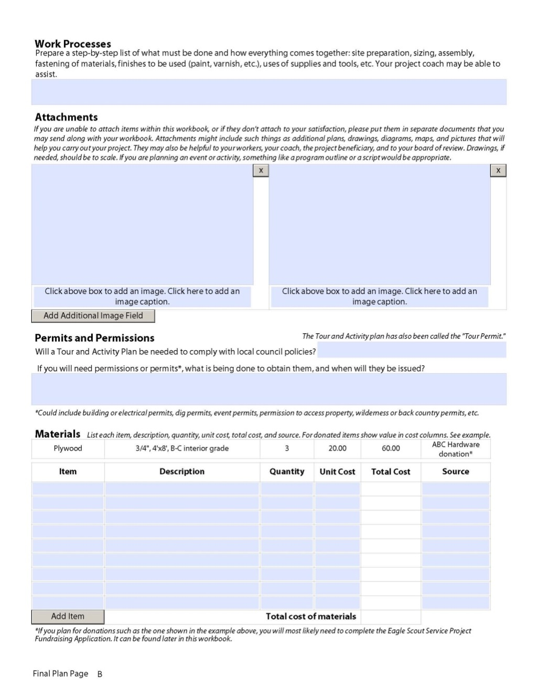
Final Plan Page B
Work Processes
Attachments
Permits and Permissions
Materials
Notes:
Attachments - section added to encourage Scouts to attach or insert separate documents (e.g., plans, drawings, maps, pictures, etc) that support their project and which should be sent along with the workbook.
Permits and Permissions - separate line provided for the Scout to indicate whether a Tour and Activity Plan will be needed to comply with local policies.

Slide 29
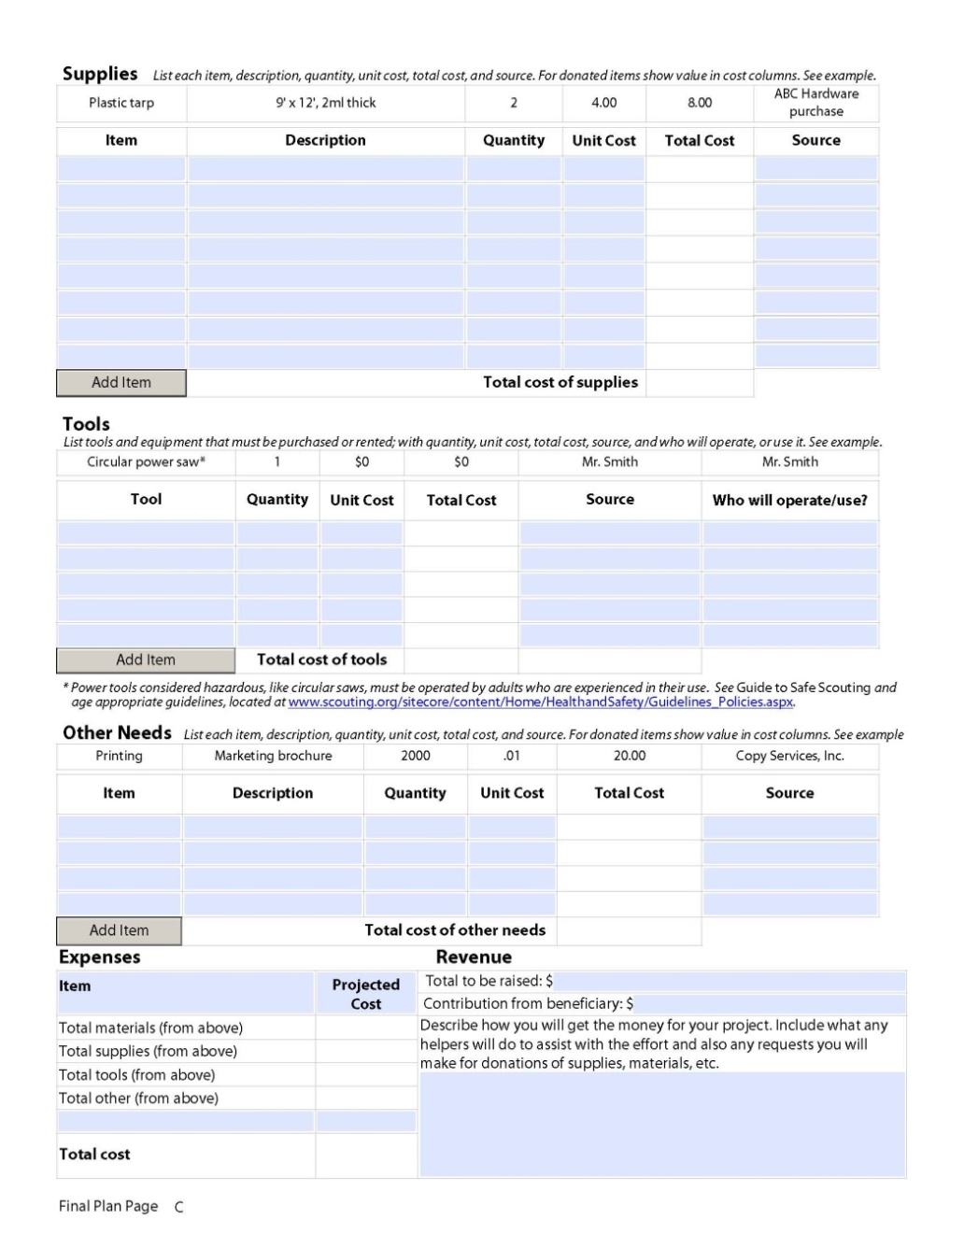
Final Plan Page C
Supplies
Tools
Other Needs
Expenses / Revenue
Notes:
Tools - link added for Guide to Safe Scouting guidelines and policies.
Other Needs - added table similar to Materials, Supplies, and Tools tables to specify other items not covered by those three categories.

Slide 30
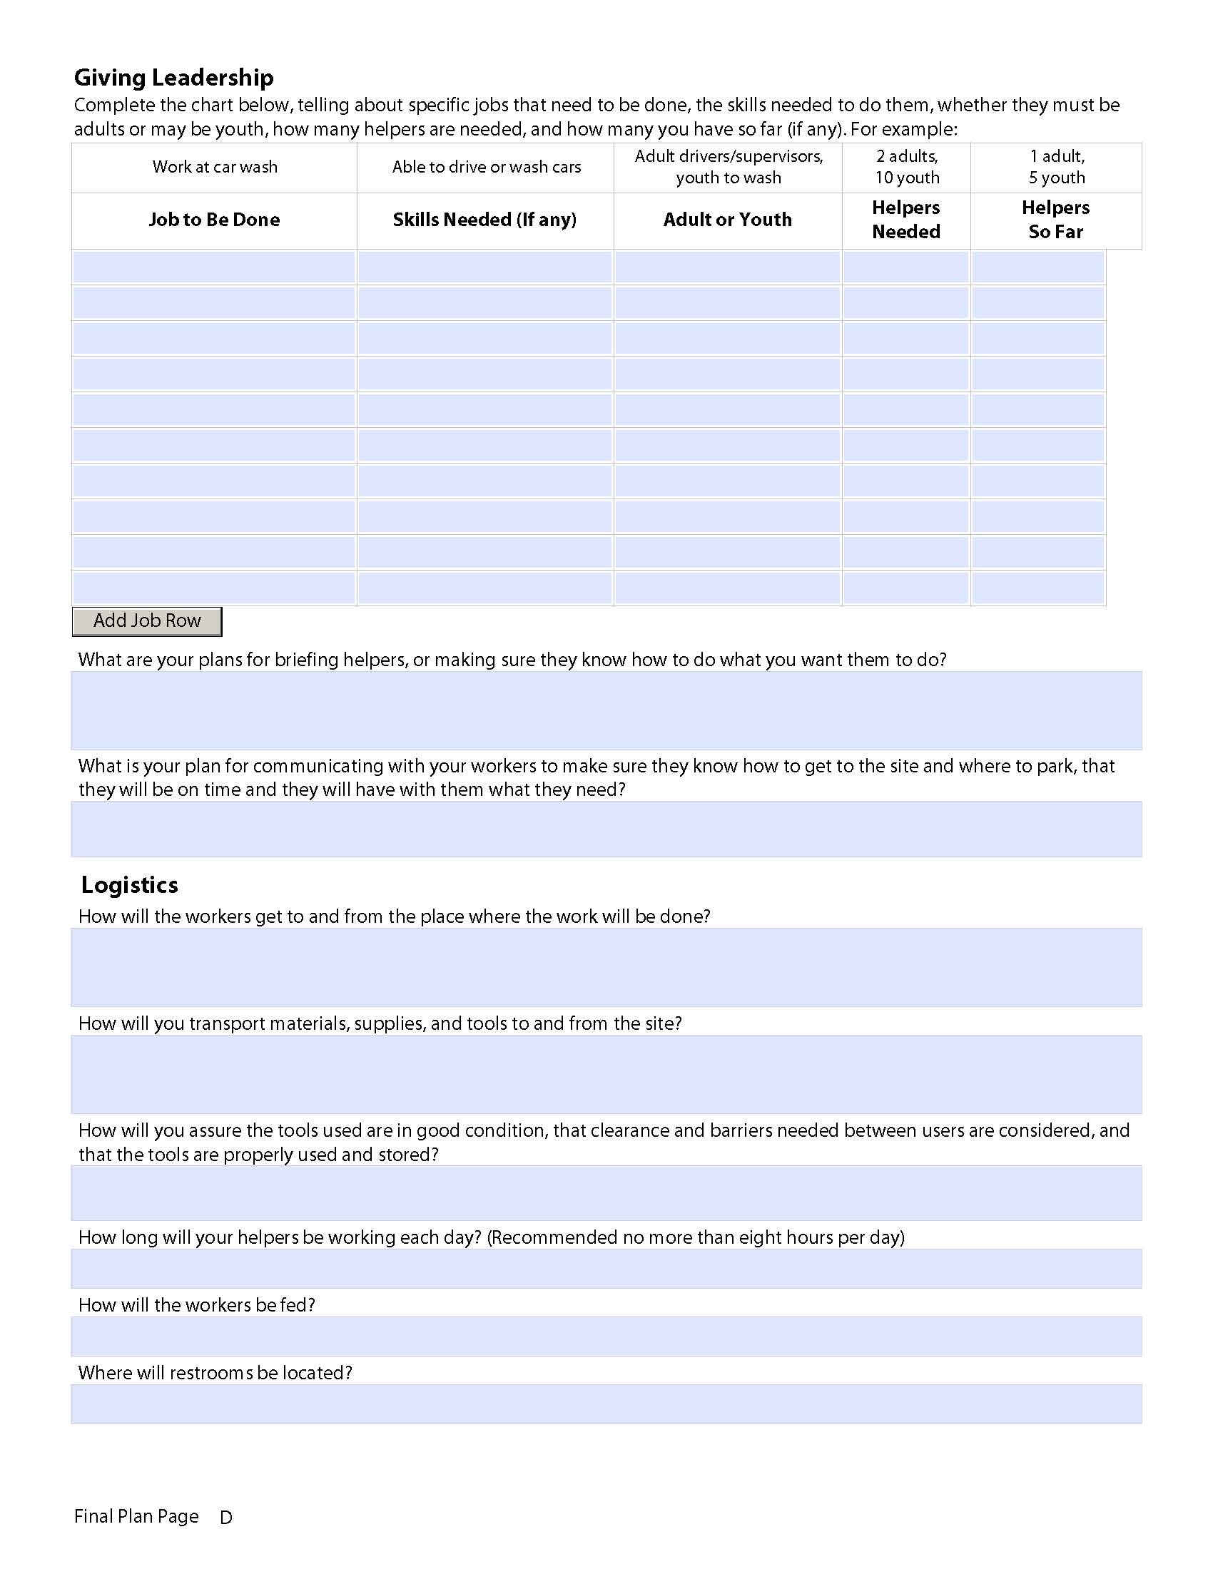
Final Plan Page D
Giving Leadership
Logistics
Notes:
Logistics
1. Additional questions were added to ensure tools used are in good condition and properly used/stored, and to identify how long helpers will be working each day.
2. Two questions were deleted regarding leftover materials and supplies and tools.

Slide 31
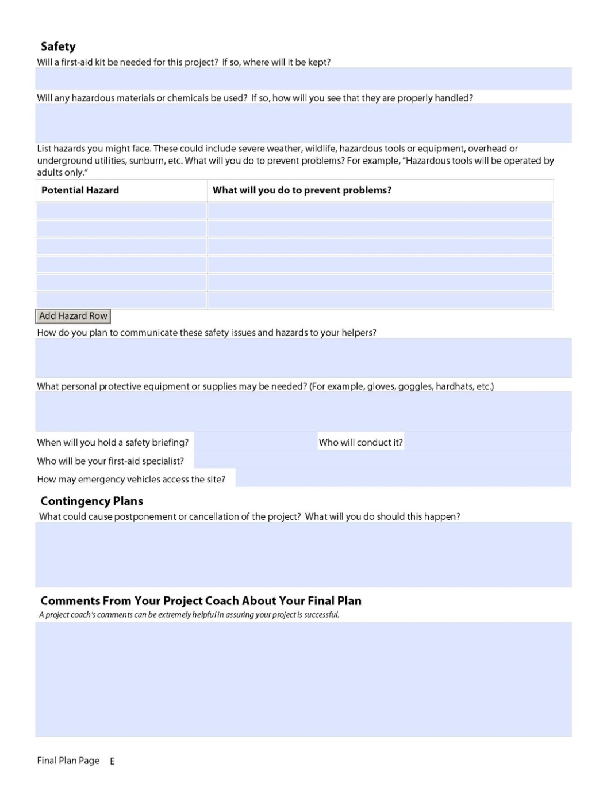
Final Plan Page E
Safety
Potential Hazard
Contingency Plans
Comments From Your Coach About Your
Final Plan
Notes:
Safety
1. Added question regarding what personal protective equipment or supplies may be needed and how emergency vehicles may access the site.
2. Modified question regarding safety briefing from a “Will you hold a safety briefing?” to “When will you hold a safety briefing?”
3. Deleted question asking “Who will be your first-aid specialist?”

Slide 32
Planning Summary
The more planning and attention to detail you do at the beginning will help your project come together in the end
Describe your project so you understand what needs to be done at every step
Your plan should be in sufficient enough detail so that:
  You and the beneficiary understand what is being done
  You can explain it to everyone else
  Your project will be successful on the planned day
Notes:
32

Slide 33
Conducting The Project
The Eagle candidate must be the project leader
The project is about leadership and service to others
Make sure others are involved so you demonstrate leadership
Don’t let adults be too helpful – have everyone provide suggestions and comments to you for decisions
Take note of changes from your original plan
Work on the project is complete when:
  The work is finished
  The excess materials, supplies and tools have been cleared from the site, as applicable
  Scout and beneficiary agree it is complete
Enter the completion date on the first page of the Project Report section of your workbook and on the Eagle Scout Rank Application at Requirement 5
Notes:
33
33

Slide 34
Project Changes
Many successful projects require changes from the original proposal. If changes are major, it is important to confirm they are acceptable to the beneficiary and BSA.
If any major change occurs in the project notify the project proposal approvers immediately, “…to be sure you [and the project] still are approved and have a chance of passing the board of review.”
GTA Para 9.0.2.7; page 65
Notes:
34

Slide 35

Project REPORT
Notes:
Added section on “Collecting Service Project Data” which asks Scouts to maintain a list of people who help and the number of hours they work. This information will be used when completing the project report and entering information into BSA’s Journey to Excellence tracking system.

Slide 36
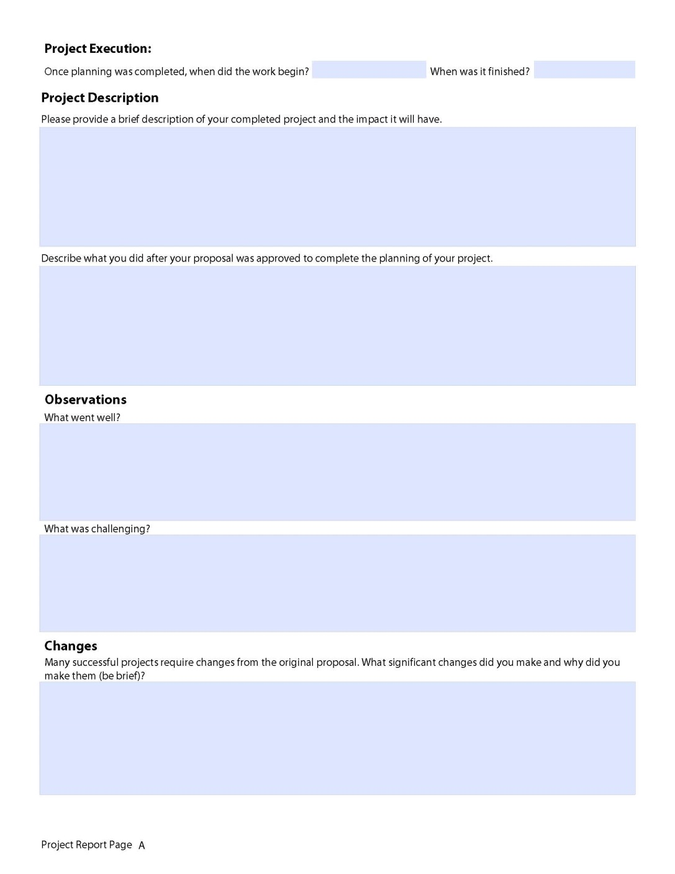
Project Report Page A
Project Execution:
Project Description
Observations
Changes
Notes:
Proposal Page A - New page (previously outside the proposal section) describing the five tests of an acceptable Eagle Scout Service Project, advice on working with the project beneficiary, developing the final plan, and beginning work on the project.
A Project Description section was added to have the Scout provide a brief description of the completed project, the impact it will have, and what the Scout did after the proposal was approved to complete the planning.
“Summary” section renamed to “Observations”.

Slide 37
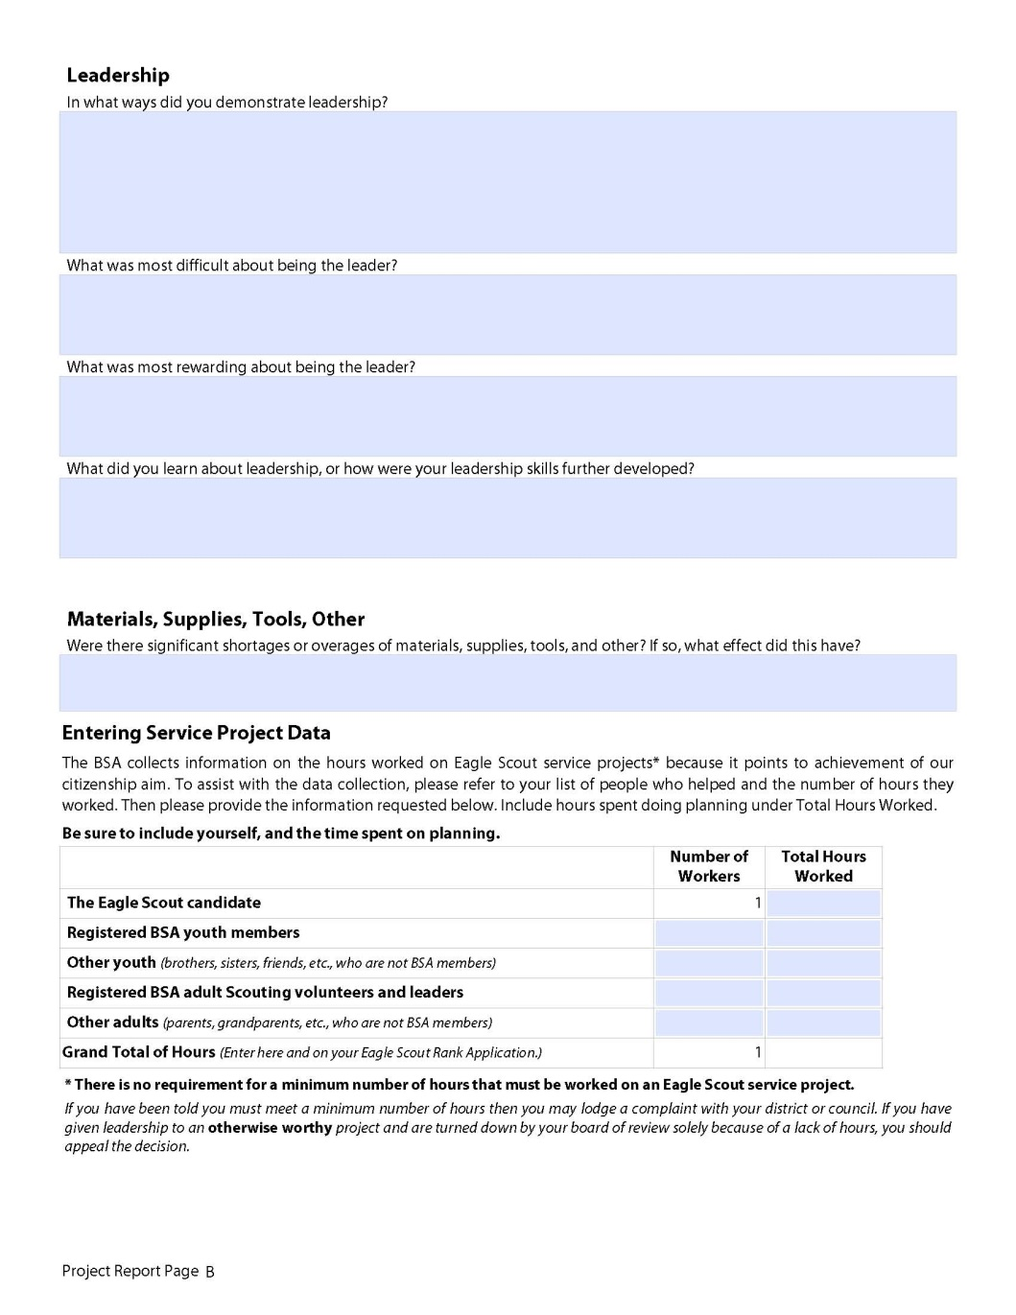
Project Report Page B
Leadership
What was:
  Most Difficult
  Most Rewarding
What did you learn about Leadership…
Materials, Supplies,
Tools, Other
Entering Service
Project Data
* There is no requirement for a minimum number of hours that must be worked on an Eagle Scout service project.
Notes:
Proposal Page B - New page (previously outside the proposal section) with all the contact information for the project.
i. Note added to the top of the page regarding importance of this information but that it is not part of the service project requirement.
ii. BSA PID number entries removed from Unit Leader and Unit Committee Chair blocks.
iii. E mail address removed from Your Council Service Center block.

Slide 38
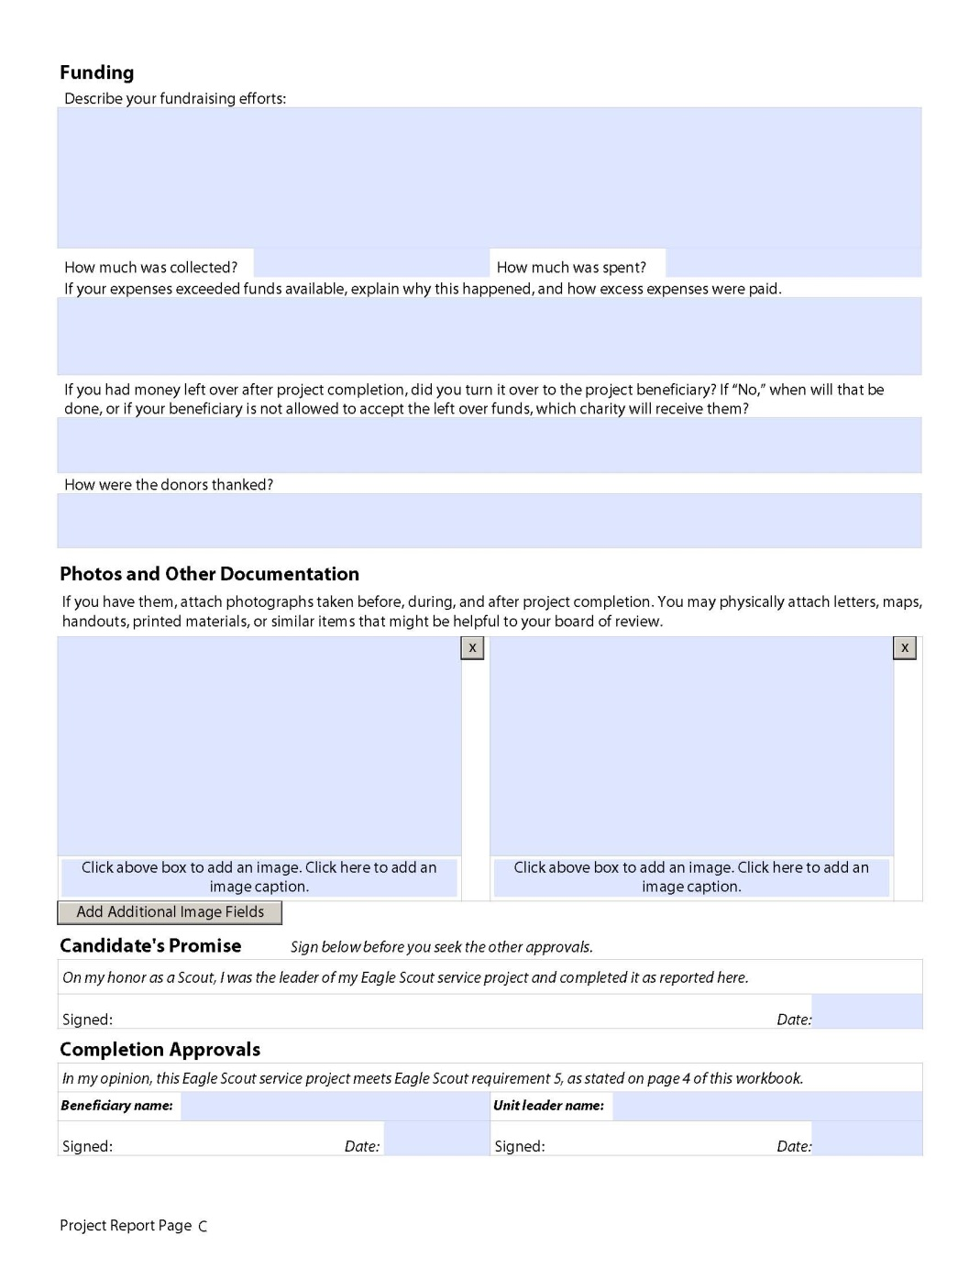
Project Report Page C
Funding
Photos and Other Documents
Candidate’s Promise
Completion Approvals
Notes:
Picture boxes are larger (two across versus three across).
Example added to Materials section indicating a little more detail should be added in order to show the Scout has a reasonable idea what is required without going into exact quantities. This idea replicated in Supplies and Tools sections,
Added Other Needs section for items that don’t fit in the other three categories.
Preliminary Cost Estimate - expanded notes to include guidance on donated materials, loaned tools/items, and the fundraising application.
Funding - the question regarding leftover funds was clarified to be consistent with other fundraising application guidance.
Photos and Other Documentation - Picture boxes are larger (two across versus three across).

Slide 39
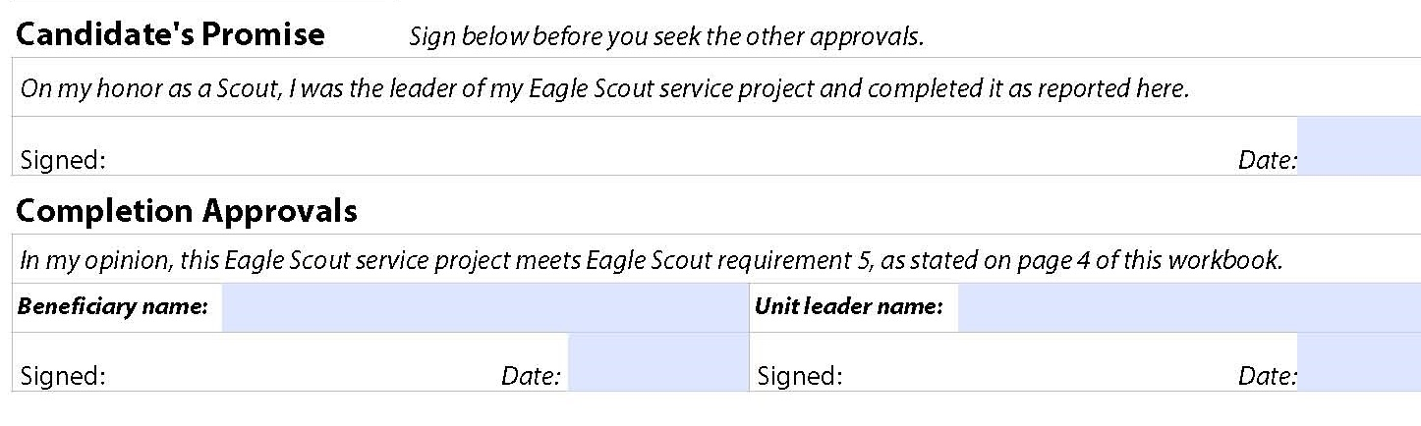
Project Report Page C
Definitely!!
Scout
Sign below before you seek the other approvals.
Beneficiary
Unit Leader

Slide 40
Final Project Approval
Board of Review members are the final approval authority that the project was properly carried out and meets standards
The following must be answered:
  In what ways did you demonstrate leadership of others?
  Give examples of how you directed the project rather than doing the work yourself
  In what way did the group benefit from the project?
  Did the project follow the plan - changes?
  If changes were made, explain why the changes were necessary
Notes:
40

Slide 41
Eagle Scout rank application (ESRA)

Slide 42
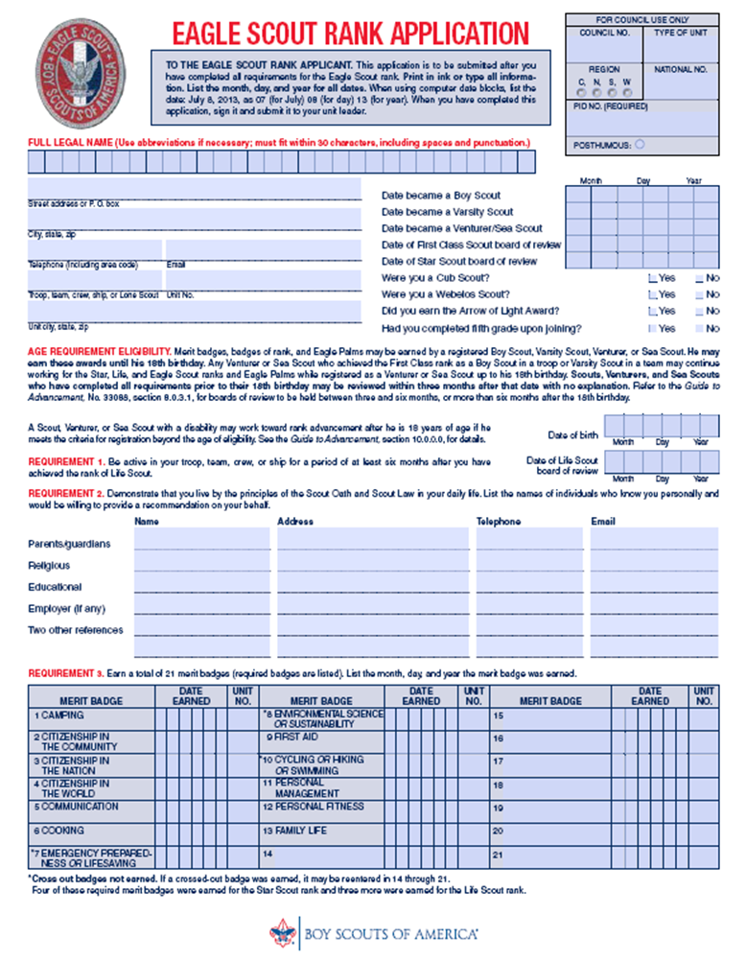
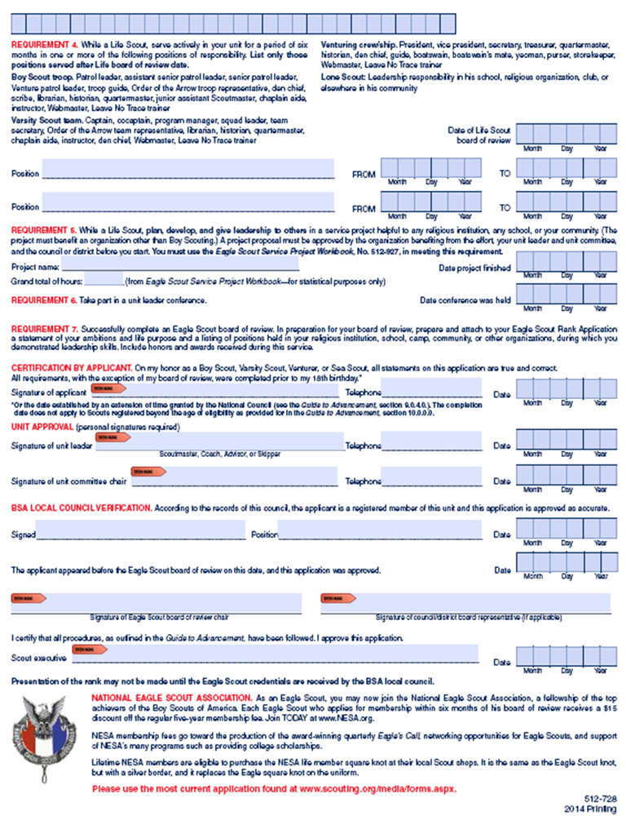
Eagle Scout
Rank Application

Slide 43
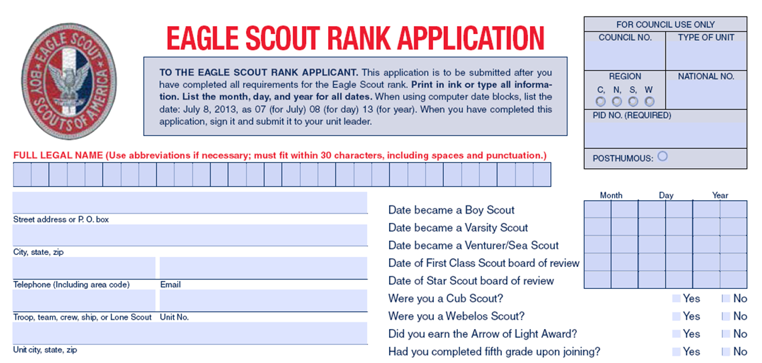
ESRA Personal Information
E
a
g
l
e
S
c
o
u
t
N
a
m
e
1 Eagle Scout Street
Rockville, MD 20817
301-555-1234
joescout@gmail.com
Troop 0461
Bethesda, MD 20814
Use your legal name – no nicknames
Spell out all words on the application except for State

Slide 44
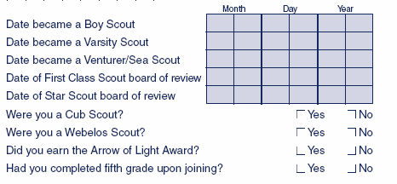
Date Became A Boy Scout
Verify the date you joined the Troop
  If in a crew, ship, or team you must have earned First Class as a Boy Scout in a Troop
  NOTE: This is important because you are not allowed to earn merit badges unless you are a registered scout.
0
5
0
5
0
2
Notes:
44

Slide 45
Board of Review Dates
Verify the Dates of Rank (Board of Review (BOR)) for First Class, Star, and Life Scout by using the Member Summary Report from Internet Advancement
0
1
1
8
0
4
0
5
2
3
0
4
Notes:
45

Slide 46
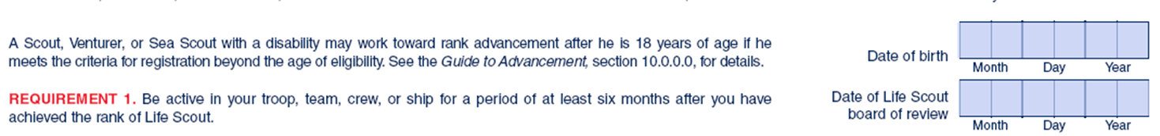
ESRA – Requirement 1
Requirement: Be active in your troop, team, crew, or ship for a period of at least six months after you have achieved the rank of Life Scout
Instructions: To ensure completion, calculate difference between Life Scout Board of Review date and Eagle Scout Board of Review date
0
7
3
0
0
6
Notes:
46

Slide 47
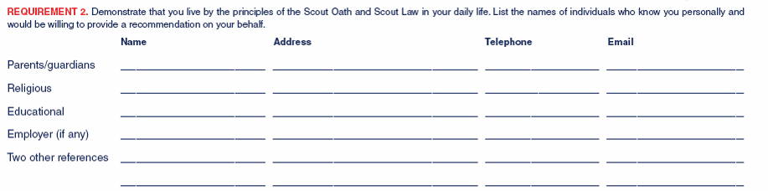
ESRA – Requirement 2
Requirement: Demonstrate that you live by the principles of the Scout Oath and Law in your daily life. List the names of individuals who know you personally and would be willing to provide a recommendation on your behalf
Instructions: All lines must be filled in – special instructions for religious, educational, and employer
Mr. & Mrs. Proud Parent
1 Eagle Scout Street, Bethesda, MD 20814
301-555-1952
Proud.Parent @ xyz.com
301-555-1952
301-555-1952
Proud.Parent @ xyz.com
Mr. & Mrs. Proud Parent
Proud.Parent @ xyz.com
Mr. & Mrs. Proud Parent
1 Eagle Scout Street, Bethesda, MD 20814
1 Eagle Scout Street, Bethesda, MD 20814
Mr. Proud Teacher
2 Eagle Scout Street, Bethesda, MD 20814
301-555-1953
Proud.teacher @ xyz.com
N/A or
List a previous employer; N/A is used only if the scout never had a paying job
Mrs. Proud Neighbor
3 Eagle Scout Street, Bethesda, MD 20814
301-555-1954
Proud.Neighbor1 @ xyz.com
Mr. Proud Neighbor
4 Eagle Scout Street, Bethesda, MD 20814
301-555-1955
Proud.Neighbor2 @ xyz.com
Notes:
47

Slide 48
Letters of Recommendation
Responses should deal with the Scouts character fitness and qualifications to be an Eagle Scout
Sealed and unopened letters are provided to the designated person
Letters are only viewed by members of the EBOR
Letters are not returned to the Scout or the unit leader
ESPG, page 38
Notes:
48

Slide 49
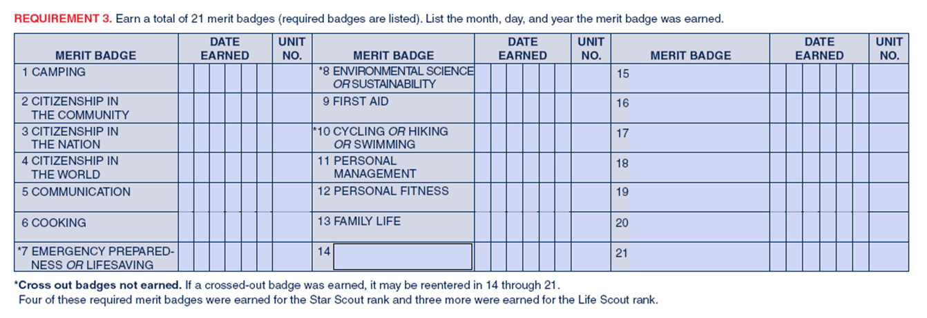
ESRA – Requirement 3
0
3
1
0
3
7
461
461
0
7
0
461
773
Mammal Study
2
5
4
Cross out the Eagle required MBs you are not using as the MB for this rank
List optional MBs in the order earned starting from the earliest
Notes:
49

Slide 50
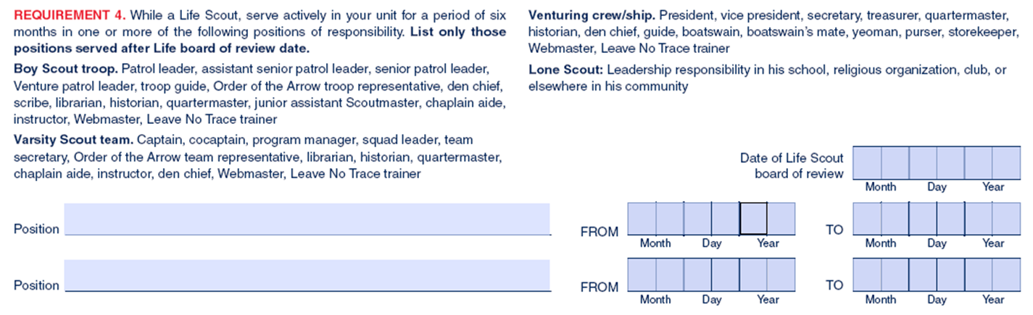
ESRA – Requirement 4
Requirement: While a Life Scout, serve actively for a period of six months in one or more of the following positions of responsibility. List only those positions served after the Life board of review date.
Instructions:
  The six months do not have to be consecutive
  Time does not have to be just prior to your application for Eagle
  If one position meets 6-months, only list one; if not, list two
  Spell out position; no abbreviations
0
7
3
0
0
6
Troop Quartermaster
(3 months)
0
7
3
0
0
6
0
3
1
1
0
7
Patrol Leader
(8 months)
1
0
1
8
0
7
0
6
2
1
0
8
Notes:
50

Slide 51
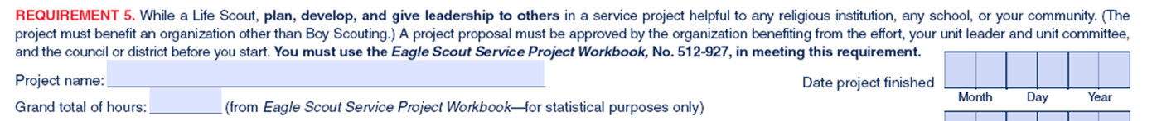
ESRA – Requirement 5
Requirement: While a Life Scout, plan, develop, and give leadership to others in a service project helpful to any religious institution, any school, or your community.
Instructions: Use up to 50 characters
  Enter benefiting organization and what was done
  Grand total of hours: Use whole numbers only - No decimals or fractions.
    72 Hours and 37 minutes = 73
  Date Project Finished: Enter when the work was done
Built Arena Benches for Local School
0
3
0
1
0
7
73
Notes:
51

Slide 52
ESRA – Requirement 6
Requirement: Take part in a unit leader conference
  e.g., Scoutmaster, Coach, Advisor, or Skipper
Instructions:
  This date must be before your 18th birthday
  Doesn’t need to be the last completed requirement
Notes:
52

Slide 53
ESRA – Requirement 7
Requirement: Successfully complete an Eagle Scout board of review. In preparation for your board of review, prepare and attach to your Eagle Scout Rank Application a statement of your ambitions and life purpose and a listing of positions held in your religious institution, school, camp, community, or other organizations, during which you demonstrated leadership skills. Include honors and awards received during this service.
Notes:
53

Slide 54
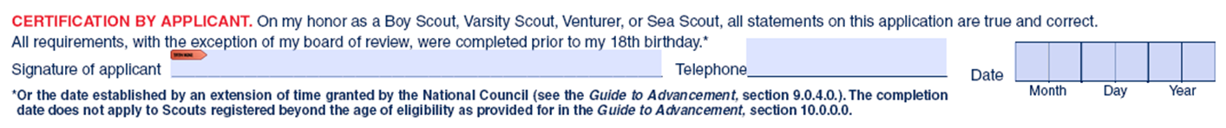
Certification by Applicant
“On my honor as a Boy Scout, Varsity Scout, Venturer, or Sea Scout, all statements on this application are true and correct. All requirements, with the exception of my board of review, were completed prior to my 18th birthday”.
Scout should sign before the Unit Leader and Committee Chair signatures
Notes:
54

Slide 55
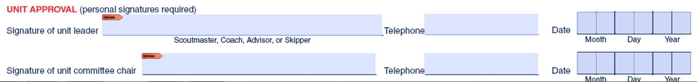
Unit Approval
These signatures indicate the unit leader and unit committee chair have made every effort to verify the accuracy of the information
All three signatures must be on the application before conducting the verification process and Eagle Board of Review
Notes:
55

Slide 56
ESRA Verification
Plan on this being a face-to-face meeting
Meet with District Eagle Representative (DER) for administrative review of completed Eagle Scout Rank Application before submitting to NCAC for Verification
Verifies completeness and accuracy of information listed on ESRA against Internet Advancement
  A unit-provided hard copy of the Scout’s Internet Advancement Member Summary Report is required during the verification
DER initials approval on the ESRA before submission to NCAC
Notes:
56

Slide 57
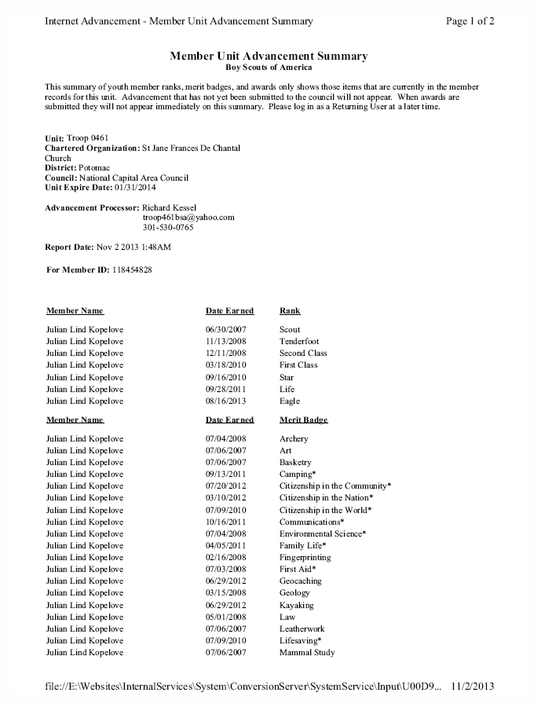
Member Summary Report
Unit Information
Ranks
Merit Badges
This is not the Individual History Report from Troopmaster

Slide 58
NCAC Verification Overview
Council administrative review of Scout’s Eagle Scout Rank Application
  Verifies all information listed on ESRA against data in Internet Advancement (ScoutNet)
Scoutmaster or Unit Committee is responsible for obtaining the verification not the Scout
  Submit only both sides of ESRA to NCAC
Signed verification page must be provided with the ESRA at EBOR
Must be completed and delivered before conducting an EBOR
Notes:
58
58

Slide 59
How to Request a DER
Go to the Sully District Eagle Candidate app at https://morning-wave-6812.herokuapp.com and fill out the information requested.
Send an email to Mr. Hondo Davids, Sully District Advancement Chair at hondo.davids@Verizon.net, if you have any issues with the app.

Slide 60
Eagle Board of Review Mechanics
Eagle boards are typically 30 to 45-minutes in length
Conducted as a discussion of the Scout’s values and beliefs
  May address leadership, Scouting, current events, goals, life purpose, community, service project, etc.
The decision of the Board must be unanimous
  All members have an equal vote
Notes:
60

Slide 61
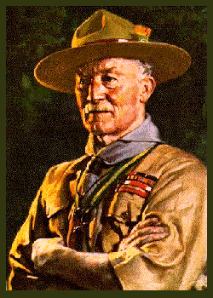


Thank You
Any Additional Questions?
For a Copy of This Presentation; Send an Email to hondo.davids@Verizon.net
Remember YPT Requirement to Have 2 Adults on email

