Slide 1
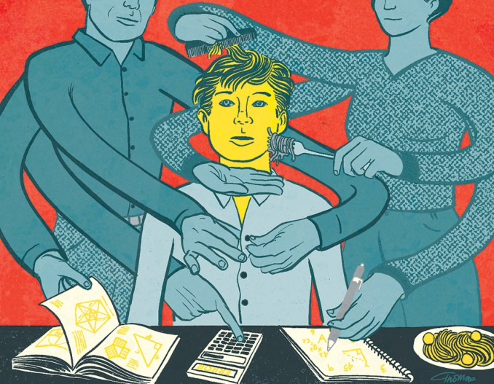
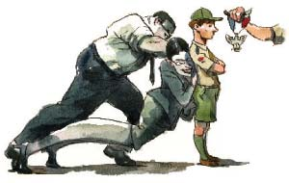
Parent Coaching

Slide 2
Parent Coaching
What’s wrong with these scenes???
Scoutmaster Steve – I’ve gone over all the requirements with Brian, so please sign his book for me so he can be promoted to tenderfoot.
Scoutmaster Silvia – I’ve coached Alison on all the requirements for her merit badge, so please sign her blue card so she can get her badge.
Scoutmaster Carol – Timmy needs to be promoted to 2nd class. He has been a tenderfoot for three months, and that’s getting off our schedule.
NOTHING….. For a Cub Scout

Slide 3
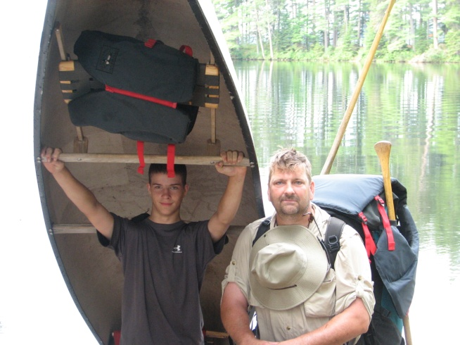
Parent Coaching
It takes a few years but that gawky 11-year-old
becomes a responsible Scout when parents
cooperate with the process.
Parents have to let their Scout and their Scout buddies figure things out.
If a new Scout packs their own pack they’ll forget something and maybe be a little uncomfortable but they will learn more from forgetting than they will if parents pack their bags for them. What they learn from that process is one step closer to the broader goal.
At first this may seem a little harsh or make a parent feel that they are not being responsible and that’s an uncomfortable feeling for most of us.

Slide 4
Parent Coaching
Step back, be supportive, understanding, and cooperate with the process. Look for teachable moments and help your Scouts figure out what to do next not by supplying answers but by asking questions.
The Scouting process is purposefully designed to be challenging and every Scout (and Scout parent) will experience frustration or discouragement from time to time.
Embrace the challenge and the chaos.
Take the inefficient, frustrating moments and turn them to your advantage to help our scouts achieve the broader scout goals.

Slide 5
Parent Coaching
The Broader Scout Goals
Ideals—spelled out in the Scout Oath, the Scout Law, the Scout motto, and the Scout slogan.
Patrol Method—Patrols are small groups of Scouts who camp together, cook together, play together, and learn together.
Outdoor Programs—Scouting is designed to take place outdoors. We camp. We hike. We get dirty.
Advancement—Scouting has a system of ranks in which Scouts learn progressively more difficult skills and take on progressively greater responsibilities.
Advancement—Scouting has a system of ranks in which Scouts learn progressively more difficult skills and take on progressively greater responsibilities.

Slide 6
Parent Coaching
Personal Growth—As Scouts plan their activities and progress toward their goals. Scouts grow as they participate in community service projects and do Good Turns for others.
Leadership Development—The Scout program encourages Scouts to learn and practice leadership skills. Every Scout has the opportunity to lead in some way.
Uniform—Like most sports teams, Scouts
wear a uniform. Like most sports teams, we
expect our Scouts to wear the uniform when they
are doing Scouting, and to wear it properly. It is
a symbol of who we are and what we do.

Slide 7
Parent Coaching
Scouting BSA is different than Cubs and most youth organizations.
In Scouting, the role of the Scouts is to have fun activities and generate achievements. The role of the adults is not the destination, but the journey. Our responsibility as adults is to promote the "process" of Scouting. What is important is:
Not the food on the campout, but that the Scouts cooked it.
Not a sharp-looking flag ceremony, but that the Scouts put it together.
Not who would make the best patrol leader, but that the Scouts elect one.
Not that Janie learns first aid, but that Carol teaches her.
Not that we cover everything on the meeting agenda, but that the senior patrol leader is in charge.

Slide 8
Parent Coaching
Our goal is not to get things done, but to create a safe and healthy environment with the training and resources that the Scouts need, and then let them do it. It can be a very messy business, and painful to watch. Meetings where the Scout leaders are in charge can be very chaotic.
It can be very tempting for adults to jump in and sort things out, because that is what adults do. But the Scouts then learn that mom and dad will continue to do everything for them

Slide 9
Parent Coaching
To be a good Scout Parent --- be a hiking stick.
Hiking sticks come in many different styles, from the plain dead branch you just found in the woods to carved and decorated staffs to high-tech aluminum models with spring-loaded tips.
A good hiking stick is a pretty handy thing to have when you're out walking in the country. Regardless of the type of stick or what they look like, they all do pretty much the same three things.
When you are going uphill, particularly if it is steep and rocky, the hiking stick can be a big help. You plant that stick in front of you, and you can use your arms to help pull you up the hill—you don't have to rely on just your legs.

Slide 10
Parent Coaching
When you are going downhill, particularly if it is steep and rocky, the hiking stick can really help you. You plant that stick in front of you, and it helps you keep your balance, takes a little of the weight off your knees, and gives you that little bit of extra support you need.
And when you're walking on the flat, well, the hiking stick is just a welcome companion on the trail.
Yep, many good Scouts have a hiking stick.
Notice that the hiking stick didn’t pull the Scout up the hill or carry them down. It gave the Scout support so they could do it themselves!
And just as a Scout should have a hiking stick to help support them on their journey, they must have adults who support them on their journey through Scouting.

Slide 11
Parent Coaching
Here is a great video about letting scouts lead themselves
“Don’t kill effectiveness for efficiency!”
“Raise [scouts], not grass.”
https://www.youtube.com/watch?v=z8MylQ_VPUI

Slide 12
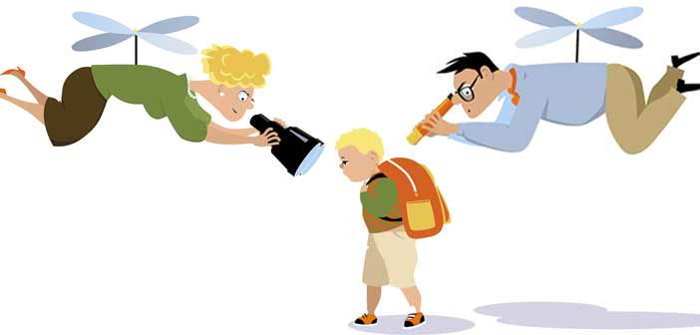
Questions?

