Slide 1
The Scoutmaster Minute

Slide 2
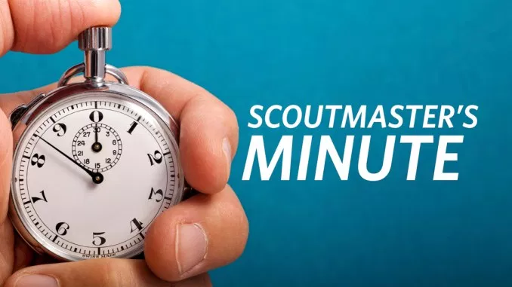
The February 1927 issue of Scouting magazine offered a nice description of the Scoutmaster’s minute that still holds true 92 years later: “The Scoutmaster says a word, tells a story or in his own way gives the boys (youth) a bit of inspiration in the way of a reminder of the Oath and Law.”

Slide 3
Effective Scoutmaster Minute Should Be:
Well-rehearsed
Personalized and delivered with good eye contact and expression
To the point, presenting a single, clear lesson
Well-paced, not overly-long and drawn out
Drawn upon events or circumstances that Scout-age youth can relate to
Applicable for all of us (using ”we” instead of “you” while addressing the Scouts)

Slide 4
Four Key Elements That Should Come Through in a Scoutmaster Minute:
1. Relevance – is the topic important to the Scouts?
2. Sincerity – does the speaker truly believe what they are saying?
3. Credibility – does the speaker exemplify what they are saying?
4. Passion – how important is the topic to the speaker?

Slide 5
Scoutmaster Minute Without Prop
https://www.youtube.com/watch?v=nDjdLJ0QHwg&feature=youtu.be

Slide 6
Scoutmaster Minute With Prop
https://www.youtube.com/watch?v=HaDVByuSvM8

