Slide 1
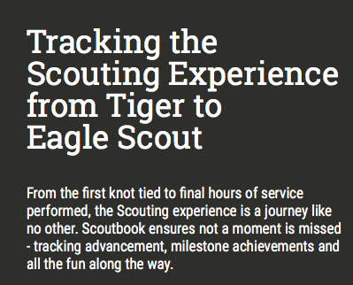

Slide 2
Scoutbook Intro https://www.youtube.com/watch?v=ss1i-SPPUpc

Slide 3
Benefits of Scoutbook
Online Access for Leaders, Parents and Scouts (if added by parents)
Quick and Easy Advancement Tracking
Forums and Messaging for Communications
Event Planning and Tracking
Attendance
Payments
ScoutNet Connection

Slide 4
Notable Features on Scout View
Colorful Patch Icons
Payment log
Advancement information
Awards
Leadership tracking
Service log
Camping log
Hiking Log
Printable Advancement Record

Slide 5
Pros
Scoutbook accessible from anywhere because it’s a web-based program
Scouts and Parents can log in information. The Information needs to be verified by an Admin.
Everyone can see what needs to be done for advancement of rank or completion of an MB
Calendar sends out reminders and has a link for a pre-filled permission slip

Slide 6
Cons
Scouts/Scouters/Parents must “Buy In” to using Scoutbook
The information is only good if it’s kept updated
Must have WIFI to access
Scouts can only access IF parents go in and enter their email address. Admins CANNOT enter this information

Slide 7
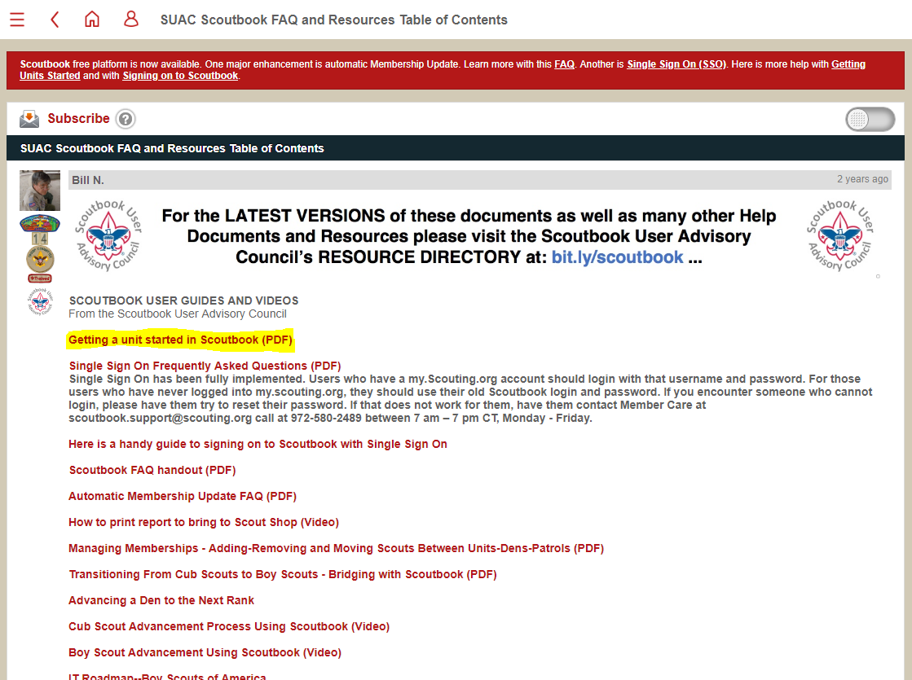
Getting Units Started
https://www.scoutbook.com/mobile/forums/using-scoutbook/86040/suac-scoutbook-faq-and-resources-table-of-contents/

Slide 8
Resources
www.scoutbook.com
https://www.scoutbook.com/mobile/forums/using-scoutbook/86040/suac-scoutbook-faq-and-resources-table-of-contents/

Slide 9
Scoutbook for Leaders (shortest version) https://www.youtube.com/watch?v=NQKYtXS11So

Slide 10
Questions?

Slide 11
Backup

Slide 12
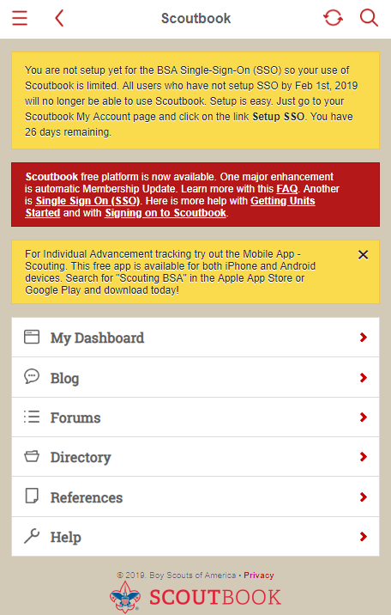
Sync My.Scouting SSO

Slide 13
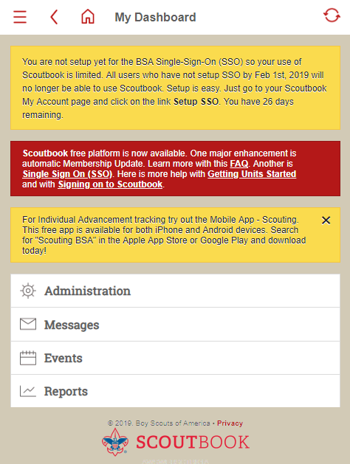
Dashboard

Slide 14
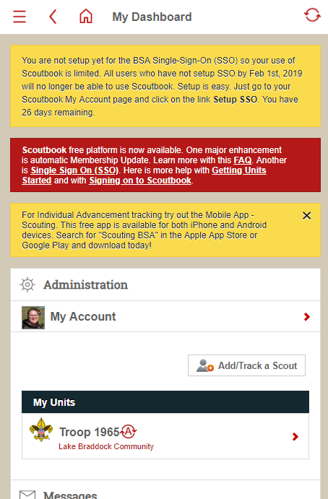
My Account

Slide 15
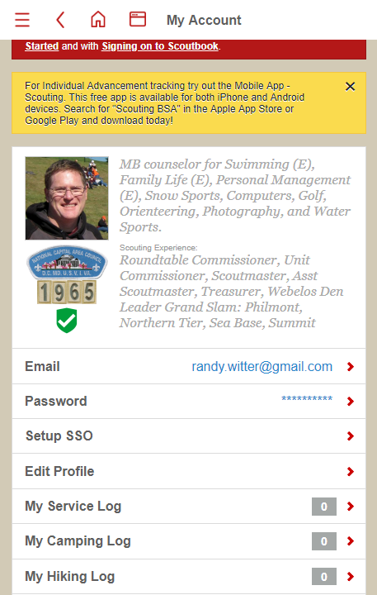
Setup SSO

Slide 16
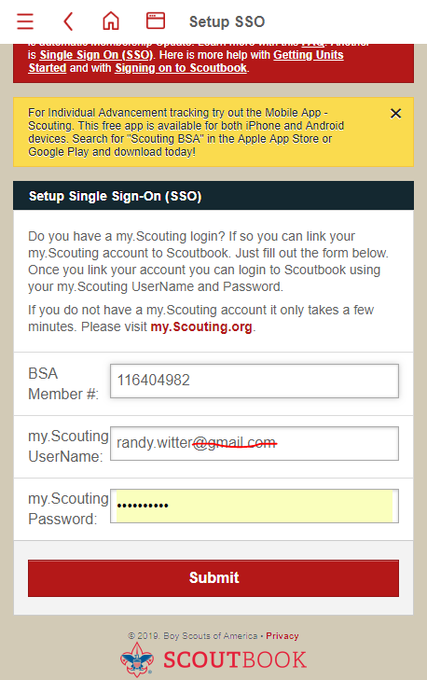
Enter My.Scouting Credentials

Slide 17
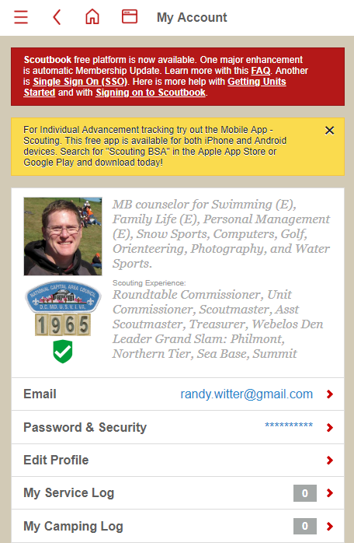
Submit—Done!
Temporary popup told me my accounts had been synched.
“Setup SSO” gone.

