Slide 1
Starting New Units

Slide 2
Starting New Units
New Unit Webpage – Outline of main steps
https://scoutingwire.org/marketing-and-membership-hub/new-unit-development/education-relationships/the-new-unit-organization-process/
New-Unit Application Form
https://filestore.scouting.org/filestore/pdf/524-402_WB.pdf

Slide 3
12 Steps to Starting New Units
1. Identify the Prospective Charter Organization
Two groups in need right now
New girl troops
LDS members
Two options
Use existing Charter Organizations
Identify new Charter Organizations

Slide 4
12 Steps to Starting New Units
2. Approach the Prospective Charter Organization
Be prepared
Initiate preliminary contact with organization head
Establish opportunity and discuss organization’s community involvement and goals
Convey the desire/opportunity for hosting a unit and associated win-win benefits
If deemed feasible, schedule a formal presentation with decision makers of the organization

Slide 5
12 Steps to Starting New Units
3. Make the Sales Call (Presentation)
Be Prepared
Initiate the Opening
Team introductions with role descriptions, open discussions about the charter organization’s community involvement and goals, put the charter organization at ease.
Make the Sale
Purpose of Scouting, benefits (for all), organization, program, role of chartered org, next steps, ... etc.
Close the Sale
From what you heard, would hosting a unit help you goals? Will you lend support? Will you adopt a unit? Who should we engage with to continue the process?

Slide 6
12 Steps to Starting New Units
4. Organization Adopts the Program
Establish an organizing committee within the Charter Organization with an appointed Charter Organization Representative
Establish organization meeting dates and associated expectations

Slide 7
12 Steps to Starting New Units
5. Organizing Committee Meets
Primary role will be the next steps
6. Select and recruit leaders
7. Train the leaders
8. Organize the program (next slide)
9. Recruit youth members
10. Complete the paperwork (slide after next)

Slide 8
12 Steps to Starting New Units
8. Organize the Program
For the first round, new adult leaders will be a little more involved in establishing the shell of a unit plan. For girl troops, you may already have youth involved that can be incorporated into the planning
When are you meeting?
First several month’s activities, orientations, youth training, and campouts
Courts of Honor, summer camp reservations, fund raisers
Parent orientation dates

Slide 9
12 Steps to Starting New Units
10. Complete the Paperwork
New-Unit Application (Charter Org Head Signature)
https://filestore.scouting.org/filestore/pdf/524-402_WB.pdf
Annual Unit Charter Agreement
https://filestore.scouting.org/filestore/membership/pdf/524-182_web.pdf
Adult Leader Applications (CoR Signature)
Youth Applications (Unit Leader Signature)

Slide 11
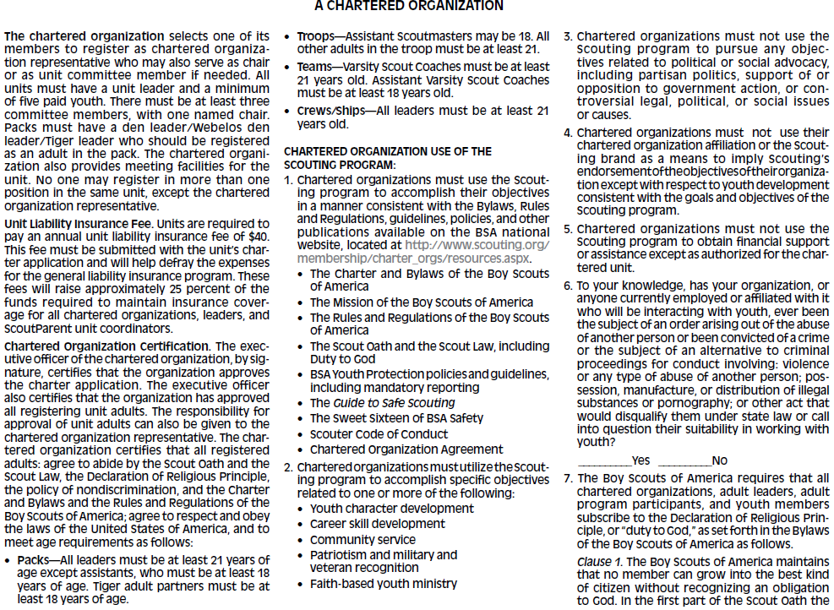
X

Slide 12
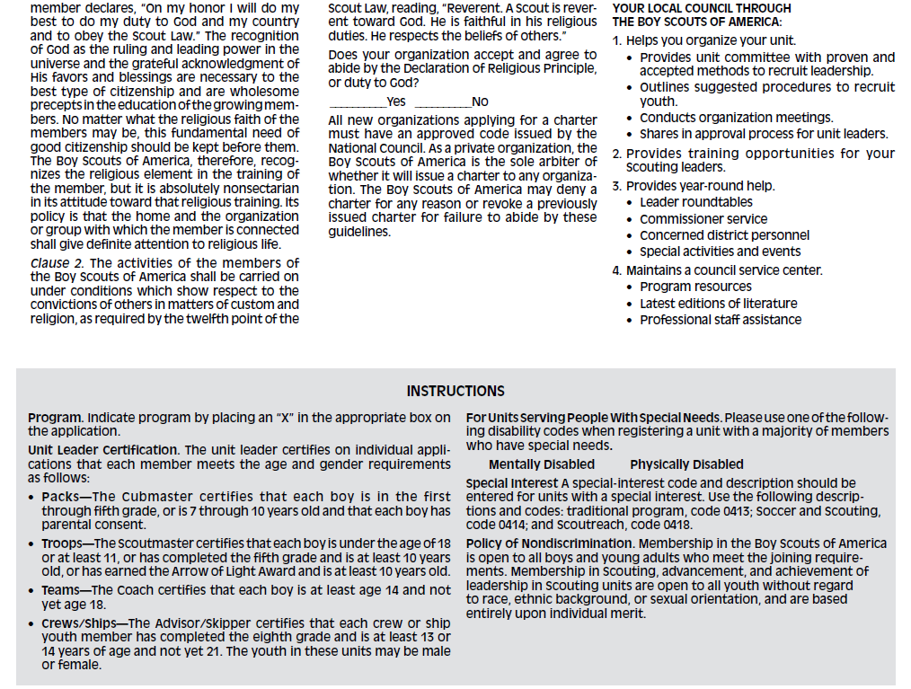
X

Slide 13
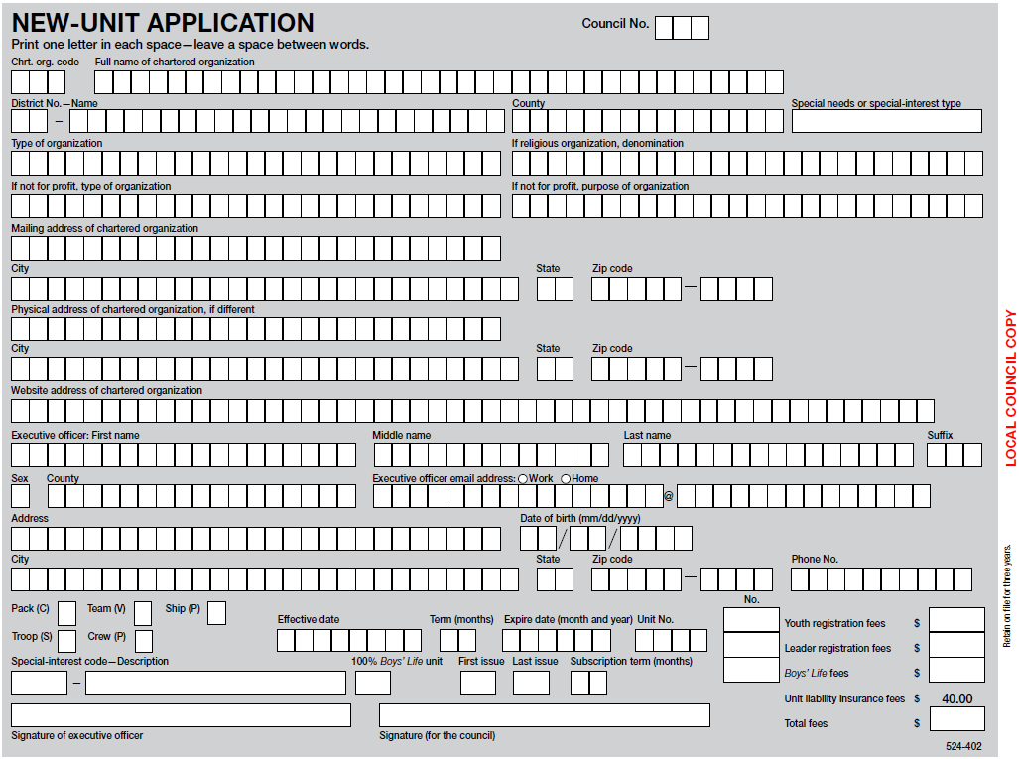
082
On 1st page of recharter for existing Orgs
25
PATRIOT DISTRICT
FAIRFAX
11
X
02012019
122019
1965
NEW GIRL TROOP

Slide 14
12 Steps to Starting New Units
11. First Unit Meeting
Swear in new youth leadership (see internet for ideas)
12. Charter Presentation/Follow-up
Present Charter at Chartered Org meeting or at special event such as first Court of Honor to the Chartered Organization Head
Follow-up and visits by Unit Commissioner for resources and unit support

Slide 15
Other Resources
New Leader Guide—Tips to get you started down the scouting trail
https://scoutingmagazine.org/2018/08/the-new-leader-guide-tips-to-get-you-started-down-the-scouting-trail/
NCAC New-Unit Checklist
http://www.ncacbsa.org/wp-content/uploads/2017/01/NCAC-New-Unit-Application-2014.docx
Order Unit Flag/Unit Numbers/Neckerchiefs – Scout Shop

Slide 16
Questions?

