Slide 1
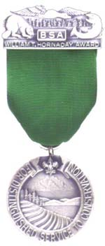
William T Hornaday Awards
What Scouters Need to Know to Make it Achievable for Our Scouts
John Nelson
Hornaday Advisor Patriot District
December 14, 2017
http://www.scouting.org/licensing/Home/Awards/HornadayAwards.aspx

Slide 2
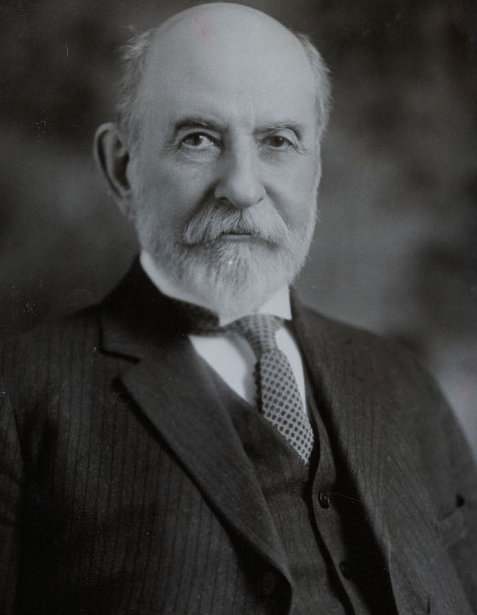
Who Was William T Hornaday?
Life Span – 1854 to 1937
Career
  Founder of the National Society of American Taxidermists
  Curator of the National Zoological Garden
  Trustee for the Buffalo Museum of Science
  First Director of the New York Zoological Garden (Bronx Zoo)
    The New York Zoological Society is now the Wildlife Conservation society
    Creator of the Permanent Wildlife Protection Fund
Working Achievements
  Changed the Zoo to wildlife habitats
  Credited with saving the American bison and Alaskan fur seal from extinction
  Ended the use of feathers in hats
Founder of the Campfire Club in 1905
Author of the 1929 BSA Bird Study Merit Badge book and wrote for Boy’s Life
National Wildlife Federation Conservation Hall of Fame
http://hornadayscrapbooks.com/about_hornaday

Slide 3
What Was His Connection to Scouts?
1911 – Conceives the idea of an independent endowment fund to protect wildlife around the worlds
  Creates the Permanent Wildlife Protection Fund with $100,000
1914 – Proposes to Boy Scouts a medal for members who provide distinguished service for the protection of wildlife
1915 – BSA accepts the offer
1921 – with no Scouts achieving the award – a committee is formed to revise the requirements
1922 – First award to Scoutmaster Harry Hall
1938 – BSA and New York Zoological Society agree on a revised program call the Hornaday Awards
1941 – First Hornaday Medal is awarded by BSA
1951 – First Hornaday Unit Award to a Troop in Bristol, Virginia
1970’s – The Hornaday Award was restructured with assistance from the DuPont Company to its current form
3
USScouting.org

Slide 4
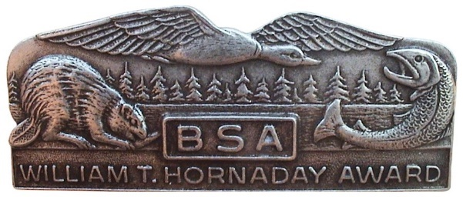
Hornaday Awards
Council Administered:
  Hornaday Unit Award (Pack, Troop, Team, Crew, Ship)
  Hornaday Badge (Scout or Venturer) – multiple MBs & project
  Hornaday Gold Badge (Scouter)
National Hornaday Committee Approved:
  Bronze Medal (Scout or Venturer) – more MBs & project
  Silver Medal (Scout or Venturer) – more MBS & additional project(s)
  Gold Medal (Adult Scouter)
  Gold Certificate (corporation, organization or individual)
https://www.doubleknot.com/cms/pageviewer.aspx?pageid=13105&preview=yes
4

Slide 5
Hornaday Award Context
What it is:
  Recognition of truly significant contributions to natural resource protection and conservation
  Learning and public awareness of natural resource conservation
  Sound stewardship of natural recourses & environmental protection
  Strengthens Scouting’s emphasis on respecting the outdoors
  More of a research project with pre and post analysis
What it is not:
  A one time effort
  For everyone
5
Notes:
Nature Deficit Disorder

Slide 6
From Start to Finish
Subject Matter Experts
Hornaday Award Guidance
Hornaday Award Support Team
Natural Resource Conservation Issue
Scout
Hornaday Project
Hornaday Award
Merit Badges
6

Slide 7
The Hornaday Project Focus
Identify a natural resource conservation problem
Address/Resolve the problem
The project must be
  Based on sound scientific principles
  Address a conservation problem
  Contribute to conservation & environment improvement
  Long-term in scale
The project does not end with physical completion
Work to determine success – or failure – and possible re-work – failure is an option
Nature is messy and unpredictable
At the end of the day – the project needs to have made a real difference
7

Slide 8
Hornaday Project & Eagle/Summit/ Quartermaster Project
Scout can use a Hornaday project for Eagle, Summit or Quartermaster
Hornaday project must have lasting value – An Eagle Project benefit is point in time
Focus must be on conservation
Hornaday requires considerable research in project selection
Hornaday uses the scientific method (approach) in the selection of the project, pre-proposal research, monitoring and recording to be done before, during and after project
Hornaday Workbook is more ‘in depth’
The approval process is similar
8

Slide 9
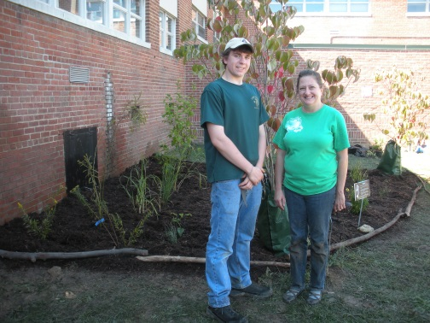
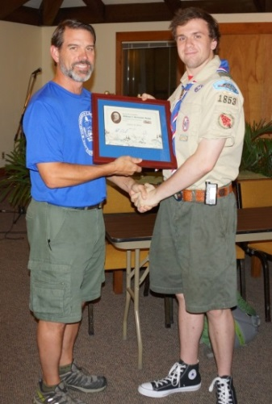
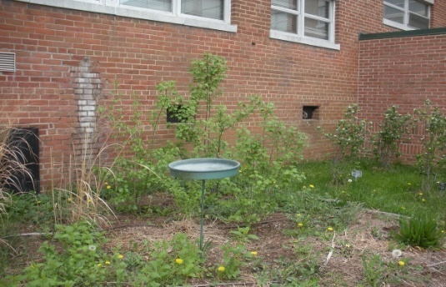
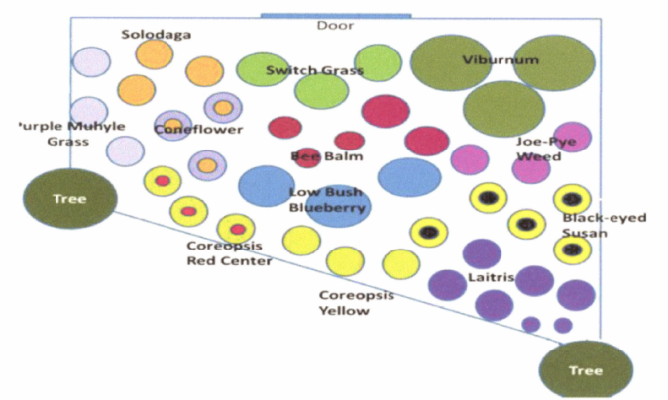
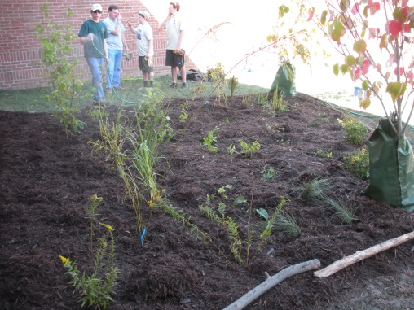
Project Example - Hornaday Badge
Andrew Brown, Old Dominion District
Pollinator Garden at Lynbrook Elementary School, Springfield VA
Create a native plant habitat that would attract a large variety of insects and birds to otherwise barren courtyard.
Augmented an already established Monarch Waystation located outside the courtyard
Developed an educational guide
Conducted pre & post project diversity census
Also an Eagle Project
9

Slide 10
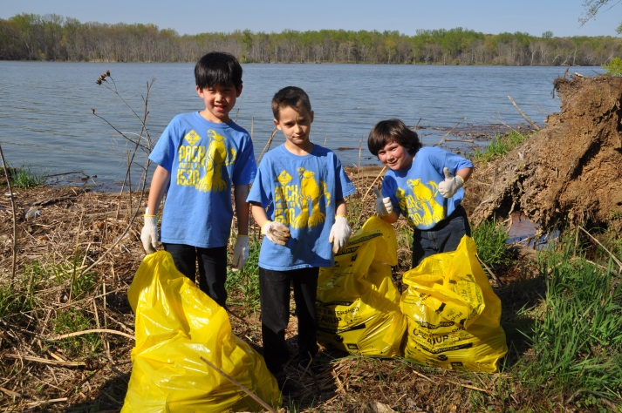
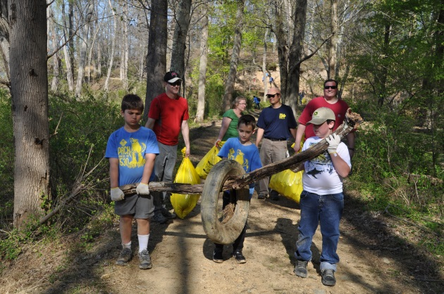
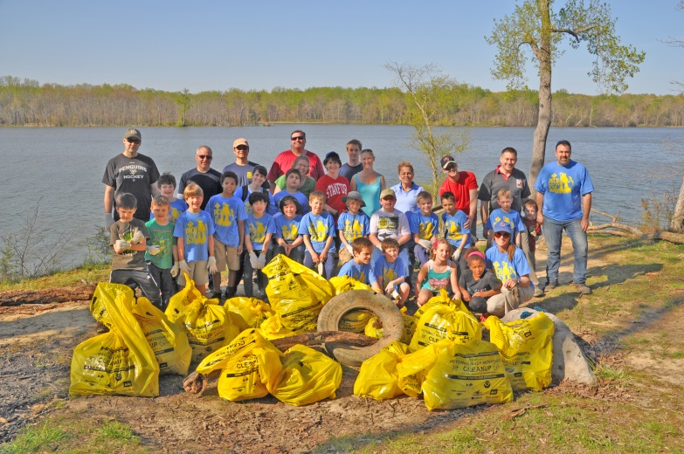
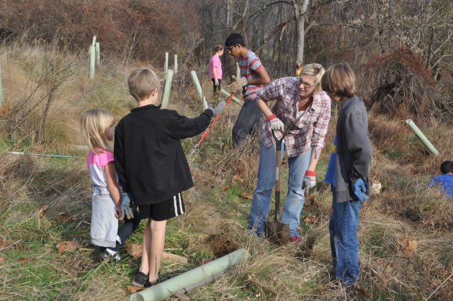
Project Example – Unit Award
Cub Scout Pack 1530, Powhatan District
Potomac River Cleanup
The Pack family removed hundreds of items from the Potomac River: glass and plastic bottles, Styrofoam, balls, car tires, packaging material and plastic bags
Planted 50+ trees and removed 600 lbs of invasive species
Cub Scouts and their families now have a greater appreciation for protecting and preserving our watershed, and saw how their actions can make a massive impact.
Supported Soil & Water Conservation and Air & Water Pollution
10

Slide 11
Action – How You Can Help?
Acquaint your unit with the Hornaday program
Challenge Scouts who might be interested in pursuing a Hornaday project
Consider adding a Hornaday unit award project to your unit’s program
John Nelson-Patriot District Hornaday Advisor
planner48@gmail.com
703-865-5130
11

Slide 12
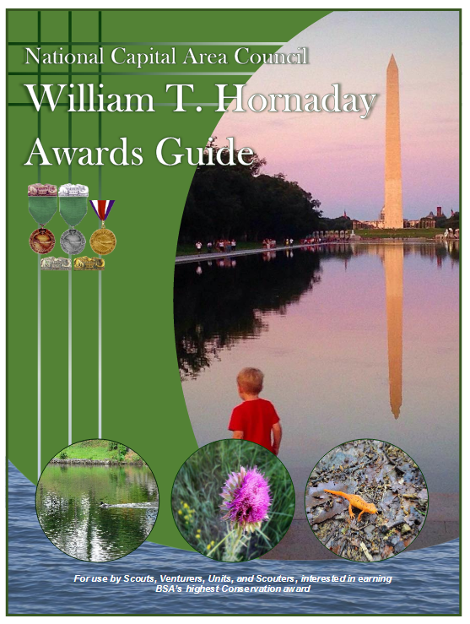
Hornaday Awards Guidance and Resources
NCAC Website: http://www.ncacbsa.org/advancement/awards-and-recognition/hornaday/
BSA Hornaday Workbook:
https://www.scouting.org/filestore/pdf/Hornaday_Award_Conservation_Project_Workbook.pdf
NCAC Hornaday Awards Guide:
http://www.ncacbsa.org/wp-content/uploads/2016/03/NCAC_Hornaday_Awards_Guide.pdf
12

Slide 13
NCAC William T Hornaday Award Advisers
1Chain Bridge Gautam Advani advanig@hotmail.com 202-258-2808
2Chain Bridge Danielle Bernstein dvbernstein@hotmail.com 410-599-9445
3Old Dominion Carol Brown cgbrown08@verizon.net 703-609-0769
4George Mason Matthew Burns burnsmj509@gmail.com 703-283-7402
5Colonial /NCAC STEM Chair Arden Dougan arden.dougan@gmail.com 925-640-6133
6Old Dominion Andrew Fuller andrew.fuller@earthlink.net 703-727-6541
7Powhatan Sara Holtz sh12sh34@gmail.com 703-901-0603
8Patuxent Rebecca Hoover revooher@gmail.com 301-752-4505
9Washington DC Aaron Marrs awmarrs@gmail.com 202-262-8722
10Bull Run Brian McDougal freezerwolf@hotmail.com 703-367-9606
11Patriot John Nelson planner48@gmail.com 703-865-5130
12Chain Bridge Donald Rossi rossida@hotmail.com 410-533-3554
13Colonial Phil Ventura pvventura@gmail.com 703-585-7439
Hornaday Adviser & Course Instructor/NCAC:
Josh Lamothe jnl82381@gmail.com 254-423-5346
NCAC Hornaday Committee Chair and Hornaday Adviser:
Will Rodger wrodger@outlook.com 202-486-6774
Hornaday Adviser & Coordinator/NCAC:
John Selstrom john.selstrom@outlook.com 703-598-7502

Slide 14
Questions?
The Hornaday Awards Program – for the Second Boy Scout Century
14

