Slide 1
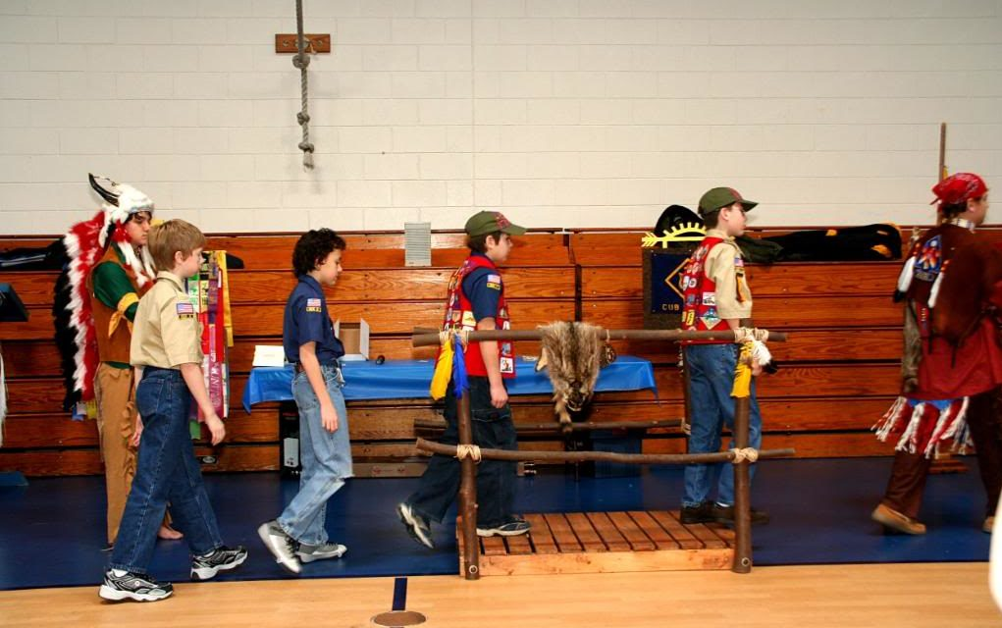
Webelos to Scout Transition

Slide 2
WEBELOS to Scouts
One of Scouting's greatest challenges is to make the next level of Scouting readily available for a young man once he meets the joining requirements.
The passage from Cub Scout pack to Boy Scout troop should be smooth, with no time lost in between. By the time Webelos Scouts are ready to cross over, they should feel excited about beginning this new adventure.

Slide 3
WEBELOS to Scouts
Cub leaders should sell the sizzle of the great outdoors. Scouting should be viewed as an ongoing adventure, and the progression should be as normal as moving from elementary school to middle school.
Work with the Cubmaster in planning a meaningful crossover ceremony at the pack's blue and gold banquet. Coordinate the ceremony and arrange for each Webelos Scout to receive a troop neckerchief and Boy Scout Handbook along with his Arrow of Light Award.
OA helps sell the sizzle.

Slide 4
WEBELOS to Scouts
Webelos to Scout Transition Timetable
August
Get names, addresses, and telephone numbers of second-year Webelos.
Plan a joint Boy Scout troop/Webelos den camping trip for October.
Plan a program of upcoming events to present at a Webelos den meeting visit in November.
Select a den chief for each Webelos den.
September
Mail a letter of introduction from the Boy Scout troop to second-year Webelos Scouts to introduce them to the troop.
Put second-year Webelos Scouts on the mailing list to receive the troop newsletter.
Continue planning the joint camping trip for October.
October
Conduct the joint camping trip with the Webelos den.
November
Attend a Webelos den meeting to teach the Webelos Scouts how the Boy Scout troop works.
Have den chiefs attend a local council or district training course.

Slide 5
WEBELOS to Scouts
December
Set a date for Webelos Scouts and their par- ents to visit a Boy Scout troop meeting
in January.
Send a form of information or greeting, letting Webelos you look forward to them joining the troop.
January
Host Webelos Scouts and their parents at a Boy Scout troop meeting.
Plan a bridging ceremony for the blue and gold banquets in February to welcome graduating Webelos Scouts to their new troop.
Attend a meeting for first-year Webelos Scouts to introduce them to Boy Scouting.
February
Hold the bridging ceremony at the blue and gold banquet.
Get new Scouts actively involved with the troop through troop activities.
Recruit parents of new Scouts to become assistant Scoutmasters or troop committee members.
March
Plan a troop activity for new Scouts to get them involved with their new troop.

Slide 6
WEBELOS to Scouts
April
Conduct summer camp orientation to encourage troop involvement.
Attend a meeting of Bear Cub Scouts to introduce them to Boy Scouting.
Sponsor a troop activity for new Scouts.
May
Work closely with new Scouts and parents during their transition to the Boy Scout troop, ensuring their needs are met and that their move has been natural and fun.
Work on rank advancement with new Scouts.
June
Ensure that all new Scouts attend summer camp.
July
Work closely with new Scouts and parents during their transition to the Boy Scout troop, ensuring their needs are met and that their move has been natural and fun.
Work on rank advancement with new Scouts.

Slide 7
WEBELOS to Scouts
Who attends the Bridging Ceremony?
Who talks to the new scouts?
Scoutmaster, senior patrol leader, scouts?
Who talks to the new adults?
Scoutmaster, senior patrol leader, scouts?

Slide 8
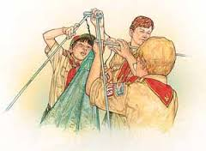
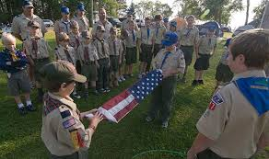
WEBELOS to Scouts
New Scout Weekend, Advancement Camp
At a local campground
Taught by older scouts
All basic scouting needs – tents, 1st aid, cooking, Flag Ceremony, Hike, CAMPFIRE

Slide 9
WEBELOS to Scouts
Parent Education Boy Scouts is a whole lot different than Cub Scouts or Webelos Scouts. The idea of graduating from a Cub Scout pack to a Boy Scout troop may be intimidating for some Webelos Scouts and their parents.

Slide 10
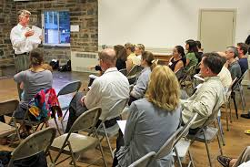
WEBELOS to Scouts
Get parents immediately involved as committee members or ASMs

Slide 11
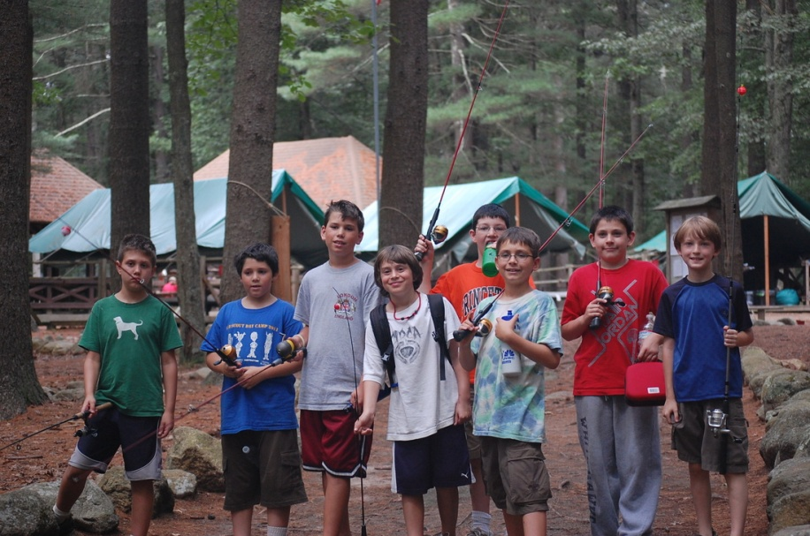
THIS is what we want the parents to understand ... They watch and assist, but the boys lead themselves

Slide 12
Questions?

