Slide 1
JASM
Junior Assistant
Scout Master

Slide 2
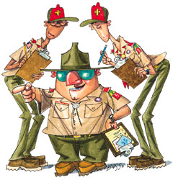
JASM
What is a JASM?
A Scout Master’s Flunky?
A real ASM?
The Scout master’s “enforcer”?
A nice-to-have?
A valuable troop member?

Slide 3
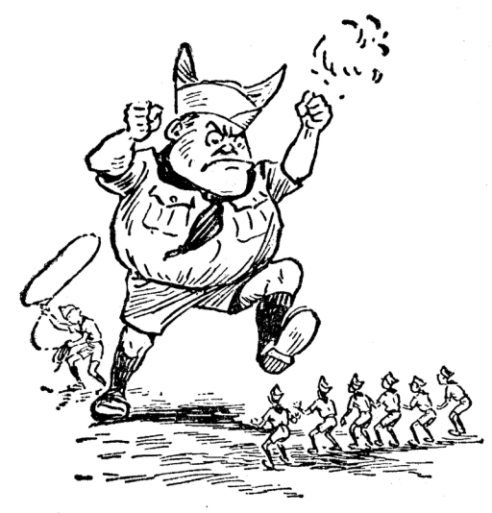
JASM
Scoutmaster has to control, lead and train
Do you have a 16- or 17-year-old Scout who has already been senior patrol leader but still wants to serve his fellow Scouts.
The junior assistant Scoutmaster is a young man who is at least 16 — but not yet 18 — and is appointed by the Senior Patrol Leader with the advice and approval of the Scoutmaster.
The junior assistant Scoutmaster, sometimes called a JASM, functions as an assistant Scoutmaster and reports to the Scoutmaster.

Slide 4
JASM
Junior Assistant Scoutmasters Function as assistant Scoutmasters (except for leadership responsibilities reserved for adults 18 and 21 years of age or older).
Accomplish any duties assigned by the Scoutmaster.
Set a good example.
Wear the Scout uniform correctly.
Live by the Scout Oath and Scout Law.
Show and help develop Scout spirit.

Slide 5
JASM
Youth Protection --- Though a junior assistant Scoutmaster functions as an adult leader in some ways, he still must follow BSA youth policies regarding two-deep adult leadership, sleeping quarters, driving, etc.)
For 16- and 17-year-old Scouts working on Star, Life or Eagle Scout: junior assistant Scoutmaster is a qualifying position of responsibility for those ranks.

Slide 6
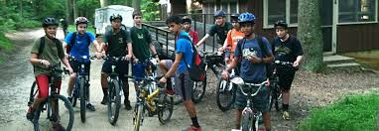
JASM
THIS is what you can do with your best senior scout(s) after they finish their leadership roles in the Troop.
Make sure they understand you expect them to do work and keep a log to discuss good and bad points of the Troop with the Scout Master.
THIS is where JASMs need to be – not sitting with a bunch of old ASMs in the corner

Slide 7
JASM
What to do with them??
Use junior assistant Scoutmasters as new Scout patrol advisers and teachers of such advanced skills as backpacking, lashing and rock climbing.
Have JASMs serve as liaisons with the troop’s brother Cub Scout pack.
Encourage JASMs to aid in the patrol leaders’ council’s annual program planning conference by sharing their experiences in camping and program activities.

Slide 8
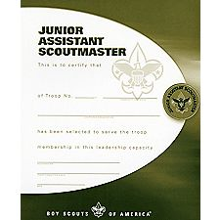
JASM
Officially recognize/promote the new JASM
While still a scout in the Troop – his role is different.

