Slide 1
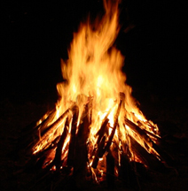
Campfire Programs

Slide 2
Campfires
One very important part of the outdoor program is the Campfire. It takes planning to put together a memorable Campfire. Its not just the flickering flames, but the heat and light generated by skits, songs, readings, stories, and roasted marshmallows
The key components of a good campfire program are Skits, Songs, and Stories. These three types of entertainment can be done any place and at any time, but no place nor time is better than around a campfire at dusk. Often times, while sitting at the fire, someone will just start telling a story and from there another person will tell a joke, and on it goes. This works fine for a couple people, but for a group you can plan ahead and prepare an exciting, memorable evening with little work.

Slide 3
Campfires
Your campfire program should have a definite, planned structure. It should
happen similarly to how a fire burns - starting small, building to a bright
excitement, and then tapering off to glowing embers.
Opening - gather people together and light the fire. If the fire is already
burning, knock it down to coals and have extra kindling and fuel wood ready.
Stack new wood on to start your campfire program and a fast, bright flame will
start things off.
Lighter - its best to start with a short, well-known, fast song. There are a
bunch of good campfire songs at Boy Scout Songs.
Burning - Alternate Skits, Songs, and Stories with different people presenting.
Dying - Plan slower songs like Unicorn Song or America the Beautiful.
Closing - Wrap up with a short story or thankful prayer for the day.
Ashes - after the program ends, you may say its 'lights out' or let folks sit around
telling quieter ghost stories and such.

Slide 4
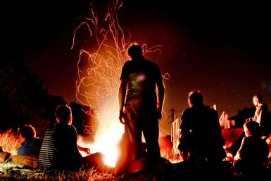
Campfire Magic
Chemicals - Adding a small amount of chemicals to a hot burning fire can have an 'Ooooh-aaaah' effect. It's important to do these only after all cooking has been done on the fire and when there is little wind so the smoke can rise up rather than into campers' faces.
Chemical Flame Change
Copper Chloride BLUE flame
Borax(laundry) LIGHT GREEN flame
Copper Sulfate(tree root killer) GREEN flame
Strontium Chloride RED flame
Potassium Chloride (water softener salt)PURPLE flame
Calcium Chloride BLUE flame
Lithium Chloride PINK flame
Alum GREEN flame
Sodium Chloride(table salt) ORANGE flame
Magnesium Sulfate(Epsom salts) WHITE flame

Slide 5
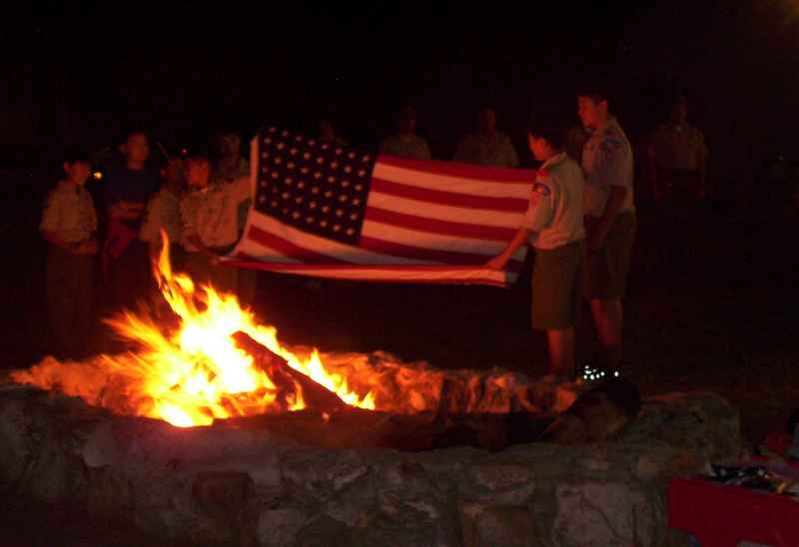
Campfires
The Program Patrol and Master of Ceremonies should
follow several common - sense rules:
Complete the Campfire Planner
Preview new or unfamiliar skits
Reserve the right to edit or veto Patrol skits, within reason.
No inappropriate language or ethnic humor is allowed.
Be respectful and affirming of everyone.
Remind participants to bring whatever props they need.
Remind everyone to speak loudly, so all can hear.
Do a flag retirement as part of the campfire.
.

Slide 6
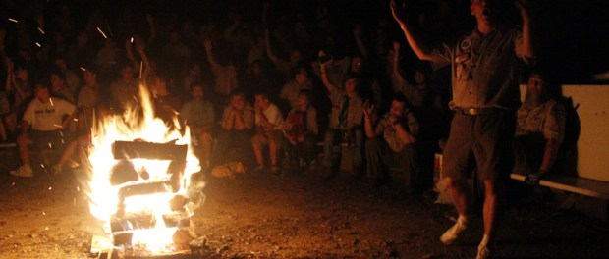
Campfires
Campfire Etiquette
Prohibit flashlights from the circle.
No Clapping or Booing - that's why we have 'cheers'
No Talking - unless you're involved in an activity.
Make a no - talking rule.
The campfire circle is sacred and always quiet before and after the fire.
If wood needs to be added to the fire, only the Keeper of the Flame may do it.
No booing.
Crowd control is easier if you insist on silence as the group enters the campfire ring.
Make sure there is sufficient light so they can find their seats.
Discipline is important. Encourage enthusiasm, but maintain control.
Get everyone involved in songs or stunts.
Recognition should be a part of every campfire program. Have a number of cheers planned; be prepared to explain and show them, then let the group cheer each group of performers.
Inspiration contributes to showmanship and is essential to a successful campfire.
Quiet as the embers die. Ask everyone to leave the campfire circle

Slide 7
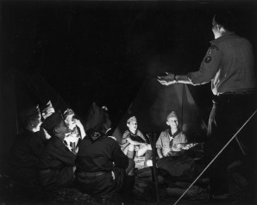
Campfires
And because everything scout-ish was discovered and written down100 years ago….
TROOP 219 CAMPFIRE PROGRAM PLANNING AND SKIT BOOK
http://www.t219.org/references/Troop219CampfireProgram_v03.pdf
http://www.t219.org/references/Troop219CampfireProgram_v03.pdf

